Slide 1
Class App 2.0
Flow Chart

Slide 2
Why Class App 2
This app aims at helping teachers automate student seating based on behavior and student needs.

Slide 3
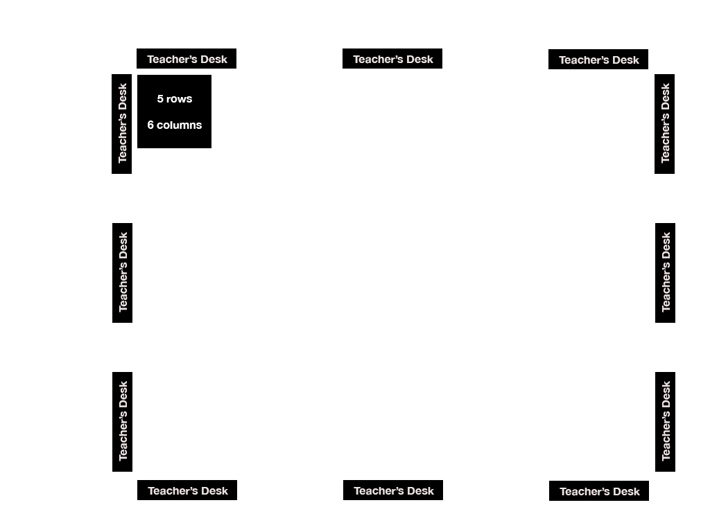
Page 1

Slide 4
Page 1 Notes
Page 1 will establish teacher desk orientation and classroom arrangement template
Time of completion half a day.

Slide 5
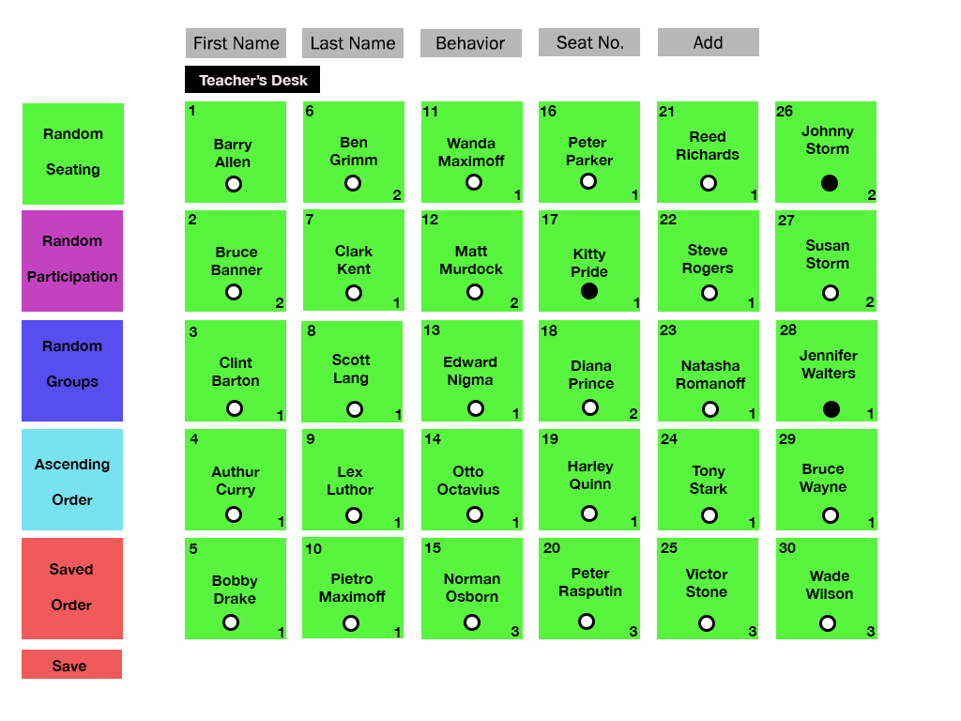
Page 2 Random Seating
Notes:
1. Put id and class for each button

Slide 6
Page 2 Notes
Random Seating button will randomize students.
Selecting radio button will randomize every student but the ones selected by the radio buttons.
Students may be added, assigned to a seat and assigned a behavior number.
Color coordinate button to seats
Save preset will allow for configuration to be saved.
Time of completion 7 days.

Slide 7
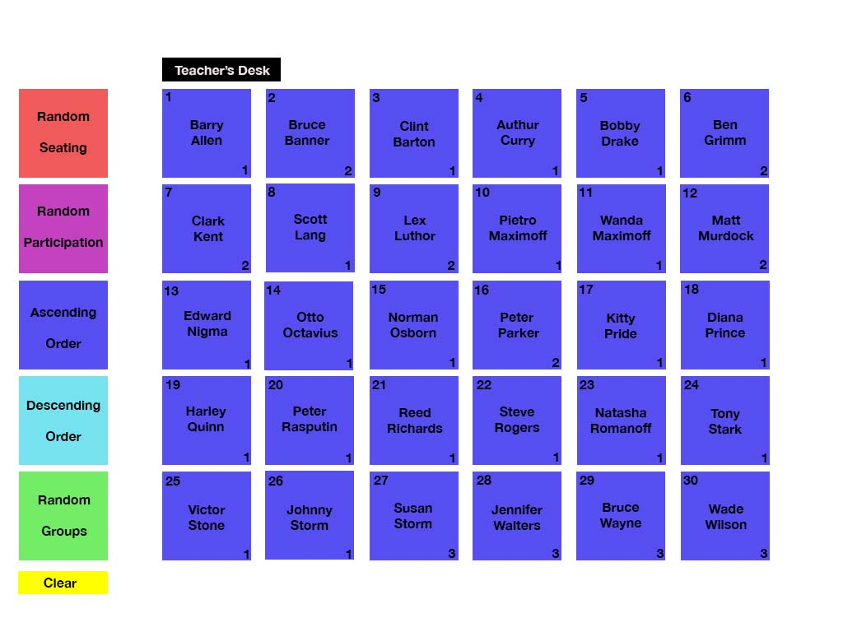
Ascending Order – clicked!
Notes:
Ids should match specific seat numbers

Slide 8
Tentative Goals for Ascending Order section
1. Populate names in alphabetical order.
2. Allow for seats to match button color
Notes:
Code completed

Slide 9
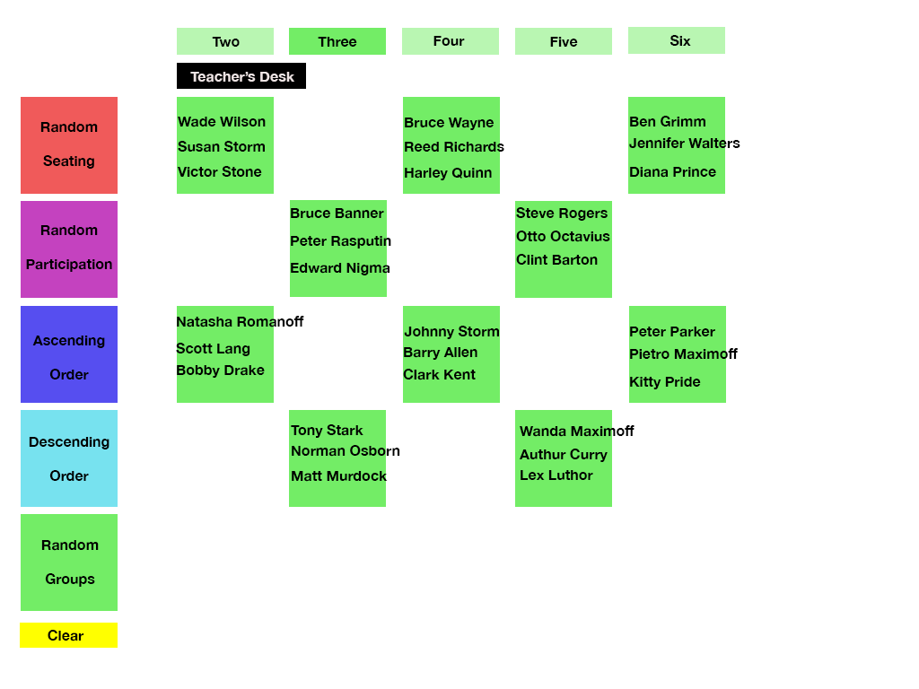
Random Groups - Clicked
Notes:
Code completed

Slide 10
1. Populate names in alphabetical order. Tentative Goals for Random Groups section
1. Allow for user to select groups of 2, 3, 4, 5, or 6,
2. Allow for random generation of groups
3. Allow for clear button to clear groups.
4. Allow for seats to match with button color.

