Slide 1
Seating and Participation App
Flow Chart

Slide 2
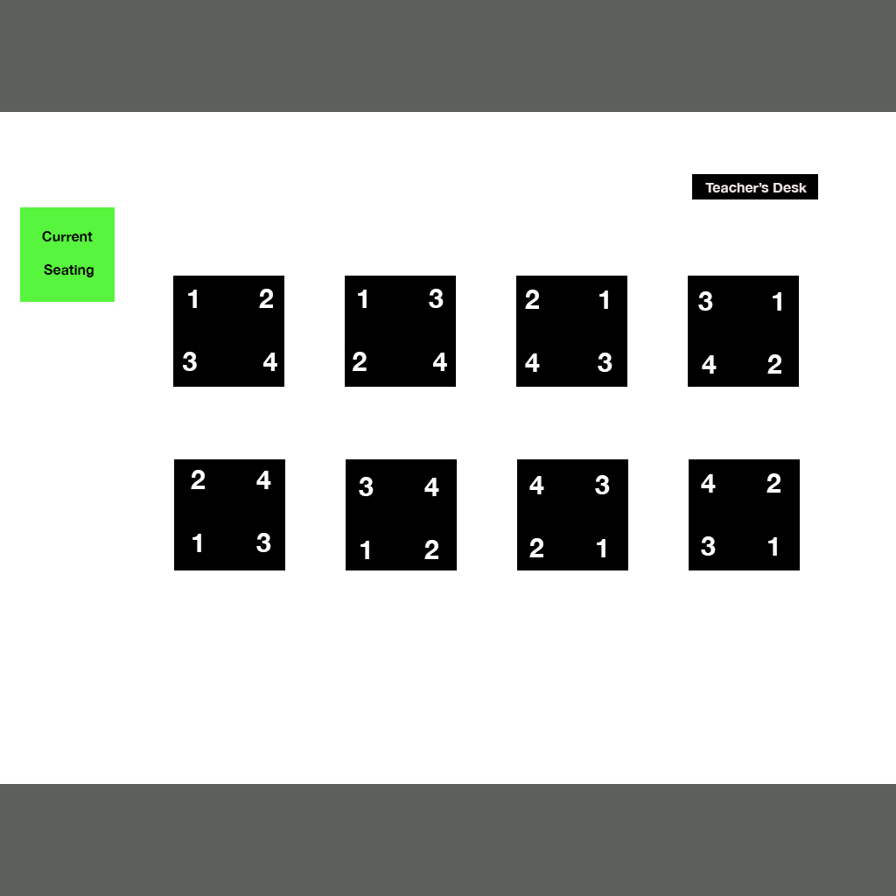
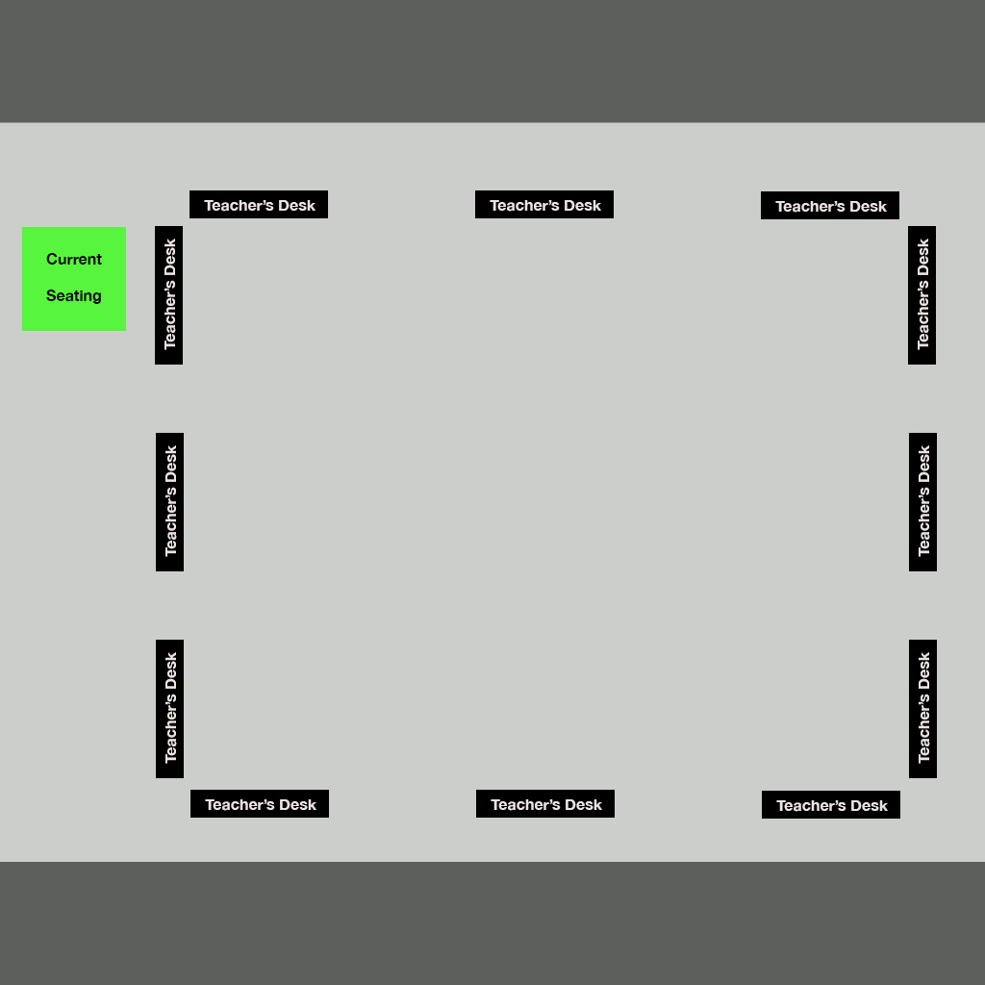
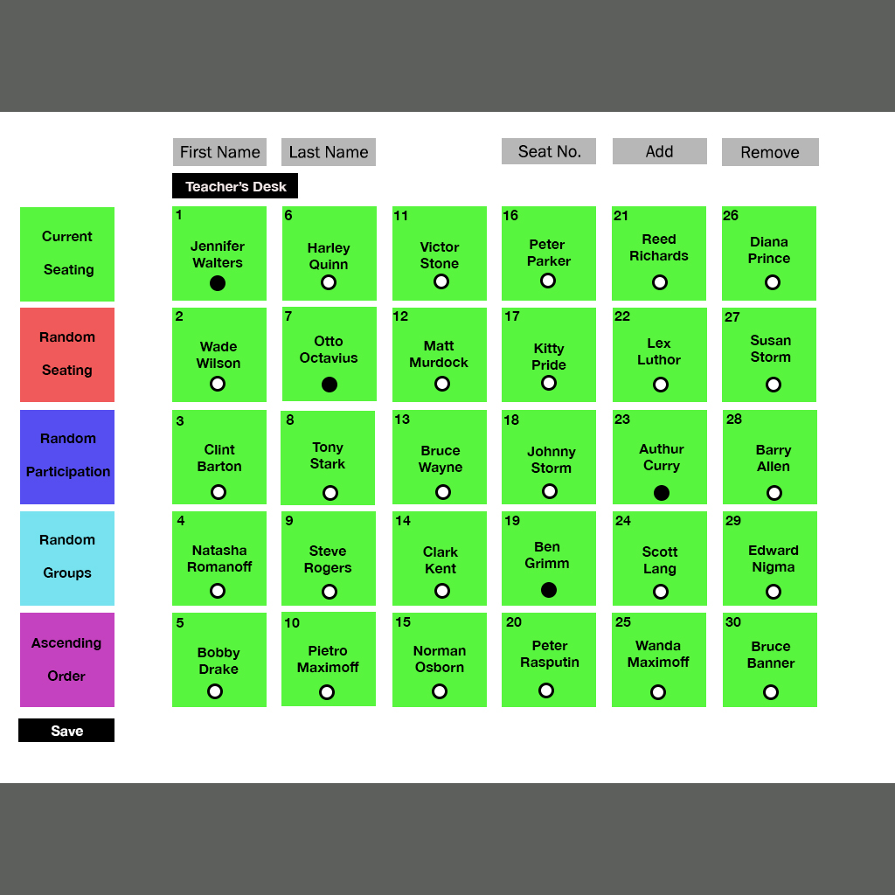
Main Page
Header
Teacher’s
Desk “Clicked”
Template or
Current Seating
“clicked”
Footer
Current Seating
“Clicked”
Start by clicking ANY of the “Teacher’s
Desk” or “Current Seating” Button

Slide 3
Main page Functionality
1. The main page will establish the orientation of the teacher’s desk.
2. If user clicks on teacher’s desk it will route user to student desk orientation page.
3. User can also link to a “current seating” page to go to a previous template.

Slide 4
Technology/Time
1. Will use Jquery and Javascript to establish page links.
2. Will use css, HTML, and materialize for page design.
3. 24 hours for the design of main page.
4. 24 hours for establishing functionality.

Slide 5
Desk Orientation
Clicking “current seating” button will take user to current seating page.
Clicking a template will allow the desks
to be configured to the users desire.
Template
“clicked”
Current Seating
“clicked”

Slide 6
Desk Orientation Functionality
1. User can click “current seating” button to go to a previous configuration.
2. User can click on a template to orient seats to user desire.
3. clicking on a template or on “current seating” button will take user to “current seating” page.

Slide 7
Technology/Time
1. Will use Jquery and Javascript to establish page links.
2. Will use css, HTML, and materialize for page design.
3. 24 hours for the design of desk orientation page.
4. 24 hours for establishing design and links.

Slide 8
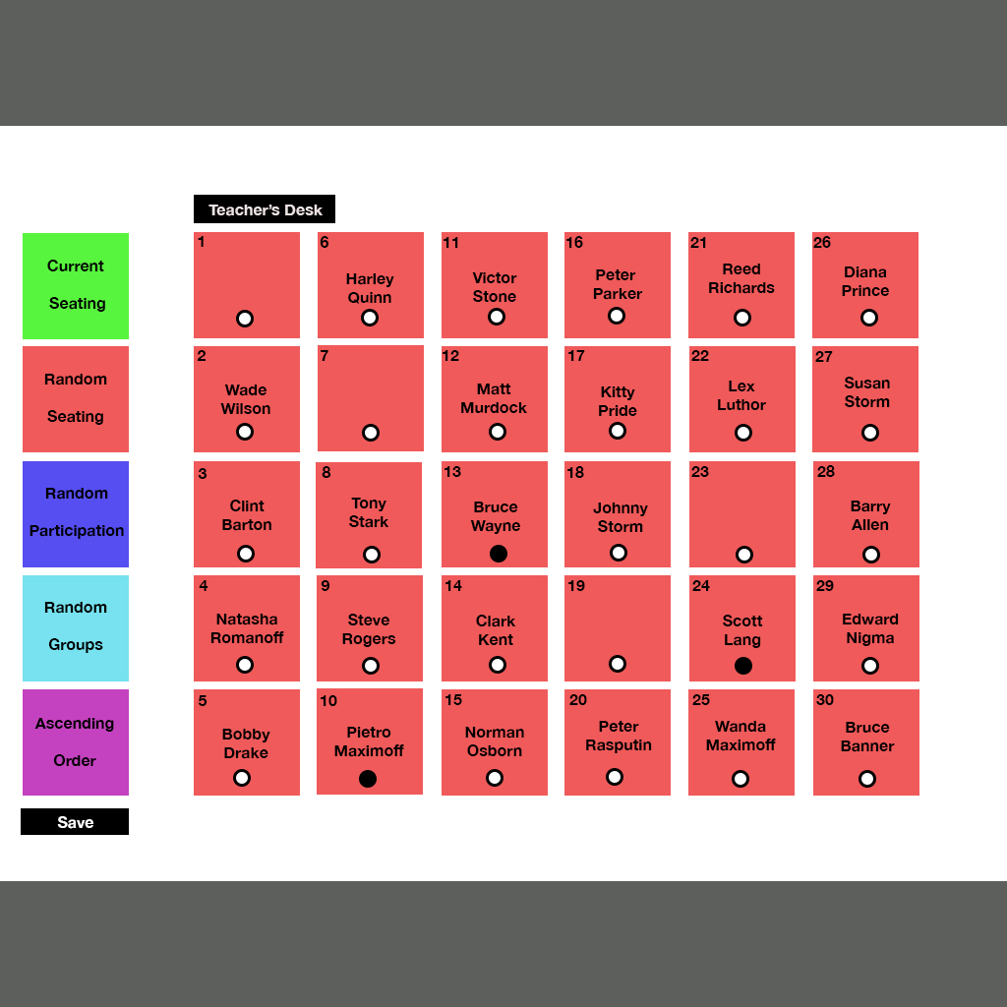
02 Current Seating
Function
Button Panel
Header
Input and add new students by seat selection
Use radio buttons and remove button to select students to remove
After students have been added
or removed the configuration is
saved
Random Seating “clicked”
Footer
Notes:
1. Put id and class for each button

Slide 9
Current Seating Functionality
1. Current Seating will either generate a random arrangement or populate a saved arrangement.
2. User may add students by writing a last name and first name, selecting a seat number and pressing add.
3. User may remove students by selecting radio buttons and clicking remove.
4. Upon completion of modifications user selects “save” to keep default or edited configuration.

Slide 10
Current Seating Functionality
5. User may manually arrange seating in current seating.
6. After pressing save, user may go to any other functionality.

Slide 11
Technology/Time
1. Will use Jquery and Javascript to establish logic of save and radio buttons.
2. Will use css, HTML, and materialize for page design.
3. 24 hours for the design of current seating page.
4. 24 hours for establishing functionality and logic.
5. Will establish a data base in Mongo db

Slide 12
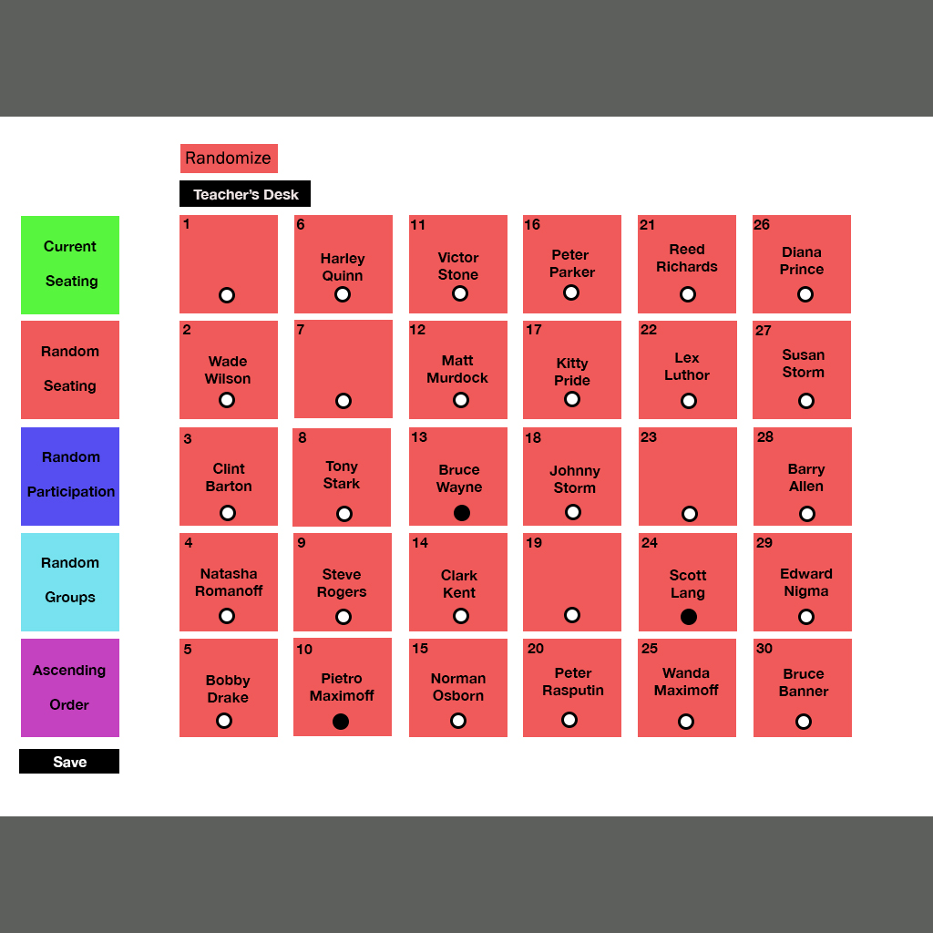
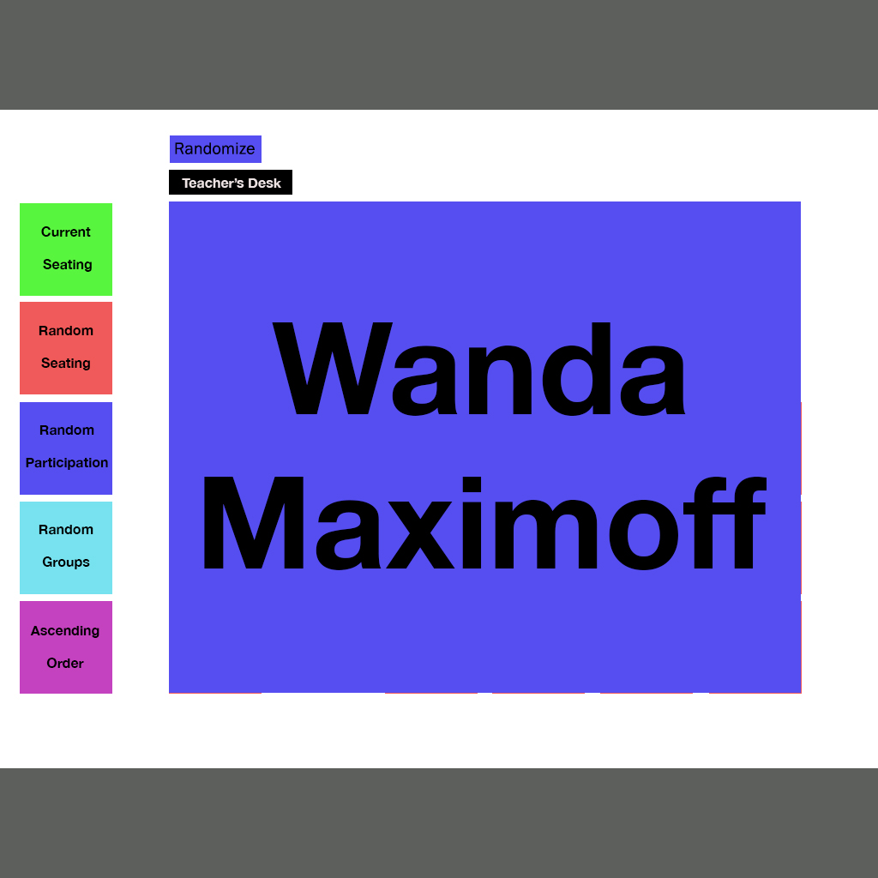
03 Random Seating
Click “Randomize” to randomize
student seats
Click radio buttons to select students which will not be randomize.
User can save configuration by
clicking “save”
Random Participation
“clicked”
Notes:
Ids should match specific seat numbers

Slide 13
Random Seating Functionality
1. “Random Seating” populates “Current Seating” configuration.
2. User then presses “randomize” to get a new arrangement.
3. User may use radio buttons to prevent names from randomizing.
4. When user gets desired configuration, they can press “save” button to record current configuration.

Slide 14
Random Seating Functionality
5. Upon pressing “save” button the configuration becomes available in current seating.

Slide 15
Technology/Time
1. Will use Jquery and Javascript to establish logic of save and radio buttons.
2. Will use css, HTML, and materialize for page design.
3. 24 hours for the design of random participation page.
4. 24 hours for establishing functionality and logic.

Slide 16
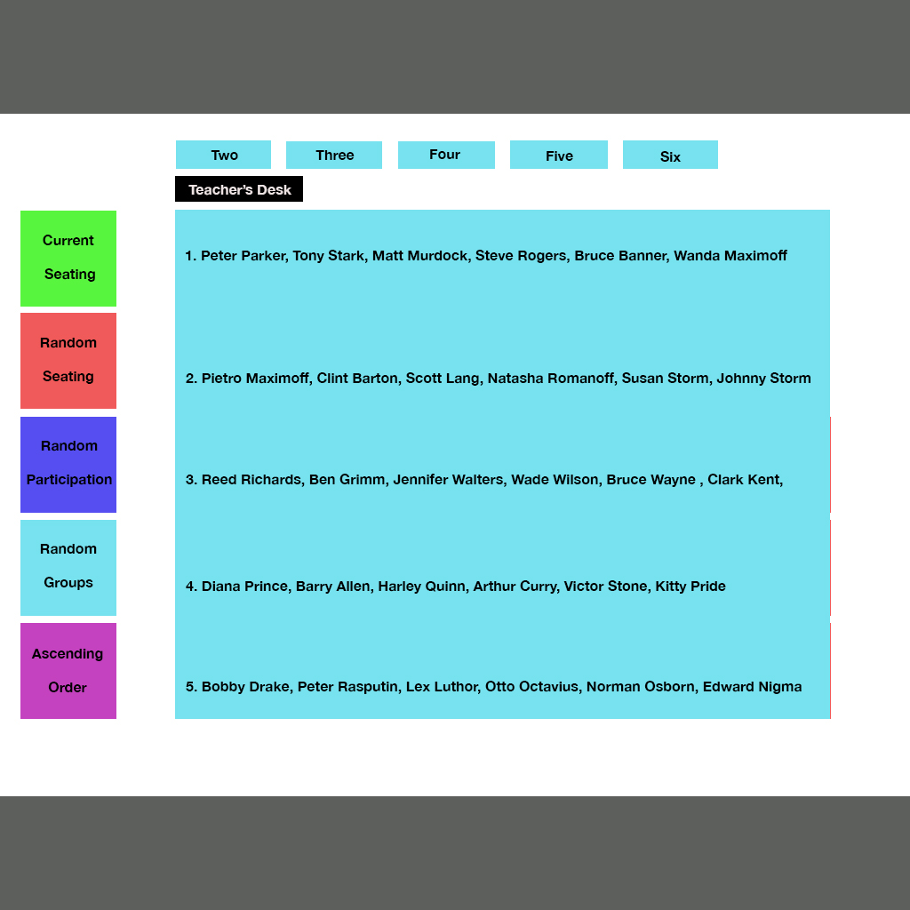
04 Random Participation
Clicking “Randomize” to obtain a random participation list.
Names populate in this box. Names will not repeat until all names are passed.
Random Groups
“clicked”
Notes:
Code completed

Slide 17
Random Participation Functionality
1. When uses presses “Random Participation” a random student name will populate.
2. If user keeps clicking “randomize” button a new name will populate until all names are passed.

Slide 18
Technology/Time
1. Will use Jquery and Javascript to establish random button.
2. Will use css, HTML, and materialize for page design.
3. 24 hours for the design of random participation page.
4. 24 hours for establishing functionality and logic.

Slide 19
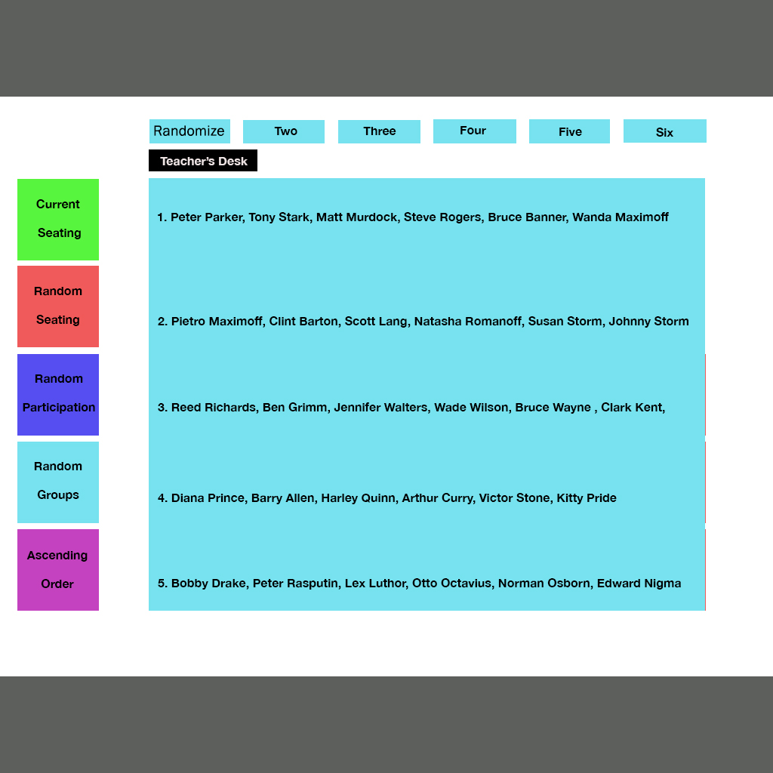
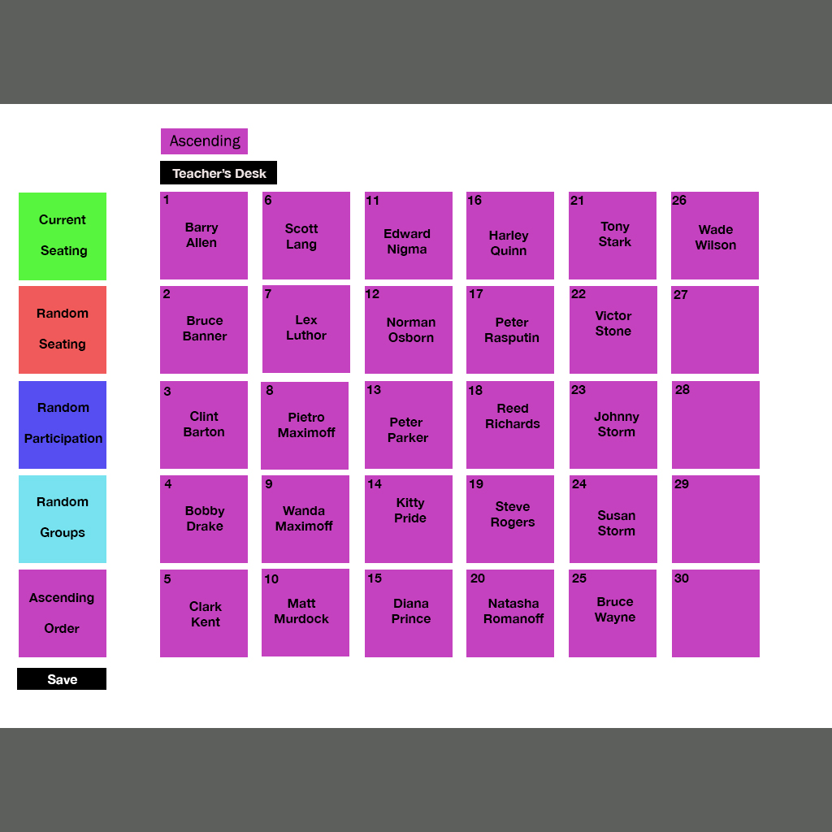
05 Random Groups
Click “Randomize” button to randomize class. Data obtained from Mongo db
Click “Two, Three, Four, Five, or Six” to obtain groups of the random order.
Groups populate in this box.
Ascending Order
“clicked”

Slide 20
Random Groups Functionality
User can click on “randomize” button to shuffle class names then click a button with a number (“two”) to obtain a group of that size.
To obtain other random groups, user must click “randomize” button again to re-shuffle the class list and then select other group numbers.

Slide 21
Technology/Time
1. Will use Jquery and Javascript to establish random groups button.
2. Will use css, HTML, and materialize for page design.
3. 24 hours for the design of random groups page.
4. 24 hours for establishing functionality and logic.

Slide 22
06 Ascending Order
Click “Ascending” button to alphabetize class order starting with seat 1.
User can save configuration by
clicking “save”

Slide 23
Ascending Order Functionality
User can click on “ascending order” to alphabetize names starting in seat 1.
User can save configuration by clicking “save”
“save configurations automatically appear in “current seating” page.

Slide 24
Technology/Time
1. Will use Jquery and Javascript to establish ascending order button.
2. Will use css, HTML, and materialize for page design.
3. 24 hours for the design of ascending order page.
4. 24 hours for establishing functionality and logic.

