Slide 1
Class App
Flow Chart

Slide 2
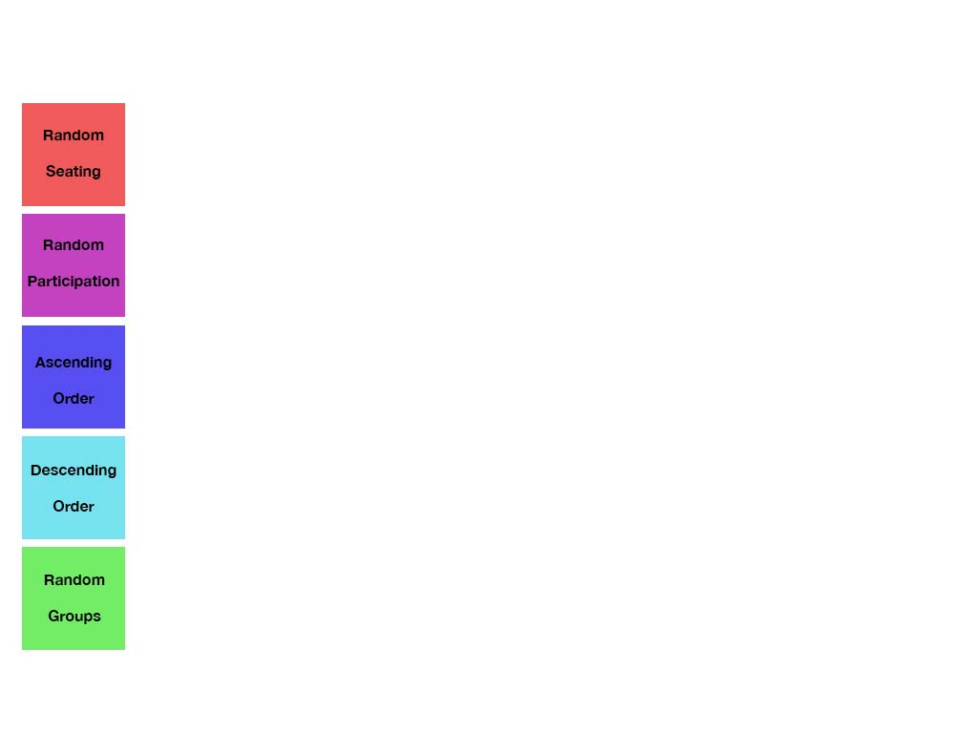
Main Page (Splash)
Notes:
1. Put id and class for each button

Slide 3
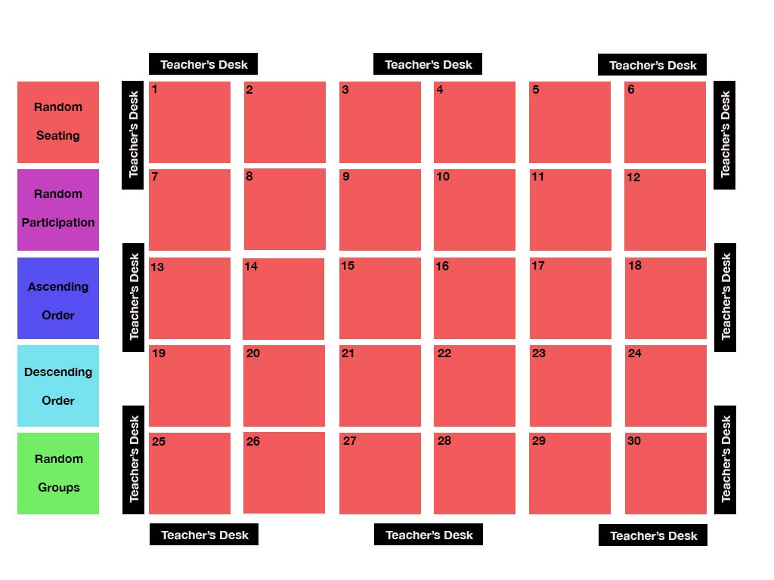
Random Seating – clicked!

Slide 4
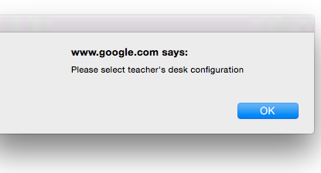
Alert “select a desk”
Notes:
Hidden div to include please select teachers desk

Slide 5
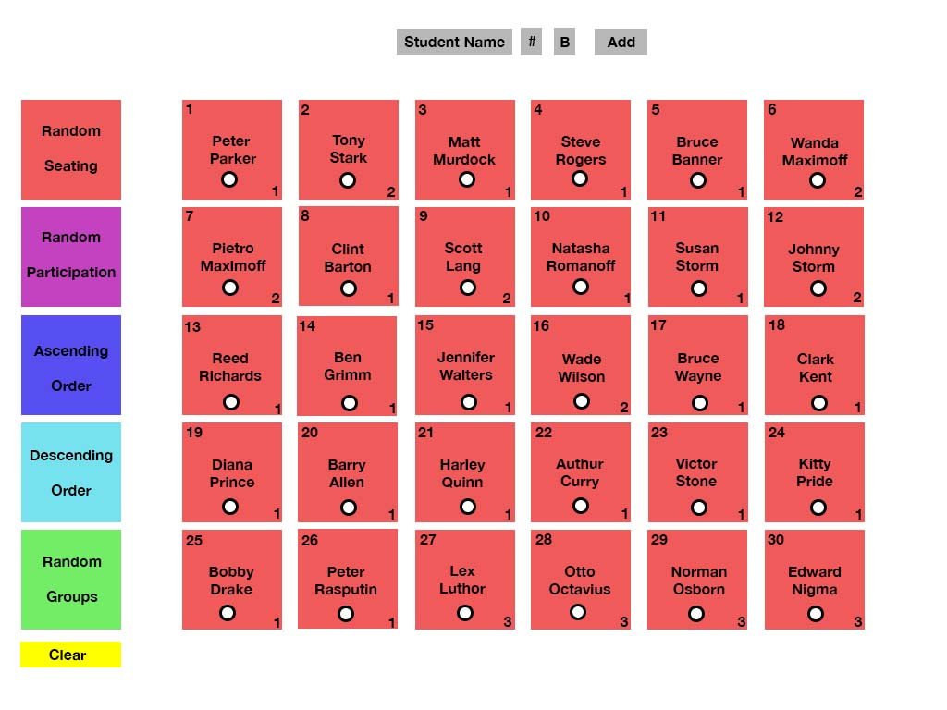
When Teacher’s Desk button is clicked

Slide 6
Tentative Goals for Random Seating section
1. Student names populate from msql when “teacher’s desk” is clicked.
2. Allow for manual input of student name, number, and behavior number.
3. Allow for an empty entry with a seat # will clear that seat.
4. Allow for clear button at the bottom to clear all names and allow manual entry.
5. Every time “random seating” is clicked, the seats organize in random order.

Slide 7
Tentative Goals for Random Seating section
6. Allow for appending or overriding of names when adding name and number.
7. Must include number for add to work.
8. Allow for boxes to be color coordinated with random seating button.
9. Put radio button to keep seats you do not want to randomize.

Slide 8
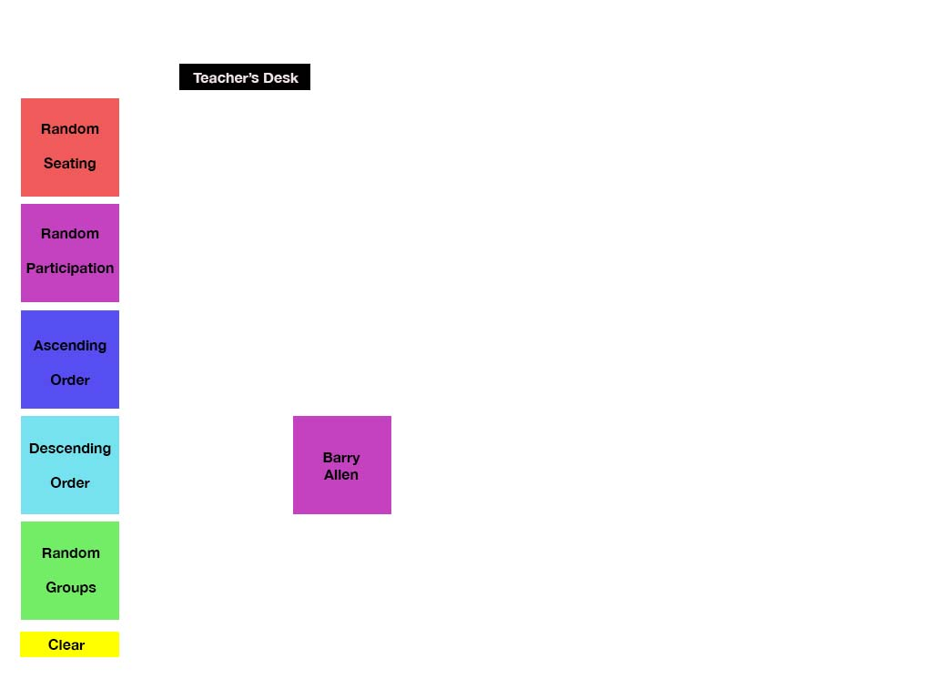
Random Participation-clicked!

Slide 9
Tentative Goals for Random Participation section
1. Clear all names and auto populate one random name at a time.
2. Color coordinate seat to match button.
3. Allow for clear button to clear all names

Slide 10
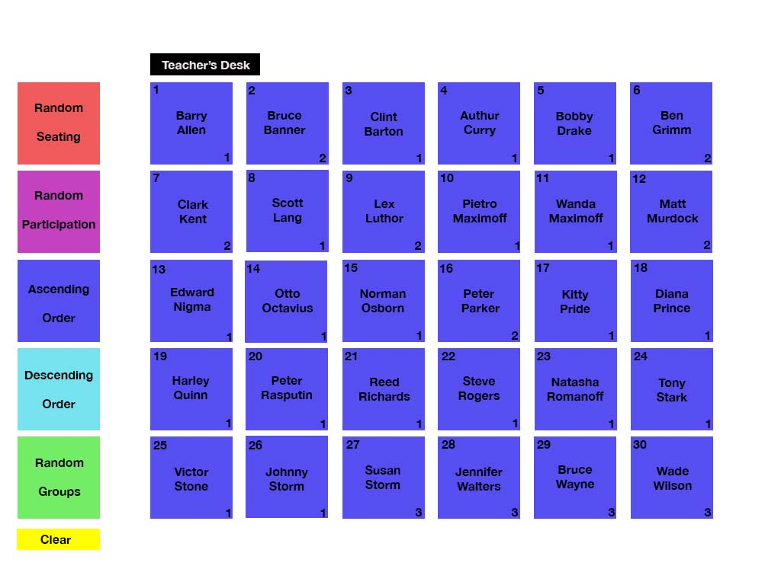
Ascending Order – clicked!
Notes:
Ids should match specific seat numbers

Slide 11
Tentative Goals for Ascending Order section
1. Populate names in alphabetical order.
2. Allow for seats to match button color

Slide 12
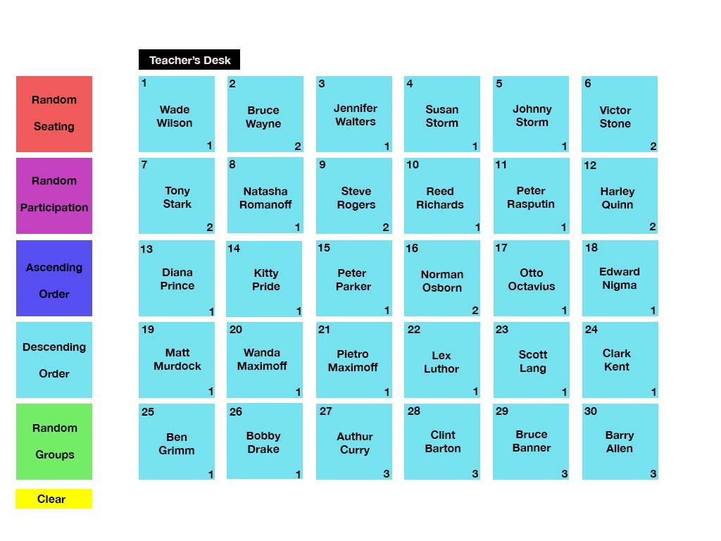
Descending Order – clicked!

Slide 13
Tentative Goals for Descending Order section
1. Populate names in reverse alphabetical order.
2. Allow for seats to match button color

Slide 14
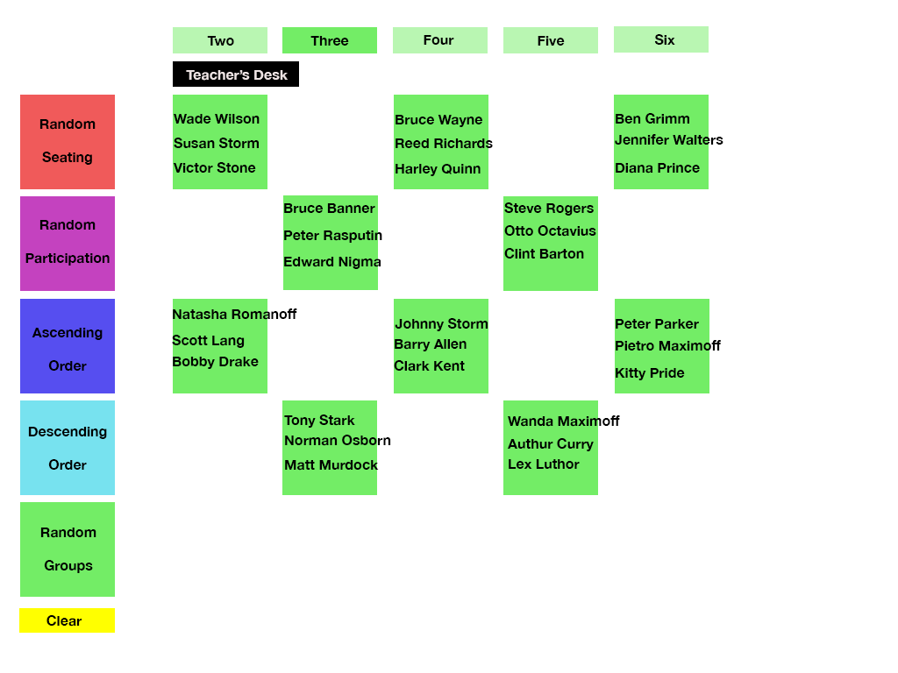
Random Groups - Clicked

Slide 15
1. Populate names in alphabetical order. Tentative Goals for Random Groups section
1. Allow for user to select groups of 2, 3, 4, 5, or 6,
2. Allow for random generation of groups
3. Allow for clear button to clear groups.
4. Allow for seats to match with button color.

