Slide 1
Diploma project proposal
Development of an AI-Assisted Platform for Generating Playable Browser Games from User-Provided Storylines
Aim: generate a playable 2D browser game from a creator’s story.
Candidate users: people without game-development experience.
Team responsibilities
Almadi Madiuly: frontend and UX/UI
Zhaksylyk Aldiyar: backend and platform
Yessengeldi Nurgeldi: AI generation and validation
Astana IT University / SE-2417 / Supervisor: Shyngys Alshynov / October 2026
01
Notes:
Official project title and team: docs/proposal.md and supplied supervisor proposal. Objectives: investigate user needs and relevant research, define a feasible game representation and mechanics, implement the authoring/platform/generation modules, and evaluate playability and narrative correspondence. Intended result: meaningful actions and a reachable ending. First-version genre and acceptance bounds remain preliminary. Writers, educators and small creative teams are candidate groups. Each student presents their own module and research contribution.
Initial pre-defense, 23 October 2026. Architecture and requirements are proposals. No running generator, executed product tests or usability study is evidenced. Relative source paths refer to the diploma repository.

Slide 2
Relevance and descriptive survey results
Team-provided export: 142 response records
98/142 (69.0%) report no experience or beginner level.
65/142 (45.8%) prefer browser play, a plurality below half.
Stated interest in a future prototype
57/142 (40.1%) selected “Yes” to considering a future prototype.
These preferences do not establish demand, adoption or feasibility.
Interpretation and evidence limits
Team reports student respondents in a convenience sample.
Respondent identities have not been independently verified.
2 Relevance / Supplied CSV, 23 October 2026 / Percentages use all 142 records
02
Notes:
Source: supplied From a Game Idea to a Playable Browser Game.csv, 142 response records, 13 columns, SHA-256 e4de510a012aa13a0b7a88d1e7ea7527bd918603f8cf5acb88185633d501124a. Descriptive audit: survey-csv-analysis-2026-10-23.md. Q2: 47 No experience plus 51 Beginner = 98/142 (69.0%). Q5: browser-playable 65/142 (45.8%), the largest category but below half. Q10: Yes 57/142 (40.1%), Maybe 48/142 (33.8%), No 37/142 (26.1%). All these questions have 142 nonblank records. Percentages round to one decimal. The team describes the records as student respondents in a convenience sample. Independent respondent identity and provenance verification were not available. Counts describe the team-provided export and cannot establish representative demand, adoption, usability or technical generation success. The live response total has not been reconciled against the uploaded file. No exclusions were inferred. Public questionnaire: https://docs.google.com/forms/d/e/1FAIpQLSejcDY8RyGi2cUsdgC0cmcEjf1Xdfd6Vi0JNV2Nqn-m25j7Dg/viewform?usp=dialog . The separate committee criterion of 3–5 user discussions or substantive actual-client agreement remains undocumented.
Initial pre-defense, 23 October 2026. Architecture and requirements are proposals. No running generator, executed product tests or usability study is evidenced. Relative source paths refer to the diploma repository.

Slide 3
Preliminary literature review
Twelve research publications
The report reviews generation, formal game rules, validation and authoring UX. Each source has a contribution and a limitation.
Separate quality criteria
ByteSized32 distinguishes execution, story fidelity and winnability. Its text-game results require further study in 2D browser games.
Design implications
Investigate a validated game specification and controlled runtime. Explain system limits and failures to the author.
3 Literature / 12 research publications summarized in the report
03
Notes:
Source: report §3 and references [4]–[15], twelve research publications. Scientific venues and preprints are distinguished in citations. This count describes the report selection, not every entry in the longer repository draft. Key sources: Wang et al., ByteSized32, EMNLP 2023, https://aclanthology.org/2023.emnlp-main.830/ ; Amershi et al., Guidelines for Human-AI Interaction, CHI 2019, https://doi.org/10.1145/3290605.3300233 . Recent work includes Rogosch and Schrader, Applied Sciences 2026, https://doi.org/10.3390/app16062932 ; Agarwal et al., GAMED.AI, ACL Demonstrations 2026, https://doi.org/10.18653/v1/2026.acl-demo.84 ; Cai et al., Spec2Game, preprint 2026, https://arxiv.org/abs/2610.04253 . Literature motivates hypotheses. It does not establish user demand or reliable arbitrary story generation.
Initial pre-defense, 23 October 2026. Architecture and requirements are proposals. No running generator, executed product tests or usability study is evidenced. Relative source paths refer to the diploma repository.

Slide 4
Comparison of existing systems
Rosebud AI
Documents prompt-based browser-game creation, playable previews and iterative revision. It is the closest comparator.
GDevelop and AI Dungeon
GDevelop exposes game events and experimental gameplay tests. AI Dungeon supports interactive text narratives.
Research focus
Investigate specification checks, a verified ending and disclosed simplifications together. Comparative advantage remains unmeasured.
4 Existing systems / Three systems and nine common criteria / Documentation review
04
Notes:
Sources: docs/existing-systems.md and report §4. Official descriptions: https://rosebud.ai/tutorial ; https://gdevelop.io/blog/make-games-with-ai-agent-gdevelop-automated-prompt ; https://wiki.gdevelop.io/gdevelop5/interface/gameplay-tests/ ; https://help.aidungeon.com/getting-started . Nine criteria: natural-language input, genre control, browser play, actions/rules, ending, validation, simplification record, recovery, sharing/versions. GDevelop documents experimental tests that simulate input/assert outcomes, including AI assistance. Testing by itself is not a unique contribution. Not documented denotes a documentation gap, not absence. No hands-on comparative reliability benchmark has been executed.
Initial pre-defense, 23 October 2026. Architecture and requirements are proposals. No running generator, executed product tests or usability study is evidenced. Relative source paths refer to the diploma repository.

Slide 5
Preliminary technology alternatives
Server and asynchronous jobs
Spring Boot with RabbitMQ or FastAPI with Celery. Durable job handling and team experience guide the choice.
Generation method
Direct code, structured game data or templates. Structured data offers a bounded validation path, with less freedom in mechanics.
Browser runtime
Phaser, PixiJS or Godot web export. A manual action-and-ending prototype will test the proposed Phaser direction.
5 Technology / Three decisions with two or three alternatives each
05
Notes:
Source: report §5, docs/technology-comparison.md and docs/technology/*.md. Spring Boot/RabbitMQ offers explicit durable orchestration with more integration work. FastAPI/Celery fits a Python-centered prototype but still requires reliability controls. Structured game data is the provisional direction because it can constrain operations and validate references/ending conditions. Direct code offers flexibility with greater execution and validation risk. Templates offer predictability with narrower expression. Phaser is the proposed game framework, PixiJS requires more game logic, and Godot introduces an editor/build/export workflow. Team integration experiments and supervisor review will determine final choices. No alternatives have been benchmarked in this project.
Initial pre-defense, 23 October 2026. Architecture and requirements are proposals. No running generator, executed product tests or usability study is evidenced. Relative source paths refer to the diploma repository.

Slide 6
Initial requirements and acceptance
Must: input and generation status
Preserve the story and preferences. Reject incomplete input. Show the recorded state and a useful error when generation fails.
Must: playable and understandable result
Launch the validated version. Its primary action changes game state, an ending is reachable, and simplifications include reasons.
Quality requirements
Must: reject invalid or unsafe content before publication. Should: support keyboard access and understandable responsive controls.
6 Requirements / Priorities and observable acceptance / Survey provenance pending
06
Notes:
Source: report §6, docs/requirements.md and component requirement drafts. Requirements currently derive from proposal and literature/engineering rationale. CSV record provenance must be reconciled before treating descriptive preferences as verified user evidence for a requirement. Proposed supported mechanics, bounds and numeric targets require review. FR-1 author input, FR-2 recorded status, FR-3 validated play/action/ending, FR-4 disclosure or visible failure, NFR-1 validation and privilege boundary, NFR-2 keyboard/responsive usability. More detailed test mappings remain in repository. No acceptance test results exist.
Initial pre-defense, 23 October 2026. Architecture and requirements are proposals. No running generator, executed product tests or usability study is evidenced. Relative source paths refer to the diploma repository.

Slide 7
Proposed component architecture
Authoring client
Platform API and jobs
Generation worker
Story, preferences, status
results and version history
Project/version records
queue and artifact delivery
Intent and specification
validation and bounded repair
Versioned data and job status
Trusted 2D browser runtime
Interprets validated game data and provides controls, progression and an ending.
7 Architecture / Component draft / Context and use cases in appendices
07
Notes:
Source: docs/architecture.md, diagrams/component.mmd and component.svg. Conceptual responsibilities: authoring client, platform API and jobs, generation worker, fixed browser runtime. Storage keeps projects, jobs, versions and approved artifacts. An external model provider returns untrusted candidate data. Validation precedes publication. Queue states lead to ready or failed. Exact API/schema/retry/resource limits remain proposed. Context and use cases follow in slides 11–12.
Initial pre-defense, 23 October 2026. Architecture and requirements are proposals. No running generator, executed product tests or usability study is evidenced. Relative source paths refer to the diploma repository.

Slide 8
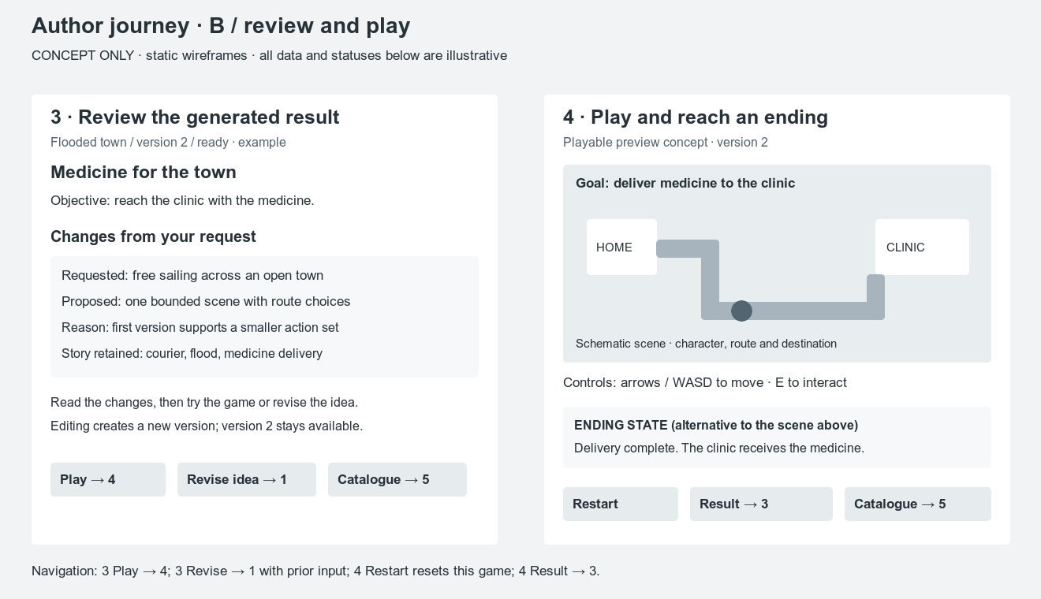
Conceptual authoring and play journey
Six proposed states
Idea and preferences
Recorded job progress
Result and simplifications
Play and ending
Catalogue and versions
Failure and retry
Static mockups
Usability study pending
8 UX prototype / Conceptual screens with illustrative data / prototype/
08
Notes:
Source: prototype/README.md and prototype/result-play.svg. Embedded source image comes from the existing deck, preserved at its original position. Illustrative game, status, controls and endings describe intended behavior. The author journey covers story/preferences, progress, result/simplifications, play/ending, catalogue/versions, failure/retry. No live generation, gameplay implementation or observed usability result is represented.
Initial pre-defense, 23 October 2026. Architecture and requirements are proposals. No running generator, executed product tests or usability study is evidenced. Relative source paths refer to the diploma repository.

Slide 9
Verification and evaluation plan
Baseline and measurement conditions
Use a manually authored game to check the runtime. Freeze prompts and record the browser, model, configuration and all attempts.
Separate outcome measures
Measure valid output, launch, primary action and ending separately. Two reviewers assess story fidelity and record disagreements.
Failure reporting and execution status
Retain rejected requests and failed runs. No product tests or generation measurements have yet been executed.
9 Evaluation / Planned measures, fixed conditions and a manual-game baseline
09
Notes:
Sources: docs/verification-plan.md and tests/evaluation-prompts.md, report §9. Planned denominators include all attempted prompts, with not-run cases reported separately. State actual trial/repetition conditions before evaluation. Baseline checks runtime launch/controls, not automated narrative interpretation. Retain input/configuration/artifact versions and validation/action traces. Separate schema validity, browser launch, consequential action, reachable ending and narrative correspondence. Two reviewers use a rubric and record disagreement. Inject queue/provider/invalid-result failures. Search timeout means completion unverified. No measured quality, latency or cost results exist.
Initial pre-defense, 23 October 2026. Architecture and requirements are proposals. No running generator, executed product tests or usability study is evidenced. Relative source paths refer to the diploma repository.

Slide 10
Project plan and supervisor review
Provisional milestones
By mid December: evidence and agreed scope. January–March: manual game, generation pilot and integration. By May: evaluation and revision.
Organization and risks
Eight proposed project issues assign owners and reviews. Risks include oversized mechanics, invalid output and integration delays.
Supervisor and repository status
Supervisor requests concise coverage of every section. Artifact review, real YouTrack links, peer-review evidence and submission tag remain pending.
10 Management and 11 Supervisor / docs/project-plan.md / docs/supervisor-feedback.md
10
Notes:
Sources: docs/project-plan.md, docs/youtrack-backlog.md, docs/supervisor-feedback.md, submission audit. The eight proposed implementation/evidence issues are separate from the historical 36-task document-preparation plan. Risks and mitigations: bound the mechanic set, validate generated data and ending checks, agree a versioned contract before integration, record evidence limitations. The parent audit verified a live public repository: https://github.com/lastnurik/diploma . Its remote branch points to ac44921. Committee/supervisor access, independent student contributions and actual peer-reviewed PRs remain unverified. No local pre-defense-1 tag. No actual YouTrack issue links supplied. Supervisor message emphasizes proposal/relevance, minimal repository/tasks and all sections at minimal depth. It does not establish substantive review of these artifacts or acceptance of survey as discussion substitute. Roadmap is provisional and supersedes the original accelerated implementation dates. No interviews are scheduled for the immediate package.
Initial pre-defense, 23 October 2026. Architecture and requirements are proposals. No running generator, executed product tests or usability study is evidenced. Relative source paths refer to the diploma repository.

Slide 11
Appendix: proposed system context
Story and
parameters
→
Proposed platform
Minimum
prompt
→
Author
Story and play
Model provider
(optional)
Authoring and browser runtime
Platform API and jobs
Generation and validation
Managed data and artifacts
←
Status and
game
←
Candidate
data
The platform validates candidate data before publication.
The controlled runtime interprets approved game data.
7 Architecture / Editable context summary / diagrams/system-context.mmd
11
Notes:
Source: diagrams/system-context.mmd. This context summary distinguishes the author and optional model provider from the proposed platform boundary. Internal responsibilities are shown in slide 7. Story/settings/gameplay input enters the browser client; it returns progress, game, ending or errors. The AI service sends only minimum required prompt data externally and treats output as untrusted. Managed storage remains within the proposed platform responsibility. All diagram text and nodes are editable slide objects.
Initial pre-defense, 23 October 2026. Architecture and requirements are proposals. No running generator, executed product tests or usability study is evidenced. Relative source paths refer to the diploma repository.

Slide 12
Appendix: proposed author use cases
AI-assisted browser-game platform
UC-01 Enter or edit story
UC-02 Submit generation
Author
uses →
UC-03 Check progress or failure
UC-04 Inspect simplifications
UC-05 Play, finish and replay
UC-06 Browse saved versions
UC-07 Edit and regenerate
7 Architecture / Editable use-case summary / diagrams/use-case.mmd
12
Notes:
Source: diagrams/use-case.mmd and docs/use-cases.md. Author associations cover all seven cases. Main scenario: enter a story and preferences, submit, observe progress, inspect outcome/simplifications, play to an ending and replay. Alternative scenarios: controlled failure followed by editing/regeneration, or opening a saved version. Use cases describe proposed behavior, not executed features. All nodes/text are editable slide objects.
Initial pre-defense, 23 October 2026. Architecture and requirements are proposals. No running generator, executed product tests or usability study is evidenced. Relative source paths refer to the diploma repository.

