Slide 1
AI-assisted browser game generation
From a creator’s idea or storyline to a playable 2D browser game
Initial review: eleven sections at minimal depth.
Analysis and design drafts, with implementation and evaluation ahead.
Team and proposed contributions
Almadi Madiuly: frontend and UX/UI
Zhaksylyk Aldiyar: backend and platform
Yessengeldi Nurgeldi: AI generation and validation
1 Proposal · docs/proposal.md
01
Notes:
Full title: Development of an AI-Assisted Platform for Generating Playable Browser Games from User-Provided Storylines. Astana IT University, Software Engineering, SE-2417. Initial diploma review, 22 October 2026. Supervisor: Shyngys Alshynov.
Evidence paths are relative to work/diploma/. All claims describe preparation drafts as at 22 October 2026. No runnable game or generator exists.

Slide 2
Relevance and direct evidence
Problem hypothesis
Nontechnical creators may have stories without the programming or engine skills to make them playable.
Research questions
Which actions and story elements must survive simplification? What output would creators accept?
Current evidence boundary
No user discussions or survey results. Plan 3–5 discussions or substantive client agreement before confirming needs.
2 Relevance · docs/evidence/relevance.md · questionnaire.md
02
Notes:
Direct evidence gaps: no administered survey, user interviews or substantive client agreement. Three to five actual user discussions or qualifying client agreement remain pending. Writers, educators and small creative teams are candidate groups, not validated segments.
Evidence paths are relative to work/diploma/. All claims describe preparation drafts as at 22 October 2026. No runnable game or generator exists.

Slide 3
Literature informs separate quality checks
Narrative and game rules
An explicit game specification can connect story intent with actions, progression and an ending.
Execution, fidelity and completion
ByteSized32 motivates separate checks. A game that launches can still misrepresent its story or lack a reachable ending.
Human–AI interaction
Explain capabilities, simplifications and failures. Literature supports design choices, while user demand remains unverified.
3 Literature · docs/literature.md
03
Notes:
The repository draft reviews 14 scholarly sources, with peer-reviewed works, a book chapter and two identified preprints distinguished. Key sources: Wang et al., ByteSized32, EMNLP 2023, https://aclanthology.org/2023.emnlp-main.830/ ; Amershi et al., Guidelines for Human-AI Interaction, 2019, https://www.microsoft.com/en-us/research/publication/guidelines-for-human-ai-interaction/ . This slide reports the draft synthesis, not independent validation of each result.
Evidence paths are relative to work/diploma/. All claims describe preparation drafts as at 22 October 2026. No runnable game or generator exists.

Slide 4
Existing systems establish relevant precedents
Rosebud AI
Prompt-based browser game creation and iterative preview. Closest comparator to the proposed platform.
GDevelop and AI Dungeon
GDevelop exposes objects and event rules. AI Dungeon supports open-ended interactive text narratives.
Proposed investigation
A bounded specification, disclosed simplifications and explicit completion checks. No measured advantage over existing tools.
4 Desk comparison · docs/existing-systems.md
04
Notes:
Official product documentation desk review, 22 October 2026. Rosebud: https://rosebud.ai/tutorial ; GDevelop: https://gdevelop.io/blog/make-games-with-ai-agent-gdevelop-automated-prompt ; AI Dungeon: https://help.aidungeon.com/getting-started . Nine shared criteria in the repository. No hands-on benchmark. Undocumented checks do not establish that a competitor lacks them.
Evidence paths are relative to work/diploma/. All claims describe preparation drafts as at 22 October 2026. No runnable game or generator exists.

Slide 5
Technology choices remain provisional
Platform and asynchronous jobs
Proposed Spring Boot API, PostgreSQL, RabbitMQ and Python worker. Confirm job handoff and failure handling in a small feasibility test.
Generation and validation
Generate structured game data. Check schema, references and reachable ending, then repair within an agreed limit or fail clearly.
Trusted browser runtime
Proposed Phaser 3 runtime interprets validated data. First demonstrate a handwritten game with an action and ending.
5 Alternatives · docs/technology-comparison.md · docs/technology/
05
Notes:
Three areas each compare three alternatives. Recommended server/jobs: Spring Boot, PostgreSQL, RabbitMQ and a separate Python worker. Generation: structured game data plus validation/repair. Runtime: Phaser 3. Alternative server stacks include Python/Celery and Go/Asynq. Runtime alternatives include PixiJS and Godot web export. The team has not installed or demonstrated the proposed stack.
Evidence paths are relative to work/diploma/. All claims describe preparation drafts as at 22 October 2026. No runnable game or generator exists.

Slide 6
Draft requirements define observable outcomes
Authoring and traceability
Retain story and preferences. Track project, version and job. Show recorded status and preserve prior results when retrying.
Playable result
Declare objective, actions, controls and ending. Show requested mechanics, actual simplifications and reasons before play.
Quality and safety
Reject invalid or unsafe data. Bound retries and resource use. Test exact-version delivery, keyboard access and reproducibility.
6 Requirements · docs/requirements.md · docs/decisions/scope-and-contract.md
06
Notes:
Requirements draft contains 13 functional requirements and 8 nonfunctional requirements, with Must/Should priority, provenance and observable acceptance. Examples: R-03 actual status, R-06 simplification disclosure, R-08 reachable ending, R-09 exact validated runtime version, Q-01 safe data boundary. No requirement has confirmed user-evidence provenance yet.
Evidence paths are relative to work/diploma/. All claims describe preparation drafts as at 22 October 2026. No runnable game or generator exists.

Slide 7
Proposed architecture separates four responsibilities
Authoring client
Platform API and jobs
Generation worker
Story, preferences, status
results and version history
Project/version records
queue and artifact delivery
Intent and specification
validation and bounded repair
Versioned game data and status
Trusted 2D browser runtime
Loads a validated version, applies allowed actions and reports progress and ending.
7 Architecture · docs/architecture.md · diagrams/component.svg
07
Notes:
This is a conceptual decomposition of the proposed architecture. The platform records job and version status, the worker returns candidate structured game data and checks, and a fixed browser runtime interprets only validated data. Queued, generating and validating may lead to ready or failed. Exact contract, limits and access policy remain open.
Evidence paths are relative to work/diploma/. All claims describe preparation drafts as at 22 October 2026. No runnable game or generator exists.

Slide 8
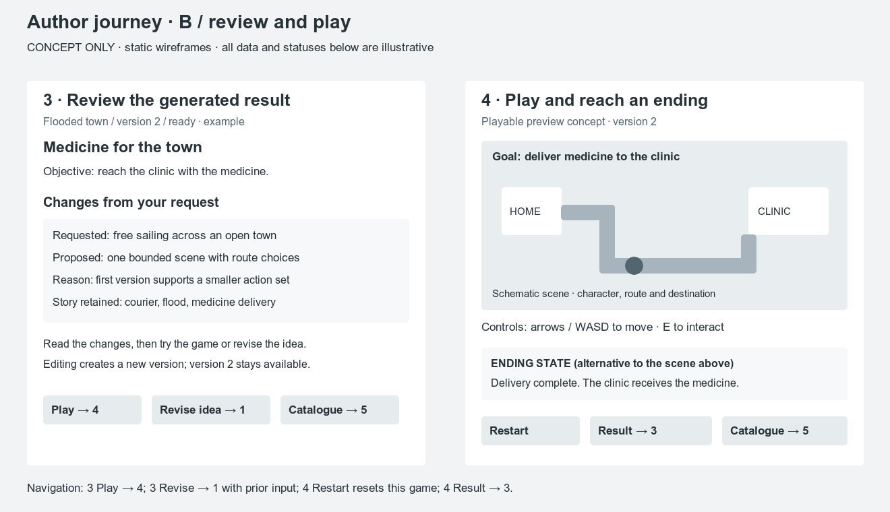
A conceptual journey supports author review
Six proposed states
Idea and preferences
Recorded job progress
Result and simplifications
Play and ending
Catalogue and versions
Failure and retry
Static concept.
No user evaluation.
8 UX concept · prototype/README.md · prototype/*.svg
08
Notes:
Static low-fidelity wireframes cover input/preferences, recorded progress, result and simplifications, play and ending, catalogue/version history, and failure/retry. No usability study, live generation or implemented gameplay is represented. Illustration uses prototype/result-play.svg rendered to PNG without changing its contents.
Evidence paths are relative to work/diploma/. All claims describe preparation drafts as at 22 October 2026. No runnable game or generator exists.

Slide 9
Verification separates launch from game quality
Baseline and integration checks
Start with a manually authored valid game. Exercise schema errors, duplicate jobs, provider failure and safe artifact delivery.
Gameplay and narrative checks
Record validity, browser launch, main actions, observed ending and story fidelity separately. Retain failures and rejected requests.
Status today
Test cases and prompt corpus are prepared. No running game, executed test evidence or measured success rate exists.
9 Verification · docs/verification-plan.md · tests/evaluation-prompts.md
09
Notes:
The verification draft lists V01–V18. Prompt corpus separates manually authored calibration from fixed evaluation prompts, supported cases, conditional simplifications and transparent rejections. Planned measures require conditions and denominators. A search timeout means unverified completion, not an impossible ending. No tests or generation runs have executed.
Evidence paths are relative to work/diploma/. All claims describe preparation drafts as at 22 October 2026. No runnable game or generator exists.

Slide 10
Next work closes evidence and handoff gaps
Scope and research decisions
Collect 3–5 discussions or substantive client agreement. Obtain supervisor feedback on mechanic scope, requirements and evaluation.
Repository and task tracker
Local drafts and a 36-task preparation plan exist. Remote repository, access, YouTrack links, student reviews and submission tag remain open.
Review and implementation sequence
All eleven sections have initial drafts. Substantive supervisor artifact review is pending. Agree scope and contract before building the first manual game.
10 Management · project-plan.md / 11 Supervisor · supervisor-feedback.md
10
Notes:
Evidence: docs/project-task-plan.md, docs/plan-reconciliation.md, docs/october-submission.md, docs/supervisor-feedback.md. The 36 tasks prepare eleven sections, repository and presentation. They are separate from the implementation roadmap. Supervisor clarification keeps every section at minimal depth plus Git/YouTrack. No substantive artifact review comments, real student peer-review history, reviewed tag or remote/YouTrack verification are evidenced.
Evidence paths are relative to work/diploma/. All claims describe preparation drafts as at 22 October 2026. No runnable game or generator exists.

