Slide 1
DATAWEAVE
By Team
LAST_SHIP

Slide 2
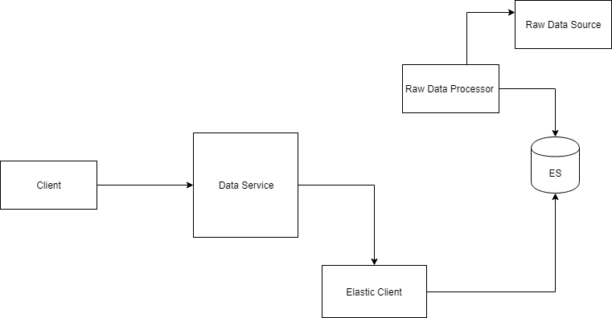
Solution Diagram

Slide 3
Technology Stack
Java
Elastic Search
HTML ,CSS, Javascript

