Slide 1
Program Language PHP

Slide 2

Today's subject
install appserv
basic php file

Slide 3
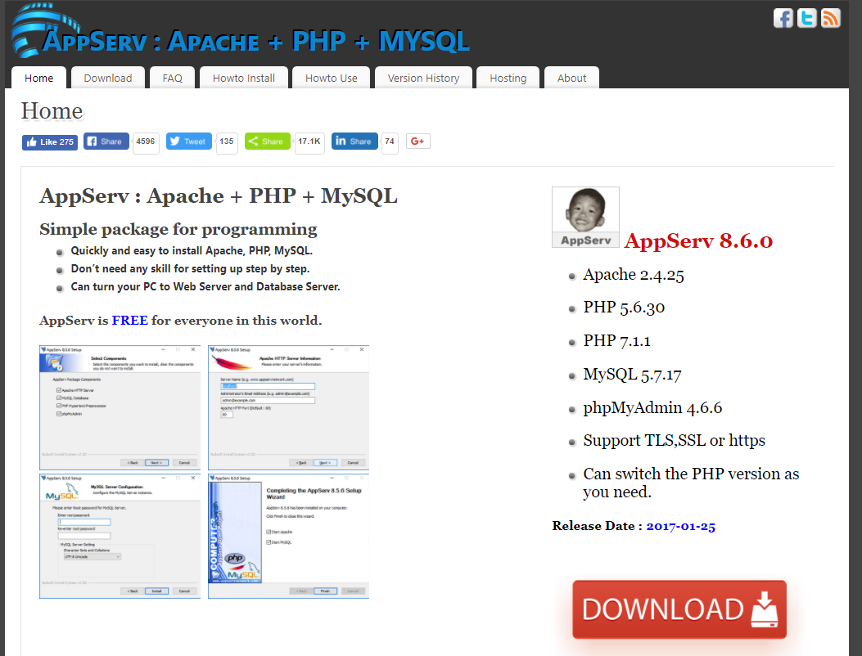
how to install appserv
download from follow URL.
https://www.appserv.org/en/
install
mysql server password "12345678"
start appserv
start apache
start mysql

Slide 4
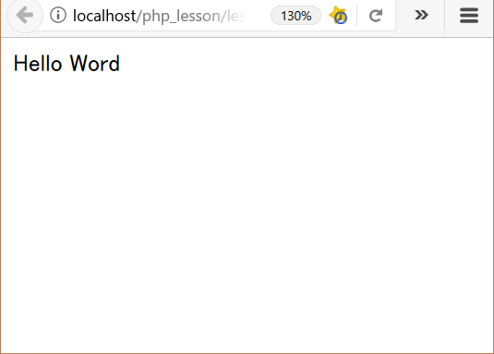
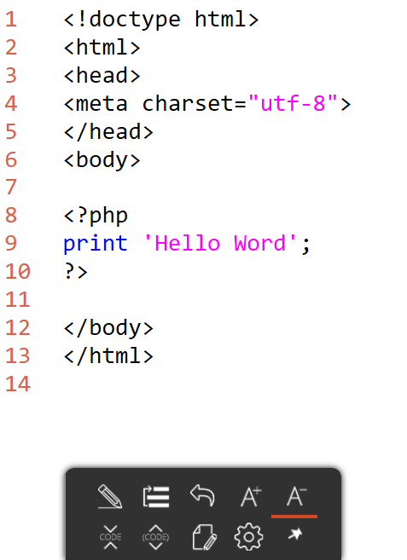
lesson01_1
explanation
L1-6: HTML header
L8-10: PHP program code
L12-13: HTML footer
output
folder: C:\appserv\php_lesson\ file name: lesson01_1.php

