Slide 1
Program Language PHP
This subject is "Database and phpMyAdmin"
download document and program from follow URL.
https://goo.gl/U1z3sL

Slide 2
RDBMS (Relational DataBase Management System)
A relational database management system (RDBMS) is a database management system (DBMS) that is based on the relational model invented by Edgar F. Codd, of IBM's San Jose Research Laboratory. Most databases in widespread use are based on the relational database model.

Slide 3
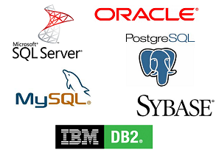
RDBMS brands
etc

Slide 4

MySQL
Many of the world's largest and fastest-growing organizations including Facebook, Google, Adobe, Alcatel Lucent and Zappos rely on MySQL to save time and money powering their high-volume Web sites, business-critical systems and packaged software.

Slide 5

phpMyAdmin
phpMyAdmin is a free software tool written in PHP, intended to handle the administration of MySQL over the Web. phpMyAdmin supports a wide range of operations on MySQL and MariaDB. Frequently used operations (managing databases, tables, columns, relations, indexes, users, permissions, etc) can be performed via the user interface, while you still have the ability to directly execute any SQL statement.

Slide 6
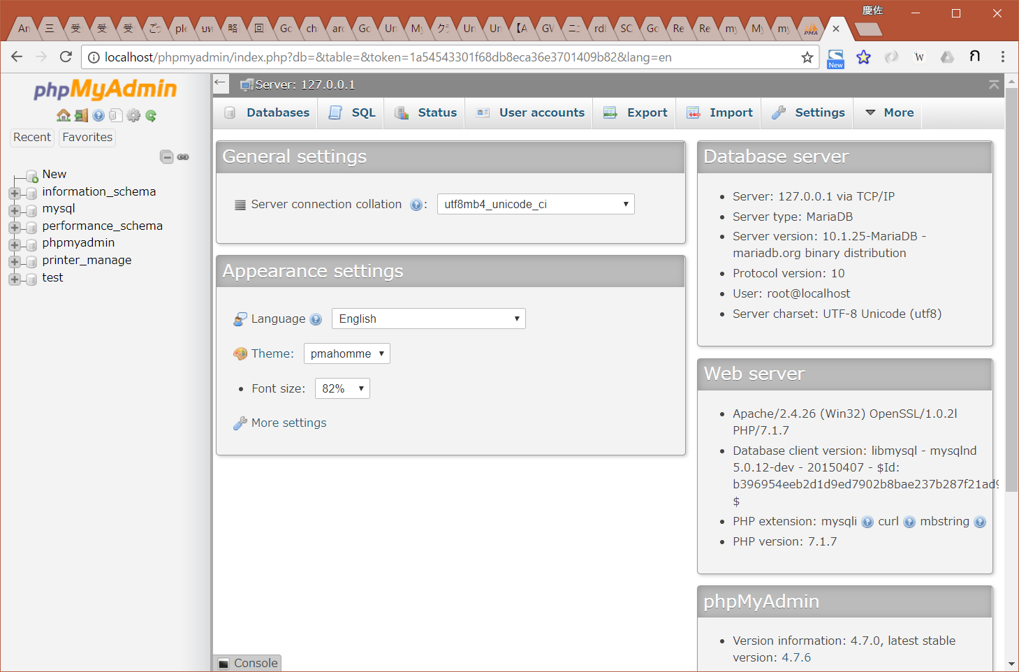
phpMyAdmin login
http://localhost/phpmyadmin/
User: root
Pw: 12345678

Slide 7
create database(DB)
1. create database
database name: test
collation: utf8_bin

Slide 8
create table
1. create table (number of columns: 2)
other field do not input
type=int => integer varchar => string
length is "max character length"
"primary key" may consist of a single attribute or multiple attributes in table.
name | id | student_name
type | int | varchar
length |  | 255
index | primary key

Slide 9
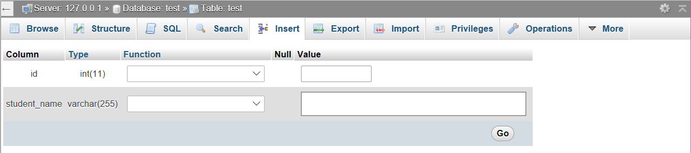
insert
1. insert data
insert 3-5 data.
anything is OK.

Slide 10
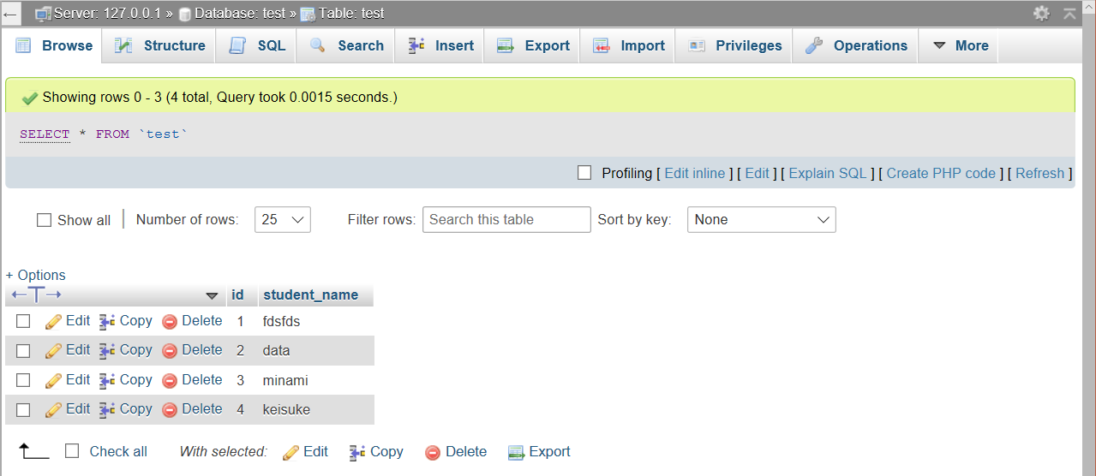
browse
Use "edit", "copy", "delete"

Slide 11
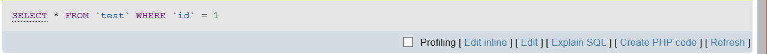
SQL
When you run insert, browse, search, and edit, phpMyAdmin show SQL command.
When you use database in PHP, you must write SQL command.

