Slide 1
Program Language PHP

Slide 2

Today's subject
install appserv
basic php

Slide 3
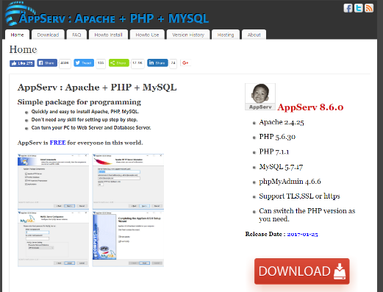
how to install appserv
download from follow URL.
https://www.appserv.org/en/
install
mysql server password "12345678"

Slide 4
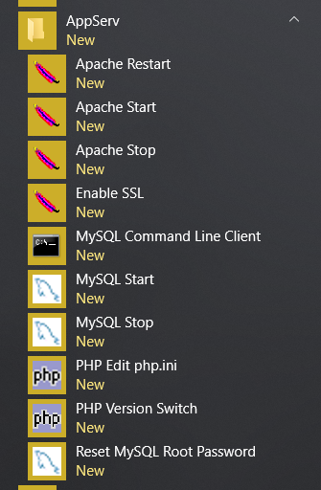
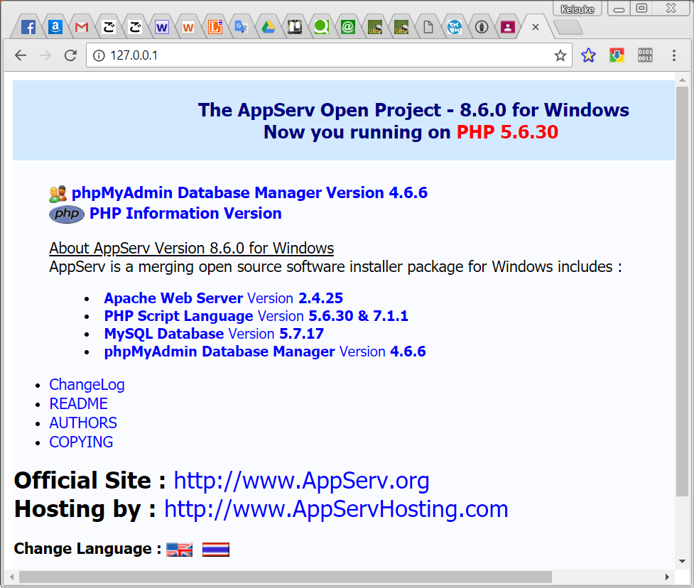
how to start appserv
Start AppServ
apache start
mysql start
Access by Chrome.
http://localhost/
or
http://127.0.0.1/
It means that webserver(AppServ) is started.

Slide 5
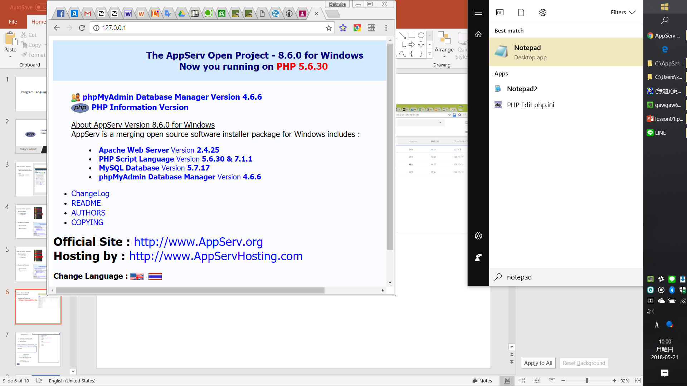
TextEditor(Notepad)
Launch notepad
Search notepad
Click notepad

Slide 6
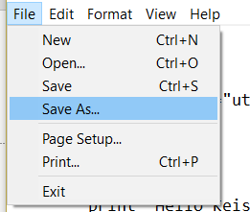
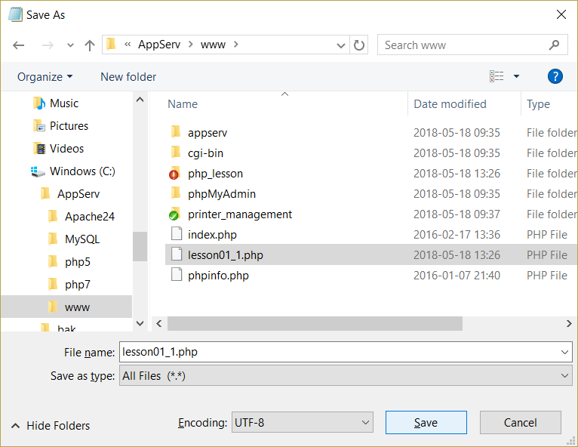
Create php program (lesson01_1.php)
<!doctype html>
<html>
<head>
<meta charset="utf-8">
</head>
<body>
<?php
print 'Hello Keisuke เคสุเกะ';
?>
</body>
</html>
Write program.
Save Launch notepad
File -> Save As…
Folder: C:/AppServ/www
FileName: lesson01_1.php
Encoding: UTF-8
Click “Save”

Slide 7
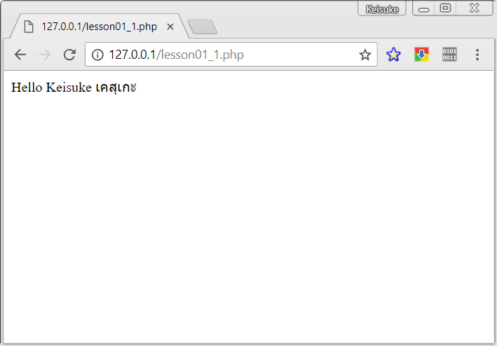
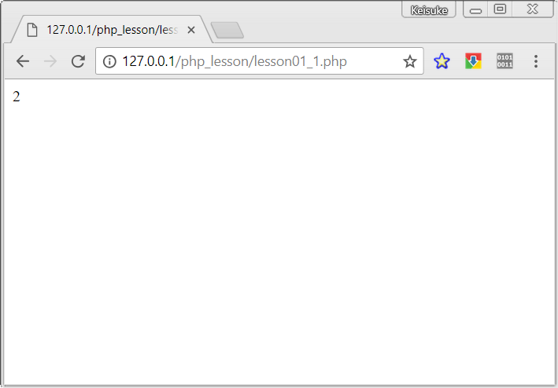
Show php program (lesson01_1.php)
Access by Chorome. http://127.0.0.1/lesson01_1.php
You can try to change program.
Change to your name.
print 1+2;

Slide 8
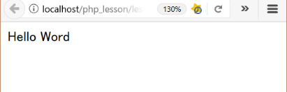
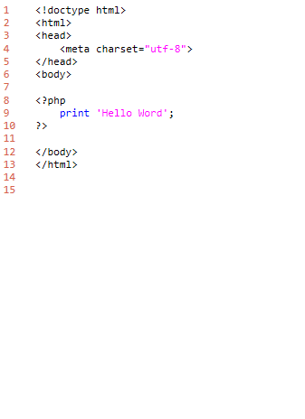
lesson01_1
3. folder: C:\appserv\www\php_lesson\ file name: lesson01_1.php
download "lesson01_1.php"
add program and save file.
show browser
3. http://localhost/php_lesson/lesson01_1.php
explanation
L1-6: HTML header
L8-10: PHP program code
must write <?php and ?>
command print
L12-13: HTML footer

Slide 9
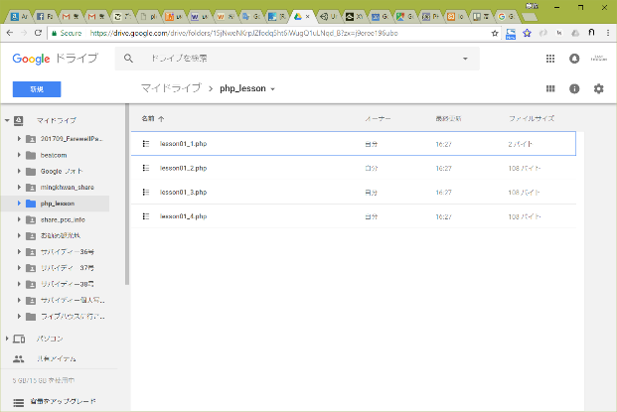
lesson document & program template
download from follow URL.
https://goo.gl/U1z3sL

Slide 10
lesson01_1
3. folder: C:\appserv\www\php_lesson\ file name: lesson01_1.php
download "lesson01_1.php"
add program and save file.
show browser
3. http://localhost/php_lesson/lesson01_1.php
explanation
L1-6: HTML header
L8-10: PHP program code
must write <?php and ?>
command print
L12-13: HTML footer

Slide 11
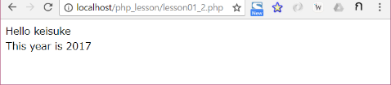
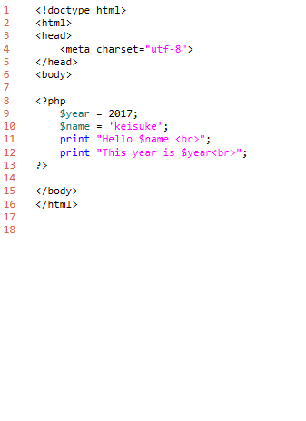
lesson01_2
3. folder: C:\appserv\www\php_lesson\ file name: lesson01_2.php
download "lesson01_2.php"
add program and save file.
show browser
3.http://localhost/php_lesson/ lesson01_2.php
explanation
L1-6: HTML header
L8-10: PHP program code
L9,10: define variables
L11,12: print variables
L15-16: HTML footer

Slide 12
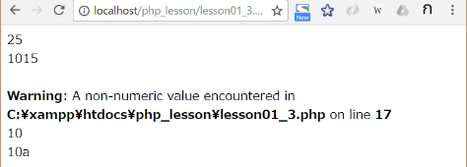
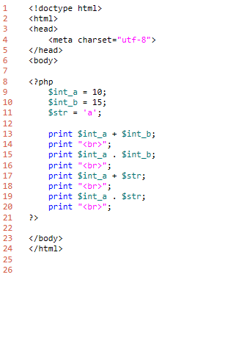
lesson01_3
3. folder: C:\appserv\www\php_lesson\ file name: lesson01_3.php
download "lesson01_3.php"
add program and save file.
show browser
3.http://localhost/php_lesson/ lesson01_3.php
explanation
L1-6: HTML header
L8-10: PHP program code
L13,14: int + int
L15,16: int . int
L17,18: int + string
L19,20: int . string
L23-24: HTML footer

Slide 13

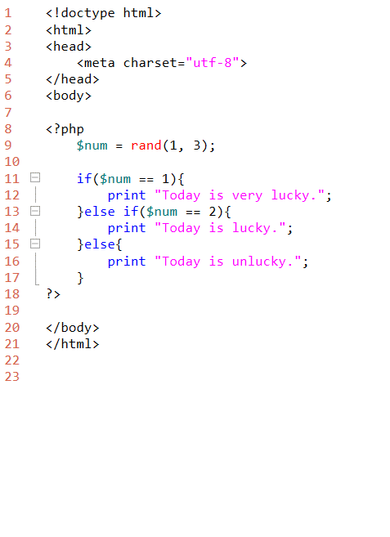
lesson01_4
3. folder: C:\appserv\www\php_lesson\ file name: lesson01_4.php
download "lesson01_4.php"
add program and save file.
show browser
3.http://localhost/php_lesson/ lesson01_4.php
explanation
L1-6: HTML header
L8-10: PHP program code
L9: command rand
L11: command if
L13: command else if
L15: command else
L23-24: HTML footer

