Slide 1
Program Language PHP

Slide 2
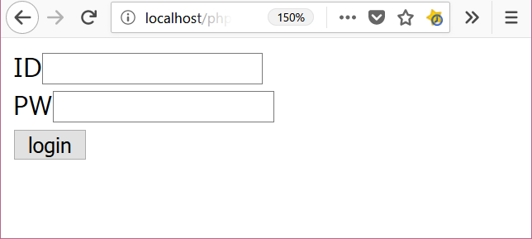

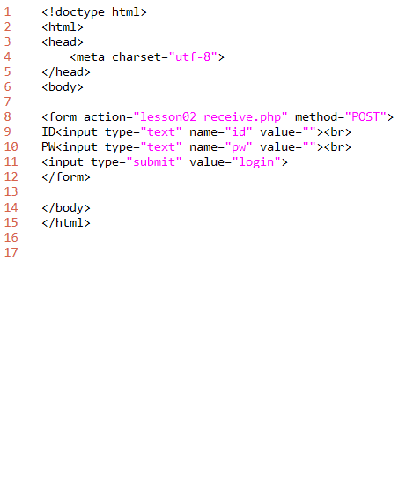
lesson02
2. folder: C:\appserv\php_lesson\ file name: lesson02_form.php
download " lesson02_form.php"
add program and save file.
show browser
3.http://localhost/php_lesson/ lesson02_form.php
explanation
L1-6: HTML header
L8-12: form tag
form tag
input type="text"
input type="submit"
L14-15: HTML footer

Slide 3
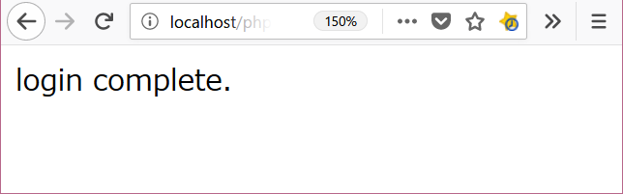
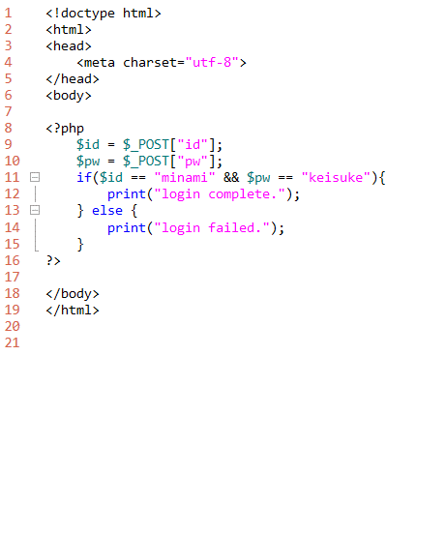
lesson02
2. folder: C:\appserv\php_lesson\ file name: lesson02_receive.php
download " lesson02_receive.php"
add program and save file.
show browser
click button from lesson02_form.php
output
explanation
L1-6: HTML header
L8-10: PHP program code
must write <?php and ?>
command print
L12-13: HTML footer

Slide 4

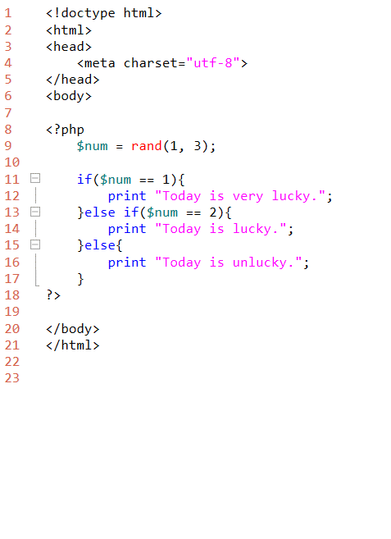
lesson01_4
3. folder: C:\appserv\www\php_lesson\ file name: lesson01_4.php
download "lesson01_4.php"
add program and save file.
show browser
3.http://localhost/php_lesson/ lesson01_4.php
explanation
L1-6: HTML header
L8-10: PHP program code
L9: command rand
L11: command if
L13: command else if
L15: command else
L23-24: HTML footer

