Slide 1
Program Language PHP

Slide 2
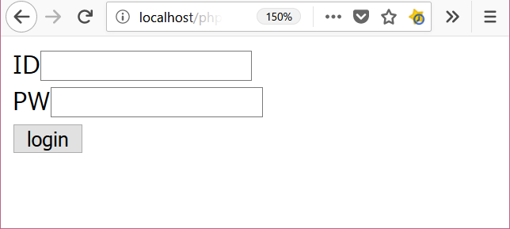

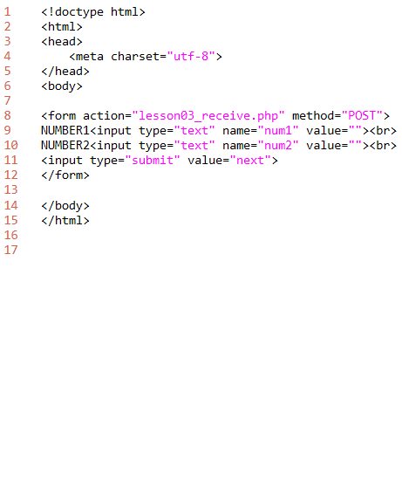
lesson03
download "lesson03_form.php"
add program.
explanation
L1-6: HTML header
L8-12: form tag
L14-15: HTML footer
output
folder: C:\appserv\php_lesson\ file name: lesson03_form.php

Slide 3
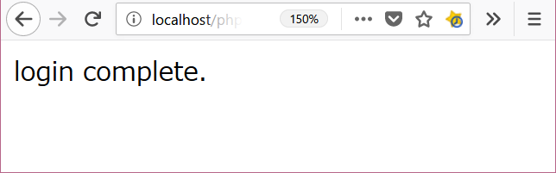
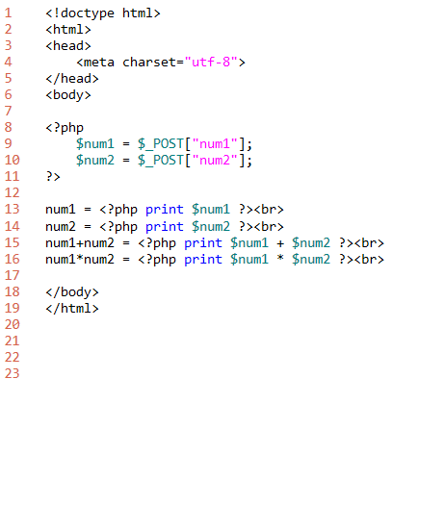
lesson03
download "lesson03_receive.php"
add program.
explanation
L1-6: HTML header
L8-16: PHP program code
must write <?php and ?>
command print
L18-19: HTML footer
output
folder: C:\appserv\php_lesson\ file name: lesson03_receive.php

