Slide 1
Program Language PHP

Slide 2

Today's subject
install appserv
basic php

Slide 3
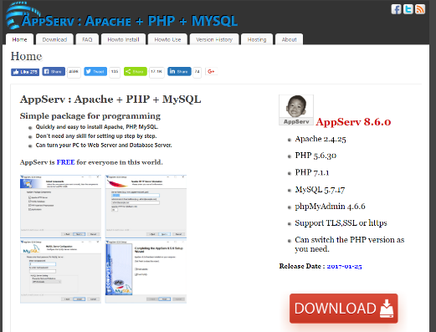
how to install appserv
download from follow URL.
https://www.appserv.org/en/
install
mysql server password "12345678"
start appserv
apache start
mysql start
Use browser to follow URL.
http://localhost/
or
http://127.0.0.1/

Slide 4
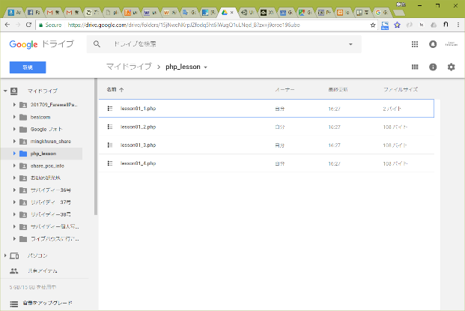
lesson document & program template
download from follow URL.
https://goo.gl/U1z3sL

Slide 5
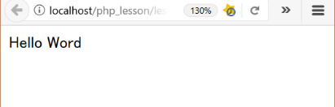
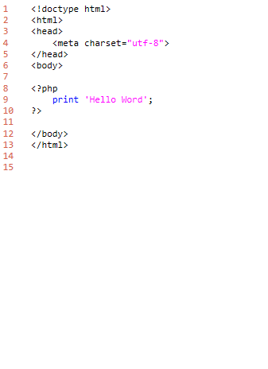
lesson01_1
3. folder: C:\appserv\www\php_lesson\ file name: lesson01_1.php
download "lesson01_1.php"
add program and save file.
show browser
3. http://localhost/php_lesson/lesson01_1.php
explanation
L1-6: HTML header
L8-10: PHP program code
must write <?php and ?>
command print
L12-13: HTML footer

Slide 6
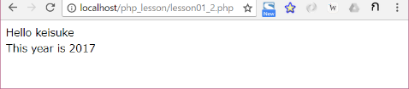
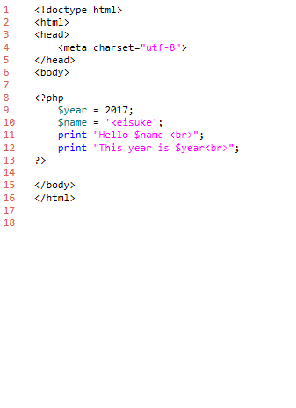
lesson01_2
3. folder: C:\appserv\www\php_lesson\ file name: lesson01_2.php
download "lesson01_2.php"
add program and save file.
show browser
3.http://localhost/php_lesson/ lesson01_2.php
explanation
L1-6: HTML header
L8-10: PHP program code
L9,10: define variables
L11,12: print variables
L15-16: HTML footer

Slide 7
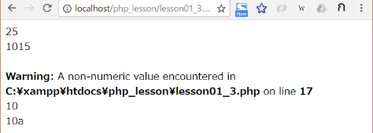
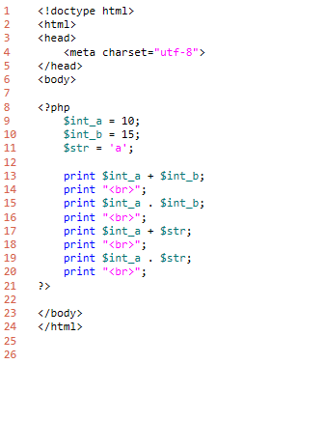
lesson01_3
3. folder: C:\appserv\www\php_lesson\ file name: lesson01_3.php
download "lesson01_3.php"
add program and save file.
show browser
3.http://localhost/php_lesson/ lesson01_3.php
explanation
L1-6: HTML header
L8-10: PHP program code
L13,14: int + int
L15,16: int . int
L17,18: int + string
L19,20: int . string
L23-24: HTML footer

Slide 8

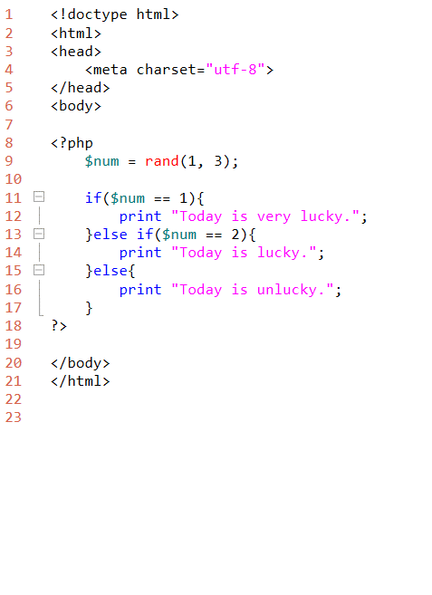
lesson01_4
3. folder: C:\appserv\www\php_lesson\ file name: lesson01_4.php
download "lesson01_4.php"
add program and save file.
show browser
3.http://localhost/php_lesson/ lesson01_4.php
explanation
L1-6: HTML header
L8-10: PHP program code
L9: command rand
L11: command if
L13: command else if
L15: command else
L23-24: HTML footer

