Slide 1
Program Language PHP
This subject is "form"
download document and program from follow URL.
https://goo.gl/U1z3sL

Slide 2
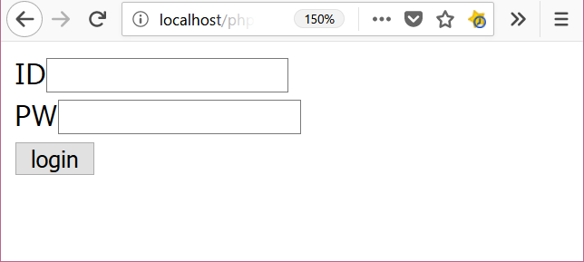

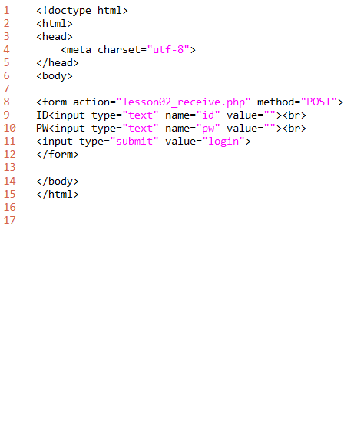
lesson02
2. folder: C:\appserv\php_lesson\ file name: lesson02_form.php
download " lesson02_form.php"
white this program and save file.
show browser
3.http://localhost/php_lesson/ lesson02_form.php
explanation
L1-6: HTML header
L8-12: form tag
form tag
input type="text"
input type="submit"
L14-15: HTML footer

Slide 3
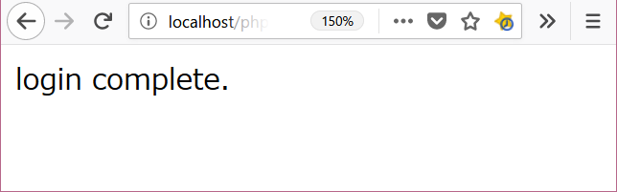
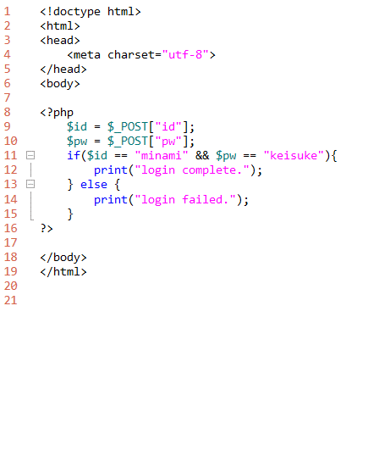
lesson02
2. folder: C:\appserv\wwwphp_lesson\ file name: lesson02_receive.php
download " lesson02_receive.php"
write this program and save file.
show browser
click button from lesson02_form.php
explanation
L1-6: HTML header
L8-10: PHP program code
L9,10: use $_POST and receive form data.
L11-15: check login id and password.
L23-24: HTML footer

