Slide 1
Program Language PHP
This subject is "form, input, textarea and so on"
download document and program from follow URL.
https://goo.gl/U1z3sL

Slide 2
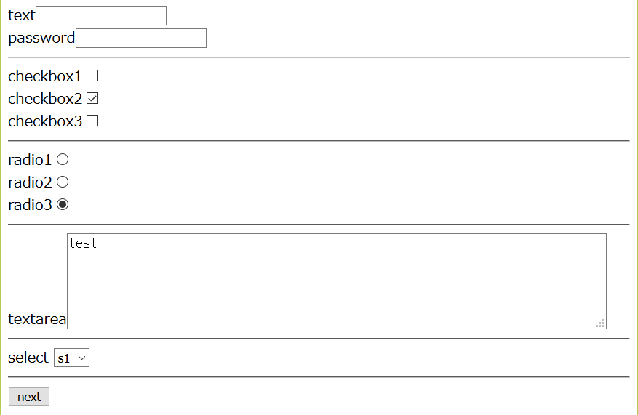

lesson03
<!doctype html>
<html>
<head>
<meta charset="utf-8">
</head>
<body>
<form action="lesson05_receive.php" method="POST">
text<input type="text" name="text1" value=""><br>
password<input type="text" name="pass1" value=""><br>
<hr>
checkbox1<input type="checkbox" name="c1" value="1"><br>
checkbox2<input type="checkbox" name="c1" value="2" checked><br>
checkbox3<input type="checkbox" name="c1" value="3"><br>
<hr>
radio1<input type="radio" name="r1" value="1"><br>
radio2<input type="radio" name="r1" value="2"><br>
radio3<input type="radio" name="r1" value="3" checked><br>
<hr>
textarea<textarea name="ta" cols="70" rows="5">test</textarea><br>
<hr>
select
<select name="sel">
<option value="s1">s1</option>
<option value="s2">s2</option>
<option value="s3">s3</option>
</select>
<hr>
<input type="submit" value="next">
</form>
</body>
</html>
download "lesson03_form.php"
write this program.
http://localhost/php_lesson/lesson03_form.php
explanation
L1-6: HTML header
L8-30: form tag
L32-33: HTML footer
output
folder: C:\appserv\php_lesson\ file name: lesson03_form.php

Slide 3
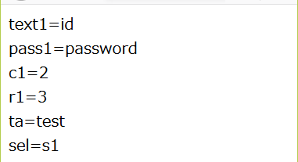
lesson03
<!doctype html>
<html>
<head>
<meta charset="utf-8">
</head>
<body>
<?php
$text1 = $_POST["text1"];
$pass1 = $_POST["pass1"];
$c1 = $_POST["c1"];
$r1 = $_POST["r1"];
$ta = $_POST["ta"];
$sel = $_POST["sel"];
?>
text1=<?php print $text1; ?><br>
pass1=<?php print $pass1; ?><br>
c1=<?php print $c1; ?><br>
r1=<?php print $r1; ?><br>
ta=<?php print $ta; ?><br>
sel=<?php print $sel; ?><br>
</body>
</html>
download "lesson03_receive.php"
write this program.
click button from lesson03_recieve.php
explanation
L1-6: HTML header
L8-16: PHP program code
L17-22: show variables
L24-25: HTML footer
output
folder: C:\appserv\php_lesson\ file name: lesson03_receive.php

