Slide 1
Program Language PHP
This subject is "table tag"
download document and program from follow URL.
https://goo.gl/U1z3sL

Slide 2

lesson04
<!doctype html>
<html>
<head>
<meta charset="utf-8">
</head>
<body>
<table>
<tr>
<td>first name</td>
<td>family name</td>
</tr>
<tr>
<td>keisuke</td>
<td>minami</td>
</tr>
</table>
</body>
</html>
download "lesson04_table.php"
write this program.
explanation
L1-6: HTML header
L9-21: table tag
L11,16: table tr : line
L12,13,17,18: table td : column
14-15: HTML footer
folder: C:\appserv\php_lesson\ file name: lesson04_table.php

Slide 3
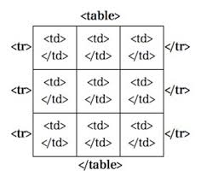
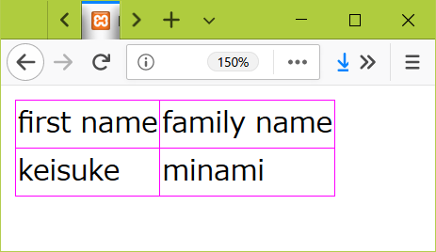
css
<style>
table {
border-collapse: collapse;
}
table, th, td {
border: solid 1px #ff00ff;
}
</style>
add text in a program. (line6)
folder: C:\appserv\php_lesson\ file name: lesson04_table.php

Slide 4
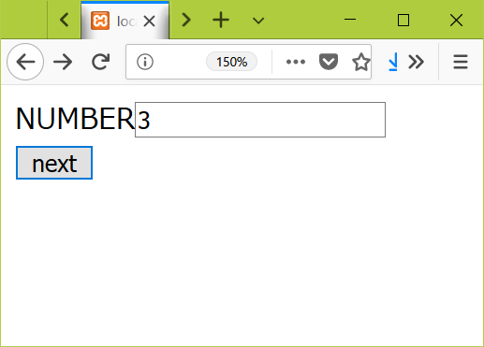
lesson04 2
<!doctype html>
<html>
<head>
<meta charset="utf-8">
</head>
<body>
<form action="lesson04_receive.php" method="POST">
NUMBER
<input type="text" name="num" value=""><br>
<input type="submit" value="next">
</form>
</body>
</html>
download "lesson03_form.php"
write this program.
click button from lesson04_form.php
explanation
L1-6: HTML header
L8-12: form tag
L14-15: HTML footer
output
folder: C:\appserv\php_lesson\ file name: lesson04_form.php

Slide 5
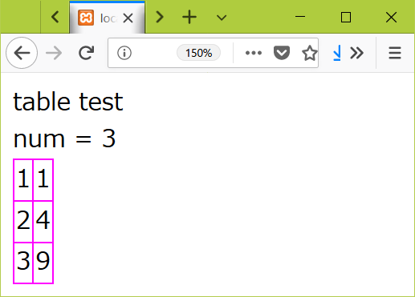
lesson04 2
<!doctype html>
<html>
<head>
<meta charset="utf-8">
</head>
<style>
table {
border-collapse: collapse;
}
table, th, td {
border: solid 1px #ff00ff;
}
</style>
<body>
table test<br>
<?php
$num = $_POST["num"];
print("num = $num<br>");
?>
<table>
<?php
for($i = 1; $i <= $num; $i ++){
?>
<tr>
<td><?php print $i; ?></td>
<td><?php print $i*$i; ?></td>
</tr>
<?php
}
?>
</table>
</body>
</html>
download "lesson03_receive.php"
write this program.
explanation
L1-14: HTML header
L8-13: CSS
L12-33: show table
L35-36: HTML footer
output
folder: C:\appserv\php_lesson\ file name: lesson04_receive.php

