Slide 1
Program Language PHP
This subject is "Database and phpMyAdmin"
download document and program from follow URL.
https://goo.gl/U1z3sL

Slide 2
RDBMS (Relational DataBase Management System)
A relational database management system (RDBMS) is a database management system (DBMS) that is based on the relational model invented by Edgar F. Codd, of IBM's San Jose Research Laboratory. Most databases in widespread use are based on the relational database model.

Slide 3
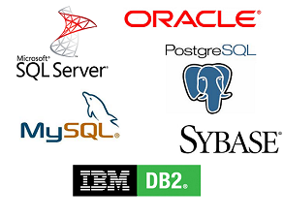
RDBMS brands
etc

Slide 4

MySQL
Many of the world's largest and fastest-growing organizations including Facebook, Google, Adobe, Alcatel Lucent and Zappos rely on MySQL to save time and money powering their high-volume Web sites, business-critical systems and packaged software.

Slide 5

phpMyAdmin
phpMyAdmin is a free software tool written in PHP, intended to handle the administration of MySQL over the Web. phpMyAdmin supports a wide range of operations on MySQL and MariaDB. Frequently used operations (managing databases, tables, columns, relations, indexes, users, permissions, etc) can be performed via the user interface, while you still have the ability to directly execute any SQL statement.

Slide 6
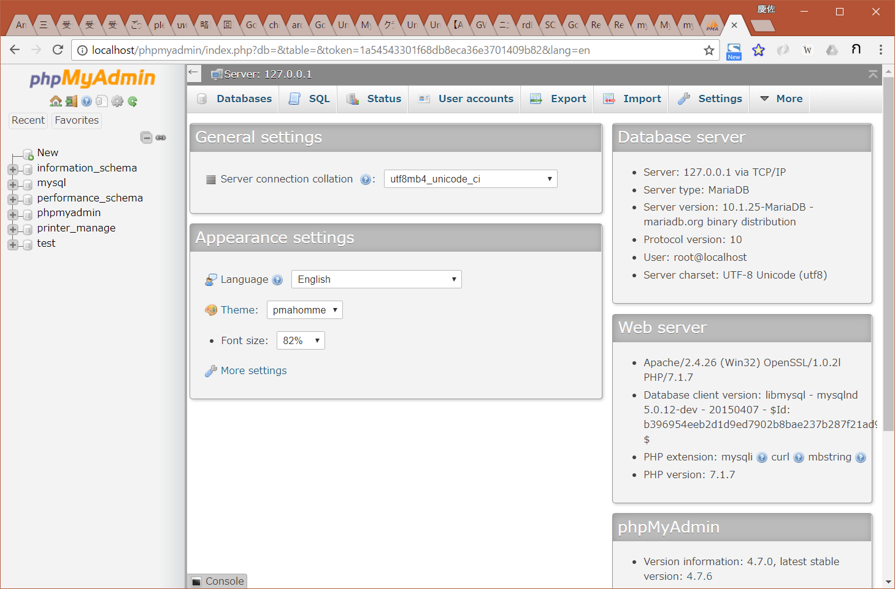
phpMyAdmin login
http://localhost/phpmyadmin/
User: root
Pw: 12345678

Slide 7
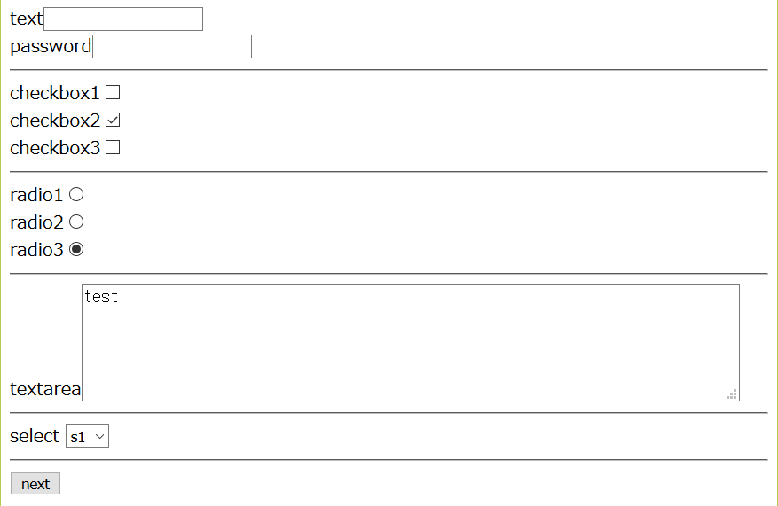

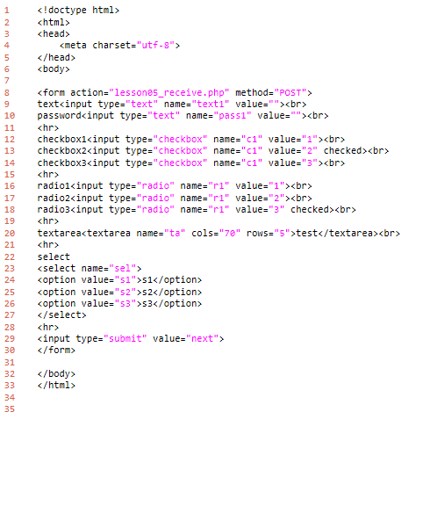
lesson05
download "lesson05_form.php"
write this program.
http://localhost/php_lesson/lesson05_form.php
explanation
L1-6: HTML header
L8-30: form tag
L32-33: HTML footer
output
folder: C:\appserv\php_lesson\ file name: lesson03_form.php

Slide 8
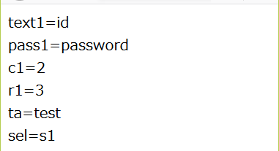
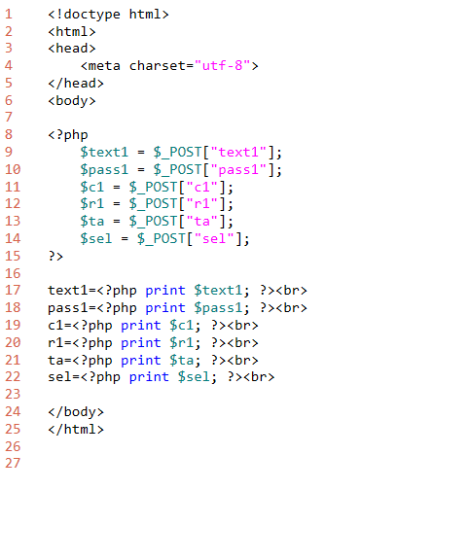
lesson05
download "lesson05_receive.php"
write this program.
click button from lesson05_form.php
explanation
L1-6: HTML header
L8-16: PHP program code
L17-22: show variables
L24-25: HTML footer
output
folder: C:\appserv\php_lesson\ file name: lesson03_receive.php

