Slide 1
Program Language PHP
This subject is "form"
download document and program from follow URL.
https://goo.gl/U1z3sL

Slide 2
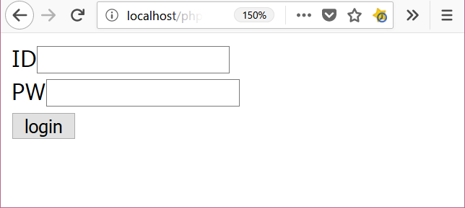

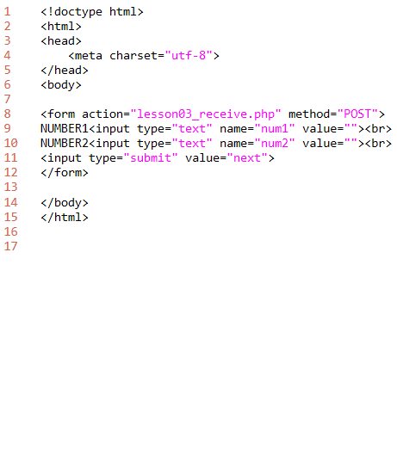
lesson03
2. folder: C:\appserv\php_lesson\ file name: lesson03_form.php
download "lesson03_form.php"
write this program.
http://localhost/php_lesson/lesson03_form.php
explanation
L1-6: HTML header
L8-12: form tag
L14-15: HTML footer
output
folder: C:\appserv\php_lesson\ file name: lesson03_form.php

Slide 3
lesson03
2. folder: C:\appserv\php_lesson\ file name: lesson03_form.php
<!doctype html>
<html>
<head>
<meta charset="utf-8">
</head>
<body>
<form action="lesson03_receive.php" method="POST">
NUMBER1<input type="text" name="num1" value=""><br>
NUMBER2<input type="text" name="num2" value=""><br>
<input type="submit" value="next">
</form>
</body>
</html>
download "lesson03_form.php"
write this program.
http://localhost/php_lesson/lesson03_form.php
explanation
L1-6: HTML header
L8-12: form tag
L14-15: HTML footer
output
folder: C:\appserv\php_lesson\ file name: lesson03_form.php

Slide 4
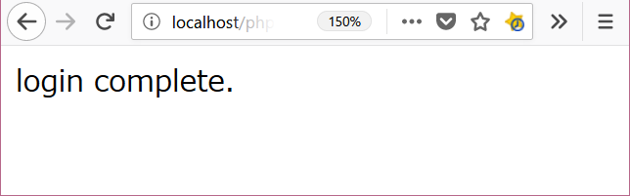
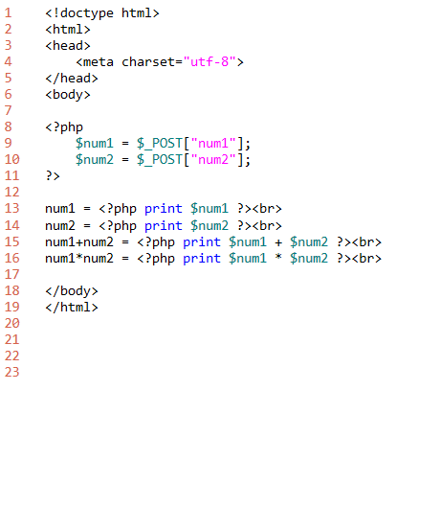
lesson03
2. folder: C:\appserv\php_lesson\ file name: lesson03_receive.php
download "lesson03_receive.php"
write this program.
click button from lesson03_form.php
explanation
L1-6: HTML header
L8-16: PHP program code
must write <?php and ?>
command print
L18-19: HTML footer
output

