Slide 1
Program Language PHP

Slide 2

Today's subject
install appserv
basic php

Slide 3
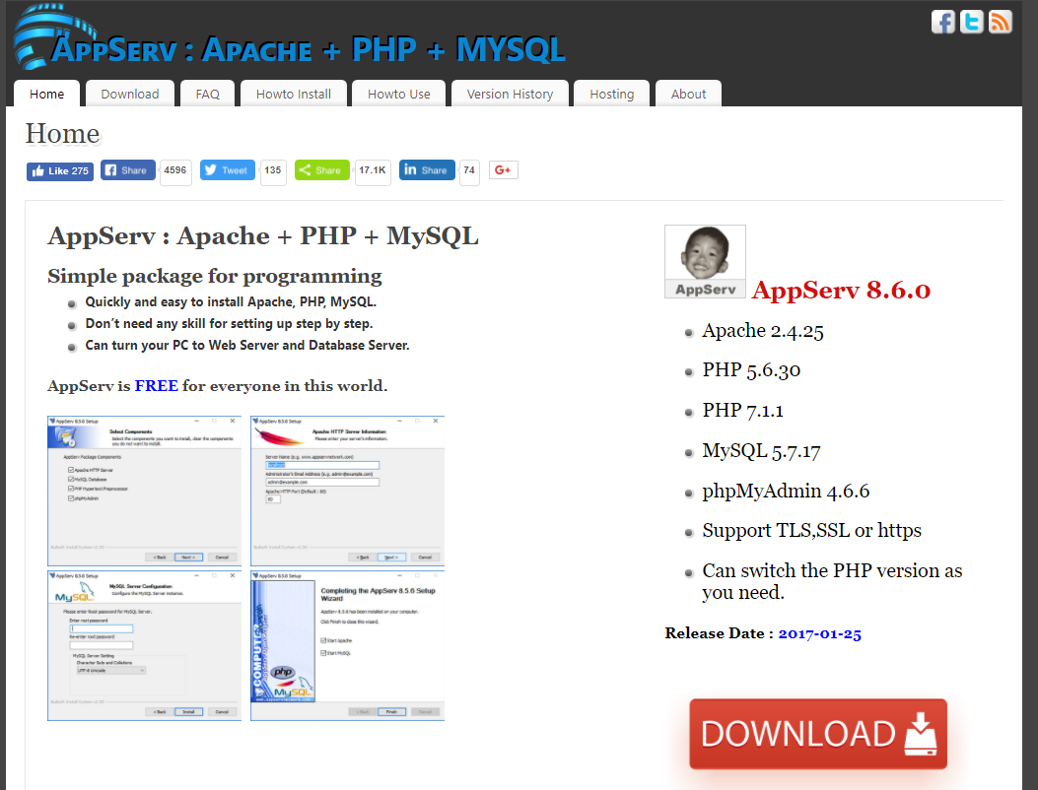
how to install appserv
download from follow URL.
https://www.appserv.org/en/
install
mysql server password "12345678"
start appserv
start apache
start mysql

Slide 4
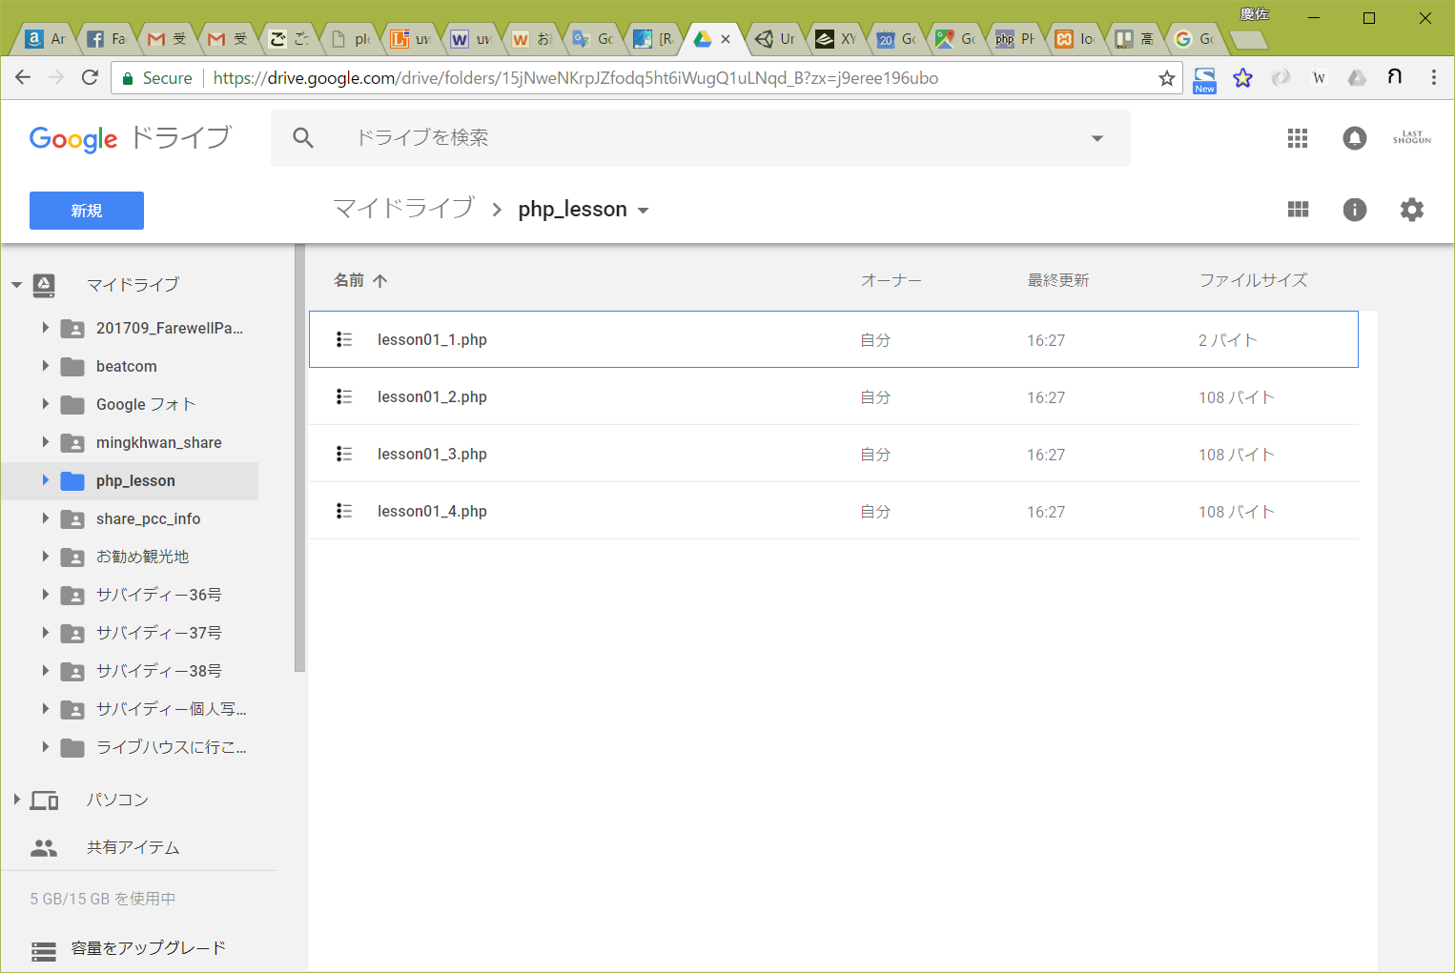
lesson document & program template
download from follow URL.
https://goo.gl/U1z3sL

Slide 5
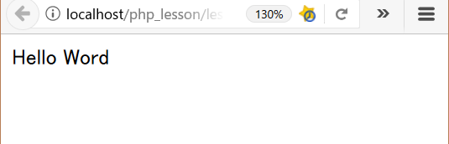
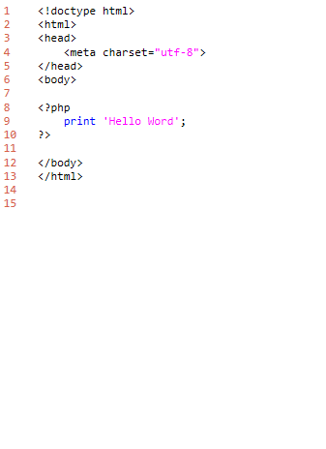
lesson01_1
download "lesson01_1.php"
add program.
explanation
L1-6: HTML header
L8-10: PHP program code
must write <?php and ?>
command print
L12-13: HTML footer
output
folder: C:\appserv\php_lesson\ file name: lesson01_1.php

Slide 6
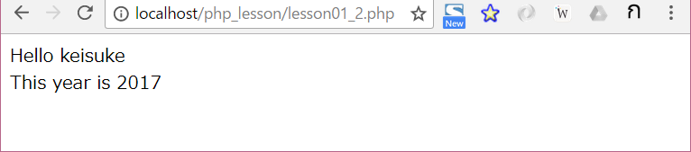
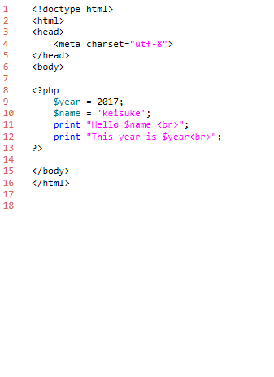
lesson01_2
explanation
L1-6: HTML header
L8-10: PHP program code
L9,10: define variables
L11,12: print variables
L15-16: HTML footer
output
folder: C:\appserv\php_lesson\ file name: lesson01_2.php

Slide 7
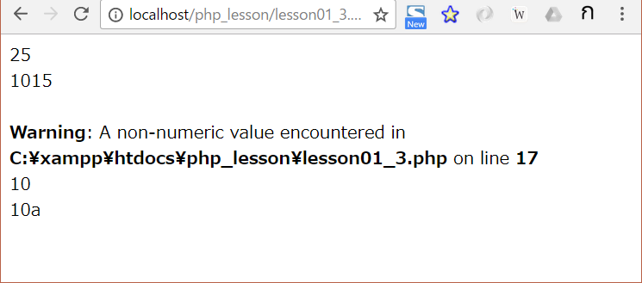
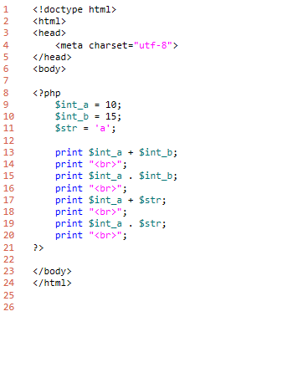
lesson01_3
explanation
L1-6: HTML header
L8-10: PHP program code
L13,14: int + int
L15,16: int . int
L17,18: int + string
L19,20: int . string
L23-24: HTML footer
output
folder: C:\appserv\php_lesson\ file name: lesson01_2.php

Slide 8
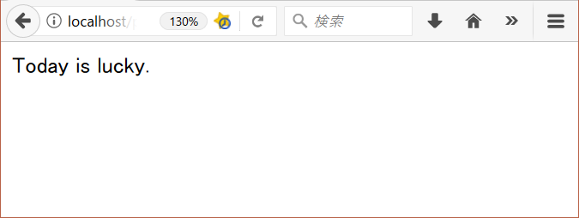
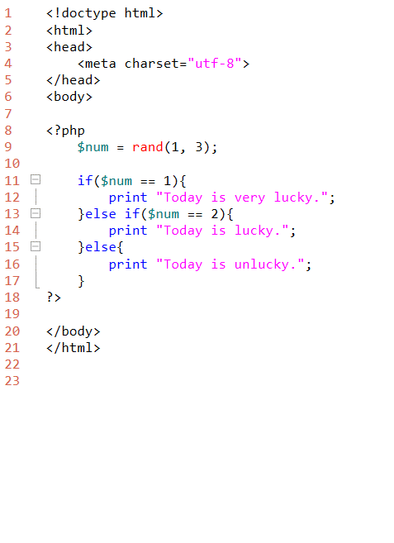
lesson01_4
explanation
L1-6: HTML header
L8-10: PHP program code
L9: command rand
L11: command if
L13: command else if
L15: command else
L23-24: HTML footer
output
folder: C:\appserv\php_lesson\ file name: lesson01_2.php

