Slide 1

Repository and Unit of Work

Slide 2

Data Mapper Layer
„A system with a complex domain model often benefits from a layer, such as the one provided by Data Mapper, that isolates domain objects from details of the database access code.”
(Martin Fowler)
[ Entity Framework is useful ]

Slide 3
Data Query Layer
„In such systems it can be worthwhile to build another layer of abstraction over the mapping layer where query construction code is concentrated.”
(Martin Fowler)
[ Gather all data queries in a separate layer ]

Slide 4
Repository
„A Repository mediates between the domain and data mapping layers, acting like an in-memory domain object collection.”
(Martin Fowler)

Slide 5
Repository - Benefits
Use the storage like an in-memory collection
„Provides a more object-oriented view of the persistence layer.” (Martin Fowler)
Get, Add, Remove
NO: Update
NO: Save
Will be implemented by Unit of Work
Eliminates duplicate query logic
Hides the details of accessing the data storage
The usage of Entity Framework is a detail.

Slide 6
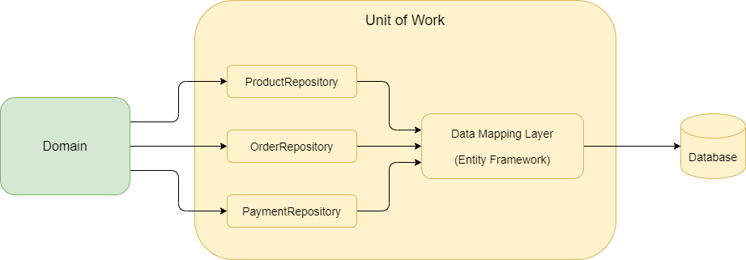
Unit of Work
“The Unit of Work maintains a list of objects affected by a business transaction and coordinates the writing out of changes.”
(Martin Fowler)

Slide 7
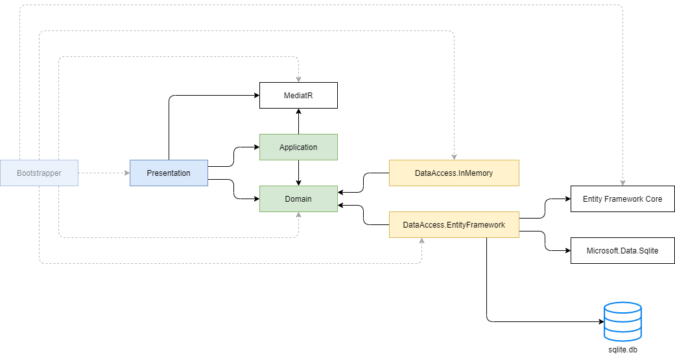
Architecture Diagram

Slide 8
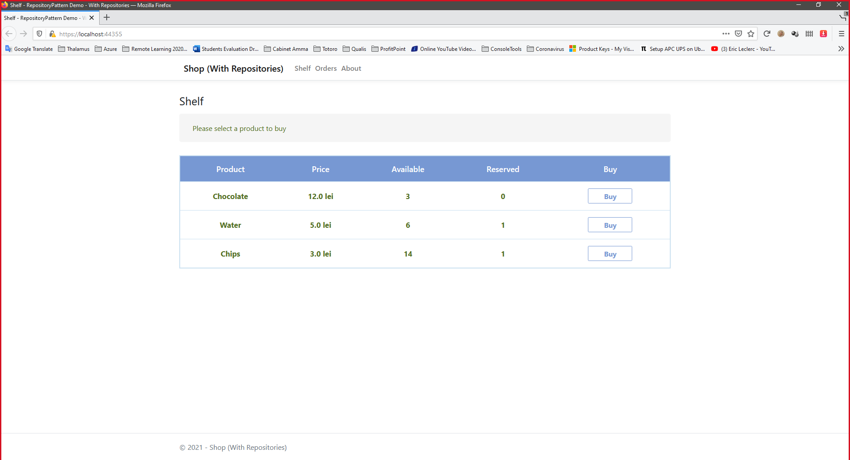
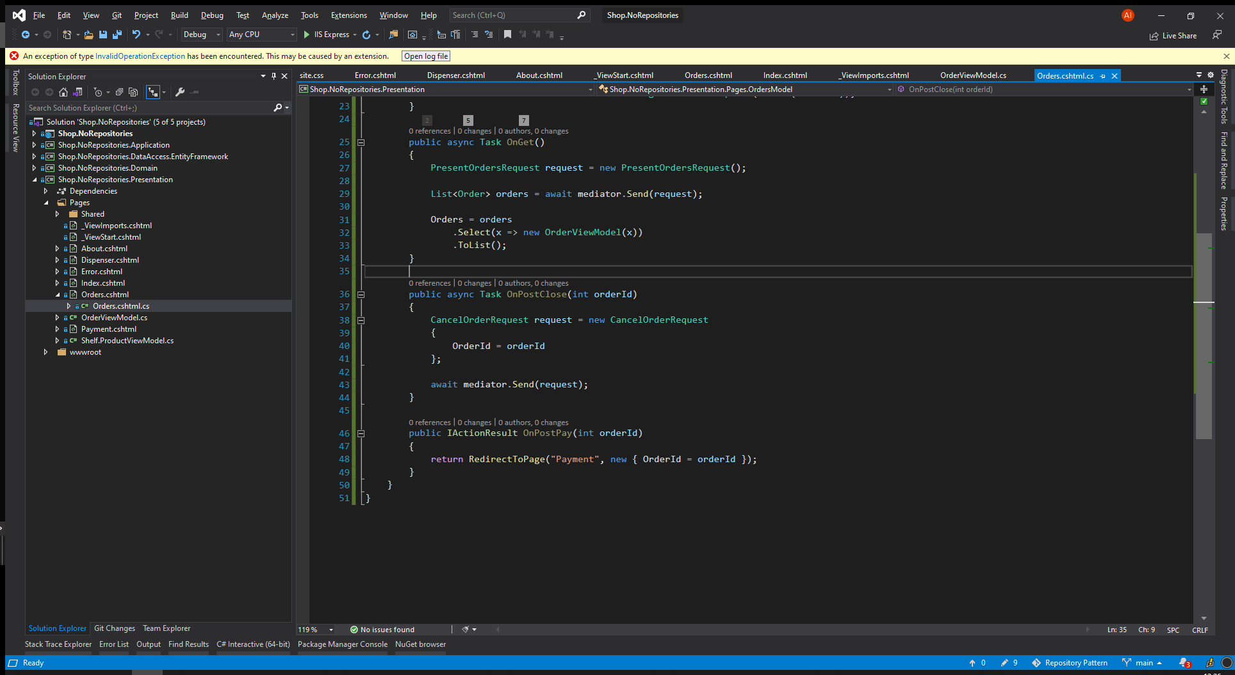
Demo

Slide 9
Entity Framework vs Custom Repositories
DbSet<T> is a Repository
(+) Hides the details of accessing the data
(+) Emulates an in-memory collection
(-) We have no place where to write custom queries that can be later used in multiple places in the rest of the application.
DbContext is a Unit of Work
(+) Ensures data consistency
It provides the `SaveChanges` method.

Slide 10
Common Mistakes
Repositories that return View Models
Update method in repositories
Save method in repositories
Repositories that return IQueryable

Slide 11
Conclusions
Repositories
in-memory collections
NO Update() method
Unit of Work
Keeps track of all changes.
Compete() method
Saves everything or nothing.

Slide 12
Thank You

