Slide 1

Repository and Unit of Work

Slide 2

Data Mapper Layer
„A system with a complex domain model often benefits from a layer, such as the one provided by Data Mapper, that isolates domain objects from details of the database access code.”
(Martin Fowler)

Slide 3
Data Query Layer
„In such systems it can be worthwhile to build another layer of abstraction over the mapping layer where query construction code is concentrated.”
(Martin Fowler)

Slide 4
Repository
„A Repository mediates between the domain and data mapping layers, acting like an in-memory domain object collection.”
(Martin Fowler)

Slide 5
Repository - Benefits
Use the storage like an in-memory collection
„Provides a more object-oriented view of the persistence layer.” (Martin Fowler)
Get, Add, Remove
NO: Update
NO: Save
Will be implemented by Unit of Work
Eliminates duplicate query logic
Hides the details of accessing the data storage
The usage of Entity Framework is a detail.

Slide 6
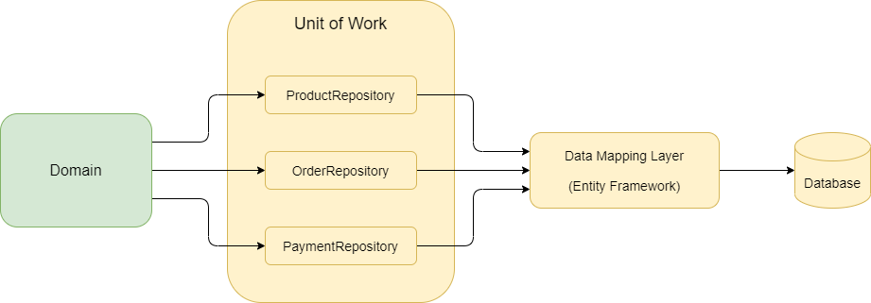
Unit of Work
“The Unit of Work maintains a list of objects affected by a business transaction and coordinates the writing out of changes.”
(Martin Fowler)

Slide 7
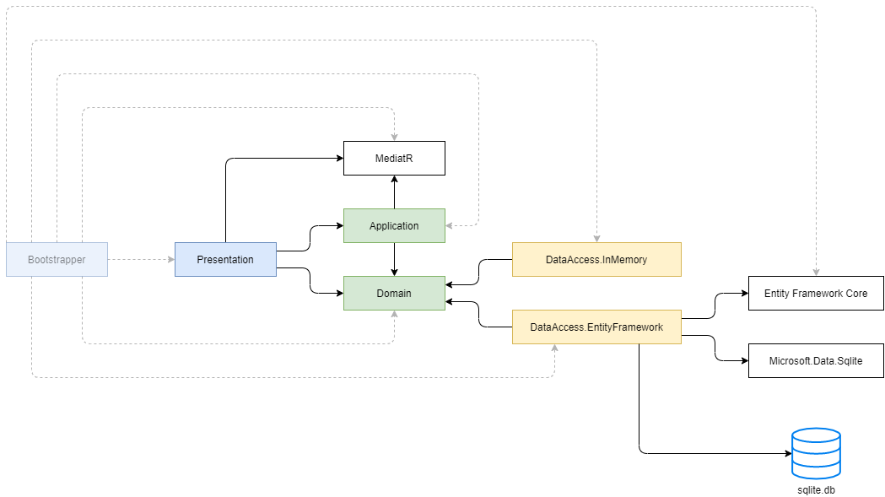
Demo (Architecture Diagram)

Slide 8
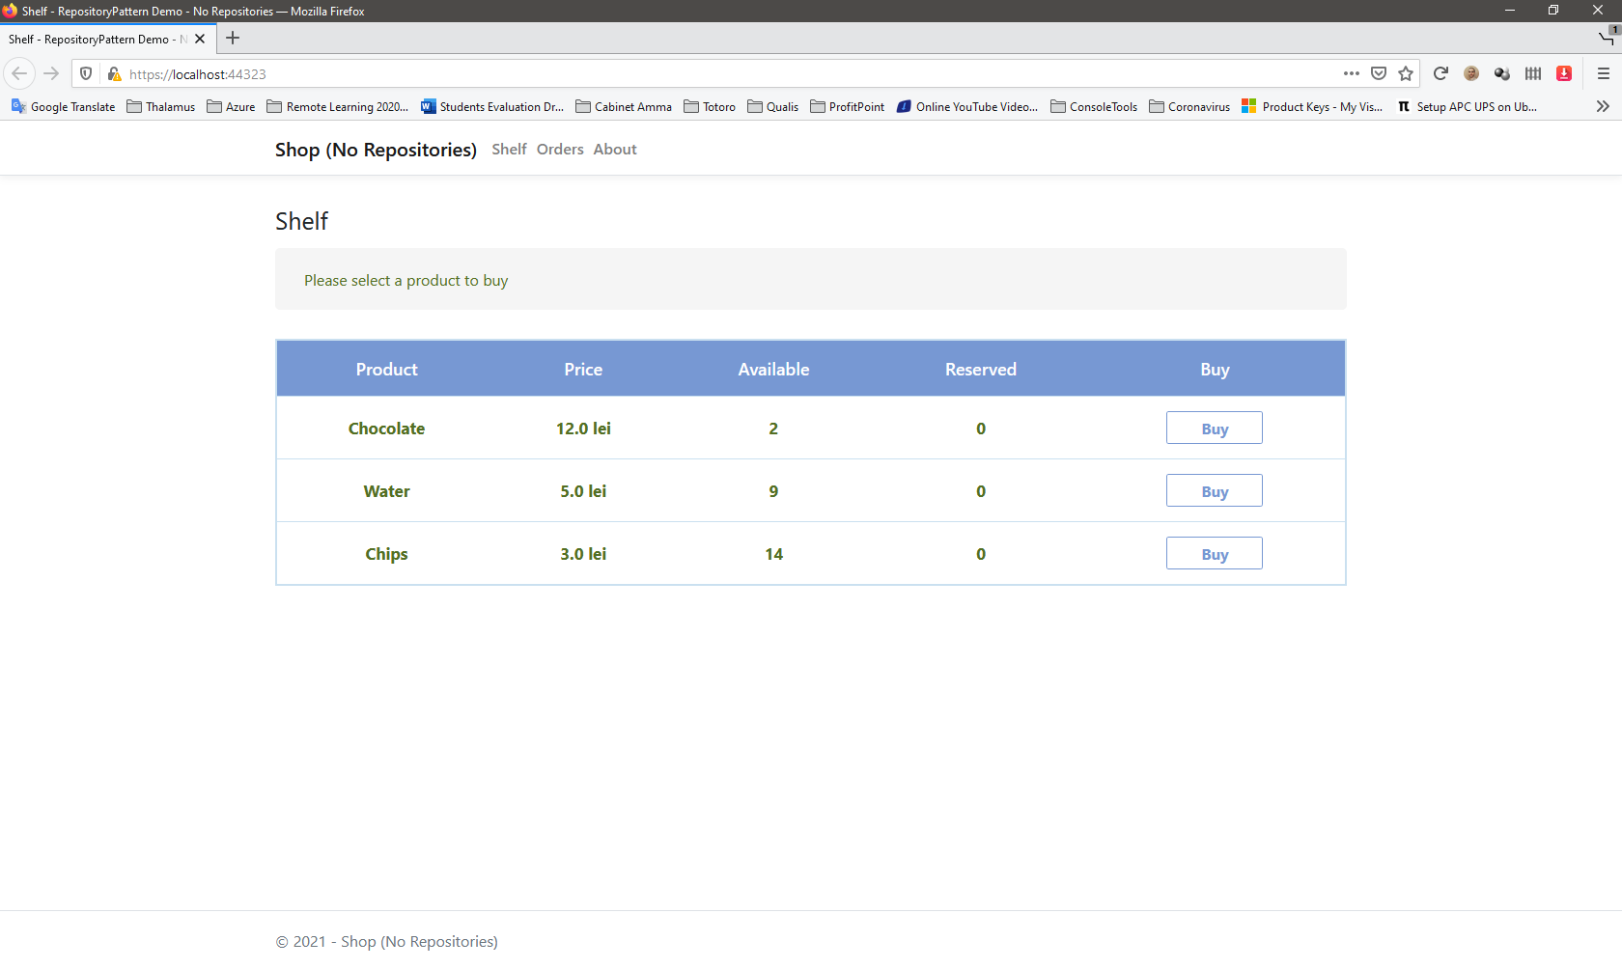
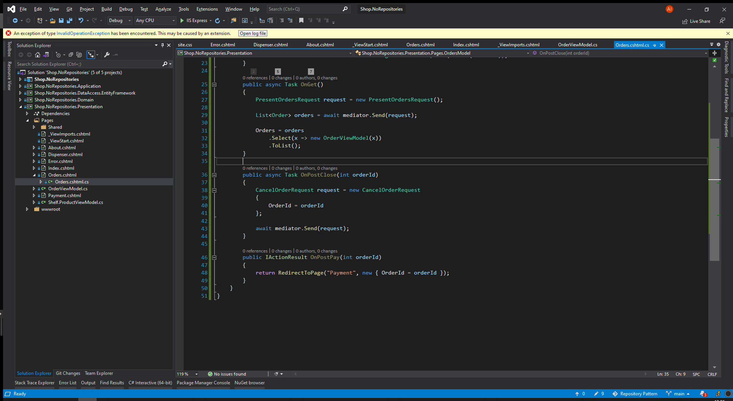
Demo (The Code)

Slide 9
Entity Framework vs Custom Repositories
DbSet<T> is a Repository
(+) Hides the details of accessing the data
(+) Emulates an in-memory collection
(-) We have no place where to write custom queries that can be later used in multiple places in the rest of the application.
DbContext is a Unit of Work
(+) Ensures data consistency
It provides the `SaveChanges` method.

Slide 10
Common Mistakes
Repositories that store and return View Models
Update() method in repositories
Save() method in repositories
Repositories that return IQueryable

Slide 11
Conclusions
Repositories
In-memory collections
NO Update() method
Unit of Work
Keeps track of all changes.
Compete() method
Saves everything or nothing.

Slide 12
Useful Links
Good presentation of Repository Pattern (30 min) by Mosh Hamedani
https://www.youtube.com/watch?v=rtXpYpZdOzM&feature=youtu.be
The Shop Application – GitHub
https://github.com/lastunicorn/Shop

Slide 13
Thank you

