Slide 1

BiblioExchange
Deyan Delchev

Slide 2



BiblioExchange Purpose
BiblioExchange is platform for second hand books. It has 3 main features:
Information database for books and authors which also support reviews and ratings.
Listing where user can create listing for book or books and upload images on them
Simple chats between to users

Slide 3

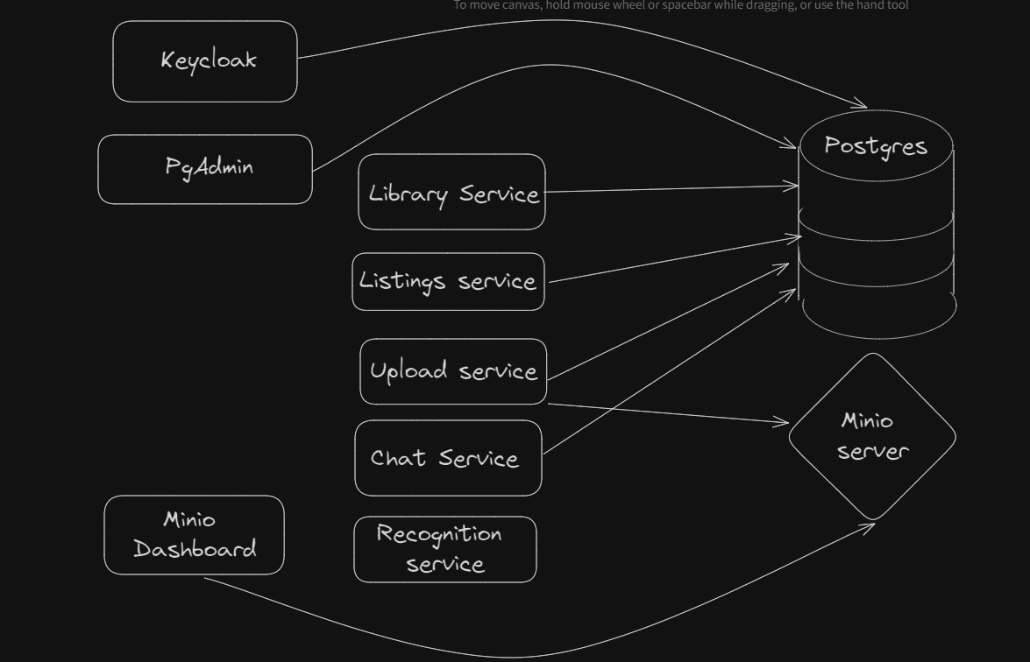
Architecture
The architecture is microservice based:
Keycloak for identity management
Postgresql for DB
Minio for strorage bucket
Library service for Information database
Listings service for listing
Upload service for better control over the file upload + easy integration with the other services
Chat service for real-time communication between two users
Recognition service for utilities like barcode reader

Slide 4
Library service
The library service has 2 aggregate roots - author and book:
Authors have ratings (like page views and stars) and reviews which can be deeply nested(it doesn`t have depth limit) and books
Books have also have ratings and reviews
The service have integration with keycloak in the form of jwt tokens that are validate with every request. For example anonymous can only view pages, users can create and updade page, give star ratings and give reviews and admins can delete whole author or book pages also remove мalicious reviews.
Mainly CRUD functionalities.

Slide 5
Listings service + Uplaod service
The listings service has 1 aggregate root - listings which is connected many to many with the books.
The interesting thing with the listing service is the integration with the upload service. When listing is been created, presigned urls are also created by the upload service for the images. This is happening through GRPC. When somebody upload a file to a presigned url, callback is called to notify the listing service for the successful upload, for an error or the expiration of the url. The listing services can specify what file formats, max size and the user id as validation when somebody is trying to upload file to presigned url. The file are uploaded to minio storage bucket.
Both services also have keycloak integratrions with jwt tokens.

Slide 6
Chat service
The chat service has 1 aggregate root – messages.
The chat services allows two users to chat. It`s using websockets. Messages are saved in the database. Easily can be add file upload functionality because of the core library I created which allows easy reuse.

Slide 7
Bonus - Recognition service
Simple python flask server for barcode-readings.

Slide 8

Thank You!

