Slide 1



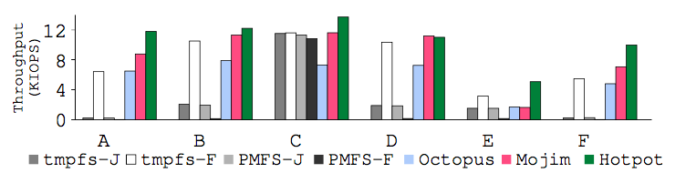
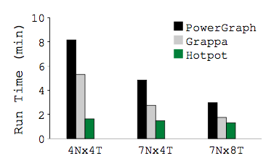
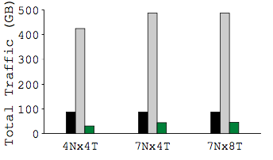
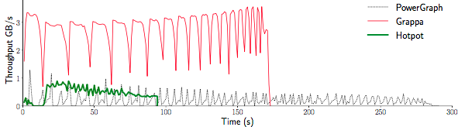
Distributed Shared
Persistent Memory
Yizhou Shan, Shin-Yeh Tsai, Yiying Zhang
Distributed Shared Persistent Memory (DSPM)
Motivation
A New Framework for Persistent Memories (PM)
Using distributed PM in datacenters
Global, shared, and persistent memory space
Access in-PM data with memory load/store
Name data and make them persistent
Integrates Distributed Shared Memory and Distributed Storage
One-layer approach, no data marshaling/unmarshalling
Integrate distributed memory coherence and data replication
Usages of DSPM
Scale out single-node PM apps
Run storage systems on PM
Port memory/DSM-based system to run on PM
PM and PM Apps
3D Xpoint, PCM, STTM
PM-based heap, DB, FS
Memory Sharing
Datacenter apps use many threads that share a lot of data (e.g., TensorFlow, PowerGraph)
Lack of Distributed PM Support
Traditional storage systems target slow, block-based devices
Memory/DSM systems do not handle data durability/reliability
Fast Network
RDMA, InfiniBand, RoCE
Remote access is not as costly
Our DSPM System: Hotpot
Hotpot Architecture
An Open-Source Kernel-Level DSPM System
Easy-to-use abstraction
Direct load/store access to distributed PM
Flexible data consistency levels
High reliability and availability
Integrates memory cache and persistent data replication with morphable PM pages
New distributed protocols to ensure both memory coherence and data reliability
In kernel on top of customized network stack
Triggered by page fault and xact APIs
Central Dispatcher for cluster membership mgmt and initialization tasks
Hotpot APIs
API | Explanation | Backward
open (close) | Open or create (close) a DSPM dataset | Same as Posix
mmap (munmap) | Map (munmap) a DSPM region in a dataset to application address space | Same as Posix
commit | Commit a set of data and make N persistent replicas | Similar to msync
acquire | Acquire single writer permission
thread-barrier | Helper function to synchronize threads on different nodes | Similar to pthread barrier
Evaluation
Environment
Xeon E5-2620 v3, 128 GB DRAM
40Gbps Mellanox ConnectX-3 InfiniBand NIC
CentOS 7.1 distribution and 3.11.1 linux kernel
Persistent Naming and Addressing
MongoDB and YCSB
Modified MongoDB v2.7.0 storage engine with 120 LOC
Compare with tmpfs, PMFS, Octopus, and Mojim
3 nodes, 10K ops on a database with 100K 1 KB records
Flat Namespace
Data organized as datasets all under root partition
Flat naming is efficient and fits datacenter application usages
Globally Consistent and Persistent Pointers
Same virtual address across machines
Pointers can sustain power failures
Data Durability and Reliability
Distributed (Persistent) Graph
A graph engine built on top of Hotpot using PowerGraph design
Compare with Grappa and PowerGraph
PageRank with Twitter (41 M vertices, 1 B directed edges)
Multiple Readers Multiple Writers
Concurrent outstanding dirty data allowed
Weaker consistency, better parallelism
Distributed atomic commit protocol
Cached copies updated and replication made during commit
Multiple Readers Single Writer
One writer to a PM page at a time
Trade parallelism for consistency
Similar to release consistency with acquire and commit
MRMW Commit Example
MRSW Commit Example
Get Hotpot at https://github.com/WukLab/Hotpot
Notes:
1

