Slide 1

Exploring Popular Wikipedia Pages
Lucy Chen
Michael Lasutschinkow
CMSC12300 Final Project
Prototype Presentation

Slide 2
The Questions
What trends are there in Wikipedia page hits?
Which pages are disproportionately (un)popular, and why?
Can we tell where users tend to start on Wikipedia, and where they tend to go afterward?

Slide 3
The Data
Wikipedia Hits Database
  The database contains hourly information about page hits to every page
Wikilinks Database
  For each Wikipedia page, this database shows the pages that are linked to by that page

Slide 4
The Approach : Random Model
The random model : using only incidence data (i.e. the Wikilinks information about which other pages a given page links to), calculate the equally-weighted probability of going from page j to page k in one step
These probabilities are contained in a transition matrix A where Ajk = Pr(j->k)
We included a discount factor to account for the tendency to leave Wikipedia

Slide 5
The Approach
By multiplying this matrix by itself n times, we can obtain the probability of starting on one page and ending at another in exactly n steps
Summing over these transition matrices gives us the proportion of hits each page receives across all n steps of the iteration

Slide 6
The Approach : How may Steps?
- Obviously, the number of steps in the iteration has an impact on the data, but less so with each progressive iteration due to the discount factor
- This matrix multiplication is the computationally-expensive part of our prototype, so we wanted to find a way to minimize calculation without sacrificing the potential accuracy of the model

Slide 7
The Approach : Comparison and Optimization
- At every step, we calculated the difference between the expected page hits under the random surfer model and the number of page hits actually received in the data for each page
- The model continues to iterate until it reaches the point at which none of the pages' statistics above changed by more than the threshold amount (5% in our model)

Slide 8
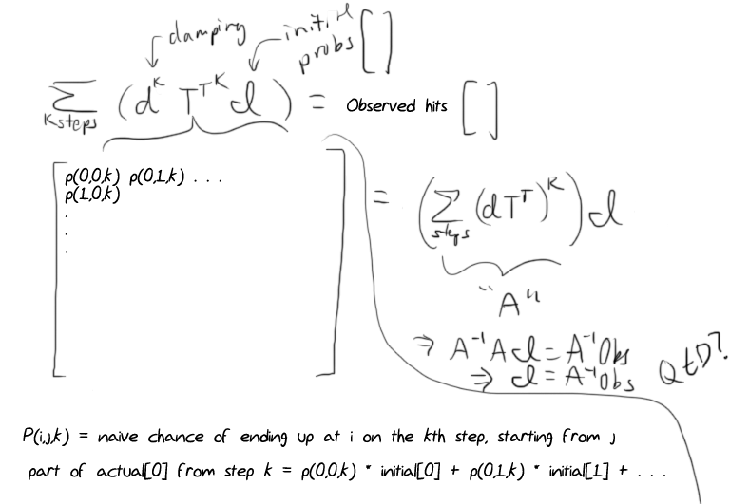
The Non-Approach
“Doesn't this make a linear system of equations somehow?
Can we find an exact solution for the initial probabilities?”
Yes, but it gives answers with negatives, which is nonsensical and useless.

Slide 9
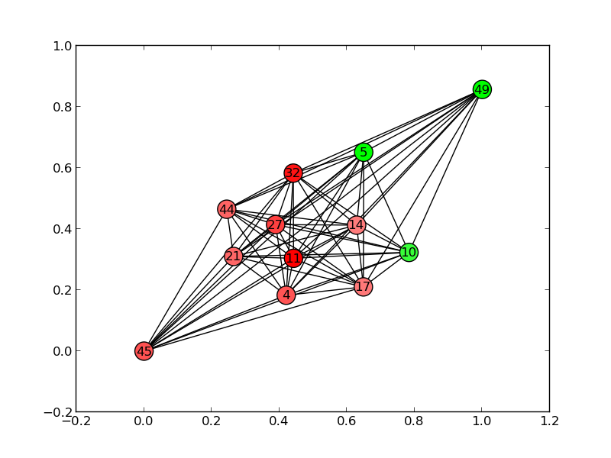
Visual Exploration

Slide 10
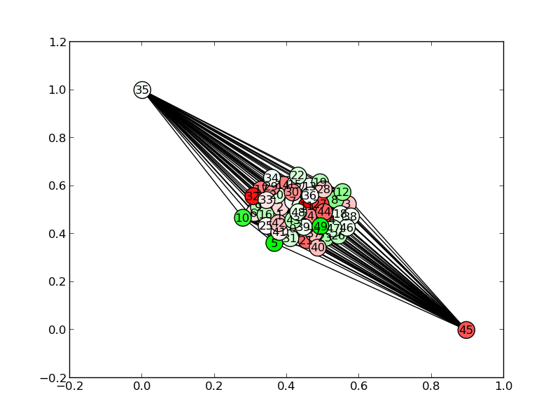
Unwieldy Visual Exploration

Slide 11
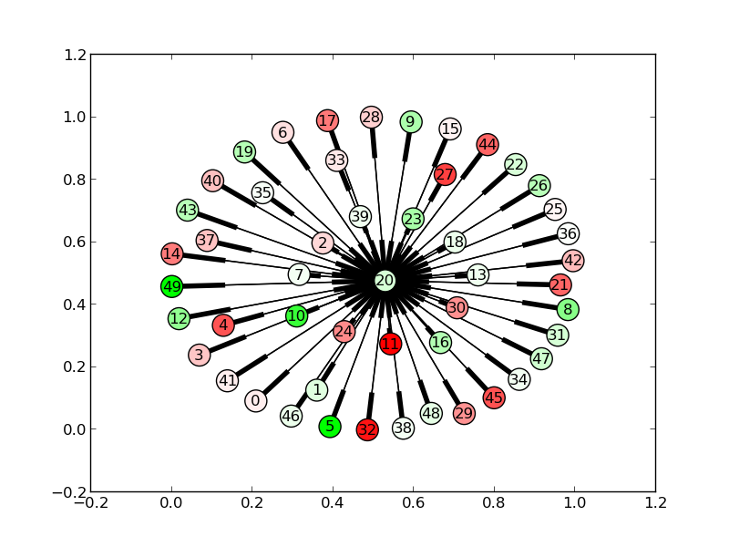
Visual Exploration

Slide 12
To a Full-Scale Model
Expansion of the Model
  The actual Wikipedia data is much larger and less random than our prototype data
  The timespan of the Wiki data means that we may be able to implement a multi-period model with some degree of predictive power

Slide 13
To a Full-Scale Model
Ideas for Expansion
  Parallelism : matrix multiplication with millions of pages
  Tentative use of MPI library to implement computation and communication
  Prediction : create a dynamic model that has greater predictive power than random surfer model

Slide 14
?

