Slide 1
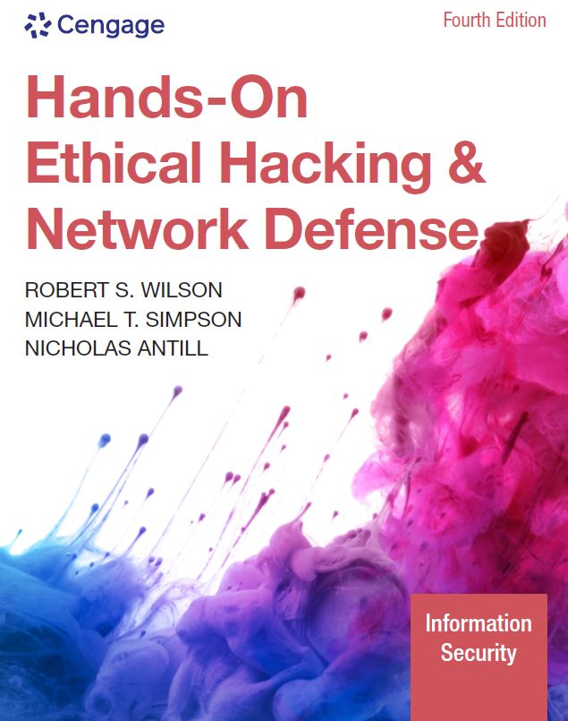
Hands-On Ethical Hacking and Network Defense, Edition 4
Module 2: TCP/IP Concepts Review
Simpson, Antill, Wilson, Hands-On Ethical Hacking and Network Defense, 4th Edition. © 2023 Cengage. All Rights Reserved. May not be scanned, copied or duplicated, or posted to a publicly accessible website, in whole or in part.

Slide 2
Module Objectives
By the end of this module, you should be able to:
Explain the TCP/IP protocol stack
Explain the basic concepts of IP addressing
Explain the binary, octal, and hexadecimal numbering systems

Slide 3
Overview of TCP/IP (1 of 2)
Protocol
Language used by computers to communicate with one another over the Internet or across an office
Transmission Control Protocol/Internet Protocol (TCP/IP)
Most widely used
TCP/IP stack: Combination of two protocols (TCP and IP)
Four distinct layers
Network
Internet
Transport
Application

Slide 4
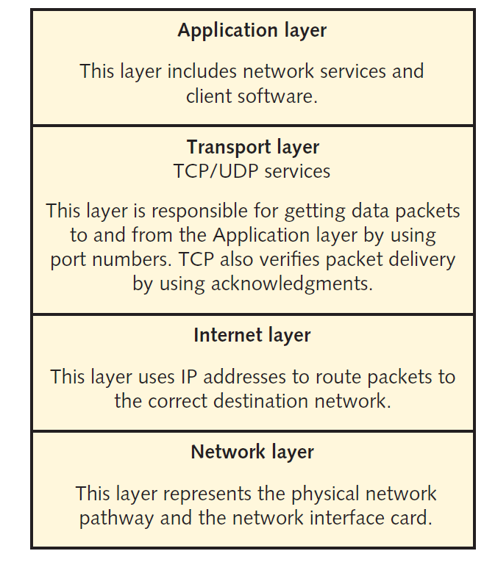
Overview of TCP/IP (2 of 2)
Figure 2-1 The TCP/IP protocol stack

Slide 5
The Application Layer
Protocols are the front end to the lower-layer protocols in the TCP/IP stack
This layer is what you can see and touch

Slide 6
Application-Layer Programs
Application | Description
Hypertext Transfer Protocol Secure (HTTPS) | The primary protocol used to communicate over the web (see RFC 2818 at www.ietf.org for details)
File Transfer Protocol (FTP) | Allows different operating systems (OSs) to transfer files between one another
Simple Mail Transfer Protocol (SMTP) | The main protocol for transmitting email messages across the Internet
Simple Network Management Protocol (SNMP) | Primarily used to monitor devices on a network, such as monitoring a router’s state remotely
Secure Shell (SSH) | Enables users to securely log on to a remote server and issue commands interactively
Internet Relay Chat (IRC) | Enables multiple users to communicate over the Internet in discussion forums
Telnet | Enables users to insecurely log on to a remote server and issue commands interactively

Slide 7
The Transport Layer
Encapsulates data into segments
Segments can use TCP or UDP to reach a destination host
TCP is a connection-oriented protocol, which means the sender doesn’t send any data to the destination node until the destination node acknowledges that it’s listening to the sender
TCP three-way handshake example
Computer A sends computer B a SYN (synchronize) packet
Computer B replies with a SYN-ACK packet set
Computer A replies with an ACK (acknowledgement) packet

Slide 8
TCP Segment Headers (1 of 2)
Critical components of a TCP header:
TCP flags
Initial sequence number (ISN)
Source and destination port numbers
Abused by hackers
To protect a network, you need to know the basic methods of hacking into networks

Slide 9
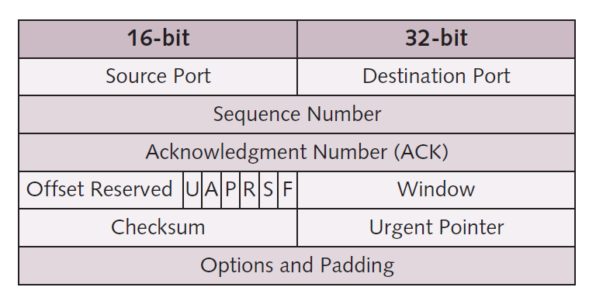
TCP Segment Headers (2 of 2)
Figure 2-2 TCP header diagram

Slide 10
TCP Flags
Each flag occupies one bit of the TCP segment
Can be set to 0 (off) or 1 (on)
Six flags of a TCP segment
SYN flag: Synchronize flag signifies the beginning of a session
ACK flag: Acknowledgment flag acknowledges a connection
PSH flag: Push flag is used to deliver data directly to an application
URG flag: Urgent flag signifies urgent data
RST flag: Reset flag resets or drops a connection
FIN flag: Finish flag signifies that the connection is finished

Slide 11
Initial Sequence Number
ISN is a 32-bit number
Tracks packets received by a node
Allows reassembly of large packets that have been broken up into smaller packets
ISN is sent through steps one and two of TCP three-way handshake
Sending node ISN is sent with SYN packet
Receiving node ISN is sent back to the sending node with SYN-ACK packet

Slide 12
TCP Ports (1 of 8)
TCP packet
Has two 16-bit fields
Contains source and destination port numbers
Port
Logical, not physical, component of a TCP connection
Can be assigned to a process that requires network connectivity
Example: The HTTPS service uses port 443 by default
Helps you stop or disable unnecessary services
The more services running on a server, the more ports are open for a potential attack

Slide 13
TCP Ports (2 of 8)
Only 1023 ports are considered well known
List of well-known ports
Visit the Internet Assigned Numbers Authority (IANA): www.iana.org
Ports 20 and 21
File Transfer Protocol (FTP)
Was the standard for moving or copying large files
Used today to a lesser extent because of the popularity of HTTP
Requires a logon name and password
More secure than Trivial File Transfer Protocol (TFTP)

Slide 14
TCP Ports (3 of 8)
Port 22
Secure Shell (SSH)
Uses encryption and authentication
To create a secure channel over an unsecure network
Used to secure logons, file transfers, and port forwarding
FTP using SSH is known as SFTP
Port 25
Simple Mail Transfer Protocol (SMTP)
Email servers listen on this port

Slide 15
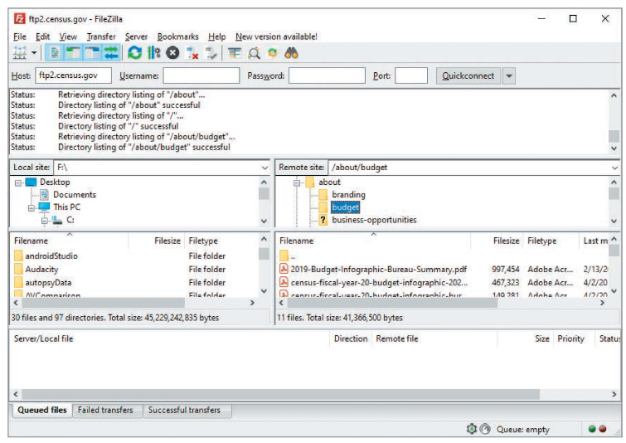
TCP Ports (4 of 8)
Figure 2-3 Connecting to an FTP site

Slide 16
TCP Ports (5 of 8)
Port 53
Domain Name System (DNS)
Used to connect users to websites using URLs instead of IP addresses
Most networks require a DNS server
Port 69
Trivial File Transfer Protocol
Used for transferring router and backup router configurations
Port 80
Hypertext Transfer Protocol (HTTP)
Used when connecting to a web server

Slide 17
TCP Ports (6 of 8)
Port 143
IMAP
Used by email clients to retrieve email messages from a mail server over a TCP/IP connection
Port 443
Secure Hypertext Transfer Protocol
Used when you connect to a web server
Typically, reserved for secure connections
Port 993
IMAP over SSL/TLS uses port 993
Preferred over the unsecured version IMAP, which uses port 143

Slide 18
TCP Ports (7 of 8)
Port 110
Post Office Protocol 3 (POP3)
Used for retrieving email messages from a mail server
Port 119
Network News Transfer Protocol
Used to connect to a news server for use with newsgroups

Slide 19
TCP Ports (8 of 8)
Port 135
Remote Procedure Call (RPC)
Critical for operation of Microsoft Exchange Server and Active Directory
Port 139
NetBIOS
Used by Microsoft’s NetBIOS Session Service to share resources
Port 143
Internet Message Access Protocol 4
IMAP4 uses this port to retrieve email

Slide 20
User Datagram Protocol (UDP)
Fast but unreliable delivery protocol
Operates on the Transport layer
Used for its speed
Does not need to verify whether the receiver is listening or ready to accept the packets
UDP depends on higher layers of TCP/IP stack to handle problems
Referred to as a connectionless protocol

Slide 21
The Internet Layer
Routes packets to a destination address
Uses a logical address (i.e., IP address)
IP addressing packet delivery is connectionless
Internet Control Message Protocol (ICMP)
Sends messages related to network operations
Helps network professionals to troubleshoot network connectivity problems
ping command
Tracks the route a packet traverses from a source IP address to a destination IP address
traceroute command

Slide 22
ICMP Type Codes (1 of 3)
ICMP type code | Description
0 | Echo Reply
3 | Destination Unreachable
4 | Source Quench
5 | Redirect
6 | Alternate Host Address
8 | Echo
9 | Router Advertisement
10 | Router Solicitation
11 | Time Exceeded
12 | Parameter Problem
13 | Timestamp
14 | Timestamp Reply

Slide 23
ICMP Type Codes (2 of 3)
ICMP type code | Description
15 | Information Request
16 | Information Reply
17 | Address Mask Request
18 | Address Mask Reply
19 | Reserved (for Security)
20 to 29 | Reserved (for Robustness Experiment)
30 | Traceroute
31 | Datagram Conversion Error
32 | Mobile Host Redirect
33 | IPv6 Where-Are-You
34 | IPv6 I-Am-Here
35 | Mobile Registration Request

Slide 24
ICMP Type Codes (3 of 3)
ICMP type code | Description
36 | Mobile Registration Reply
37 | Domain Name Request
38 | Domain Name Reply
39 | Skip
40 | Photuris
41 to 255 | Reserved

Slide 25
Knowledge Check Activity 2-1
The netstat command indicates that POP3 is in use on a remote server. Which port is the remote server most likely using?
Port 25
Port 110
Port 143
Port 80
Notes:
Instructions:
Use the Knowledge Check questions to periodically pose a question to students during class to gauge how well they can recall the material that was presented.

Slide 26
Knowledge Check Activity 2-1: Answer
Which port is the remote server most likely using?
Answer: b. Port 110
One option to retrieve email from a mail server is to access port 110 using Post Office Protocol 3 (POP3).

Slide 27
Polling Activity 2-1
On a Windows computer, what command can you enter to show all open ports being used?
netstat
ipconfig
ifconfig
nbtstat
Notes:
Instructions:
1. Use this activity to solicit student opinions about concepts in the module or to play a game.
2. Go to kahoot.com, or the platform of your preference, and log in or sign up.
3. Create the challenge.
4. Teacher Tip: Turn off the timer to prioritize accuracy or turn on the nickname generator to avoid inappropriate nicknames.
5. Invite players by sharing the link or PIN.
6. This can be done synchronously during class or asynchronously for review or homework.

Slide 28
Polling Activity 2-1: Answer
On a Windows computer, what command can you enter to show all open ports being used?
Answer: a. netstat
To view all open ports being used on your computer, open the Command Prompt window, type netstat, and press Enter.

Slide 29
Polling Activity 2-2
The ISN is set at which step of the TCP three-way handshake?
1, 2, 3
1, 3
1
1 and 2
Notes:
Instructions:
1. Use this activity to solicit student opinions about concepts in the module or to play a game.
2. Go to kahoot.com, or the platform of your preference, and log in or sign up.
3. Create the challenge.
4. Teacher Tip: Turn off the timer to prioritize accuracy or turn on the nickname generator to avoid inappropriate nicknames.
5. Invite players by sharing the link or PIN.
6. This can be done synchronously during class or asynchronously for review or homework.

Slide 30
Polling Activity 2-2: Answer
The ISN is set at which step of the TCP three-way handshake?
Answer: d. 1 and 2
Steps 1 and 2 of the TCP three-way handshake send an ISN.

Slide 31
IP Addressing (1 of 5)
An IPv4 address consists of 4 bytes divided into two components:
Network address
Host address
IP addresses can be classified into three classes based on the starting decimal number of the first byte:
Class A
Class B
Class C

Slide 32
TCP/IP Address Classes
Address class | Range | Address bytes | Number of networks | Host bytes | Number of hosts
Class A | 1 to 126 | 1 | 126 | 3 | 16,777,214
Class B | 128 to 191 | 2 | 16,128 | 2 | 65,534
Class C | 192 to 223 | 3 | 2,097,152 | 1 | 254

Slide 33
IP Addressing (2 of 5)
An IP address is composed of 4 bytes (an octet)
A byte is equal to 8 bits (octet)
Sometimes, an IP address is defined as four octets instead of 4 bytes
Class A
The first byte of a Class A address is reserved for the network address
Makes the last three bytes available to assign to host computers
Supports more than 16 million host computers
Limited number of Class A addresses
Reserved for large corporations and governments
Format: network.node.node.node

Slide 34
IP Addressing (3 of 5)
Class B
Divided evenly between a two-octet network address and a two-octet host address
Supports more than 65,000 hosts
Assigned to large corporations and Internet Service Providers (ISPs)
Format: network.network.node.node

Slide 35
IP Addressing (4 of 5)
Class C
Three-octet network address and one-octet host address
Resulting in more than two million Class C addresses
Each address supports up to 254 host computers
Usually available for small businesses and home use
Format: network.network.network.node
Subnetting
Allows a network administrator to divide large networks into smaller segments (subnets)
Subnetting concepts are important
For performance and security purposes

Slide 36
IP Addressing (5 of 5)
Subnet mask
Each network must be assigned a subnet mask
Helps distinguish the network address bits from the host address bits
Subnet mask example:
The IP address 128.214.018.016 in binary is:
10000000.11010110.00010010.00010000
If the subnet mask is 255.255.255.0, it’s expressed in binary as:
11111111.11111111.11111111.00000000
The subnet part of the IP address is:
10000000.11010110.00010010
The host part of the IP address is:
00010000

Slide 37
The IP address 128. 214. 018. 016
10000000. 11010110. 00010010. 00010000
255. 255. 255. 0,
11111111. 11111111. 11111111. 00000000
10000000. 11010110. 00010010. 00010000
11111111. 11111111. 11111111. 00000000
-----------------------------------------------------------------------------
10000000. 11010110. 00010010. 00000000 ANDing
Result is Network Address
10000000. 11010110. 00010010. 00000000
128. 214. 018. 0

Slide 38
Knowledge Check Activity 2-2
What class is the IP address 172.16.0.1?
Class A
Class B
Class C
Class D
Notes:
Instructions:
Use the Knowledge Check questions to periodically pose a question to students during class to gauge how well they can recall the material that was presented.

Slide 39
Knowledge Check Activity 2-2: Answer
What class is the IP address 172.16.0.1?
Answer: b. Class B
Based on the starting decimal number of the first byte in this IP address, it is understood that it falls in the 128 to 191 range. This range corresponds to the Class B address class.

Slide 40
CIDR Notation
Almost all of the world’s IPv4 addresses are in use
Long-term solution is IPv6 addressing
Short-term fix was CIDR (Classless Inter-Domain Routing)
Allowed for more efficient IP-assignment space
Example:
192.168.1.0/24
The number following the “/” is the prefix

Slide 41
CIDR Addressing (1 of 2)
CIDR prefix | # Class C equivalent | Number of usable hosts
/27 | 1/8th of a Class C | 30 hosts
/26 | 1/4th of a Class C | 62 hosts
/25 | 1/2 of a Class C | 126 hosts
/24 | 1 Class C | 254 hosts
/23 | 2 Class C | 510 hosts
/22 | 4 Class C | 1022 hosts
/21 | 8 Class C | 2046 hosts
/20 | 16 Class C | 4094 hosts
/19 | 32 Class C | 8190 hosts
/18 | 64 Class C | 16,382 hosts
/17 | 128 Class C | 32,766 hosts
/16 | 1 Class B | 65,534 hosts
/15 | 2 Class B | 131,070 hosts

Slide 42
CIDR Addressing (2 of 2)
CIDR prefix | # Class C equivalent | Number of usable hosts
/14 | 4 Class B | 262,142 hosts
/13 | 8 Class B | 524,286 hosts
/12 | 16 Class B | 1,048,574 hosts
/11 | 32 Class B | 2,097,150 hosts
/10 | 64 Class B | 4,194,302 hosts
/9 | 128 Class B | 8,388,606 hosts
/8 | 1 Class A | 16,777,214 hosts

Slide 43
Planning IP Address Assignments
Each network segment that’s separated by a router must have a unique IP address
Network portion and host portion of an IP address cannot contain all 0s or all 1s
Accessing entities and services on other networks
Each computer must have the IP address of its gateway
TCP/IP Internet layer uses subnet mask to determine destination computer’s network address before sending a packet to another computer
If the address is different from the sending computer’s network address, the sending computer relays the packet to the IP address specified in the gateway parameter
Gateway computer then forwards the packet to its next destination
The packet eventually reaches the destination

Slide 44
IPv6 Addressing
Internet Protocol version 6 (IPv6)
IPv4 wasn’t designed with security in mind
Has caused many current network vulnerabilities
Developed to increase IP address space and provide additional security
Uses 16 bytes, or a 128-bit address
2¹²⁸ available addresses
Security testers should be aware that all newer OSs are configured to enable IPv6
Some router-filtering devices, firewalls, and intrusion detection systems are not
Hackers can bypass these security systems

Slide 45
Discussion Activity 2-1
How many hosts can a CIDR /24 network have?
Discuss the answer with your classmates.
Notes:
Instructions:
Use the Discussion activity to encourage group conversation about a related topic of interest.

Slide 46
Discussion Activity 2-1: Answer
How many hosts can a CIDR /24 network have?
Answer: 254
Explanation: A CIDR prefix of /24 can have around 254 usable hosts, and it belongs to the 1 Class C equivalent.

Slide 47
Overview of Numbering Systems
As a security professional, knowledge of numbering systems will come into play
Binary
Octal
Hexadecimal

Slide 48
Reviewing the Binary Numbering System (1 of 2)
Binary numbering system uses 2 as its base
Each binary digit (bit) is represented by a 0 or 1
Byte
Contains 8 bits
Can represent 2⁸ (256) different numbers
File permissions are represented with bits
1 represents having permission
111 (rwx): All permissions apply
0 removes permission
101 (r-x): User can read and execute the file but not write to it

Slide 49
Reviewing the Binary Numbering System (2 of 2)
Example of determining binary values:
Learn and memorize the columns for binary numbers
From right to left, these numbers represent increasing powers of two
128 64 32 16 8 4 2 1
2⁷ 2⁶ 2⁵ 2⁴ 2³ 2² 2¹ 2⁰
To determine the value of binary number 01000001
128 64 32 16 8 4 2 1
2⁷ 2⁶ 2⁵ 2⁴ 2³ 2² 2¹ 2⁰
0 1 0 0 0 0 0 1
Add the columns containing 1s to convert to a decimal number
64 + 1 = 65

Slide 50
Understanding Nibbles (1 of 2)
Nibble: Half a byte or 4 bits
Helps with reading numbers by separating the byte
Example: 1111 1010 versus 11111010
Components
High-order nibble: 4 bits on the left
Low-order nibble: 4 bits on the right

Slide 51
Understanding Nibbles (2 of 2)
Converting 1010 1010 to decimal
Low-order nibble
1010 = 10 (base 10)
Multiply high-order nibble by 16
1010 = 10 x 16 = 160 (base 10)
128 + 32 = 160

Slide 52
Reviewing the Octal Numbering System (1 of 2)
Uses 8 as its base
Written by using these eight values: 0, 1, 2, 3, 4, 5, 6, and 7
Octal digits can be represented with only 3 bits
The number 7 is written as 00000111
UNIX permissions
Owner permissions (rwx)
Group permissions (rwx)
Other permissions (rwx)
Setting permission (rwxrwxrwx) means they all have read, write, and execute permissions

Slide 53
Reviewing the Octal Numbering System (2 of 2)
Changing permissions with the chmod Command
chmod command: Allows altering the permissions of files and directories in Unix and Linux systems
Used to change permissions in two ways
To provide the permissions as an octal number
Allows targeting specific permission sets (owner, group, or other) and turning individual read, write, or execute permissions on or off
Need to specify who you are setting permissions for, what change are you making (adding or removing the permission), and which permission you are setting

Slide 54
Reviewing the Hexadecimal Numbering System
Hexadecimal: A base-16 numbering system
Valid numbers range from 0 to 15
Hex number consists of two characters
Each character represents a nibble
Value contains alphabetic letters
Example: A represents the number 10 and F represents 15
Hex numbers are sometimes expressed with “0×” in front of them
You multiply the value in each column by the value of the column to determine hex numbers
Converting a hex number to binary
Write each nibble from left to right

Slide 55
Reviewing the Base-64 Numbering System
A common use for base 64
The encoding and transportation of binary files sent through email
All you need to know now:
There are a number of ways in which attackers can use base 64 to obfuscate their actions
Character or symbol | Representation in base 64
Uppercase A to Z | 0 to 25
Lowercase a to z | 26 to 51
Numerals 0 to 9 | 52 to 61
+ and / symbols | 62, 63

Slide 56
Self-Assessment
Recall which protocols are connectionless.
Recall what numbering system is used to express IPv6 addresses.
Notes:
Instructions:
Use the Self-Assessment question to encourage students to evaluate their progress or goals in the course, as well as determine how they might apply their learning or grow as an individual.

Slide 57
Summary
Now that the lesson has ended, you should be able to:
Explain the TCP/IP protocol stack
Explain the basic concepts of IP addressing
Explain the binary, octal, and hexadecimal numbering systems

