Slide 1
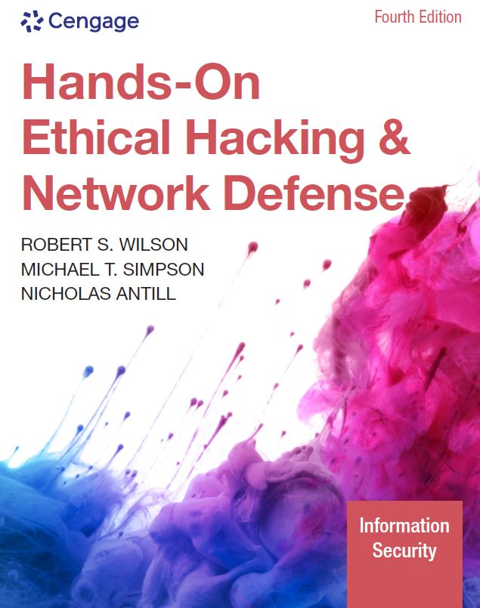
Hands-On Ethical Hacking and Network Defense, Edition 4
Module 1: Ethical Hacking Overview
Simpson, Antill, Wilson, Hands-On Ethical Hacking and Network Defense, 4th Edition. © 2023 Cengage. All Rights Reserved. May not be scanned, copied or duplicated, or posted to a publicly accessible website, in whole or in part.

Slide 2
Icebreaker: Interview Simulation
The class will be broken up into pairs of students.
Each pair of students will interview each other to discover interesting or unusual facts about the other person.
Then each pair will introduce the other member to the class.
Think about connecting a story from your personal experience about hacking and discuss whether hacking can be ethical or not.
Notes:
Instructions:
Task: This is an introductory exercise for the beginning of a course.
Objectives: To provide an informal way for participants to learn about each other and begin working together. This exercise also gives students practice speaking in front of a group, introduces them to interviewing, and gives the instructor insight into who the students are and what is important to them. The exercise also provides the instructor an idea about students’ knowledge of ethical hacking.
Instructions: Break the class into pairs of students. Have them interview each other to discover interesting facts and then introduce each other to the class.
Average Time in Class: 30–45 minutes
Note: To adapt this activity for an online learning environment, conduct the interviews using a web conferencing tool (e.g., Zoom or Microsoft Teams). When you break the class into pairs, send the pairs into breakout rooms for 10 minutes to interview each other. When the class comes back together, give each pair two to four minutes to introduce each other to the rest of the class and present their opinions.

Slide 3
Module Objectives
By the end of this module, you should be able to:
Describe the role of an ethical hacker
Describe what you can do legally as an ethical hacker
Describe what you can’t do as an ethical hacker

Slide 4
Introduction to Ethical Hacking
Ethical hackers
Hired by companies to perform penetration tests
Penetration test
Attempt to break into a company’s network to find the weak links
Vulnerability assessment
Tester attempts to enumerate all vulnerabilities found in an application or on a system
Security test
Tester analyzes a company’s security policy and procedures
Reports any vulnerabilities to management

Slide 5
The Role of Security and Penetration Testers (1 of 5)
Hackers access computer system or network
Without the authorization of the systems owner
Considered as breaking the law; can go to prison
Crackers
Break into systems to steal or destroy data
The U.S. Department of Justice
Labels all illegal access to a computer or network systems as hacking
Ethical hacker
Performs most of the same activities a hacker does
With the permission of the owner or company

Slide 6
The Role of Security and Penetration Testers (2 of 5)
Script kiddies or packet monkeys
Derogatory terms to refer to younger, inexperienced people
They copy code or use tools created by knowledgeable programmers without understanding how they work
Programs or scripts used by experienced penetration testers
To carry out attacks
Python, Ruby, Perl, or C
Script
A set of instructions
Runs in sequence to perform tasks on a computer system

Slide 7
The Role of Security and Penetration Testers (3 of 5)
Hacktivist
A person who hacks computer systems for political or social reasons
Penetration testers
Usually have a laptop computer with multiple OSs and hacking tools

Slide 8
The Role of Security and Penetration Testers (4 of 5)
Job requirements for a penetration tester might include:
Perform vulnerability, attack, and penetration assessments
In Internet, Intranet, and wireless environments
Perform discovery and scanning
For open ports and services
Apply appropriate exploits
To gain access and expand access as necessary

Slide 9
The Role of Security and Penetration Testers (5 of 5)
Participate in activities
Involving application penetration testing and application source code review
Interact with the client as required throughout the engagement
Produce reports documenting discoveries during the engagement
Debrief with the client at the conclusion of each engagement
Participate in research and provide recommendations
For continuous improvement
Participate in knowledge sharing
Demonstrate a good understanding of current country, state, and city cyber laws

Slide 10
Polling Activity 1-1
An ethical hacker is also known as a/an _____.
penetration tester
administrative tester
continuity tester
High Pot tester
Notes:
Instructions:
1. Use this activity to solicit student opinions about ethical hacking and related concepts in the module or to play a game.
2. Go to kahoot.com, or the platform of your preference, and log in or sign up.
3. Create the challenge.
4. Teacher tip: Turn off the timer to prioritize accuracy, or turn on the nickname generator to avoid inappropriate nicknames.
5. Invite players by sharing the link or PIN.
6. This can be done synchronously during class or asynchronously for review or homework.

Slide 11
Polling Activity 1-1: Answer
An ethical hacker is also known as a/an _____.
Answer: a. penetration tester
An ethical hacker is also called a “security tester” or a “penetration tester.”

Slide 12
Knowledge Check Activity 1-1
The U.S. Department of Justice defines a hacker as which of the following?
A person who accesses a computer or network without the owner’s permission
A penetration tester
A person who uses phone services without payment
A person who accesses a computer or network system with the owner's permission
Notes:
Instructions:
Use the Knowledge Check questions to periodically pose a question to students during class to gauge how well they can recall the material that was presented.

Slide 13
Knowledge Check Activity 1-1: Answer
The U.S. Department of Justice defines a hacker as which of the following?
Answer: a. A person who accesses a computer or network without the owner’s permission
The U.S. Department of Justice labels all illegal access to computer or network systems as “hacking.”

Slide 14
Penetration-Testing Methodologies (1 of 3)
White box model
The tester is told what network topology and technology the company is using
May be given a floor plan
Tester is permitted to interview IT personnel and company employees
Makes the penetration tester’s job easier
Black box model
Staff is not aware of the test
Tester is not given any diagrams or details about the technologies used
Burden is on the tester to find details using different techniques
Tests security personnel’s ability to detect an attack

Slide 15
Penetration-Testing Methodologies (2 of 3)
Gray box model
Hybrid of the white and black box models
Company gives tester only partial information
Example: OSs are used, but no network diagrams

Slide 16
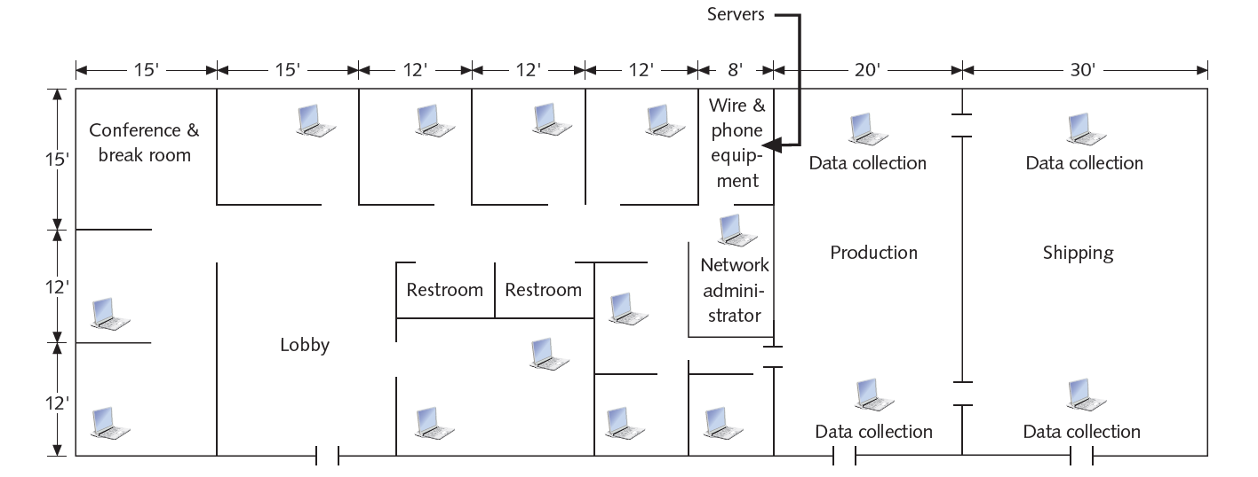
Penetration-Testing Methodologies (3 of 3)
Figure 1-1 A sample floor plan

Slide 17
Certification Programs for Network Security Personnel
Certification programs
Available in almost every area of network security
Minimum certification
CompTIA Security+ certification or have equivalent knowledge
Prerequisite for Security+ certification is CompTIA Network+ level of knowledge

Slide 18
CompTIA PenTest+
CompTIA PenTest+
PenTest+Advanced certification that verifies successful candidates have the knowledge and skills required to:
Plan and scope an assessment
Understand legal and compliance requirements
Perform vulnerability scanning and penetration testing
Analyze data
Effectively report and communicate results

Slide 19
Offensive Security Certified Professional (OSCP)
OSCP
An advanced certification that requires students to demonstrate hands-on abilities to earn their certificates
Covers network and application exploits
Gives students experience in:
Developing rudimentary buffer overflows
Writing scripts to collect and manipulate data
Trying exploits on vulnerable systems

Slide 20
Certified Ethical Hacker
Developed by the International Council of Electronic Commerce Consultants (EC-Council)
The multiple-choice Certified Ethical Hacker (CEH) exam is based on 22 domains the tester must be familiar with
EC-Council website
Most likely to be placed on a team that conducts penetration tests
Called a Red team
Composed of people with varied skills who perform the tests
Unlikely that one person will perform all tests

Slide 21
O S S T M M Professional Security Tester (OPST)
Open Source Security Testing Methodology Manual (O S S T M M) Professional Security Tester
Designated by the Institute for Security and Open Methodologies (ISECOM)
The OPST certification uses the O S S T M M as its standardized methodology
Written by Peter Herzog
Five main topics (i.e.,
professional,
enumeration,
assessments,
application, and
verification)
ISECOM website

Slide 22
Certified Information Systems Security Professional (C I S S P)
C I S S P
Issued by the International Information Systems Security Certification Consortium (ISC²)
Not geared toward technical IT professionals
Tests security-related managerial skills
Usually more concerned with policies and procedures
Consists of questions from ten domains
ISECOM website

Slide 23
SANS Institute
SysAdmin, Audit, Network, Security (SANS) Institute
Offers training and IT security certifications through Global Information Assurance Certification (GIAC)
Top 25 Software Errors list
One of the most popular SANS Institute documents
Details most common network exploits
Suggests ways of correcting vulnerabilities
SANS website

Slide 24
Which Certification Is Best?
Penetration testers and security testers
Need technical skills to perform duties effectively
Must also have:
A good understanding of networks and the role of management in an organization
Skills in writing and verbal communication
Desire to continue learning
Danger of certification exams
Some participants simply memorize terminology
Don’t have a good grasp of subject matter or complex concepts

Slide 25
Knowledge Check Activity 1-2
A team composed of people with varied skills who attempt to penetrate a network is called which of the following?
a. Green team
b. Blue team
c. Black team
d. Red team
Notes:
Instructions:
Use the Knowledge Check questions to periodically pose a question to students during class to gauge how well they can recall the material that was presented.

Slide 26
Knowledge Check Activity 1-2: Answer
A team composed of people with varied skills who attempt to penetrate a network is called which of the following?
Answer: d. Red team
A team composed of people with varied skills who attempt to penetrate a network is called a red team. A red team might include a programming expert who can perform SQL injections or other programming vulnerability testing.

Slide 27
Discussion Activity 1-1
Dan is a “packet monkey” who uses prewritten scripts to gain access to others’ computers.
Discuss why hackers such as Dan are referred to as packet monkeys or script kiddies.
Notes:
Instructions:
Use the Discussion activity to encourage group conversation about a related topic of interest.

Slide 28
Discussion Activity 1-1: Answer
Discuss why hackers such as Dan are referred to as packet monkeys or script kiddies.
Answer: Younger, inexperienced people
Explanation: Some hackers are skillful computer experts, but others are younger, inexperienced people, such as Dan, whom experienced hackers refer to as script kiddies or packet monkeys. These derogatory terms refer to people who copy code or use tools created by knowledgeable programmers without understanding how they work.

Slide 29
What You Can Do Legally
Laws involving technology change as rapidly as technology itself:
As a security tester, you should:
Keep abreast of what’s happening in your area
Find out what is legal for you locally
Be aware of what is allowed and what you should not or cannot do
Laws vary from state to state and country to country
Example: In some states, the possession of lockpicking tools constitutes a crime

Slide 30
Laws of the Land
Having hacking tools on your computer might be illegal
Contact local law enforcement agencies before installing hacking tools
Laws are written to protect society
Written words are open to interpretation
Example: In Hawaii, the state must prove that the person charged with committing a crime on a computer had the “intent to commit a crime”
Make sure you’re aware of the dangers of being a security tester

Slide 31
Overview of Recent Hacking Cases (1 of 3)
State and Year | Description
Kansas, 2021 | A resident of Ellsworth County, Kansas, was charged with one count of tampering with a public water system and one count of reckless damage to a protected computer during unauthorized access. The indictment alleged that a former employee knowingly accessed the Ellsworth County Rural Water District’s protected computer system without authorization. During this unauthorized access, the accused allegedly performed activities that shut down the processes at the facility, which affected cleaning and disinfecting procedures, with the intention of harming the public drinking water system. If found guilty, the accused faces up to 25 years in prison and a fine of up to $500,000 for illegally accessing the protected computer and tampering with the water system.
California, 2021 | A former employee of an IT consulting firm accessed the server of a company in Carlsbad, California, and deleted more than 1,200 of the company’s 1,500 Microsoft user accounts. The employee was apparently retaliating for being fired. The attack affected most of the Carlsbad company’s employees so that they could not access email or other network services, effectively shutting down the company for days and causing continuous IT problems for three months. The former contractor was sentenced in federal court to two years in prison and ordered to pay the company more than $560,000.

Slide 32
Overview of Recent Hacking Cases (2 of 3)
State and Year | Description
Nevada, 2021 | A Russian national offered $1 million to an employee of Tesla’s electric battery plant in Nevada in a scheme to have the insider introduce malicious software into the company’s computer network. The malware attack was designed to extract data from the company’s network and then demand a ransom for its return. The ransomware case is considered unusual because it involves face-to-face bribery rather than anonymous hacking via the Internet. Such an attack typically carries a penalty of up to five years in prison and a $250,000 fine.
Atlanta, 2021 | A Cypriot national hacked into major websites as a teenager and threatened that he would release stolen user information unless the websites paid a ransom. The hacker identified vulnerable websites, including those for sports news and online games, and then stole personally identifiable information from user and customer databases. He became the first Cypriot national extradited from Cyprus to the United States, and paid nearly $600,000 in restitution to his victims. In addition, he has been sentenced to federal prison for at least three years.

Slide 33
Overview of Recent Hacking Cases (3 of 3)
State and Year | Description
New Jersey, 2021 | While employed at a data analytics and risk assessment firm based in New Jersey, a resident of Moorefield, Nebraska, obtained confidential information that belonged to the firm—including names, passwords, email addresses, and telephone numbers of clients—and then attempted to sell the information. Nearly two years after his arrest, the hacker was sentenced to three years of supervised release and ordered to pay restitution of more than $290,000.
Florida, 2021 | A Florida high school conducted online voting to select a homecoming queen but found out that an assistant principal in the school district manipulated the vote electronically. She accessed a network database storing confidential student information—including grades, medical history, and credentials—and then used the credentials to cast ballots in favor of her daughter. The pair were arrested and charged with fraudulently accessing confidential student information. The daughter was expelled from the high school, and her mother was suspended from her job as they awaited sentencing.

Slide 34
Research in-Class Activity
Recent Hacking Cases
Research on the internet to find out most recent (2023) hacking cases.
Upload on the blackboard, as directed by the professor.

Slide 35
Is Port Scanning Legal? (1 of 3)
Some states consider it non-invasive or non-destructive in nature and deem it legal
Not always the case
Be prudent/careful before using penetration-testing tools
Federal government does not see infringements, such as port scanning, as a violation of the U.S. Constitution
Allows each state to address them separately
Research your state laws before using what you learn
Read your ISP’s “Acceptable Use Policy”

Slide 36
In-class Activity
Activity: Is port scanning legal? Research and develop a table showing all states of the USA where Port Scanning is legal and where it is not.

Slide 37
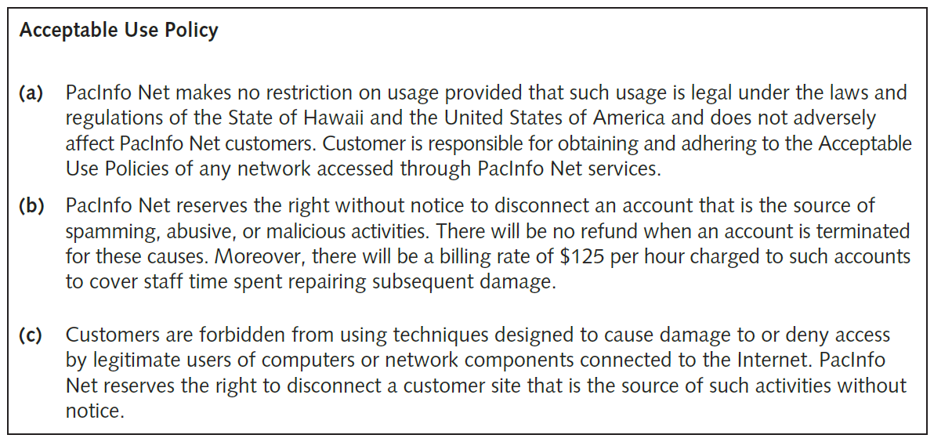
Is Port Scanning Legal? (2 of 3)
Figure 1-3 Sample acceptable use policy

Slide 38
Is Port Scanning Legal? (3 of 3)
Internet Relay Chat (IRC) bot
Program that sends automatic responses to users
Gives the appearance of a person on the other side of a connection
Virtual private network (VPN)
Consider whether your computer is connected to your business network by a VPN
Many people work from home using a VPN to connect to their work network
May end up scanning work computers, which could be problematic

Slide 39
Federal Computer Crime Laws (1 of 4)
Federal law | Description
The No Electronic Theft Act (P.L. 105 to 147) | Extends the reach of criminal copyright law to specifically include electronic means as one method for committing the crime (17 U.S.C. § 501(a)(1)). The act also expands the scope of the criminal conduct covered under this crime, allowing for prosecutions without showing that the distributor of the copyrighted material profited from the activity.
The Economic Espionage Act (EEA) | The EEA offers trade secret protection to both businesses and the government. The significance of information to society and the problems that are attached to protecting this information make the EEA an important step in how the law can provide protection from computer crime.
The Computer Fraud and Abuse Act (CFAA). Title 18, Crimes and Criminal Procedure. Part I: Crimes, Chapter 47, Fraud and False Statements, Sec. 1030: Fraud and related activity in connection with computers | This law makes it a federal crime to access classified information or financial information without authorization.

Slide 40
Federal Computer Crime Laws (2 of 4)
Federal law | Description
The Identity Theft and Assumption Deterrence Act (ITADA) [18 U.S.C. Section 1028(a)(7)] | This act criminalizes identity theft and allows courts to assess the losses suffered by individual consumers. While the CFAA covers certain aspects of identity theft, the ITADA addresses restitution and relief for the victims.
Electronic Communication Privacy Act. Title 18, Crimes and Criminal Procedure. Part I: Crimes, Chapter 119, Wire and Electronic Communications Interception and Interception of Oral Communications, Sec. 2510: Definitions and Sec. 2511: Interception and disclosure of wire, oral, or electronic communications prohibited | These laws make it illegal to intercept any communication, regardless of how it was transmitted.
U.S. PATRIOT Act, Sec. 217. Interception of Computer Trespasser Communications | This act largely seeks to amend previous privacy and surveillance laws and fund government surveillance programs. It also specifies ways for the government to monitor individuals and allows victims of cybercrimes to monitor the activity of trespassers on their systems.

Slide 41
Federal Computer Crime Laws (3 of 4)
Federal law | Description
Homeland Security Act of 2002, H.R. 5710, Sec. 225: Cyber Security Enhancement Act of 2002 | This amendment to the Homeland Security Act of 2002 specifies sentencing guidelines for certain types of computer crimes.
The Computer Fraud and Abuse Act. Title 18, Crimes and Criminal Procedure, Sec. 1029: Fraud and related activity in connection with access devices | This law makes it a federal offense to manufacture, program, use, or possess any device or software that can be used for unauthorized use of telecommunications services.

Slide 42
Federal Computer Crime Laws (4 of 4)
Federal law | Description
Stored Wire and Electronic Communications and Transactional Records Act. Title 18, Crimes and Criminal Procedure. Part I: Crimes, Chapter 121, Stored Wire and Electronic Communications and Transactional Records Act, Sec. 2701: Unlawful access to stored communications (a) Offense. Except as provided in subsection of this section whoever (1) intentionally accesses without authorization a facility through which an electronic communication service is provided; or (2) intentionally exceeds an authorization to access that facility; Sec. 2702: Disclosure of contents | This law defines unauthorized access to computers that store classified information.

Slide 43
Polling Activity 1-2
What portion of your ISP contract might affect your ability to conduct a penetration test over the Internet?
Scanning policy
Port access policy
Acceptable use policy
Warranty policy
Notes:
Instructions:
1. Use this activity to solicit student opinions about concepts in the module or to play a game.
2. Go to kahoot.com, or the platform of your preference, and log in or sign up.
3. Create the challenge.
4. Teacher tip: Turn off the timer to prioritize accuracy, or turn on the nickname generator to avoid inappropriate nicknames.
5. Invite players by sharing the link or PIN.
6. This can be done synchronously during class or asynchronously for review or homework.

Slide 44
Polling Activity 1-2: Answer
What portion of your ISP contract might affect your ability to conduct a penetration test over the Internet?
Answer: c. Acceptable use policy
You must research your state laws before using penetration-testing tools. You should also read your ISP contract, specifically the section titled “Acceptable Use Policy” or something similar.

Slide 45
What You Cannot Do Legally
Illegal actions:
Accessing a computer without permission
Destroying data without permission
Copying information without the owner’s permission
Installing viruses on a network
Denying users access to network resources
Be careful that your actions do not prevent client’s employees from doing their jobs

Slide 46
Get It in Writing
Using a contract is good business
May be useful in court
Books on working as an independent contractor
Getting Started in Consulting by Alan Weiss
The Consulting Bible: Everything You Need to Know to Create and Expand a Seven-Figure Consulting Practice by Alan Weiss
Internet can also be a helpful resource
Will find free modifiable contract templates
Have an attorney read your contract before signing

Slide 47
Ethical Hacking in a Nutshell
Skills needed to be a security tester
Knowledge of network and computer technology
Ability to communicate with management and IT personnel
An understanding of the laws applicable in your location
Ability to apply necessary tools to perform your tasks

Slide 48
Self-Assessment
What are the different kinds of state and federal laws related to computer crime?
What are some of the legal and ethical concerns surrounding hacktivism?
Notes:
Instructions:
Use the Self-Assessment question to encourage students to evaluate their progress or goals in the course as well as to determine how they might apply their learning or grow as an individual.

Slide 49
Summary
Now that the lesson has ended, you should be able to:
Describe the role of an ethical hacker
Describe what you can do legally as an ethical hacker
Describe what you can’t do as an ethical hacker

