Slide 1
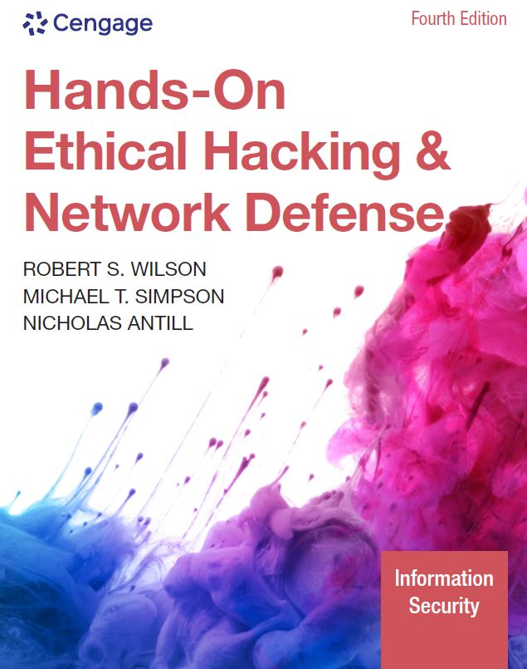
Hands-On Ethical Hacking and Network Defense, Edition 4
Module 3: Network and Computer Attacks
Simpson, Antill, Wilson, Hands-On Ethical Hacking and Network Defense, 4th Edition. © 2023 Cengage. All Rights Reserved. May not be scanned, copied or duplicated, or posted to a publicly accessible website, in whole or in part.

Slide 2
Module Objectives
By the end of this module, you should be able to:
Describe the different types of malicious software and what damage they can do
Describe methods of protecting against malware attacks
Describe the types of network attacks
Identify physical security attacks and vulnerabilities

Slide 3
Malicious Software (Malware)
Network attacks are initiated to steal data that can be used or sold for financial gain or to carry out a sociopolitical agenda
Malicious software (malware)
Virus
Worm
Trojan program
Main goal
To make money
Malware was once targeted specifically at Windows, Linux, and other traditional OSs
Now, it is written to target tablets, smartphones, and other Internet-connected devices

Slide 4
Viruses (1 of 4)
Virus: A program that attaches itself to a file or another program, often sent via email
Can’t replicate itself or operate without the presence of a host
Does not stand on its own
Examples
Phishing: The sender of a phishing email uses social engineering to lure a user into following a malicious link to a fake website
Ransomware: A type of virus that locks a target system until a ransom is paid
Bad news about viruses
No foolproof prevention method

Slide 5
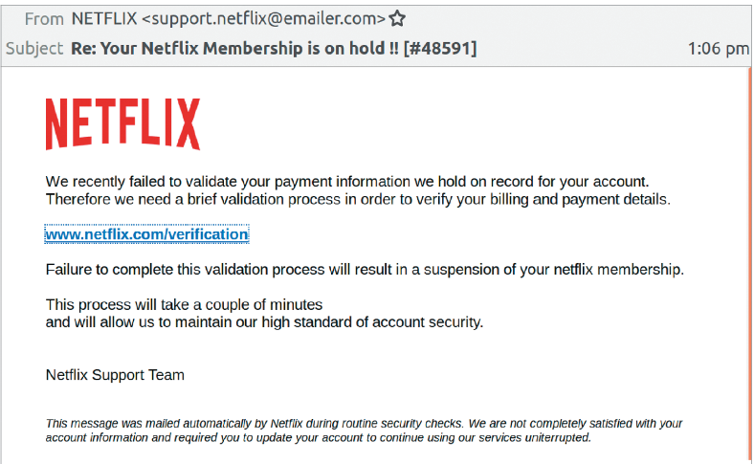
Viruses (2 of 4)
Figure 3-1 Phishing email message

Slide 6
Viruses (3 of 4) Scan+NetScane+Auto_updates
Antivirus software
Compares signatures and common malicious programmatic behaviors of known viruses against every file on a computer
Signatures are kept in a virus signature file
Must update regularly
Many antivirus software packages offer automatic updates
Network security devices
Can monitor entire networks and intercept malware before it reaches users
Sandboxing
Allows users to run programs in a secure, isolated operating area that prevents malicious files from being written to the hard drive

Slide 7
Common Computer Viruses (1 of 3)
Virus | Description
Ryuk | The Ryuk ransomware virus was responsible for more than one-third of all ransomware attacks in 2020. Ryuk is used in attacks targeting companies, hospitals, and government municipalities. Ryuk encrypts critical files and typically demands a multimillion-dollar ransom.
FormBook | FormBook is a malware family of data stealers and form grabbers. It attempts to steal the contents of the Windows Clipboard, log what you type on the keyboard, and steal data while you browse the web. It is sold as “malware-as-a-service” on hacking forums. Hackers can purchase a subscription and use the FormBook tool. FormBook is usually distributed through spam email containing malicious attachments.
CryptoLocker | CryptoLocker is less prevalent now but is considered the father of many ransomware viruses. CryptoLocker has become a term referring to families of ransomware viruses. In 2016, it was estimated to have infected more than 250,000 computers. This malware locks the user’s files in an encrypted container and requires the victim to pay ransom for their decryption. Like most malware, it is delivered through an email message that is designed to trick users into clicking a malicious link or attachment. Once a machine is infected, victims have a set amount of time to pay the ransom if they want to retrieve their files.

Slide 8
Common Computer Viruses (2 of 3)
Virus | Description
MalumPOS | Malware has targeted devices responsible for processing payments, referred to as POS (point of sale) systems. The MalumPOS virus was used in mid-2015 to attack POS devices at hotel chains. This virus was programmed to find, intercept, copy, and exfiltrate payment card information (e.g., credit/debit card numbers and other information stored on the magnetic strip of a credit card). POS attacks were rare in 2020, but a new strain seems to target personally identifying information only instead of full payment card information.
Carbanak | This virus is spread via phishing emails that almost always target financial institutions. These phishing emails contain a Word document and a malicious .cpl file. (Keep this in mind for the upcoming base-64 decoding exercise.) When it first accesses a system, the malware runs a number of checks to ensure it can gain the proper privileges to further its attack. When proper privileges are obtained or verified, the malware opens a backdoor to a few remote servers under the control of an unknown (to this point) malicious actor. This malware has been used to facilitate fraudulent transactions in financial institutions’ funds transfer systems and ATM machines.

Slide 9
Common Computer Viruses (3 of 3) HW- Latest ?
Virus | Description
Gumblar | First detected in March 2009, this malware spread by mass-hacking hundreds of thousands of websites, which then exploited visiting browsers via Adobe PDF and Flash vulnerabilities. It has made a resurgence in 2020, crashing thousands of blogs and websites that use WordPress, Drupal, Joomla, and other PHP-based constructs. The malware steals FTP credentials and uses them to further compromise websites that the victim maintains. It also hijacks Google searches and blocks access to antivirus update sites to prevent removal. Recent variations install a backdoor that attempts to connect to a botnet.
Gpcode or PGPCoder | This ransomware virus was detected in 2008 and was still active in 2020. Although not widespread, it is unique because it uses practically unbreakable 1024-bit asymmetric key encryption to hide a user’s documents on the computer and hold them for ransom until the victim pays for the encryption key.

Slide 10
Viruses (4 of 4)
Some viruses contained in email attachments were encoded in base 64
Running a base-64 decoder on suspicious email attachments can help determine if malware or viruses are detected
Examples of what to look for:
Hidden computer programs
Executable pieces of programming code known as shell
Creates an interface to an OS for issuing system commands
Should not appear in an email attachment

Slide 11
Macro Viruses
Macro virus
A virus coded as a macro in programs that support a macro programming language (e.g., Visual Basic for Applications)
Macro: Basically, a list of commands
Can be coded to carry out several malicious actions
Example
Melissa: Appeared in 1999
Viruses were created by programmers in the past
Today, even nonprogrammers can create viruses easily
Instructions on how to create a virus step by step are posted on websites
Security professionals learn from thinking like attackers

Slide 12
Worms
Worm: A program that replicates and propagates itself without having to attach itself to a host
Infamous examples:
Stuxnet
Code Red
Conficker
Theoretically, a worm that replicates itself multiple times to every user it infects can infect every computer in the world over a short period
Some infamous worms have cost businesses billions of dollars because of:
Lost productivity caused by computer downtime and time spent recovering lost data
Reinstalling programs and operating systems
Hiring or contracting IT personnel

Slide 13
Common Computer Worms (1 of 2)
Worm | Description
WannaCry | WannaCry is a ransomware cryptoworm that began its attack in 2017. It targeted vulnerabilities in the Microsoft Windows file-sharing protocol server message block (SMB), which allowed it to spread from system to system. Once on a system, it would then release its ransomware attack. Within a day, WannaCry had infected more than 230,000 computers in about 150 countries.
Flame (also called KyWiper) | Often touted as the most complex malware ever created, Flame was discovered in May 2012. It used advanced techniques to infect both local and remote computers. Its capabilities included microphone/webcam spying, keystroke logging, and screen capturing.
Stuxnet | In 2010, this malicious code was found on the industrial control systems (ICSs) in a nuclear production facility in Iran. Believed to have been delivered via USB drive, the worm may have used newly discovered Windows exploits to propagate itself, according to later analysis. Once the malware spread to a system that was running specific control software, the malware took control of the attached uranium refinement equipment, causing centrifuges to spin erratically and then fail. This is analogous to making a washing machine spin so fast that the motor burns out.

Slide 14
Common Computer Worms (2 of 2)
Worm | Description
Duqu | Detected in October of 2011, Duqu had design features similar to Stuxnet but with a different objective. Instead of causing damage to uranium refinement equipment, its goal was to steal data from users. This malware targeted government agencies in Europe and the Middle East, where the majority of infections occurred.
Storm | Detected in January 2007, this worm spread through automatically generated email messages. It is estimated that this botnet Trojan program and its variants infected millions of systems.
Waledac | This email worm harvests and forwards passwords and spreads itself in an email attachment called eCard.exe. It has many variants that can be controlled remotely. A recent variant used a geographic IP address lookup to customize the email message so that it looked like a Reuters news story about a dirty bomb that exploded in a city near the victim.
Conficker | Detected in late 2008, this botnet worm and its variants propagated through the Internet by using a Microsoft network service vulnerability. It updates itself dynamically but can be detected remotely with a standard port scanner, such as Nmap, and a special Conficker signature plug-in.
Slammer | Detected in 2003, this worm was purported to have shut down more than 13,000 ATMs of one of the largest banks in America by infecting database servers located on the same network.

Slide 15
Trojan Programs
Responsible for the most insidious attacks against networks and computers worldwide
Disguise themselves as useful programs
Can install backdoors or rootkits on a computer
Backdoors or rootkits give attackers a means of regaining access to the attacked computer later
A rootkit is created after an attack and usually hides itself in the OS tools
A good software or hardware firewall
Identifies traffic using unfamiliar ports
Common ports used by Trojans
TCP port 80 (HTTP) or UDP port 53 (DNS)

Slide 16
Trojan Programs and Ports
Trojan program | TCP ports used
Agobot, Backdoor.Hacarmy.C, Linux.Backdoor.Kaitenh, Backdoor.Clt, Backdoor.IRC.Flood.E, Backdoor.Spigot.C, Backdoor.IrcContact, Backdoor.DarkFtp, Backdoor.Slackbot.B | 6667
Backdoor.Danton | 6969
Backdoor.Nemog.C | 4661, 4242, 8080, 4646, 6565, and 3306
Backdoor.Rtkit.B | 445
Backdoor.Systsec, Backdoor.Zincite.A | 1034
Emotet | 20, 22, 80, 443, 7080, and 50000
Trickbot | 447, 8082
W32.Beagle.Y@mm | 1234
W32.Korgo.A | 13, 2041, and 3067
W32.Mytob.MX@mm | 7000

Slide 17
Spyware (1 of 2)
Sends information from the infected computer to the initiator of the spyware program on your computer
Confidential financial data
Passwords
PINs
Any other stored data
Can register each keystroke entered
Prevalent technology
Records and sends everything a user enters to an unknown person located halfway around the world
Educate users about spyware

Slide 18
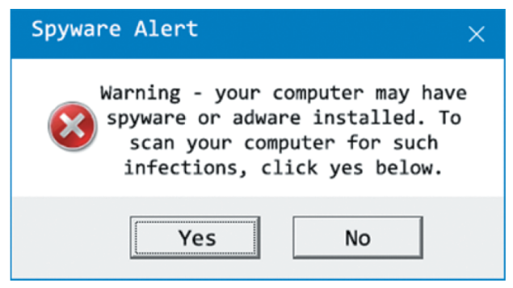
Spyware (2 of 2)
Figure 3-2 Spyware initiation program

Slide 19
Adware
Similar to spyware
Installed without users being aware of their presence
Sometimes displays a banner that notifies users of its presence
Main purpose
Determine a user’s purchasing habits
Web browsers can then display advertisements tailored to the user
Security and privacy violation
Gathers your purchasing habits
Information is likely being sent back to the hackers that deployed the adware

Slide 20
Knowledge Check Activity 3-1
What is the main purpose of malware?
Financial gain or destruction
Learning passwords
Discovering open ports
Identifying an operating system
Notes:
Instructions:
Use the Knowledge Check questions to periodically pose a question to students during class to gauge how well they can recall the material that was presented.

Slide 21
Knowledge Check Activity 3-1: Answer
What is the main purpose of malware?
Answer: a. Financial gain or destruction
The main purpose of malware is to make money. Previously, the main goal was to destroy or corrupt data or to shut down a network or computer system.

Slide 22
Knowledge Check Activity 3-2
Which of the following exploits might hide its destructive payload in a legitimate application or game?
a. Trojan
b. Macro virus
c. Worm
d. Buffer overflow
Notes:
Instructions:
Use the Knowledge Check questions to periodically pose a question to students during class to gauge how well they can recall the material that was presented.

Slide 23
Knowledge Check Activity 3-2: Answer
Which of the following exploits might hide its destructive payload in a legitimate application or game?
Answer: a. Trojan
Trojans disguise themselves as useful programs and can install a backdoor or rootkit on a computer. A rootkit is created after an attack and usually hides itself in the OS tools, so it’s impossible to detect.

Slide 24
Polling Activity 3-1
Which of the following is an example of a macro programming language?
a. C++
b. Shell
c. Basic
d. Visual Basic for Applications
Notes:
Instructions:
1. Use this activity to solicit student opinions about concepts in the module or to play a game.
2. Go to kahoot.com, or the platform of your preference, and log in or sign up.
3. Create the challenge.
4. Teacher Tip: Turn off the timer to prioritize accuracy or turn on the nickname generator to avoid inappropriate nicknames.
5. Invite players by sharing the link or PIN.
6. This can be done synchronously during class or asynchronously for review or homework.

Slide 25
Polling Activity 3-1: Answer
Which of the following is an example of a macro programming language?
Answer: d. Visual Basic for Applications
An example of a macro programming language is Visual Basic for Applications (VBA).

Slide 26
Protecting against Malware Attacks (1 of 2)
Difficult task
New viruses, worms, and Trojan programs appear daily
Antivirus programs
Can detect many malware programs
Educate users about these attacks
Users who aren’t trained thoroughly can open holes into a network that no technology can protect against

Slide 27
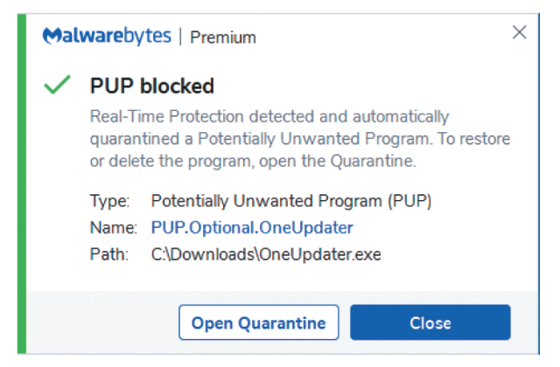
Protecting against Malware Attacks (2 of 2)
Figure 3-3 Detecting a virus

Slide 28
Educating Your Users (1 of 2)
Conducting structured training
Includes all employees and management
Email monthly security updates to all employees
Recommend virus signature database updating
Activate automatic updates
Actively phishing employees and sending them to training content if they click a link they should not click
White-listing
Allows only approved programs to run on computers
Another recommendation to make is to update virus signature files as soon as they are available from the vendor

Slide 29
Educating Your Users (2 of 2)
Two popular spyware and adware removal programs:
HitmanPro
Malwarebytes Anti-Malware (MBAM)
Training employees on safe email practices and how to recognize and avoid phishing messages
Installing firewalls
Software firewalls (for home and small-business users)
For those who don’t have a hardware firewall or an intrusion detection system (IDS)

Slide 30
Avoiding Fear Tactics
Avoid scaring users into complying with security measures
Sometimes used by unethical security testers
Against the Open Source Security Testing Methodology Manual’s (OSSTMM) Rules of Engagement
Promote awareness rather than instill fear
Users should be aware of potential threats, not terrified by them
Build on the users’ existing knowledge
Makes training easier

Slide 31
Discussion Activity 3-1
Antivirus software is one of the main points of defense against malware and network attacks. Perform research to discover five of the best “free” antivirus solutions. In a few paragraphs, describe your findings and discuss which antivirus software you think is the best and explain why.
Notes:
Instructions:
Use the Discussion activity to encourage group conversation about a related topic of interest.

Slide 32
Discussion Activity 3-1: Answer
Antivirus software is one of the main points of defense against malware and network attacks. Perform research to discover five of the best “free” antivirus solutions. In a few paragraphs, describe your findings and discuss which antivirus software you think is the best and explain why.
Answer: Some of the best antivirus solutions in the market are Avira, Panda, TotalAV, Kaspersky, and Malwarebytes. Avira has one of the best anti-malware engines in the market and is user-friendly. Panda Free Antivirus provides good virus protection and is also lightweight and secure. TotalAV’s identifies the trickiest ransomware and cryptojacking files. Kaspersky Security Cloud is another great antivirus software that also comes with plenty of additional benefits. Malwarebytes Free is a minimalistic and simple antivirus scanner, but it can miss hidden files that brands like Avira and TotalAV can detect.

Slide 33
Intruder Attacks on Networks and Computers
Attack
Any attempt by an unauthorized person to access, damage, or use network resources
Usually happens when a weakness or a vulnerability is exploited
Exploit
A specially crafted string of data intended to take advantage of a vulnerability
Network security
Concerned with the security of computers or devices that are part of a network infrastructure
Computer security
Concerned with the security of a stand-alone computing device that is not part of a network infrastructure
Computer crime
Fastest growing type of crime worldwide

Slide 34
Denial-of-Service (DoS) Attack (1 of 2)
Prevents legitimate users from accessing network resources
Attackers do not attempt to access the information on a remote computer
May just want to cripple the network
Conducting a DoS attack yourself is not wise
Only explain how the attack could be carried out

Slide 35
Denial-of-Service (DoS) Attack (2 of 2)
Ping of Death attack
Causes the victim computer to freeze and malfunction
Not as common as it was during the late 1990s
How it works
Attacker creates a large ICMP packet
More than the allowed 65,535 bytes
Large packet is fragmented into smaller packets
Reassembled at its destination
User’s system at the destination point cannot handle the reassembled oversize packet
Causes it to crash or freeze

Slide 36
Distributed Denial-of-Service Attacks
Distributed denial-of-service (DDoS) attack
Attack on the host is launched from multiple servers or workstations
Network could be flooded with billions of packets
Available network bandwidth could drop
Legitimate users may notice a performance degradation
Often, participants are not aware their computers are part of the attack
They, too, have been attacked
A Dark DDoS attack
A smoke screen to distract network defenders while another, more damaging attack is occurring

Slide 37
Buffer Overflow Attacks
Attacker finds a vulnerability in poorly written code that doesn’t check for a defined amount of memory space use
Attacker writes code that overflows buffer
Fills buffer with executable program code
OS runs this code, and the attacker’s program does something harmful
Code elevates the attacker’s permissions to an administrator’s level
Or creates a service that allows an attacker to remotely access the target system
Ensure programmers are aware of how their code might be vulnerable to attack
DevSecOps
Addresses the need for programmers to develop code with security in mind

Slide 38
Buffer Overflow Vulnerabilities (1 of 2)
Buffer overflow | Description
Cisco ASA Internet Key Exchange | Cisco Security Advisory for CVE-2016-1287 discusses a serious buffer overflow vulnerability in the Cisco ASA product line. Attackers could send a specially crafted packet to the affected device, allowing them to gain full administrative privileges. This attack could be carried out from anywhere on the Internet if ASAs are used on a company’s perimeter.
GHOST | This vulnerability made headlines across the globe when it was discovered by security researchers at Qualys. Community. Under the right conditions, GHOST could be exploited to gain administrative access to a remote system with no credentials. The vulnerability resulted from a weakness with the “glibc” library, a central component of Linux operating systems.
PAN-OS | In 2020, Palo Alto Networks released a fix for a buffer overflow vulnerability in its PAN-OS operating system found in many of its next-generation firewalls. A remote, unauthenticated attacker could use this vulnerability to disrupt system processes or to execute code.

Slide 39
Buffer Overflow Vulnerabilities (2 of 2)
Buffer overflow | Description
StageFright Android Overflow Vulnerability | Buffer overflows not only affect traditional operating systems but mobile devices as well. This vulnerability, CVE-2015-1538, was found in Android’s media playback libraries. Researchers found that a special MMS (Multimedia Messaging Service) message sent to a target Android device could cause an overflow, which allows for remote code execution without any user interaction.
VPN Product | In 2020, the NSA alerted administrators about buffer overflow vulnerabilities in three popular VPN products, namely Pulse Secure, Palo Alto GlobalProtect, and Fortinet FortiGate. The vulnerability allowed for arbitrary file downloads and remote code execution on some of these products.
Windows Server Service | Microsoft Security Bulletin MS08-067 discusses this buffer overflow vulnerability, which makes it possible for attackers to run arbitrary code placed in memory. This vulnerability allowed the infamous Conficker worm to spread.

Slide 40
Eavesdropping
An attacker can listen to unencrypted network communications
To intercept confidential information or gather credentials that can be used to extend the attack
Accomplished with sniffing tools
Sniffing tools are designed to capture copies of packets being sent across a network
To defend against the threat of eavesdropping
Network equipment and applications should be forced to communicate only over encrypted protocols
Use only valid, trusted certificates

Slide 41
Man-in-the-Middle Attacks
Attackers can inject themselves between two parties or systems communicating with one another
To manipulate messages being passed back and forth

Slide 42
Network Session Hijacking
Enables an attacker to join a TCP session
Attacker makes both parties think he or she is the other party
Complex attack beyond the scope of this book

Slide 43
Polling Activity 3-2
An exploit that attacks computer systems by inserting executable code in areas of memory because of poorly written code is called which of the following?
a. Buffer overflow
b. Trojan program
c. Virus
d. Worm
Notes:
Instructions:
1. Use this activity to solicit student opinions about concepts in the module or to play a game.
2. Go to kahoot.com, or the platform of your preference, and log in or sign up.
3. Create the challenge.
4. Teacher Tip: Turn off the timer to prioritize accuracy or turn on the nickname generator to avoid inappropriate nicknames.
5. Invite players by sharing the link or PIN.
6. This can be done synchronously during class or asynchronously for review or homework.

Slide 44
Polling Activity 3-2: Answer
An exploit that attacks computer systems by inserting executable code in areas of memory because of poorly written code is called which of the following?
Answer: a. Buffer overflow
In a buffer overflow attack, an attacker finds a vulnerability in poorly written code that doesn’t check for a defined amount of memory space use.

Slide 45
Addressing Physical Security
Protecting a network requires some basic skills
Must secure servers and computers from an attack from within the organization
Higher chance that an attacker who breaks into the network is from inside the company rather than outside

Slide 46
Keyloggers (1 of 2)
Hardware devices or software used to capture keystrokes on a computer
Software
Behaves like viruses or Trojans
Hardware
Small device that is easy to install
Examples: KeyGrabber and KeyGhost
Can be used by organizations to monitor the activity of users on their computer systems
Available as software (spyware) loaded on a computer
Retrieved information can be emailed or transferred to a remote location

Slide 47
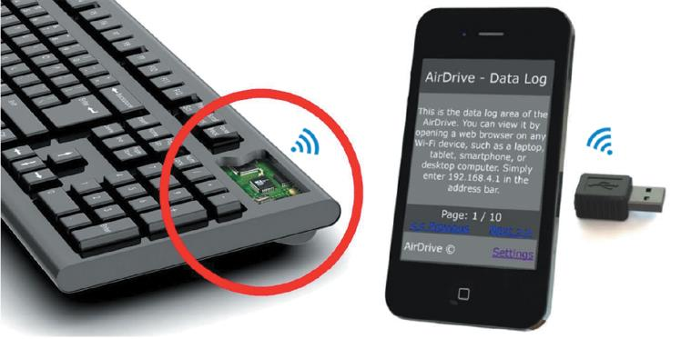
Keyloggers (2 of 2)
Figure 3-4 Wi-Fi USB keylogger, keylogger keyboard, and keylogger phone app

Slide 48
Behind Locked Doors
Lock up your servers
Average person
Can pick an American home lock in less than five minutes
Those who have more time on their hands
Can pick a deadbolt lock in under 30 seconds
Rotary locks are more difficult to crack than deadbolt locks
Require pushing in a sequence of numbered bars
Neither lock type keeps a record of who entered the locked room
Security cards can be used for better security
Biometric security devices
Read fingerprints or retinal scans and are used to restrict access to secure areas
Provide a second authentication factor

Slide 49
Self-Assessment
Describe the types of malware attacks and explain how you can protect against each of them.
Notes:
Instructions:
Use the Self-Assessment question to encourage students to evaluate their progress or goals in the course, as well as determine how they might apply their learning or grow as an individual.

Slide 50
Summary
Now that the lesson has ended, you should be able to:
Describe the different types of malicious software and what damage they can do
Describe methods of protecting against malware attacks
Describe the types of network attacks
Identify physical security attacks and vulnerabilities

