Slide 1

Hands-On Ethical Hacking and Network Defense, Edition 4
Module 4: Footprinting and Social Engineering
Simpson, Antill, Wilson, Hands-On Ethical Hacking and Network Defense, 4th Edition. © 2023 Cengage. All Rights Reserved. May not be scanned, copied or duplicated, or posted to a publicly accessible website, in whole or in part.

Slide 2
Module Objectives
By the end of this module, you should be able to:
Use web tools for footprinting
Conduct competitive intelligence
Describe DNS zone transfers
Identify the types of social engineering

Slide 3
Using Web Tools for Footprinting (1 of 4)
Many attackers do “case the joint”
Look over the location
Find weaknesses in security systems
Determine what types of locks and alarm systems are used
As a security tester
You must find out as much as you can about an organization that hired you
Footprinting (may also be called reconnaissance)
Finding information on a company’s network
Footprinting Types:
Passive and
nonintrusive

Slide 4
Using Web Tools for Footprinting (2 of 4)
Active footprinting
Actually, prodding the target network in ways that might seem suspicious to network defenders
Includes things such as:
Port scans
DNS zone transfers
Interacting with a target’s web server
Security tester uses both passive and active techniques
To discover as much as possible about the organization and its network

Slide 5
Summary of Reconnaissance Tools (1 of 4)
Tool | Function
dig (Command available on all *nix systems; can be downloaded for Windows platforms from the BIND 9 website. dig is contained in the BIND download, so download BIND.) | Perform DNS zone transfers; replaces the nslookup command.
Domain Dossier | This web tool is useful in gathering IP and domain information (including whois, DNS, and traceroute).
FOCA | Extract metadata from documents on websites to reveal the document creator’s network logon and email address, information on IP addresses of internal devices, and more.
Google and Google Hacking Database (GHDB), also called Google Dorks | Uncover files, systems, sites, and other information about a target using advanced operators and specially crafted queries. Some of these queries can be found at the GHDB (Google Hacking Database).
Google Groups | Search for email addresses in technical or nontechnical newsgroup postings.
(Google Hacking Database

Slide 6
Summary of Reconnaissance Tools (2 of 4)
Tool | Function
Maltego | Discover relevant files, email addresses, and other important information with this powerful graphic user interface (GUI) tool.
netcat (command available on all *nix systems; can be downloaded for Windows platforms from the N MAP website) | Read and write data to ports over a network.
Netcraft Site Report | Uncover the underlying technologies that a website operates on.
OSINT Framework | A collection of OSINT tools presented in an interactive web-based mind map that organizes the information visually. You can expand nodes to find collections of tools suited for the task you want to accomplish.
Recon-ng | Automate footprinting with this powerful, advanced framework using search engines, social media, and many other sources.

Slide 7
Summary of Reconnaissance Tools (3 of 4)
Tool | Function
SpiderFoot | A tool with a graphical user interface (GUI) that queries more than 100 OSINT sources to grab intelligence on email addresses names, IP addresses, domain names, web servers, and more.
Spyse | Spyse is a cybersecurity search engine. You can use it to search entire domains or individual systems for vulnerabilities, IPs, DNS records, domains, and more. Spyse claims to be “the most complete Internet assets registry for every cybersecurity professional.”
TheHarvester | Used for finding email addresses, subdomains, IPs, URLs, employee names, and more. This is a command line only tool.
WayBackMachine | Search through previous versions of the website to uncover historical information about a target.

Slide 8
Summary of Reconnaissance Tools (4 of 4)
Tool | Function
wget (command available on all *nix systems; can be downloaded for Windows platforms from Wget for Windows HTML site) | Retrieve HTTP, HTTPS, and FTP files over the Internet.
White Pages | Conduct reverse phone number lookups and retrieve address information.
Whois | Gather IP and domain information.
Zed Attack Proxy | This is a useful website analysis tool that can crawl through remote websites and even produce a list of vulnerabilities for a remote website.

Slide 9
Knowledge Check Activity 4-1
_____ is one of the components most vulnerable to network attacks.
TCP/IP
WINS
DHCP
DNS
Notes:
Instructions:
Use the Knowledge Check questions to periodically pose a question to students during class to gauge how well they can recall the material that was presented.

Slide 10
Knowledge Check Activity 4-1: Answer
_____ is one of the components most vulnerable to network attacks.
Answer: d. DNS
DNS is the network component responsible for resolving hostnames to IP addresses and vice versa. It is a major area of potential vulnerability for network attacks.

Slide 11
Discussion Activity 4-1
Identify the tools that can assist you in finding general information about an organization and its employees. Compare your choices with that of your classmates’ and discuss the various sources of organizational information.
Notes:
Instructions:
Use the Discussion activity to encourage group conversation about a related topic of interest.

Slide 12
Discussion Activity 4-1: Answer
Identify the tools that can assist you in finding general information about an organization and its employees. Compare your choices with that of your classmates’ and discuss the various sources of organizational information.
Answer: Google and Google Groups seem to be effective tools in helping gather information about an organization and its employees.

Slide 13
Conducting Competitive Intelligence
Numerous resources are available to find information legally
Competitive intelligence
Gathering information on a higher level using technology
Security professionals must:
Explain to their clients the methods used by competitors to gather confidential information

Slide 14
Analyzing a Company’s Website (1 of 8)
Webpages are an easy source of critical information
Websites are often referred to as web applications
Many available tools for this type of information gathering
Zed Attack Proxy (ZAP)
Powerful tool for Linux, macOS, and Windows
Requires Java to be installed

Slide 15
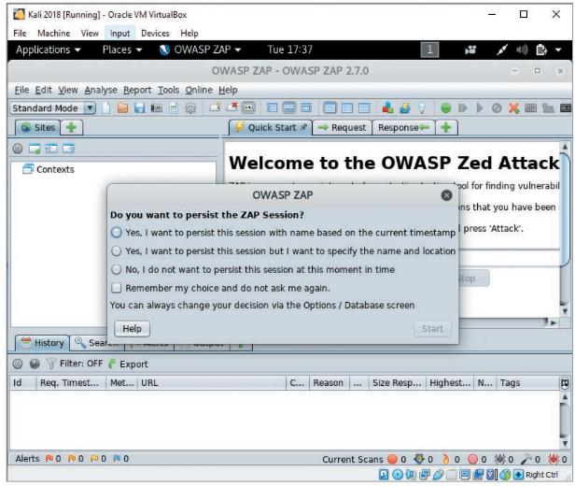
Analyzing a Company’s Website (2 of 8)
Source: OWASP.ORG
Figure 4-1 ZAP main window

Slide 16
Analyzing a Company’s Website (3 of 8)
ZAP has a feature called Launch Browser on its Quick Start tab
Automatically edits the configuration of a web browser
To direct traffic through ZAP proxy
Allows the ZAP tool to intercept and manipulate traffic sent between your web browser and the target web server
To use this feature:
Select the Quick Start tab
Choose the browser from the drop-down menu
Next to the Launch Browser button
Click the Launch Browser button

Slide 17
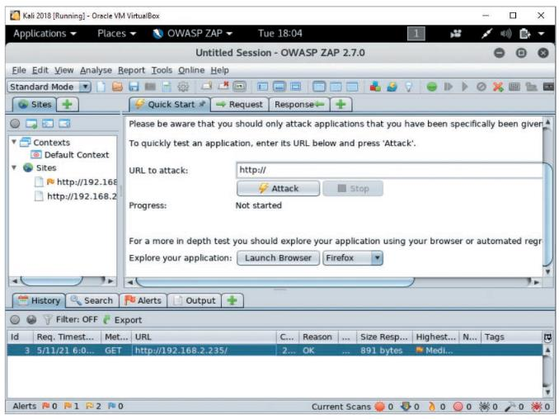
Analyzing a Company’s Website (4 of 8)
Exploring ZAP: In-Class-Activity
You may watch a video before this activity
Source OWASP.ORG
Figure 4-2 ZAP launch browser

Slide 18
Analyzing a Company’s Website (5 of 8)
Once the browser is configured:
The attacker can use the browser to navigate the target site
Target site will be listed on the History tab in the lower pane and in the Sites list in the left pane
Site can be selected for spidering
Spidering (or crawling) is an automated way to discover pages of a website by following links
Within seconds, the filenames of webpages on the “spidered” site are displayed on the URLs tab

Slide 19
Analyzing a Company’s Website (6 of 8)
After the site has been “spidered”:
You can actively scan the site using the ZAP Attack feature
Sends the web server a series of requests designed to identify vulnerabilities
Vulnerabilities will display under the Alerts tab
Indicated in the Risk Level column as either High, Medium, Low, or Informational

Slide 20
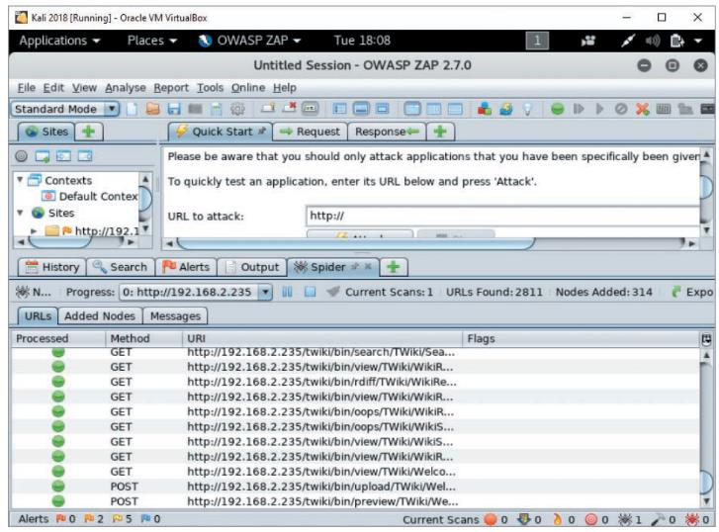
Analyzing a Company’s Website (7 of 8)
Source OWASP.ORG
Figure 4-5 Displaying filenames of content on a website

Slide 21
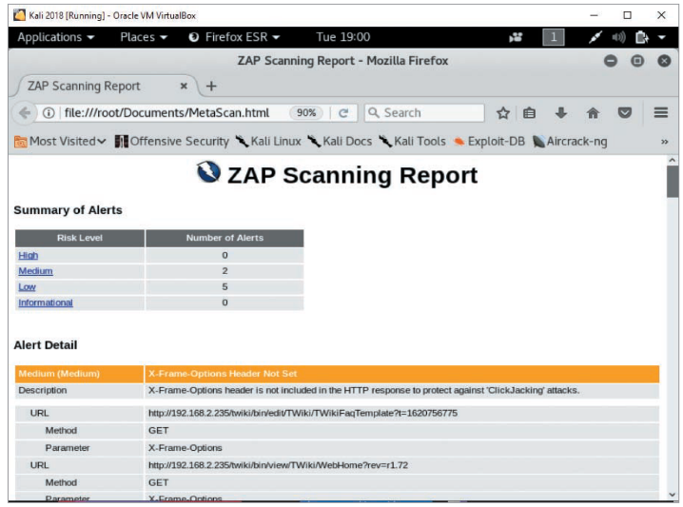
Analyzing a Company’s Website (8 of 8)
Figure 4-6 ZAP scanning report

Slide 22
Using Other Footprinting Tools
Whois utility
Commonly used web tool
Gathers IP address and domain information
Unfortunately, attackers can also use this information
Gives information on a company’s IP addresses
And any other domains the company might be part of
Class Activity – whois utility

Slide 23
Using Email Addresses
Email address
Knowing a user’s email address can help retrieve even more information
Find out a company’s email address format
You might be able to find other employees’ email accounts
By acquiring a company phone directory
By searching the Internet for any @companyname.com references
Tool to find corporate employee information
Groups

Slide 24
Using HTTP Basics (1 of 3)
HTTP operates on port 80 and HTTPS operates on port 443
Both versions use HTTP commands
Security testers can pull information from a web server using these commands
A basic understanding of HTTP
Beneficial for security testers
Return codes
Reveal information about OS used on the computer where a security test is being conducted
Most basic HTTP method
GET / HTTP/1.1.

Slide 25
HTTP Client Errors (1 of 2)
Error | Description
400 Bad Request | Request not understood by server
401 Unauthorized | Request requires authentication
402 Payment Required | Reserved for future use
403 Forbidden | Server understands the request but refuses to comply
404 Not Found | Unable to match request
405 Method Not Allowed (Note: Methods are covered later in this module.) | Request not allowed for the resource
406 Not Acceptable | Resource doesn’t accept the request
407 Proxy Authentication Required | Client must authenticate with proxy
408 Request Timeout | Request not made by client in allotted time
409 Conflict | Request couldn’t be completed because of an inconsistency

Slide 26
HTTP Client Errors (2 of 2)
Error | Description
410 Gone | Resource is no longer available
411 Length Required | Content length not defined
412 Precondition Failed | Request header fields evaluated as false
413 Request Entity Too Large | Request is larger in volume than the server can process
414 Request-URI (uniform resource identifier) Too Long | Request-URI is longer than the server is willing to accept

Slide 27
HTTP Server Errors
Error | Description
500 Internal Server Error | Request couldn’t be fulfilled by the server
501 Not Implemented | Server doesn’t support the request
502 Bad Gateway | Server received invalid response from the upstream server
504 Gateway Timeout | Server didn’t receive a timely response
505 HTTP Version Not Supported | HTTP version not supported by the server

Slide 28
HTTP Methods
Error | Description
GET | Retrieves data by URI
HEAD | Same as the GET method, but retrieves only the header information of an HTML document, not the document body
OPTIONS | Requests information on available options
TRACE | Starts a remote Application-layer loopback of the request message
CONNECT | Used with a proxy that can dynamically switch to a tunnel connection, such as Secure Sockets Layer (SSL) or Transport Layer Security (TLS)
DELETE | Requests that the origin server delete the identified resource
PUT | Requests that the entity be stored under the Request-URI
POST | Allows data to be posted (i.e., sent to a web server)

Slide 29
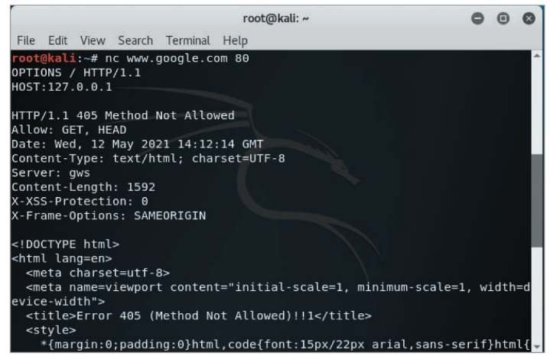
Using HTTP Basics (2 of 3)
Figure 4-8 Using the OPTIONS HTTP method

Slide 30
Using HTTP Basics (3 of 3)
If you know HTTP methods:
You can send a request to a web server
From the generated output, you can determine what OS the web server is using
Other information can be determined that could be used in an attack
Such as vulnerabilities of operating systems (OSs) and other software

Slide 31
Other Methods of Gathering Information
With just a URL, you can determine the following that a company is using:
Web server
OS
Names of IT personnel
Other unscrupulous methods:
Cookies
Web beacons

Slide 32
Detecting Cookies and Web Bugs (1 of 2)
Cookie
Text file generated by a web server
Stored on a user’s browser
Information is sent to the web server when the user returns to the website
Used to customize webpages
Some cookies cause security issues
Unscrupulous people might store personal information
Can be used to attack a computer or server

Slide 33
Detecting Cookies and Web Bugs (2 of 2)
Web bug
1-pixel ×1-pixel image file
Referenced in an <IMG> tag
Usually works with a cookie
Type of web beacon
A hidden graphic or piece of code
Embedded in a webpage to track user activity and harvest user information
Purpose is similar to spyware and adware
Comes from third-party companies specializing in data collection
Usually match the color of the webpage’s background
Renders them invisible

Slide 34
Using Domain Name System Zone Transfers (1 of 3)
Domain Name System (DNS)
Resolves host names to IP addresses and vice versa
People prefer URLs to IP addresses
DNS is a major area of potential vulnerability for network attacks
Uses name servers to resolve names
Once you determine what name server a company is using:
You can attempt to transfer all the records for which the DNS server is responsible
Process is called a zone transfer
Can be done with the dig command

Slide 35
Using Domain Name System Zone Transfers (2 of 3)
Recommended zone transfer tool
The dig command
Determining primary DNS server
Start of Authority (S O A) record
Shows for which zones or IP addresses the DNS server is responsible
Zone transfer gives an organization’s network diagram
This information can be used to attack other servers or computers that are part of the network infrastructure

Slide 36
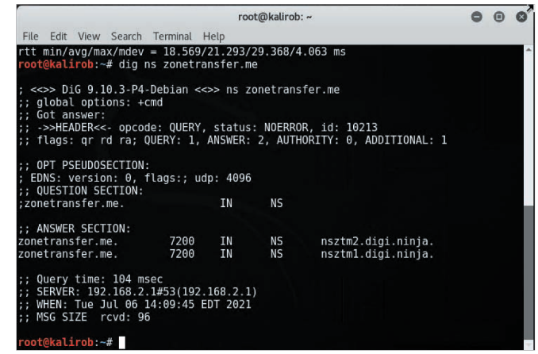
Using Domain Name System Zone Transfers (3 of 3)
Source: Kali Linux
Figure 4-14 Using the dig command

Slide 37
Knowledge Check Activity 4-2
Which of the following enables you to view all host computers on a network?
S O A
ipconfig
Zone transfers
HTTP HEAD method
Notes:
Instructions:
Use the Knowledge Check questions to periodically pose a question to students during class to gauge how well they can recall the material that was presented.

Slide 38
Knowledge Check Activity 4-2: Answer
Which of the following enables you to view all host computers on a network?
Answer: c. Zone transfers
Zone transfers enable an individual to view all host computers on a network. It basically gives an organization’s network diagram.

Slide 39
Polling Activity 4-1
What command-line tool can be used to harvest DNS information?
dns-get
dug
dig
axfer
Notes:
Instructions:
1. Use this activity to solicit student opinions about concepts in the module or to play a game.
2. Go to kahoot.com, or the platform of your preference, and log in or sign up.
3. Create the challenge.
4. Teacher Tip: Turn off the timer to prioritize accuracy or turn on the nickname generator to avoid inappropriate nicknames.
5. Invite players by sharing the link or PIN.
6. This can be done synchronously during class or asynchronously for review or homework.

Slide 40
Polling Activity 4-1: Answer
What command-line tool can be used to harvest DNS information?
Answer: c. dig
The dig command-line tool can be used to harvest information.

Slide 41
Polling Activity 4-2
To determine a company’s primary DNS server, you can look for a DNS server containing which of the following?
Cname record
Host record
PTR record
S O A record
Notes:
Instructions:
1. Use this activity to solicit student opinions about concepts in the module or to play a game.
2. Go to kahoot.com, or the platform of your preference, and log in or sign up.
3. Create the challenge.
4. Teacher Tip: Turn off the timer to prioritize accuracy or turn on the nickname generator to avoid inappropriate nicknames.
5. Invite players by sharing the link or PIN.
6. This can be done synchronously during class or asynchronously for review or homework.

Slide 42
Polling Activity 4-2: Answer
To determine a company’s primary DNS server, you can look for a DNS server containing which of the following?
Answer: d. S O A record
To determine a company’s primary DNS server, you can look for a DNS server containing a Start of Authority (S O A) record.

Slide 43
Introduction to Social Engineering (1 of 3)
Social engineering: Uses the art of deception to extract valuable information
From well-meaning people who are trying to be helpful
Art of social engineering is older than computers
Uses knowledge of human nature to gather information from people
Goals
Obtain confidential information (passwords)
Obtain other personal information
Tactics used by social engineers
Persuasion
Intimidation
Coercion
Extortion/blackmailing

Slide 44
Introduction to Social Engineering (2 of 3)
Social engineers
Probably the biggest security threat to networks
The most difficult to protect against
Main idea
“Why try to crack a password when you can simply ask for it?”
Users divulge passwords to IT personnel
Social engineers study human behavior
Create a sense of urgency to remain cordial
They recognize personality traits
Understand how to read body language
Can read a person’s tone of voice for clues

Slide 45
Introduction to Social Engineering (3 of 3)
Techniques to gain information from unsuspecting people
Urgency
Quid pro quo
Status quo
Kindness
Position
Security training
Train users not to reveal information to outsiders about OSs
Employees should confirm identity of the person asking questions
Routinely ask the person for a company phone number to call back

Slide 46
The Art of Shoulder Surfing (1 of 2)
Shoulder surfer
Reads what users enter on keyboards
Logon names
Passwords
PINs
Tools used by shoulder surfers
Memorize key positions and typing techniques
Know popular letter substitutions
$ equals s, @ equals a

Slide 47
The Art of Shoulder Surfing (2 of 2)
Prevention
Avoid typing when:
Someone is nearby
Someone nearby is talking on cell phone
Ensure display screens face away from the door
Immediately change password
If you suspect someone might have observed you entering your password

Slide 48
The Art of Dumpster Diving (1 of 2)
Attacker finds information in victim’s trash
Discarded computer manuals
Passwords jotted down
Company phone directories
Calendars with schedules
Financial reports
Interoffice memos
Company policy
Utility bills
Resumes

Slide 49
The Art of Dumpster Diving (2 of 2)
Prevention
Educate users
The possibility of dumpster diving
Proper trash disposal
Format disks before disposing them with “disk-cleaning” software that writes binary zeros on all portions of the disks
Should be done at least seven times
Discard old computer manuals offsite
Shred documents before disposal

Slide 50
The Art of Piggybacking
Trailing closely behind an employee cleared to enter restricted areas
How it works:
Watch authorized personnel enter an area
Quickly join them at security entrance
Exploit desire to be polite and helpful
Attacker wears a fake badge or security card
Prevention
Use turnstiles
Train personnel to notify security about strangers
Do not hold secured doors open for anyone
Even people you know
All employees must use access cards to enter a restricted area

Slide 51
Phishing (1 of 2)
Phishing emails
“Update your account details” is a typical subject line
Usually framed as an urgent request to visit a website
The website is a fake
The money you lose is real
Spear phishing
Combines social engineering with exploiting vulnerabilities
Attack is directed at specific people in an organization
Comes from someone the recipient knows
Mentions topics of mutual interest

Slide 52
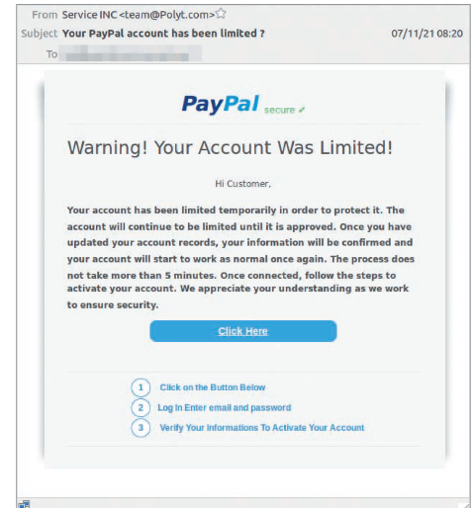
Phishing (2 of 2)
mailguard.com.au
Figure 4-15 Phishing email message

Slide 53
Self-Assessment
Explain the different methods used by social engineers to convince users to give them information.
Notes:
Instructions:
Use the Self-Assessment question to encourage students to evaluate their progress or goals in the course, as well as determine how they might apply their learning or grow as an individual.

Slide 54
Summary
Now that the lesson has ended, you should be able to:
Use web tools for footprinting
Conduct competitive intelligence
Describe DNS zone transfers
Identify the types of social engineering

