Slide 1


Department of Computer Science & Engineering
B. Tech IV-II Project Work
Mental Stress Detection in Workplaces
Using Machine Learning

Slide 2
Presented by:
P. Lasya priya : 21W51A0562
P. Dinesh Reddy :21W51A0565
S.Neeha Firdose : 21W51A0589
S. Shakeer :21W51A0592
S.Syed Basha : 21W51A0593
Under the guidance of:
Mr. G. Praburam M.E CSE
CSE Department

Slide 3
Contents:
Abstract
Problem Statement
Literature Survey
Existing methods and Disadvantages
Proposed methods and Advantages
Project Architectures
Result with Metrics
Conclusion and Future work
Bibliography

Slide 4
Abstract
Mental stress in the workplace is a growing concern, as it can negatively impact employee well-being, productivity, and overall organizational success. Traditional methods of assessing stress, such as self-reported surveys or observations, can be subjective and often fail to capture real-time stress levels. Traditional methods of assessing stress, such as self-reported surveys or observations, can be subjective and often fail to capture real-time stress levels. This project aims to develop an intelligent system for real-time mental stress detection in workplaces using machine learning techniques. The proposed system leverages multiple modalities, including physiological signals (heart rate, skin conductance), behavioral cues (speech patterns, facial expressions), and textual analysis (emails, messages) to provide a comprehensive measure of stress.

Slide 5
Problem Statement
"Development of a Machine Learning-Based System for Mental Stress Detection in Workplace Environments“. Workplace stress has become a growing concern, negatively impacting employee well-being, productivity, and overall organizational efficiency. Traditional methods of stress assessment, such as self-reported surveys, are often subjective and may not capture real-time stress patterns. To address this issue, an automated and accurate mental stress detection system is required that leverages machine learning (ML) models to predict stress levels based on physiological, behavioral, and survey-based data.

Slide 6
Literature Reviews
1.Title: A real time human stress monitoring system using Dynamic Bayesian Network
Authors: W. Liao, W. Zhang, Z. Zhu, and Q. Ji
Description: This paper presents a real-time stress monitoring system that utilizes a Dynamic Bayesian Network (DBN) to infer human stress levels based on multimodal data.
2. Title: Stress detection using EGC and EMG signals
Authors: S. Pourmohammadi and A. Maleki
Description:This paper explores stress detection using Electrocardiogram (ECG) and Electromyography (EMG) signals, offering a comprehensive analysis of signal processing techniques and classification methods.

Slide 7
3.Title: Sayopillow:Blockchain-integrated privacy-Assured IoMT Framework for stress management considering Sleep Habits.
Authors: L. Rachakonda & A. K. Bapatla
Description:The system utilizes Machine Learning (ML) algorithms to predict stress levels and provide personalized recommendations for better mental well-being. Blockchain ensures secure data storage, preventing unauthorized access while allowing controlled data sharing.
4.Title: Detection of Stress in IT Employees using Machine Learning Technique
Authors: Kanaparthi & S. Bellamkonda
Published In: 2022 International Conference on Applied Artificial Intelligence and Computing (ICAAIC)
Description: Focuses on stress detection in IT employees using ML algorithms, which likely include classification models trained on physiological and behavioral data.

Slide 8
Existing Systems
Traditional Machine Learning (ML) Approaches:
Algorithms Used: Support Vector Machine (SVM) for pattern recognition in behavioral signals.
k-Nearest Neighbors (k-NN)
for pattern recognition in physiological signals.
Transformer Models (like BERT) for text-based stress detection (e.g., analyzing employee messages/emails).

Slide 9
Disadvantages of Existing Methods:
High Computational Cost – SVM and BERT require significant processing power, making them inefficient for large datasets.
Low Real-Time Performance – k-NN and BERT have high latency, making them unsuitable for real-time stress detection.
Data Privacy Concerns – Text-based stress detection using BERT can invade privacy by analyzing sensitive emails/messages.
Scalability Issues – k-NN struggles with large datasets due to its memory-intensive nature and slow computations.
Noise Sensitivity – k-NN performs poorly with noisy physiological signals, reducing accuracy.
Feature Selection Complexity – SVM requires expert tuning of kernel functions for optimal performance.

Slide 10
Proposed System
Real-Time Data Collection: Integrating wearable sensors, facial emotion recognition, voice tone analysis, and keystroke dynamics.
Hybrid ML Approach: Combining multiple features (heart rate, facial expressions, text sentiment, work activity patterns) for better accuracy.
Predictive Stress Analysis: AI models predict stress levels before they affect performance, allowing for early intervention.
Random Forest (RF) and XGBoost are used in workplace stress detection by analyzing physiological, behavioral, and textual data from employees.

Slide 11
Advantages Of Proposed System
High Accuracy – Uses multiple decision trees, reducing errors and improving prediction reliability.
Handles Missing Data – Can effectively work with incomplete datasets without major performance loss.
Prevents Overfitting – By averaging multiple trees, it avoids overfitting compared to single decision trees.
Works Well with Small Datasets – Performs efficiently even when training data is limited.
Supports Multi-Feature Input – Can process physiological, behavioral, and textual data simultaneously for stress detection.
Robust to Noisy Data – Less sensitive to errors and outliers due to ensemble learning.

Slide 12
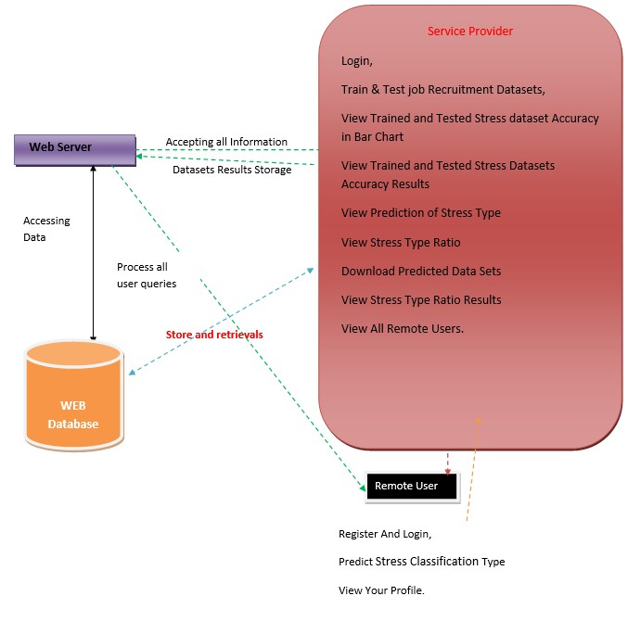
Project Architecture

Slide 13
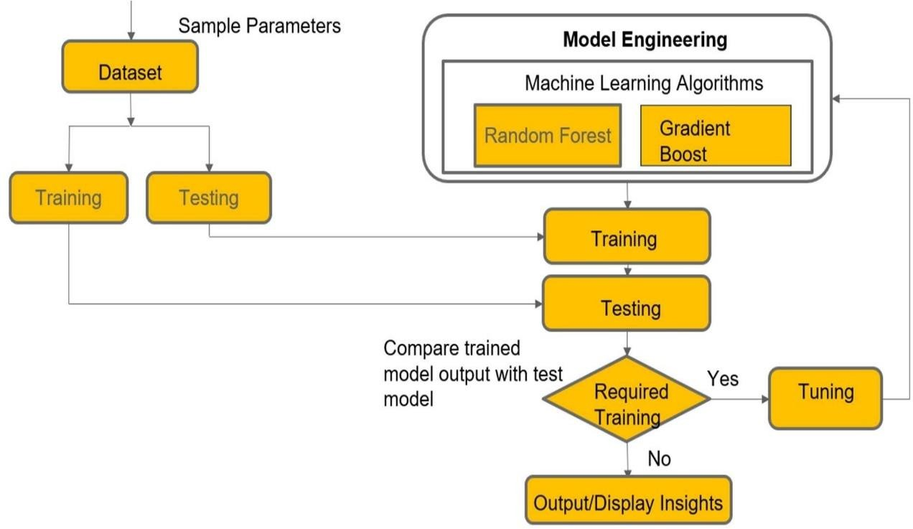
DATA FLOW DIAGRAM

Slide 14
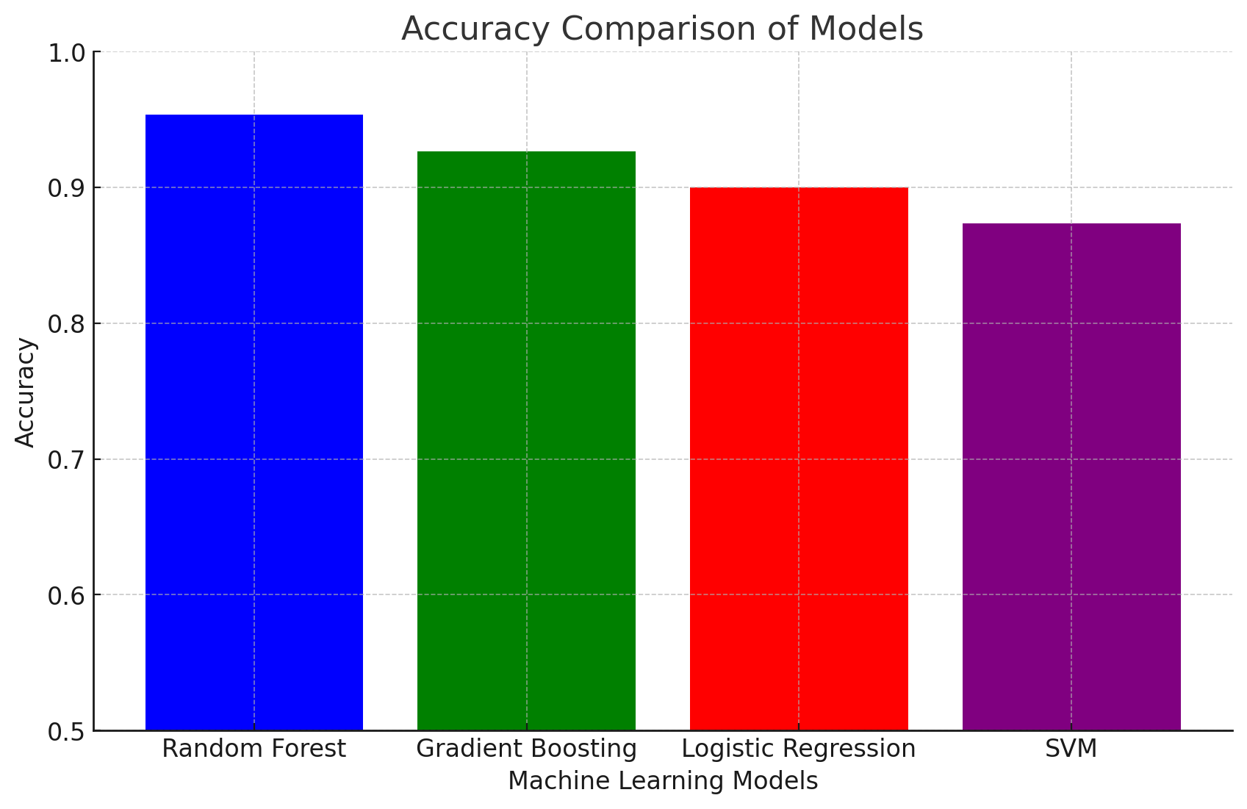
Result and Metrics

Slide 15
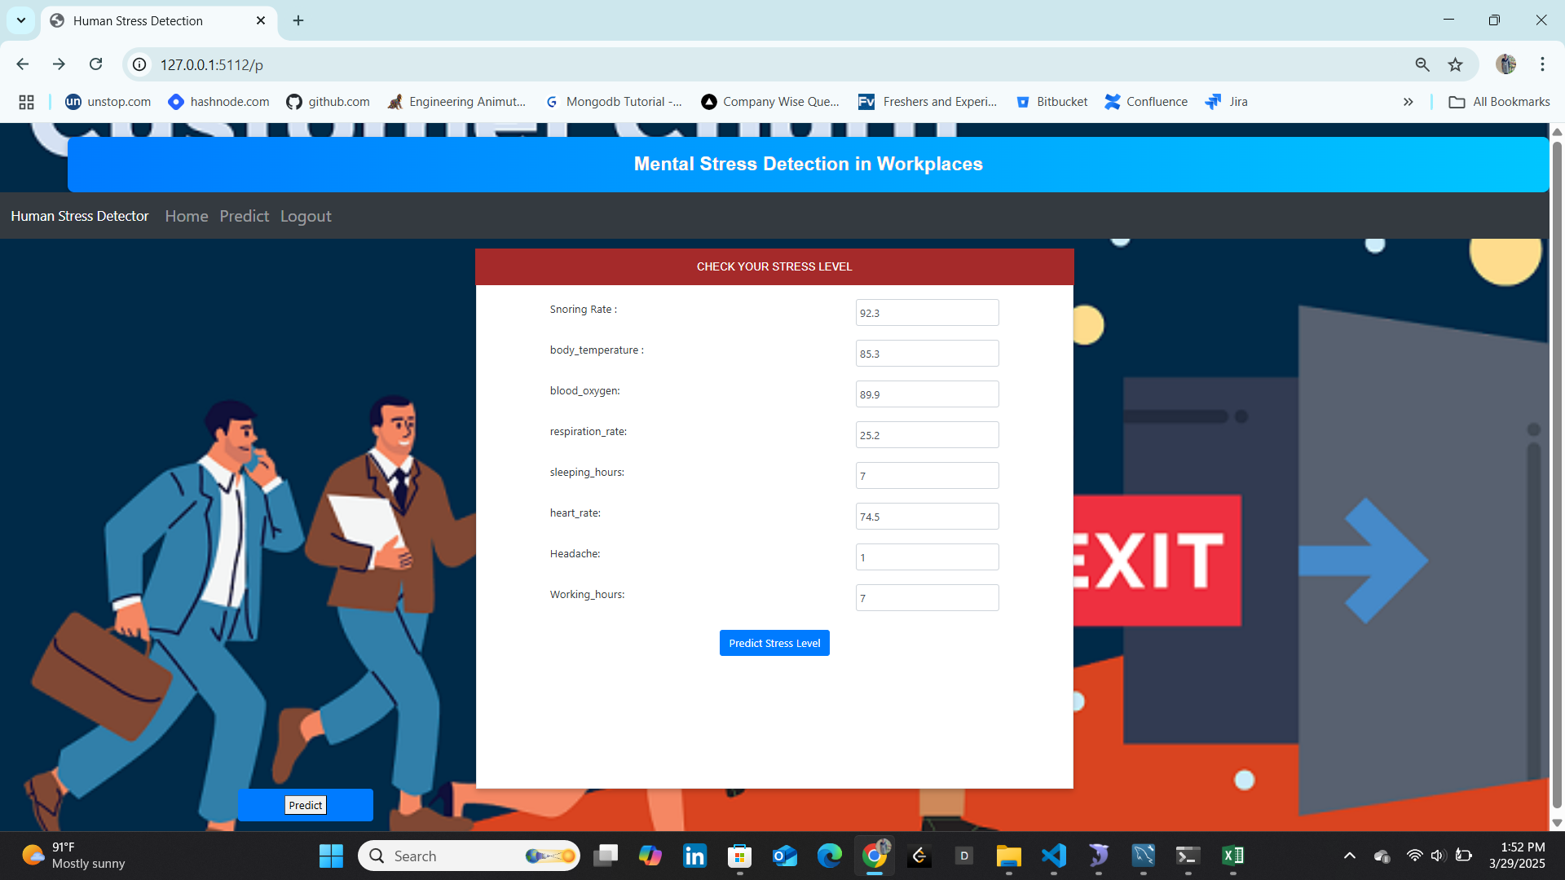

Slide 16


Slide 17
Conclusion and Future works
Stress is a significant issue faced by IT professionals, with a high percentage of individuals experiencing stress symptoms. Machine learning models have been developed to detect stress levels in IT employees using various methods such as surveys, physiological recordings, and digital footprints. The stress detection model has been trained and tested using heterogeneous machine learning algorithms, and it has been deployed using the Flask framework.The model represents stress levels on a scale ranging from 0 (rest) to 4 (extreme stress), and it can identify different types of stress, including acute, episodic, chronic, and toxic stress.
Future Enhancements:
Integration with Smart Wearables: Automating data collection from smartwatches, fitness bands, or IoT-based devices.
Enhanced AI Models: Implementing CNNs, LSTMs, or hybrid models for even more accurate predictions.
Real-time Monitoring & Alerts: Providing instant stress alerts and recommendations based on continuous monitoring.
Personalized Stress Management Plans: Offering tailored relaxation techniques, meditation guides, and lifestyle recommendations based on stress levels.

Slide 18
Bibliography
G. Giannakakis, D. Manousos, F. Chiarugi, “Stress and anxiety detection using facial cues from videos,” Biomedical Signal processing and Control”, vol. 31, pp. 89- 101, January 2017.
Nisha Raichur, Nidhi Lonakadi, Priyanka Mural, “Detection of Stress Using Image Processing and Machine Learning Techniques”, vol.9, no. 3S, July 2017.
U. S. Reddy, A. V. Thota and A. Dharun, "Machine Learning Techniques for Stress Prediction in Working Employees," 2018 IEEE International Conference on Computational Intelligence and Computing Research (ICCIC), Madurai, India, 2018, pp. 1-4.
T. Jick and R. Payne, “Stress at work,” Journal of Management Education, vol. 5, no. 3,
pp. 50-56, 1980.
Bhattacharyya, R., & Basu, S. (2018). Retrieved from ‘The Economic Times’.
OSMI Mental Health in Tech Survey Dataset, 2017.
Communications,N..World health report. 2001.URL:http://www.who.int/whr/2001/media
_centre/press_release/ en/. [
Bakker, J., Holenderski, L., Kocielnik, R., Pechenizkiy, M., Sidorova, N.. Stess@ work: From measuring stress to its understanding, prediction and handling with personalized coaching. In: Proceedings of the 2nd ACM SIGHIT International health informatics symposium. ACM; 2012, p. 673–678.

Slide 19
THANK YOU

