Slide 1

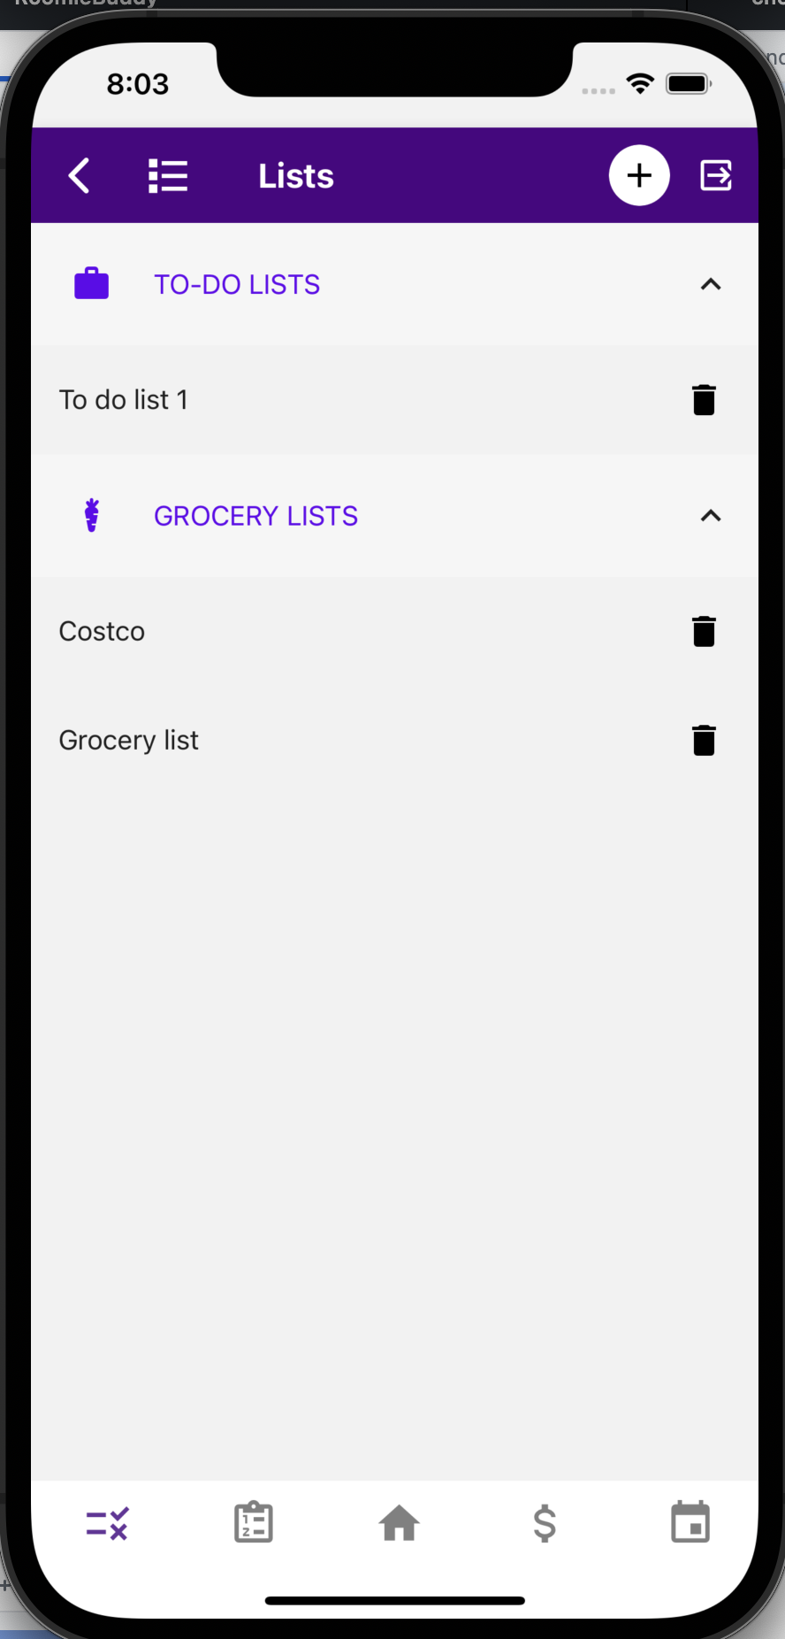
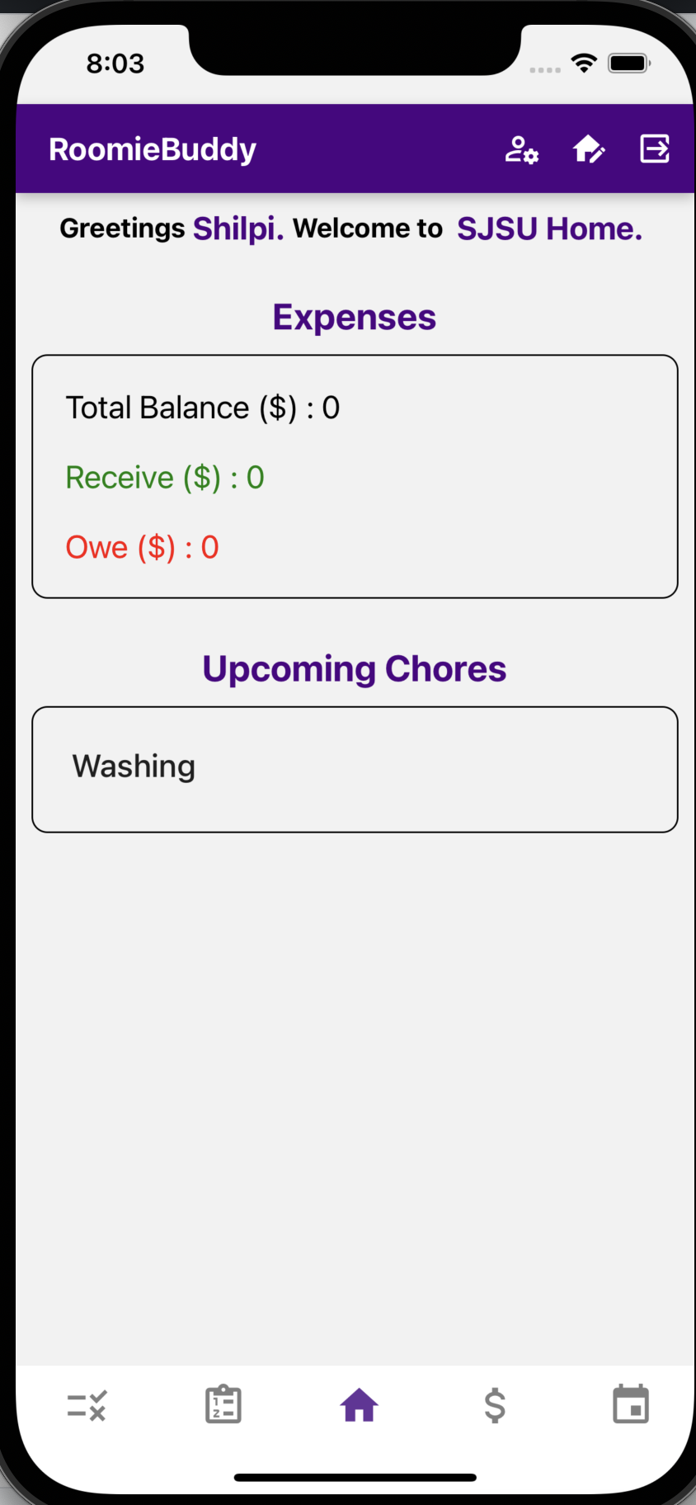
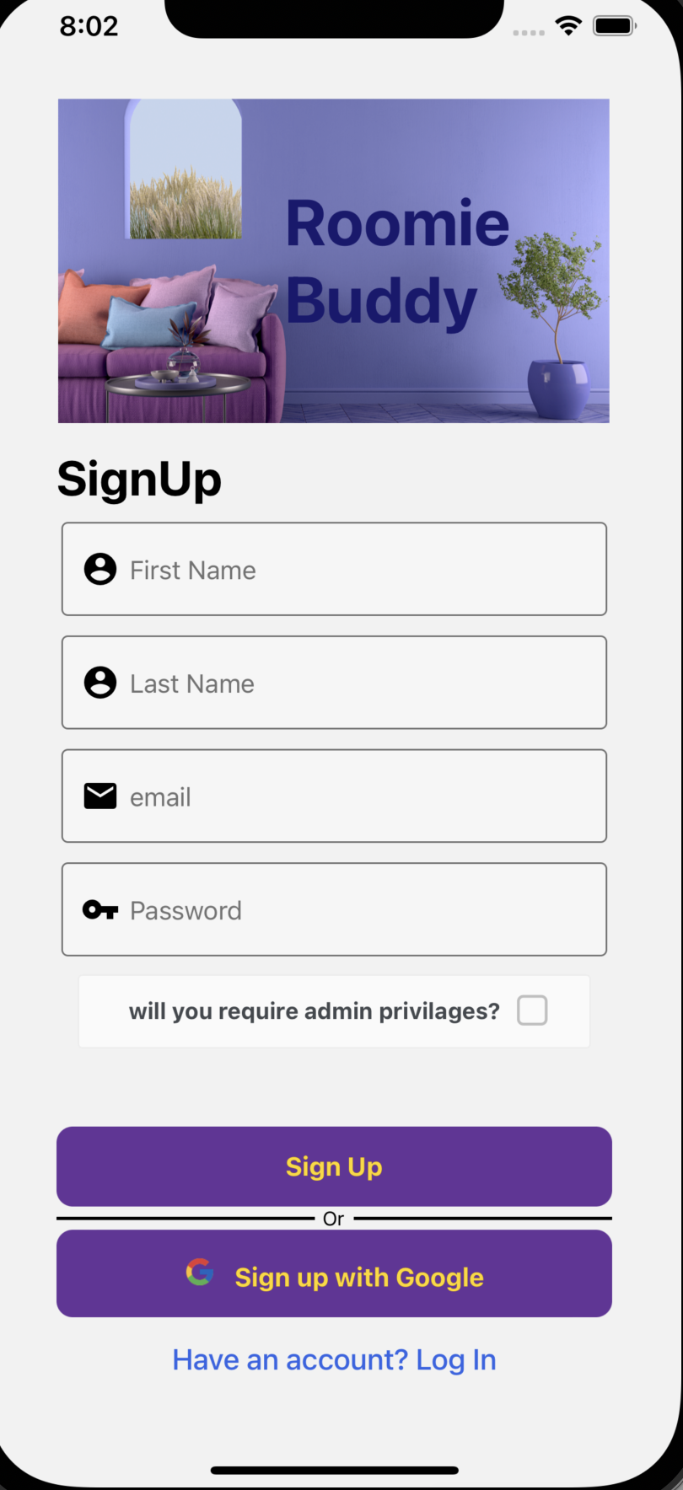
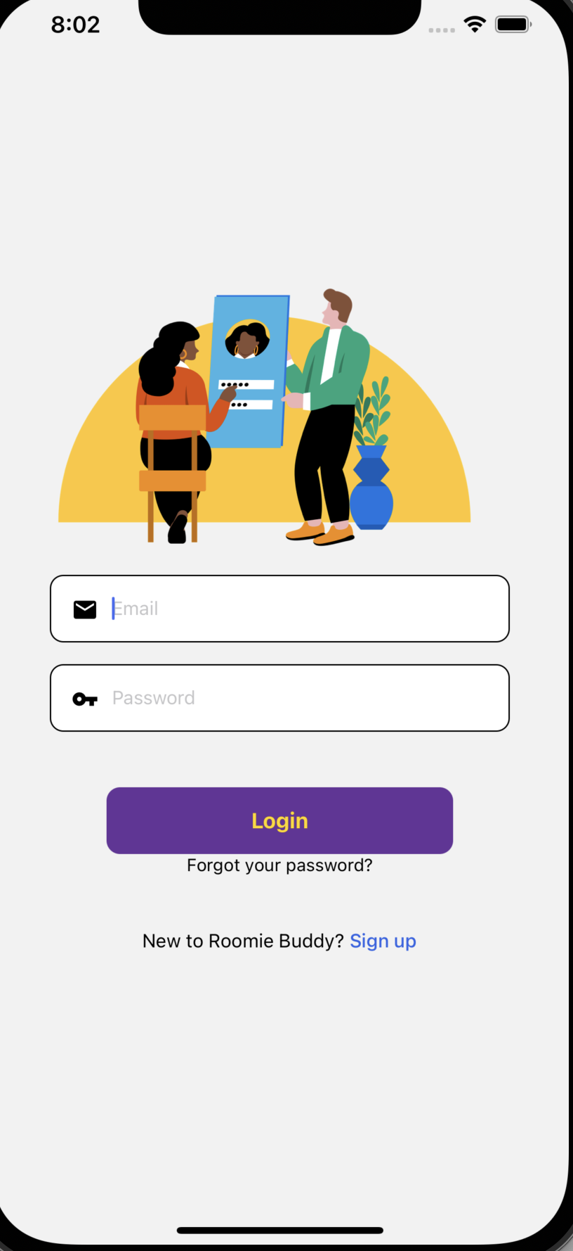

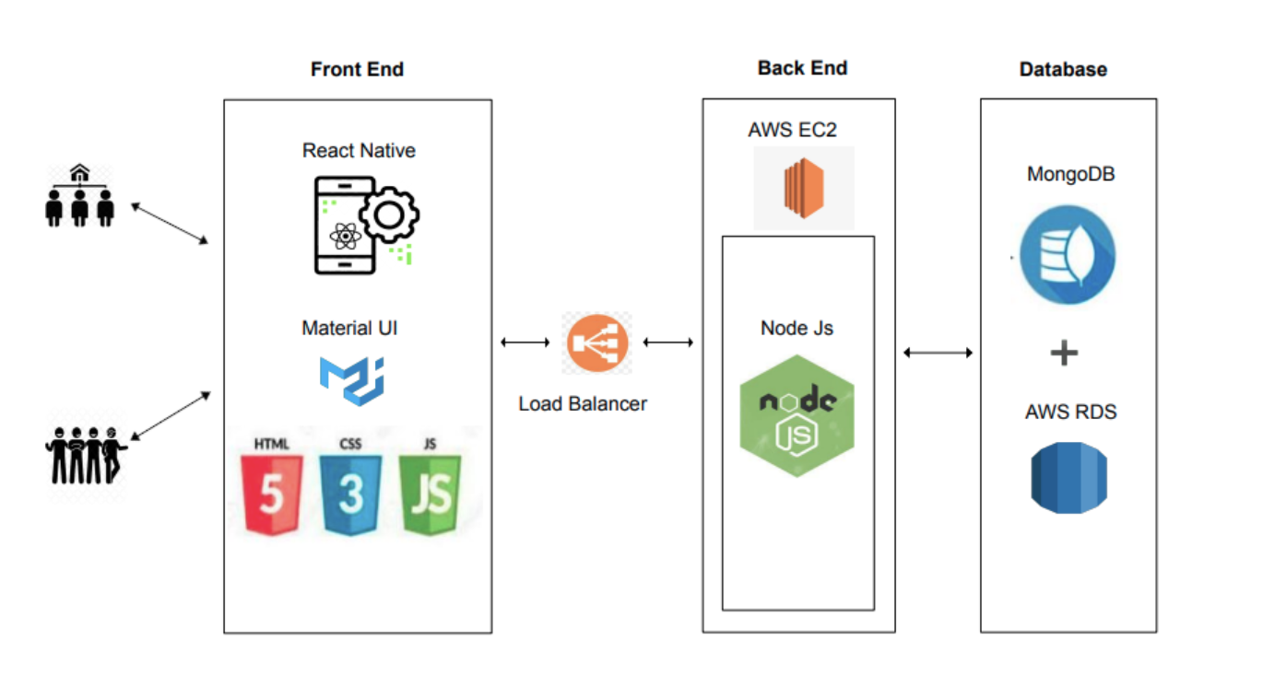
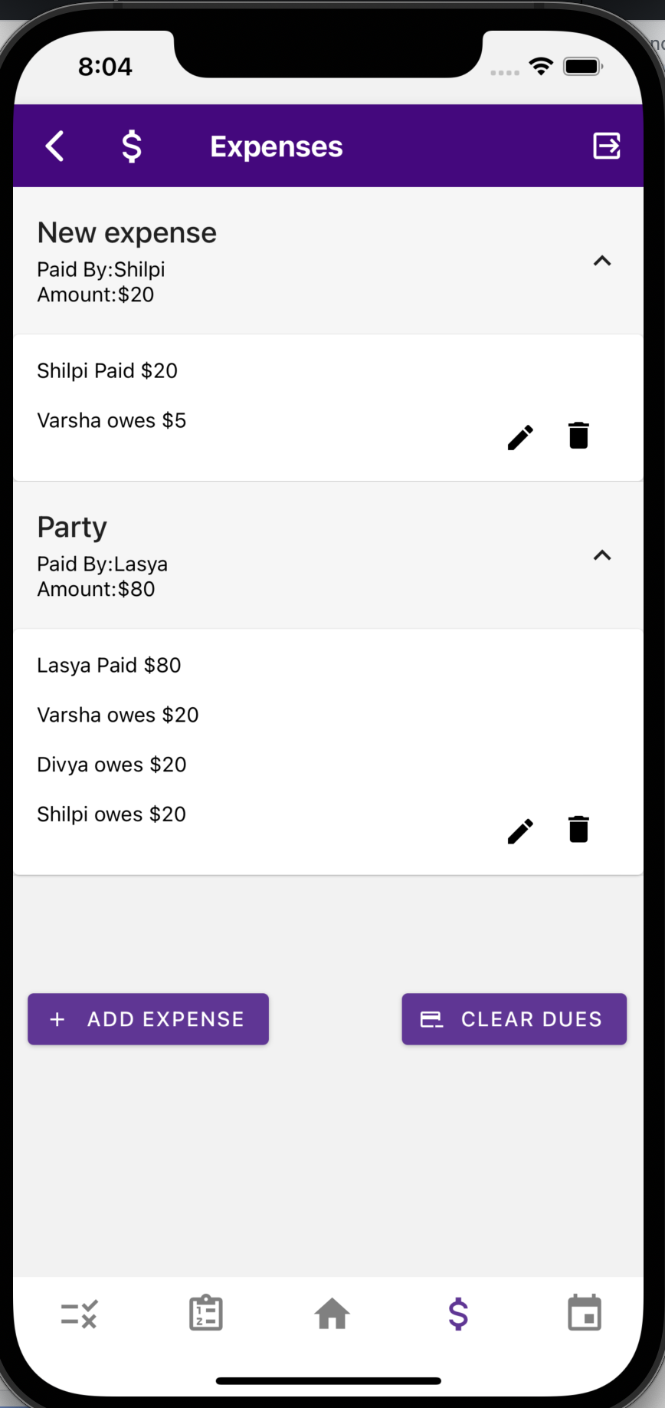
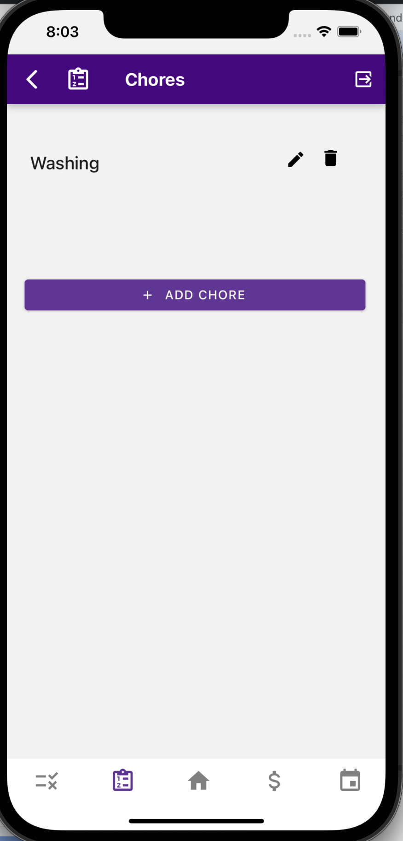
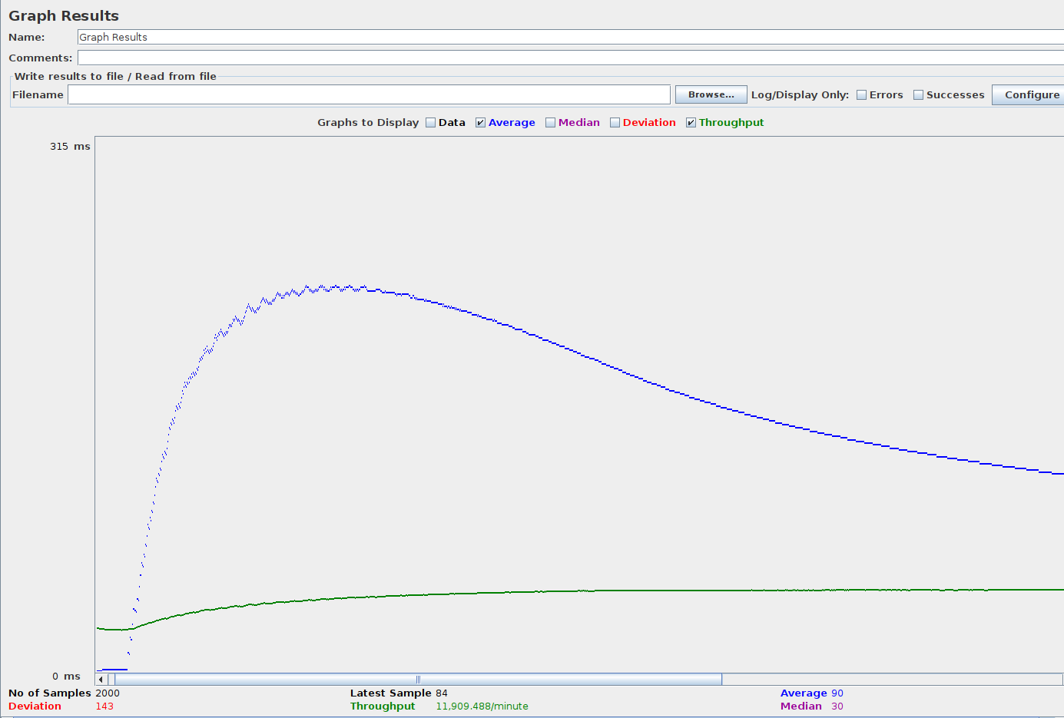
Computer Engineering Department
RoomieBuddy: A mobile application that will facilitate shared living
Project Advisor: Professor Gopinath Vinodh
Mohan, Divya (MS Software Engineering) Nalini, Lasya Beemendra
(MS Software Engineering)
Soni, Shilpi (MS Software Engineering)
Suresh, Varsha (MS Software Engineering)
Introduction
Application Features
Summary/Conclusions
In today’s fast paced life, a lot of our tasks like shopping for groceries and conversations with loved ones are performed while on the go, using mobile applications. Similarly, an application for the management of cohousing necessities can abstract away the details of sharing chores and expenses and lead to fewer awkward social situations between roommates. Oral and tacit agreements between roommates regarding household responsibilities are oftentimes forgotten and hard to keep track of. Using an application to record such information can therefore encourage reliability and enforce transparency between all members of the household.
Login Signup:
Users can create their accounts and have different levels of access based on the admin privileges. Existing users can log into the mobile application.
This mobile application is useful when dividing domestic chores fairly among family members.
When living in a shared household, features like an expense tracker, chore management, lists, and calendar event tracking come in handy, and our app provides them all.
For the students to manage their household demands, an easy-to-use and free mobile application is required. Our application offers a free integrated platform for managing all household tasks.
This application is robust and can be used to organize and track housework by all types of students and working professionals.
Room Management:
Users can create or join an existing room to communicate and coordinate with other roommates. A new room will be created if the user enters a valid room name and description. Roommates can modify the room details.
User management:
User can choose the admin privilege while signing up. User with admin privileges can invite another user to join the room by using an existing invite code. User can join the room by clicking on invitation link sent to the user. User can leave the room if the expenses are settled, and chores are completed.
Key References
[1] Natalier, K. (2003). `I'm not his Wife'. In Journal of Sociology (Vol. 39, Issue 3, pp. 253–269). SAGE Publications. https://doi.org/10.1177/00048690030393003
[2] Curşeu P. L., Boroş S., & Oerlemans L. A. G. (2012). Task and relationship conflict in short-term and long-term groups. In R. Posthuma (Ed.), International Journal of Conflict Management (Vol. 23, Issue 1, pp. 97–107). Emerald. https://doi.org/10.1108/10444061211199331
[3] Nicolò A., & Velez R. A. (2017). Divide and compromise. In Mathematical Social Sciences (Vol. 90, pp. 100–110). Elsevier BV. https://doi.org/10.1016/j.mathsocsci.2017.04.004
[4] Farhadi, A., & Hajiaghayi, M. (2017). On the Complexity of Chore Division (Version 2). arXiv. https://doi.org/10.48550/ARXIV.1710.00271
[5] Aziz, H., Caragiannis, I., Igarashi, A., & Walsh, T. (2021). Fair allocation of indivisible goods and chores. In Autonomous Agents and Multi-Agent Systems (Vol. 36, Issue 1). Springer Science and Business Media LLC. https://doi.org/10.1007/s10458-021-09532-8
The RoomieBuddy app is a single, multi-use mobile application that can help roommates manage expenses, chore schedules and room related to-do lists thereby reducing the amount of time spent in navigating different applications to track details. Further, communication pertaining to the need for certain chores or grocery list items can be done effectively by adding notes and comments. All details of the same household can effectively be tracked in a single place.
Expense Management:
Users can create expenses with fellow roommates. Expenses can also be split equally or by amount. Users can view, edit, delete and settle expenses among roommates. User will receive push notification when an expense is modified or deleted.
Chore Management:
To keep track of daily chores the user can create, view, edit and delete chores. Roommates can assign chores to each other and mark as complete when done. User will be reminded of due chores and will be notified when a chore is added or deleted.
Testing
We conducted API testing, functionality testing, and integration testing to validate the functionality of our mobile application. We will be utilizing the Mocha and Chai frameworks to test our Node.js APIs.
We performed integration testing to ensure if all the functionalities are working properly when combined.
We have tested our system’s performance under heavy load. For our application, we have performed load testing using JMeter to determine how many users our application can handle. The below figure show JMeter results for 500 and 1000 users respectively:
Architecture and Technologies
Architecture Diagram
To do and grocery lists:
Roommates can create Grocery and to do list to track their everyday tasks. User can create different lists and comment on list items. They can also delete, modify the list and mark a list Item as completed. User also receives push notification when a list is modified to alert all roommates.
Acknowledgements
Technologies Used
Client Tier: React Native, React Paper
Middle Tier: NodeJS, Passport JWT, Hapi Joi
Data Tier: SQL- AWS RDS, NoSQL- MongoDB
Cloud Technologies: AWS EC2 Instance, Amazon S3 Bucket, Elastic Load Balancer
We would like to express our heartfelt gratitude to our Project Advisor, Professor Gopinath Vinodh, who mentored us throughout our project by providing valuable feedback and guidance. We would also like to thank Professor Dan Harkey for his insightful comments and guidance.

