Slide 1

CHIREC HACKATHON
BLOOM
A project by Riyansika and Lasya
An AI powered personal growth system
https://bloom-app.ai.studio/
START

Slide 2
PROBLEM:
Low Productivity:
Lack of Self-Awareness
Burnout:
The Gap: Productivity and mental well-being are interconnected, yet most tools address them separately.

Slide 3
SOLUTION:
Personalized AI-driven analysis that adapts identifying your failures and underlying problem.
Smart Goal management
Hyper-personalization
Wellbeing integrated with productivity
Mental Clarity

Slide 4
PREVEIW

Slide 5
THE CODE
TECHNOLOGIES POWERING BLOOM
  React: Builds Bloom's interface using reusable components.
  TypeScript: Ensures code reliability by detecting type-related errors during development.
  Tailwind CSS: Creates a visually appealing, responsive, and consistent design.
  Firebase Authentication: Securely manages user registration, login, and identity.
  Cloud Firestore: Stores and retrieves user data, goals, and progress.
  Express.js: Connects the frontend with backend services and handles API requests.
  Google Gemini AI: Powers intelligent conversations, pattern recognition, and personalised assistance.
  Web Crypto API: Enables encryption and decryption to protect private journal entries.
  Vite: Speeds up development and optimises the frontend for deployment.

Slide 6
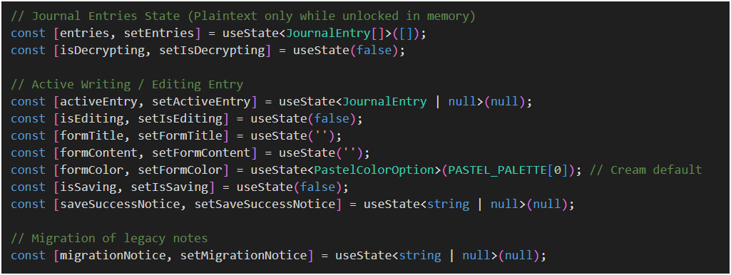
DEMO CODE

Slide 7
FUTURE EXPANSIONS
AI-Powered Predictive Insights
Advanced adaptive Personalisation
Wearable Integration
Multilingual Support
Cross-Platform Expansion

Slide 8
CHIREC HACKATHON
BLOOM
A project by Riyansika and Lasya
An AI powered personal growth system
https://bloom-app.ai.studio/
START

Slide 9
THANK YOU
CHIREC HACKATHON

