Slide 1
STOCK MARKET INVESTMENT PLATFORM
Presented by Lasya Shreya Malleswari
Mentored by Yakub sir

Slide 2
Introduction
"Stock Market Investment Platform" is a comprehensive platform designed to provide investors with a seamless experience, integrating essential tools for portfolio management and real-time market analysis. Developed with "React" for the front end, "Java SpringBoot" for the back end, and "MySQL" for database management, it ensures secure, efficient, and user-friendly interactions throughout the platform. Key features include "User Authentication and Registration" for secure access, a personalized "Dashboard" displaying portfolio performance, a "Portfolio Management Interface" for tracking and updating investments, "Stock Market Data and Visualization" with interactive charts, and "Learning Resources" to enhance financial literacy. StockScholar empowers users to make informed investment decisions with confidence.

Slide 3
Project Statement & Abstract
The project aims to develop a user-friendly web application that provides comprehensive tools to help users manage their investment portfolios. It helps users real time market data, portfolio tracking, market analysis, and educational resources, streamlining the investment process for both novice and experienced investors.

Slide 4
The Existing System
The existing system for managing stock market investments often involves a mix of multiple applications, including separate platforms for portfolio tracking, real-time data analysis, educational resources, and brokerage platforms. These require investors to navigate several tools to gather information, analyze market trends, and execute trades, which can be time-consuming and challenging, especially for beginners.

Slide 5
Proposed System
The proposed Stock Market Investment Platform aims to consolidate these
functionalities into one integrated web-application. It will enable users to access
real-time market data, analyze trends, track portfolio performance, and learn
investment strategies through a unified interface. This will allow both novice and
experienced investors to make informed decisions efficiently and minimize the
effort needed to use multiple resources.

Slide 6
Disadvantages in existing systems
Multiple platforms needed for portfolio management, data, and learning resources
Limited personalization options for analysis and content
Real-time data may be delayed or inconsistent
Basic analysis tools lacking depth for experienced users
Scattered resources make navigation difficult for beginners

Slide 7
Advantages in proposed system
All-in-one platform for portfolio, data, analysis, and learning
Personalized educational resources and analysis based on user needs
Real-time, accurate market data for better decisions
Comprehensive analysis tools for in-depth insights
Beginner-friendly with easy access to guidance and information

Slide 8
System Requirements
Hardware Requirements
Software Requirements
Processor - Intel
RAM - 4 GB (min)
Hard Disk - 20 GB
Key Board - Standard Windows Keyboard
Mouse - Two or Three Button
Monitor - SVGA
Operating System - Windows
Coding - Java
Front End - HTML, JavaScript, CSS, and XML
Back End - MySQL, MongoDB (Database)

Slide 9
Modules to implement
1. User Authentication and Registration
2. Dashboard
3. Portfolio Management Interface
4. Stock Market Data and Visualization
5. Learning Resources

Slide 10
Module 1: Login / registration
User-Friendly Interface:
Designed a responsive and intuitive UI to guide users through the registration and login processes.
Incorporated real-time feedback for user interactions, including validation errors and successful logins.
Spring Boot and MySQL Integration:
Developed RESTful APIs in Spring Boot to handle user registration, login, and session management.
Used MySQL for secure storage and retrieval of user data, ensuring data integrity and efficient queries.

Slide 11
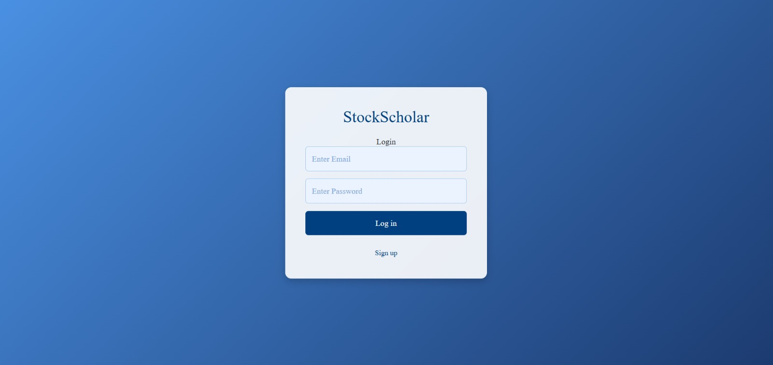
Module 1:Output Login

Slide 12
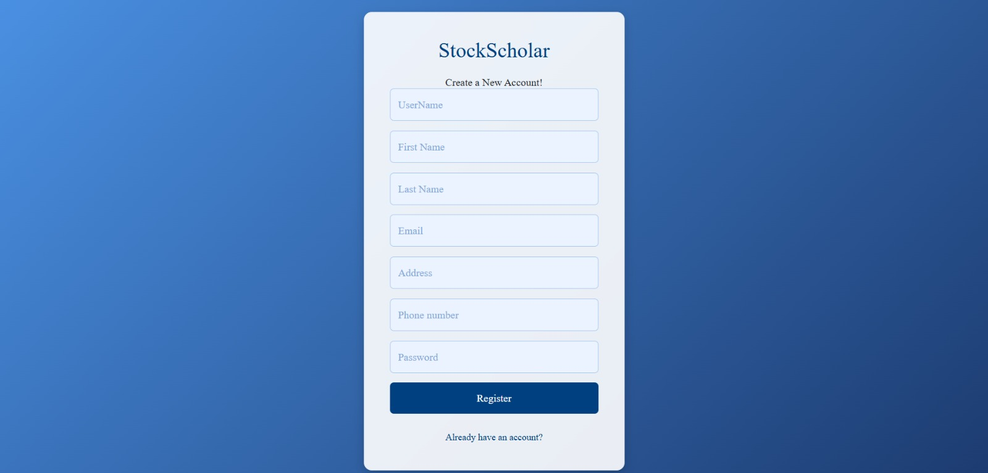
Registration

Slide 13
Module 2: dashboard
Dashboard provides an overview of portfolio performance and key insights.
User’s watchlist ,Investment performance ,Interactive graphs showing market trends
Technologies Used:
React.js:
Built responsive UI using reusable components
Managed state to display watchlist and real-time stock data
Integrated APIs for fetching real-time financial data
Chart.js:
Used for interactive charts displaying stock trends and portfolio performance
CSS: Styled interface for a modern and user-friendly design
Functional Highlights:
Real-time updates and personalized content
Intuitive navigation for tracking investments
API integration for up-to-date financial data

Slide 14
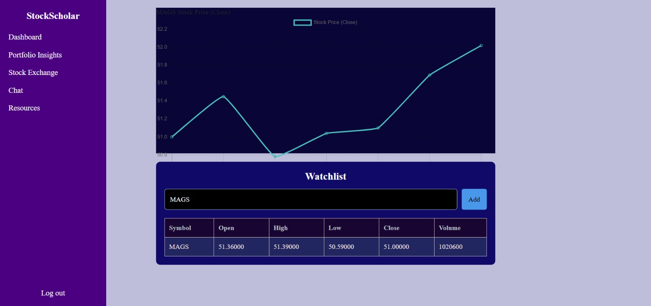
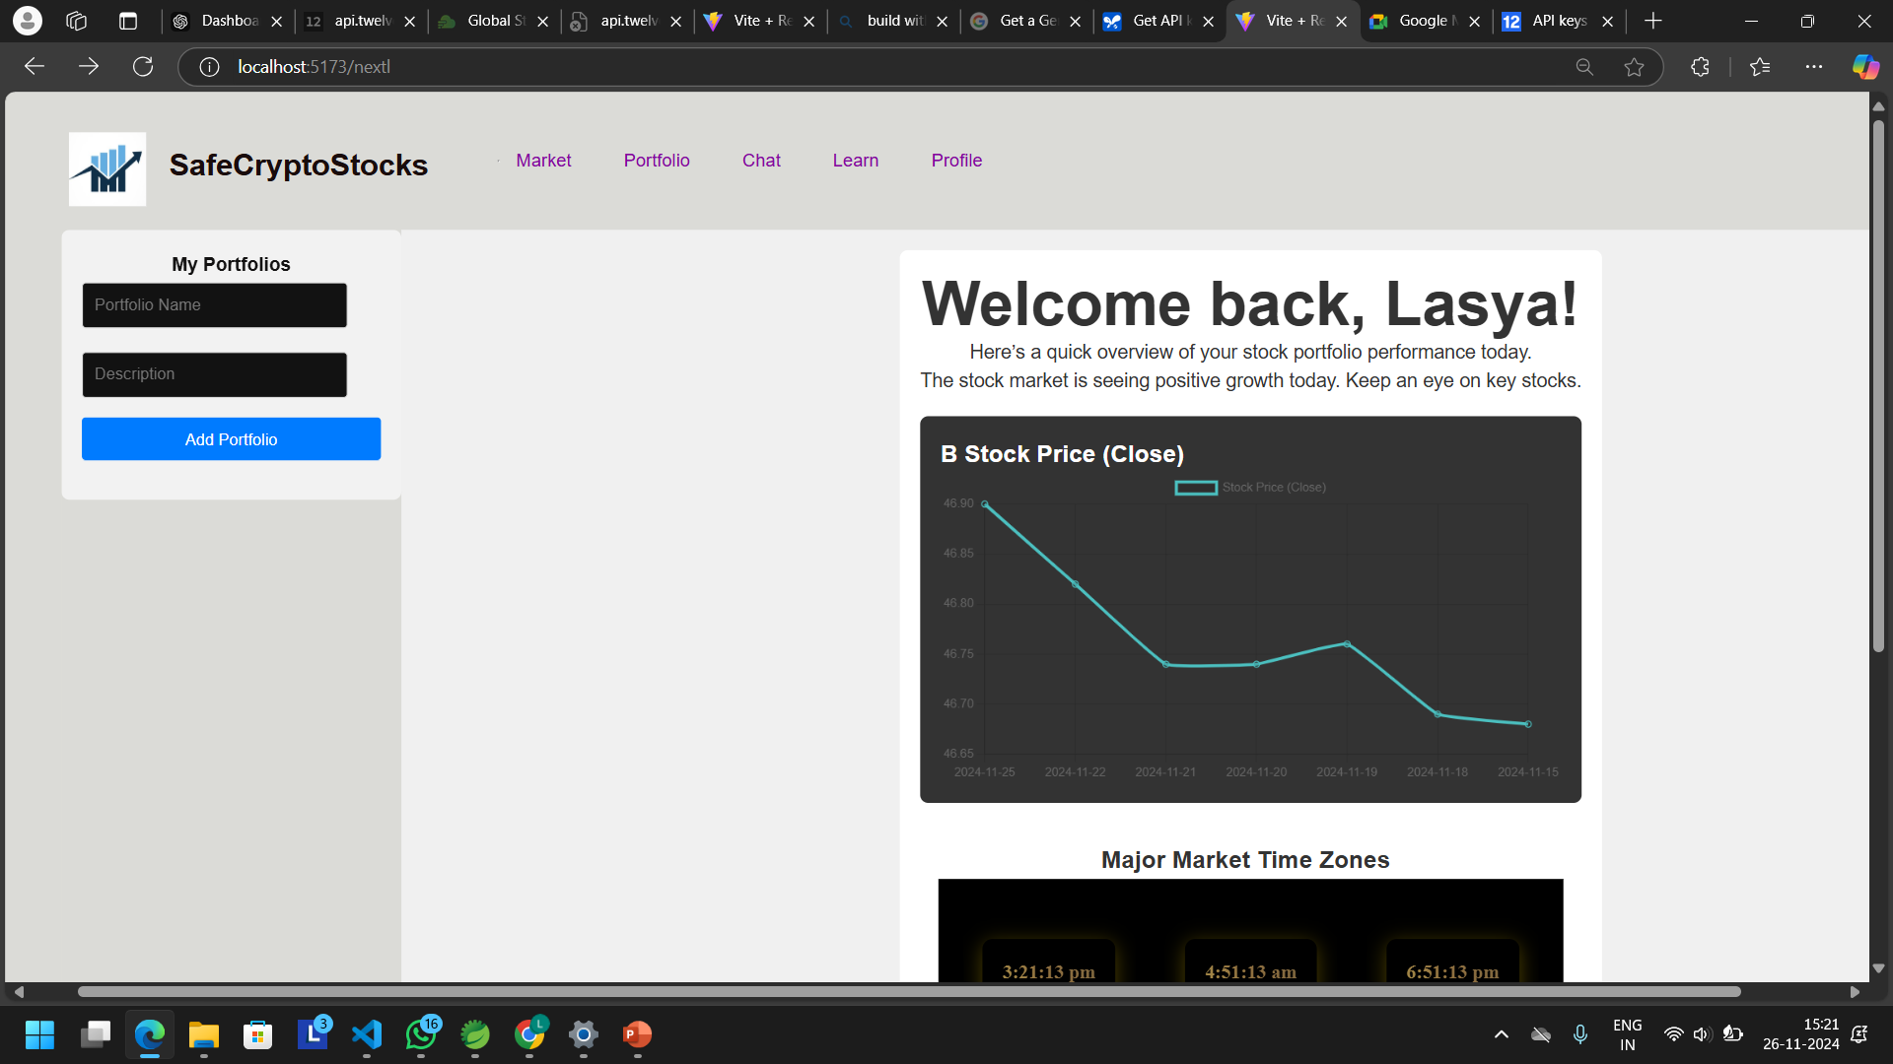
Module 2:Output DAshBoard

Slide 15
Module 3: Portfolio
The Portfolio Management section enables users to effectively track, organize, and optimize their investments. With features for adding, editing, or deleting portfolio details, it provides a seamless and intuitive interface to maintain control and stay updated on performance metrics.
Key Features:
Track stock prices and total investment value.
Real-time updates of portfolio data.
Intuitive and responsive user interface for seamless control.
Technologies Used:
Frontend:
React.js for creating a dynamic, user-friendly interface.
State management for real-time portfolio updates and interactions.
Backend:
RESTful APIs for efficient communication .

Slide 16
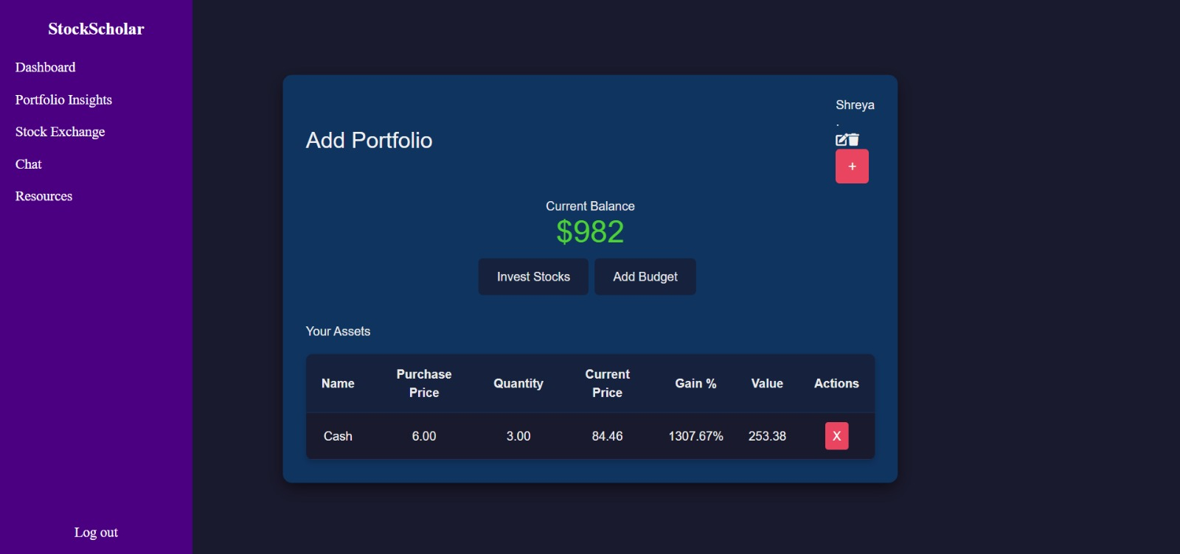
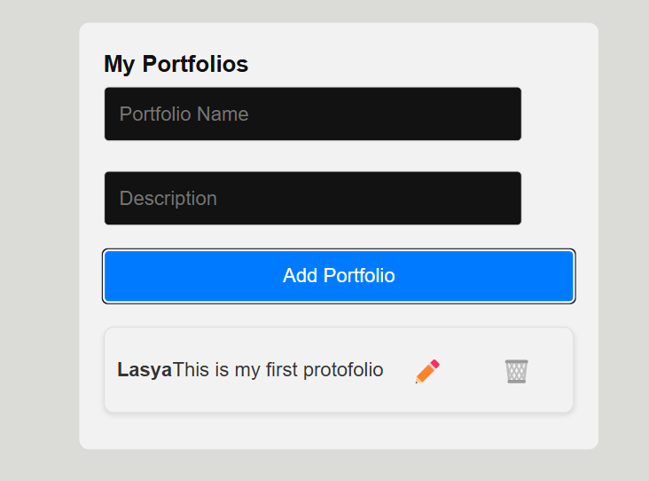
Module 3-output: portfolio

Slide 17
Module 4: Market
The Top 10 Trending Stocks section provides users with a dynamic, real-time overview of the most active stocks in the market. Powered by the Finnhub API, this feature fetches trending stock data and displays the top 10 stocks based on real-time performance, making it easier for users to stay updated on the latest market trends.
Key Features:
Real-Time Data: Displays the top 10 trending stocks based on the latest market data, including stock symbols and current market prices.
Dynamic Content: Automatically updates to reflect the most active stocks in the market, ensuring users have access to fresh information.
User-Friendly Interface: The stock list is presented in an easy-to-read format, allowing users to quickly assess the top stocks in the market.
API Integration: Utilizes the Finnhub API to fetch stock quotes and trending stock data, providing reliable and up-to-date information.

Slide 18
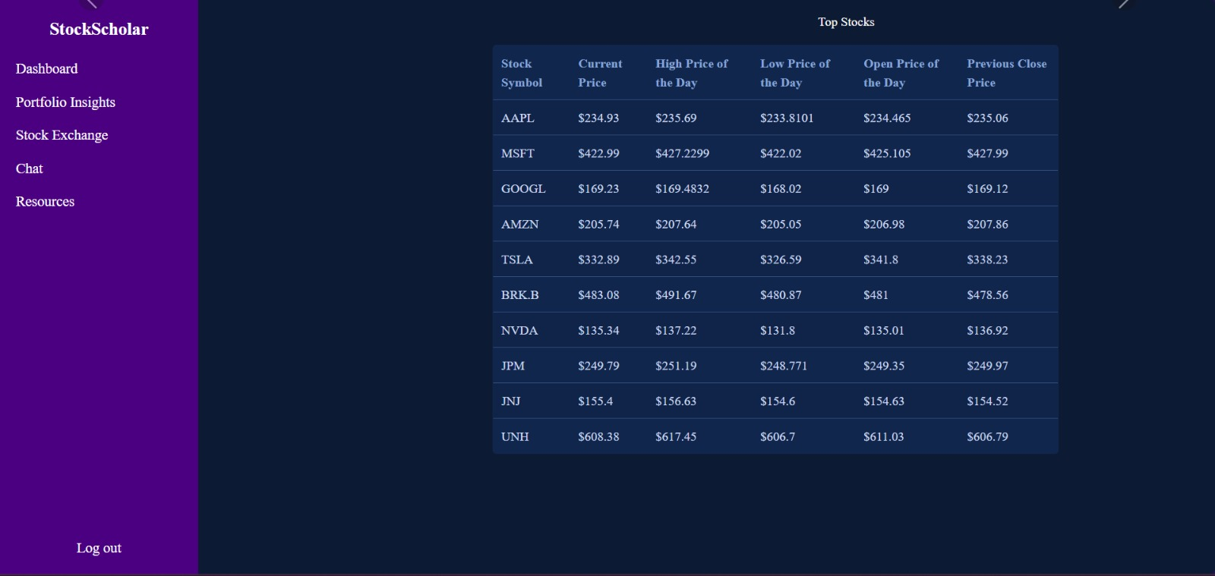
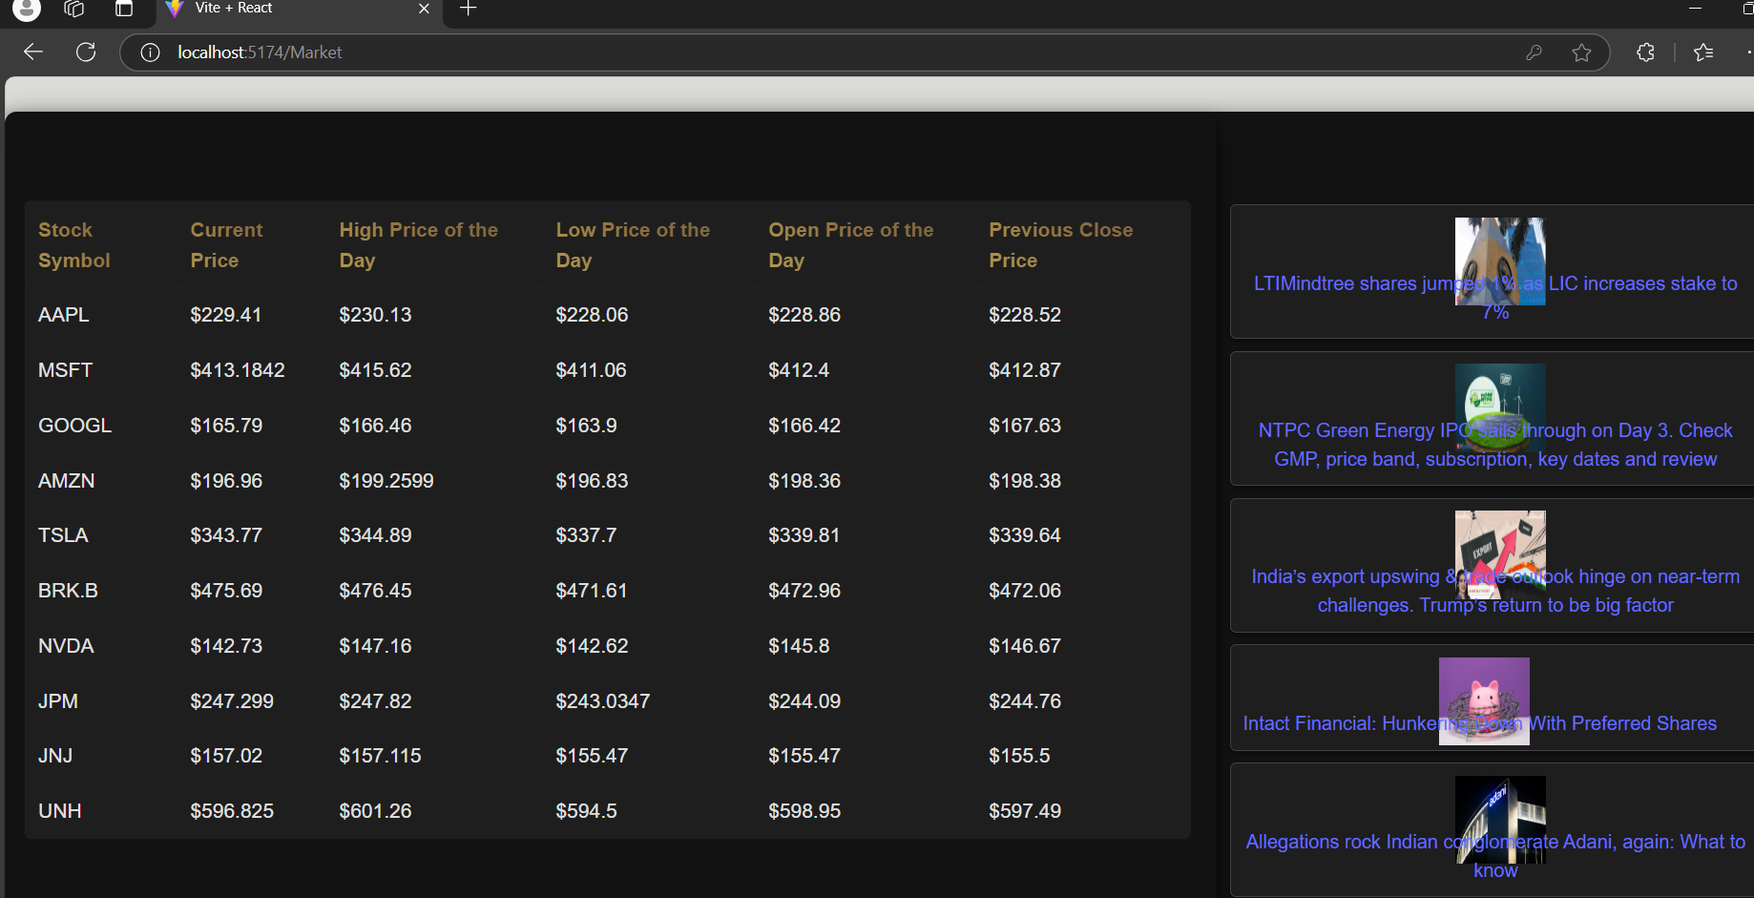
Module 4-Output: Market

Slide 19
Module 5: Learn
The Learn page offers users a curated collection of financial articles and videos powered by the Investopedia API. This section serves as an educational hub, providing real-time access to expert financial advice, investment strategies, and market insights. The content is organized into easy-to-navigate categories, enabling users to enhance their financial literacy and make informed decisions.
Interactive features include:
Search functionality to find specific topics of interest.
A sleek, user-friendly design optimized for readability and engagement.
Regularly updated resources to ensure access to the latest financial trends and concepts.

Slide 20
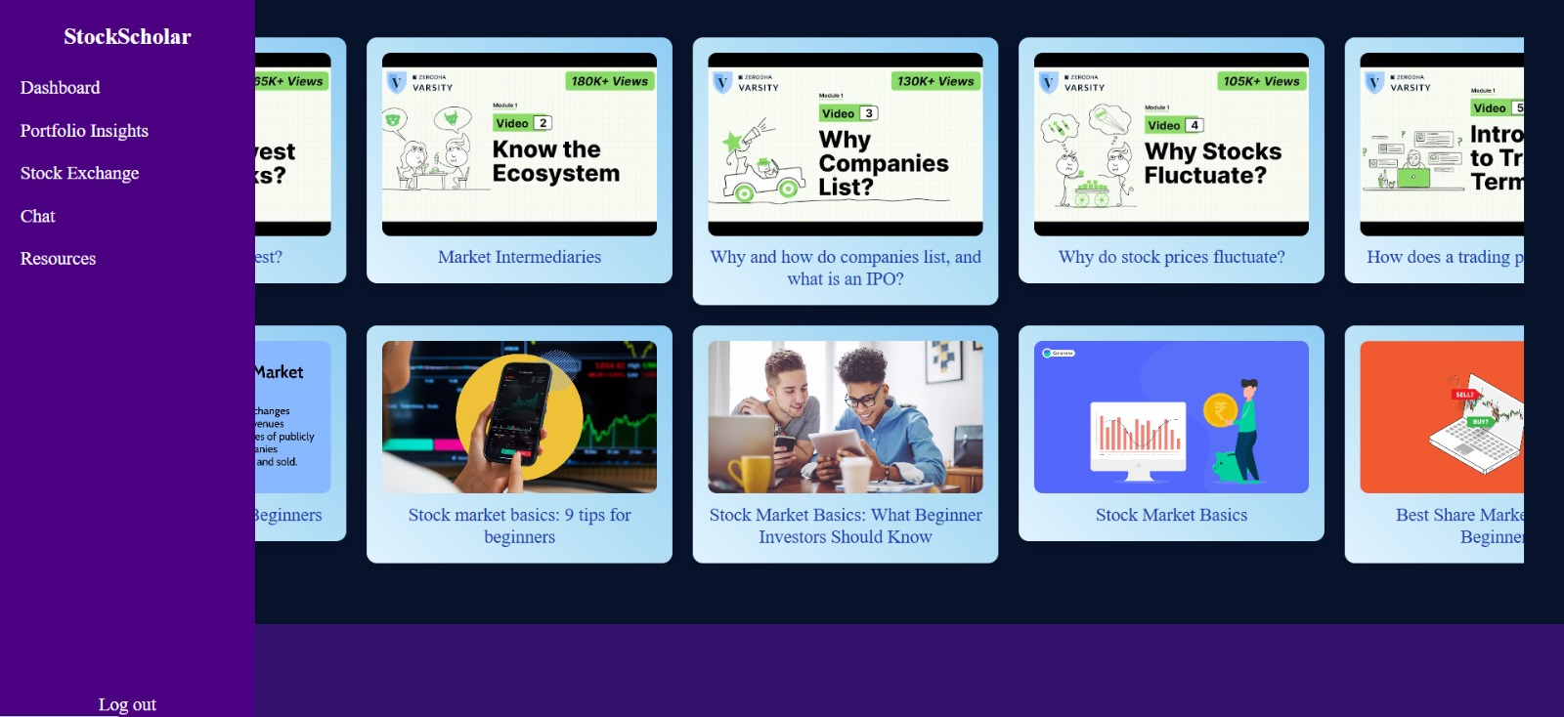
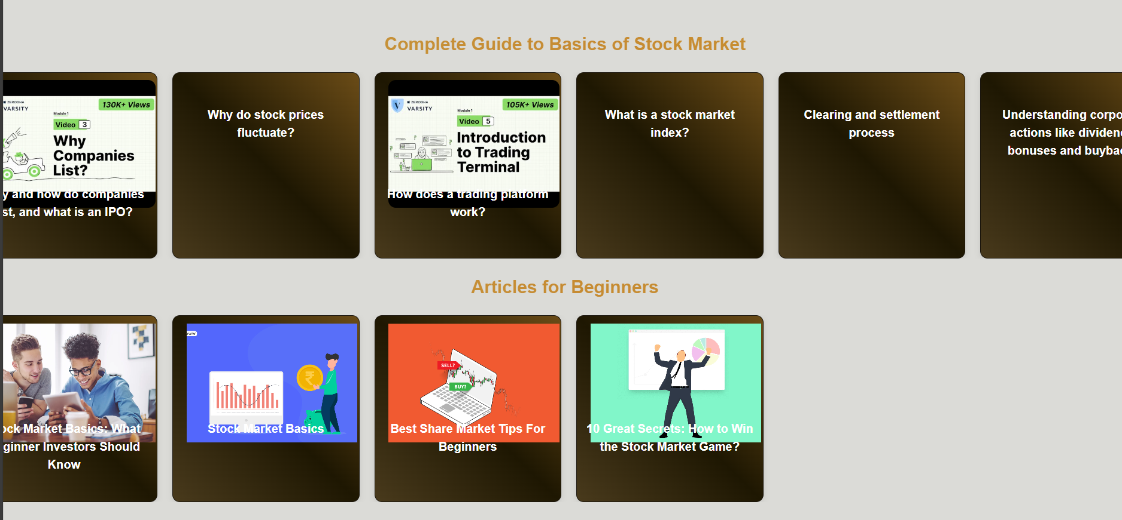
Module 4-output: Learning Resources

Slide 21
ChatBOT
enhance the functionality of SafeCryptoStocks, I integrated the Gemini API, which provides real-time stock market data. This API allows the application to fetch the latest information on selected stocks, including price, volume, and other key metrics. By using the Gemini API, the platform enables users to monitor their portfolios with up-to-date market insights, ensuring they have accurate data for making informed investment decisions. This addition enriches the user experience by offering real-time stock tracking and data-driven decision-making tools.

Slide 22
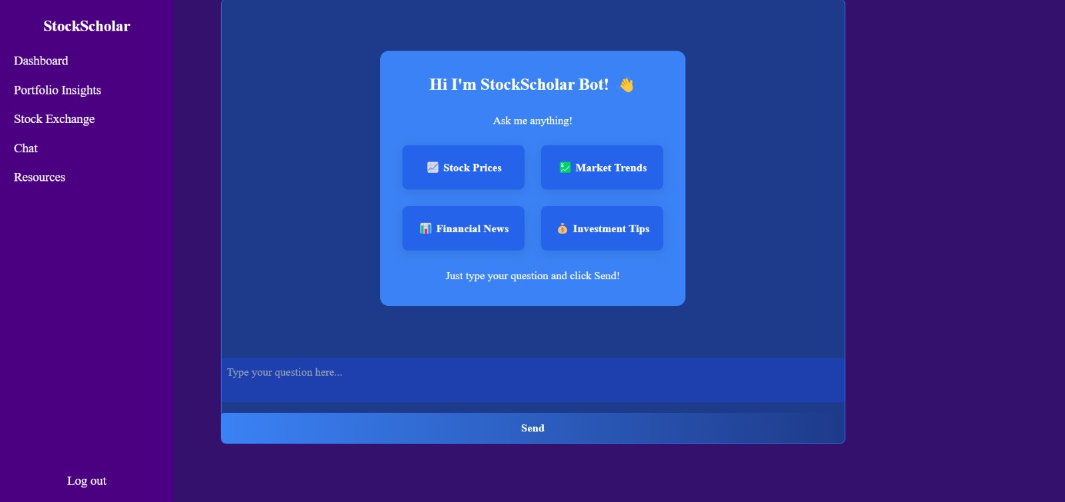
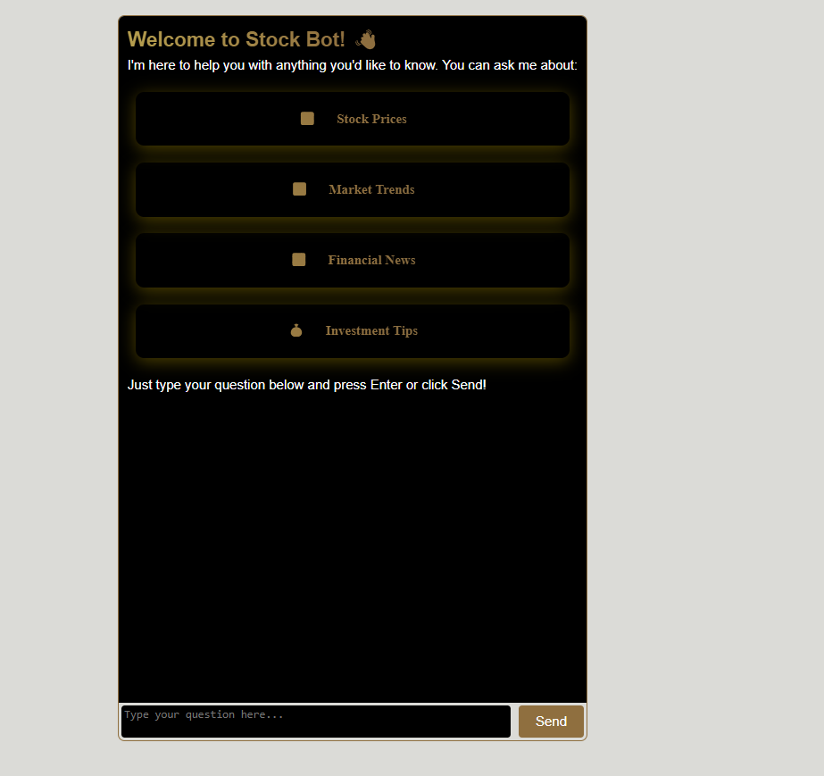
ChatBOT

Slide 23
THANK YOU

