Slide 1
SMART INDIA HACKATHON 2026
PROBLEM STATEMENT ID
SIH26200
THEME
MedTech / BioTech / HealthTech
CATEGORY
Software Platform
TEAM NAME
VectorGuard
PRIMARY STATE
Telangana State (Scalable Pan-India)
LIVE DEPLOYMENT
https://lasyakerelli-maker.github.io/vectorguard1/
VectorGuard
AI & Biotech Vector-Borne Disease & Mosquito Control System
PREDICT • PREVENT • PROTECT
“Predict mosquito threats, protect yourself and your loved ones.”
AUTONOMOUS PUBLIC HEALTH INFRASTRUCTURE
Bridging hyper-local atmospheric environmental intelligence (temperature, humidity, precipitation) with spatial hydrology GIS mapping and direct municipal complaint routing.

Slide 2
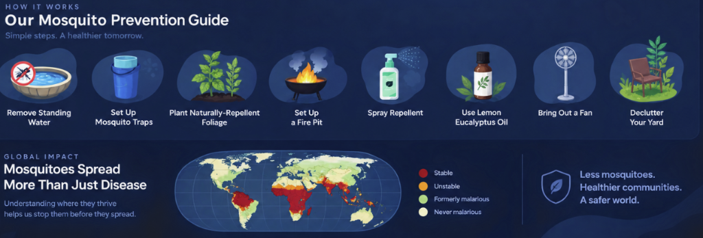
SMART INDIA HACKATHON 2026 | PS ID: SIH26200
Idea Overview: Autonomous Public Health
The Problem
Why current vector control fails
• Reactive Public Health:
Fogging and medical aid only dispatch after hospital beds fill up with severe Dengue/Malaria patients.
• Hidden Microclimates:
Urban heat islands and standing water create hyper-local breeding clusters right outside residents' doors.
• Climatic Compression:
Ambient temperatures (24°-32°C) cut larval incubation from 14 days down to 6 days.
• Bureaucratic Delay:
Citizens struggle to locate ward contacts and report standing water pools.
The VectorGuard Solution
Predictive, preventive, and localized
• Hyper-Local Risk AI:
Combines device GPS with live Open-Meteo satellite weather to calculate instant 0-100 breeding scores.
• Spatial Hydrology Mapping:
Pinpoints nearby lakes (Hussain Sagar, Durgam Cheruvu) within a 1.5 km vector flight radius.
• Targeted Biotech Guidance:
Prescribes Bacillus thuringiensis israelensis (Bti) microbial larvicide and Gambusia fish stocking.
• Direct Civic Escalation:
One-click reporting to Telangana Municipal Services (municipalservices.in ID: 259).
The Three Offerings
Core User Experience
1. Risk Prediction
Requests location upfront, tracks temperature/humidity, scores breeding vulnerability (High/Low).
2. Raise an Issue
Direct link and quick complaint submission to municipal authorities for standing water and open sewers.
3. Preventative Education
Mortality statistics, Sunday Dry Day protocol, Bti science, and interactive FAQs.

Slide 3
SMART INDIA HACKATHON 2026 | PS ID: SIH26200
Technical Architecture: Frontend, Backend & AI Engine
Frontend Architecture
What the User Sees & Interacts With
• What is Frontend?
The visual interface and interactive buttons, maps, and forms running inside the user's browser or smartphone.
• Technologies Used:
HTML5 Semantic Web, Modern JavaScript (ES Modules), Tailwind CSS framework.
• Why this choice?
Zero build-step lag, instant loading on 4G/5G mobile networks, completely responsive across all screen sizes.
• Bryan Johnson Design:
Monochromatic deep navy UI (#151d30) with medical-grade typography (Plus Jakarta Sans) to provide trust and clarity.
Backend & Data Pipelines
The Computational Engine Behind the Scenes
• What is Backend?
The data engine, mathematical calculations, API communication, and server logic that powers the website.
• Python Architecture:
Python 3.14 environment utilizing RESTful handlers, local HTTP server runtime, and automation modules.
• Open-Meteo Satellite API:
Fetches real-time ambient temperature (2m), relative humidity (%), precipitation (mm) down to 1 km resolution.
• Haversine Distance Engine:
Calculates great-circle distance between user GPS and Telangana water bodies to identify the nearest vector risk.
AI & Bio-Scoring Model
Multi-Factor Epidemiological Engine
• 1. Temperature Factor (35%)
Optimal 24°-32°C accelerates larval maturation to 6 days (+35 pts). Extreme cold/heat dampens flight.
• 2. Relative Humidity (35%)
Humidity > 60% increases mosquito lifespan to 45 days (+35 pts), enabling multiple biting cycles.
• 3. Surface Precipitation (15%)
Recent rain (>1mm) pools in ditches and containers, providing millions of oviposition nurseries (+15 pts).
• 4. Hydrological Proximity (15%)
Located within 1.5 km flight radius of lakes (Hussain Sagar, Durgam Cheruvu) (+15 pts).
• Output Classification:
Score ≥ 50 → HIGH RISK (Immediate Bti larvicide)
Score < 50 → LOW RISK (Routine source clearance)

Slide 4
SMART INDIA HACKATHON 2026 | PS ID: SIH26200
Feasibility & Viability: Scalable & Zero-Hardware
Technical & Operational Feasibility
Zero-Hardware Deployment
• Software-Only Infrastructure: Requires no expensive sensor towers or specialized field hardware; leverages existing smartphone GPS and global satellite weather APIs.
• Negligible Maintenance Cost: Operates on free Open-Meteo satellite telemetry and serverless edge delivery via GitHub Pages.
• Immediate Citizen Accessibility: No app download or installation barrier required; works instantly on any smartphone web browser.
Challenges & Overcoming Strategies
Built for Real-World Field Conditions
• Challenge: Low GPS / Signal in Remote Areas: Strategy: Built-in manual district & ward selector covering all major Telangana administrative zones.
• Challenge: Outdated Municipal Contact Books: Strategy: Integrated direct URL to official centralized portal (municipalservices.in ID 259).
• Challenge: Offline Usage in Dense Slums: Strategy: Cached preventative guides and Sunday Dry Day protocols for offline reference.
Scalability Roadmap (Telangana to Pan-India)
• Phase 1: Pilot Deployment (Present):
Live platform launched covering Greater Hyderabad (GHMC), Warangal, Karimnagar, and Nizamabad with Open-Meteo telemetry.
• Phase 2: Municipal Ward Dashboard (Next 6 Months):
Equipping ward entomology teams with geo-tagged heatmaps of stagnant water complaints for targeted Bti spraying.
• Phase 3: Drone Fleet & Biotech Integration (2027):
Direct integration with automated agricultural drone spraying units over inaccessible lake hyacinth canopies.

Slide 5
SMART INDIA HACKATHON 2026 | PS ID: SIH26200
Impact & Benefits: Autonomous Public Health
Impact on Citizens
Empowerment & Protection
• Early Surge Warning:
Alerts residents to vector breeding viability 5 to 7 days before mosquitoes reach the adult biting stage.
• Actionable Home Protocols:
Replaces anxiety with clear steps: Sunday Dry Day checklist, sealing overhead tanks, and using DEET repellents.
• Direct Grievance Voice:
Enables immediate reporting of unmaintained neighborhood water bodies without bureaucratic runarounds.
Impact on Municipalities
Efficiency & Precision Targeting
• Data-Driven Operations:
Helps municipal corporations (GHMC, GWMC) transition from random street fogging to pinpoint larvicide application.
• Biotech-First Protocols:
Promotes eco-safe Bacillus thuringiensis israelensis (Bti) and Gambusia fish over toxic chemical sprays.
• Faster Response SLA:
Pre-formatted grievance routing slashes complaint response times from weeks to 24-48 hours.
Public Health Metrics
Measurable Societal ROI
• Mortality Reduction:
Targeting vectors during the aquatic larval stage is 90% cheaper and more effective than treating hospitalized fever patients.
• Ecosystem Preservation:
Zero chemical pesticide runoff into freshwater lakes, protecting aquatic biodiversity.
• Vision 2047 Alignment:
Directly advances India's national health goals for complete vector-borne disease elimination.

Slide 6
SMART INDIA HACKATHON 2026 | PS ID: SIH26200
Research, Standards & Live System Verification
Scientific Guidelines & Standards
Grounded in Authoritative Research
• National Vector Borne Disease Control Programme (NVBDCP):
Frameworks for Urban Malaria Scheme (UMS) and Aedes source reduction protocols in Indian urban agglomerations.
• World Health Organization (WHO):
Specifications for Bacillus thuringiensis israelensis (Bti) microbial larvicides and larvivorous fish predator controls.
• Open-Meteo Meteorological Telemetry:
Validated satellite & atmospheric models (ECMWF, NOAA, DWD) for hyper-local surface temperature and humidity extraction.
• Telangana Municipal Services Act:
Direct integration standards with official civic redressal systems (municipalservices.in ID: 259).
Live System Verification
Fully Functional Platform
• Live Deployment URL:
https://lasyakerelli-maker.github.io/vectorguard1/
• Dedicated Education Page:
https://lasyakerelli-maker.github.io/vectorguard1/education.html
• GitHub Source Repository:
https://github.com/lasyakerelli-maker/vectorguard1
• Current Status:
Fully operational and accessible on all iOS/Android smartphones worldwide.
• Core Team Motto:
“Predict mosquito threats, protect yourself and your loved ones.”

