Slide 1
XG-Boost

Slide 2
Introduction
XGBoost (eXtreme Gradient Boosting) is an advanced machine learning algorithm designed for efficiency, speed and high performance.
It is an optimized implementation of Gradient Boosting and is a type of ensemble learning method that combines multiple weak models to form a stronger model.
XGBoost uses decision trees as its base learners and combines them sequentially to improve the model’s performance. Each new tree is trained to correct the errors made by the previous tree and this process is called boosting.

Slide 3
Working of the model
Start with a base learner: The first model decision tree is trained on the data. In regression tasks this base model simply predicts the average of the target variable.
Calculate the errors: After training the first tree the errors between the predicted and actual values are calculated.
Train the next tree: The next tree is trained on the errors of the previous tree. This step attempts to correct the errors made by the first tree.
Repeat the process: This process continues with each new tree trying to correct the errors of the previous trees until a stopping criterion is met.
Combine the predictions: The final prediction is the sum of the predictions from all the trees.

Slide 4
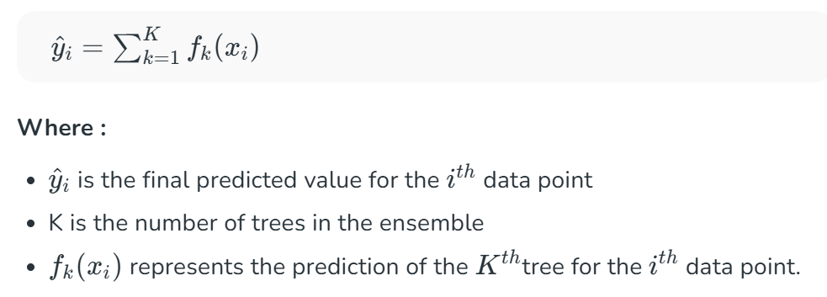
Working of the model (cont.)
It is an iterative process which start with an initial prediction set to zero.
After which each tree is added to reduce errors.
Mathematical representation of the model

Slide 5
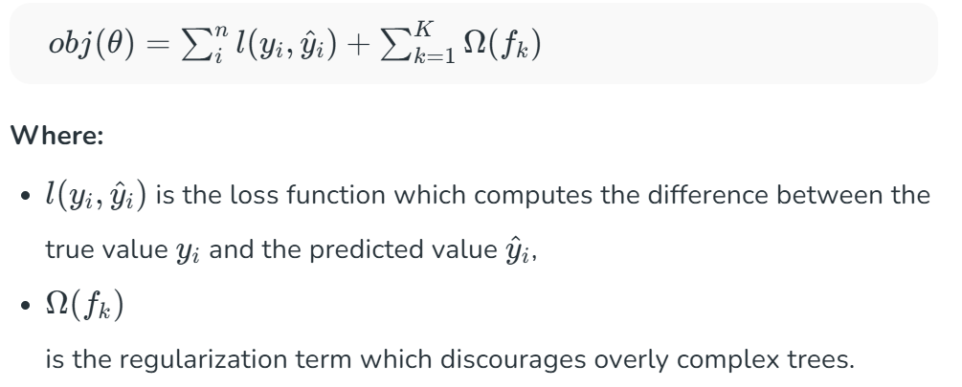
Objective function
The objective function in XGBoost consists of two parts:
a loss function – this measures how well the model fits the data
a regularization term - simplifies complex trees

Slide 6
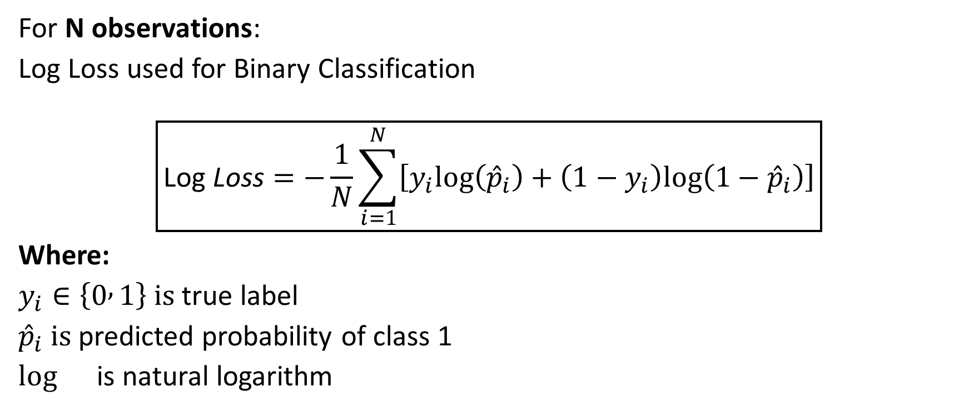
Loss Function
For N observations:
Log Loss used for Binary Classification
$$\boxed{\text{Log} \text{Loss}=−\frac{1}{N}\sum_{i=1}^{N}{\left[y_{i}log⁡\left({\hat{p}}_{i}\right)+\left(1−y_{i}\right)log⁡\left(1−{\hat{p}}_{i}\right)\right]}}$$
Where:
$y_{i}∈\left\{0 , 1\right\} is$true label
${\hat{p}}_{i} is$predicted probability of class 1
$\log{}$ is natural logarithm

Slide 7
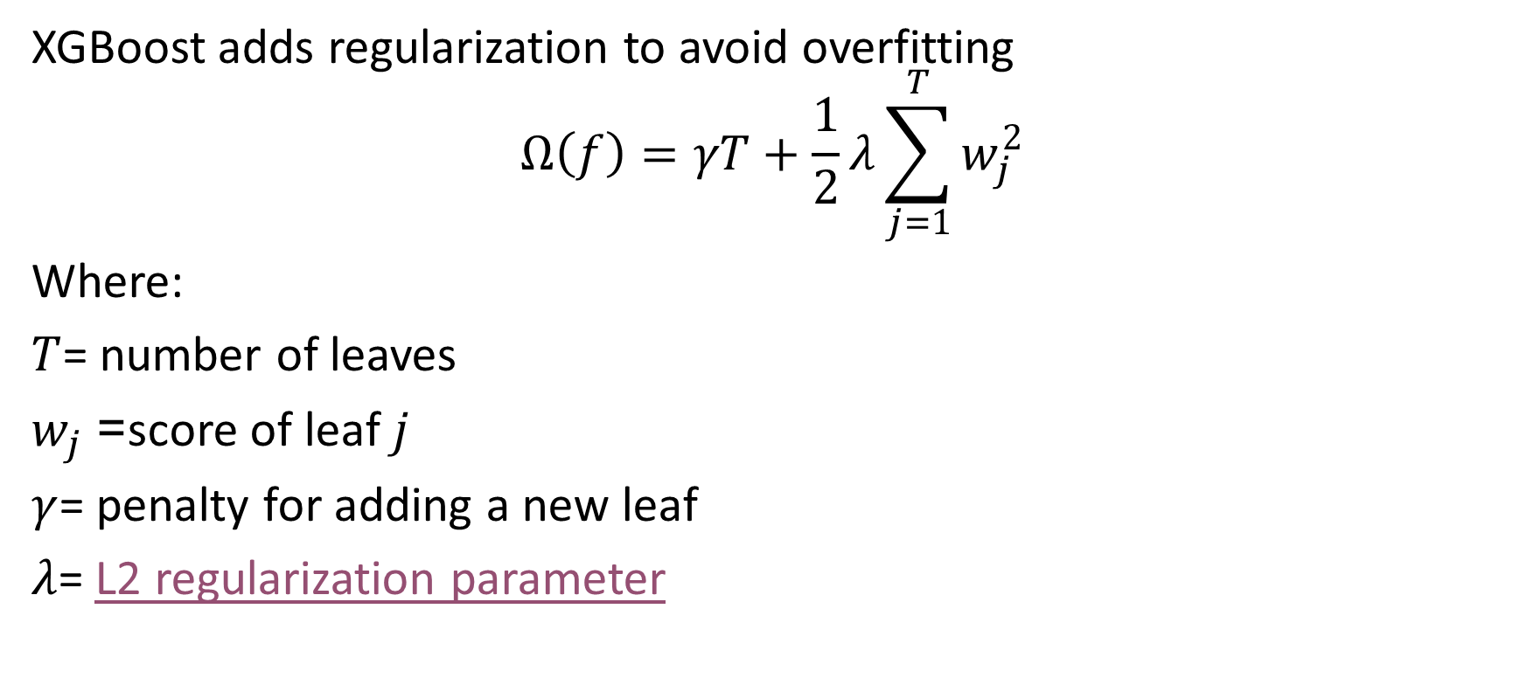
Regularization term
XGBoost adds regularization to avoid overfitting
$$Ω\left(f\right)=γT+\frac{1}{2}λ\sum_{j=1}^{T}{w_{j}^{2}}$$
Where:
$T$= number of leaves
$w_{j}$= score of leaf $j$
$γ$= penalty for adding a new leaf
$λ$= L2 regularization parameter

Slide 8
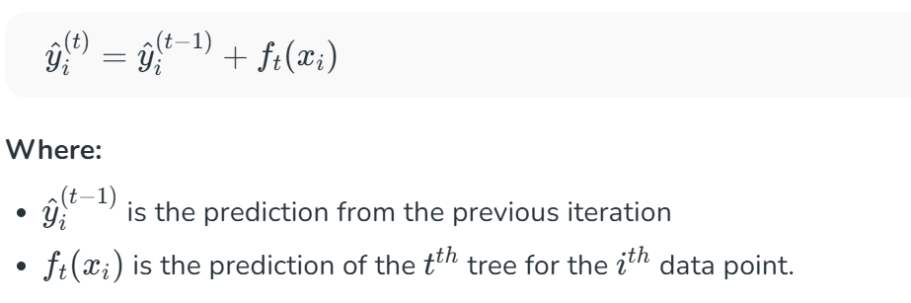

Additive Training (Boosting Process)
Instead of fitting the model all at once we optimize the model iteratively.
Trees are added one at a time.
We start with an initial prediction ${\hat{y}}_{i}^{\left(0\right)}=0$ and at each step we add a new tree to improve the model.
The updated predictions after adding the $t^{th}$ tree can be written as:

Slide 9
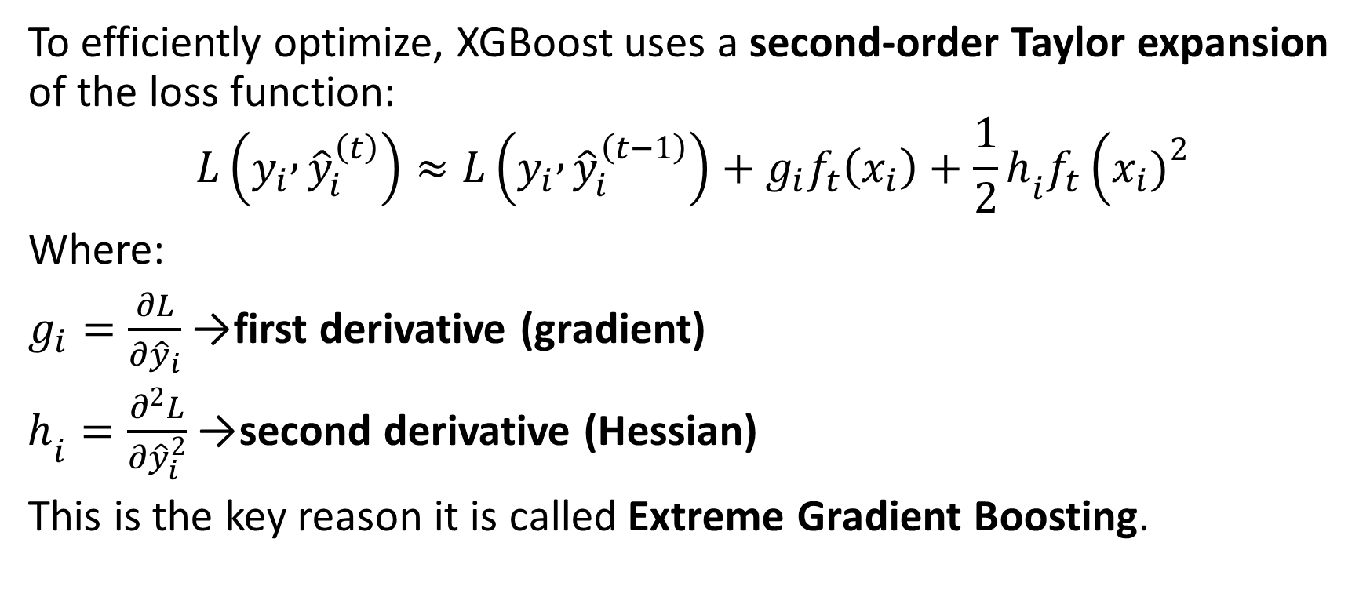
Second-Order Taylor Expansion
To efficiently optimize, XGBoost uses a second-order Taylor expansion of the loss function:
$$L\left(y_{i} , {\hat{y}}_{i}^{\left(t\right)}\right)≈L\left(y_{i} , {\hat{y}}_{i}^{\left(t−1\right)}\right)+g_{i}f_{t}\left(x_{i}\right)+\frac{1}{2}h_{i}f_{t}\left(x_{i}{\left.)\right.}^{2}\right.$$
Where:
$g_{i}=\frac{∂L}{∂{\hat{y}}_{i}}$→ first derivative (gradient)
$h_{i}=\frac{∂^{2}L}{∂{\hat{y}}_{i}^{2}}$→ second derivative (Hessian)
This is the key reason it is called Extreme Gradient Boosting.

Slide 10

Optimal Leaf Weight
For a leaf containing instances $I$, the optimal leaf weight is
$$w^{∗}=−\frac{\sum_{i∈I}{g_{i}}}{\sum_{i∈I}{h_{i}}+λ}$$

Slide 11
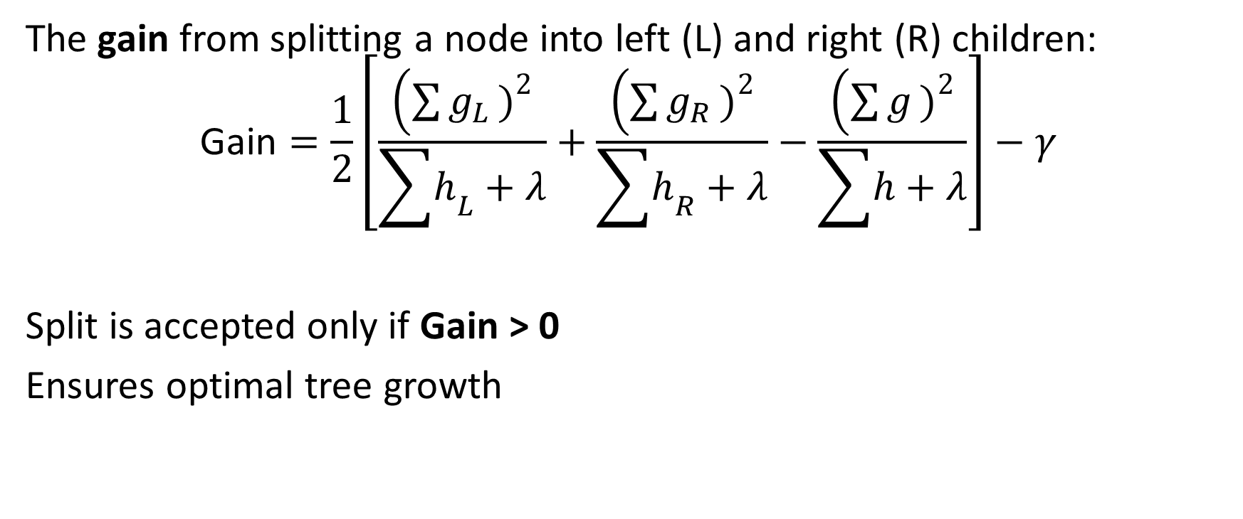
Gain from a Split
The gain from splitting a node into left (L) and right (R) children:
$$\text{Gain}=\frac{1}{2}\left[\frac{\left(\sum{g_{L}}{\left.)\right.}^{2}\right.}{\sum{h_{L}}+λ}+\frac{\left(\sum{g_{R}}{\left.)\right.}^{2}\right.}{\sum{h_{R}}+λ}−\frac{\left(\sum{g}{\left.)\right.}^{2}\right.}{\sum{h}+λ}\right]−γ$$
Split is accepted only if Gain > 0
Ensures optimal tree growth

Slide 12

Learning Rate
Scaled by a learning rate $η$:
$${\hat{y}}_{i}^{\left(t\right)}={\hat{y}}_{i}^{\left(t−1\right)}+ηf_{t}\left(x_{i}\right)$$
Smaller $η$
Model has slower learning
It does better generalization

Slide 13

Final mathematical representation
After $K$trees:
$${\hat{y}}_{i}=\sum_{k=1}^{K}{η}f_{k}\left(x_{i}\right)$$
For binary classification:
${\hat{y}}_{i}>0.5$→ Class (1)
${\hat{y}}_{i}≤0.5$→ Class (0)

Slide 14
Enhancements to the standard gradient boosting algorithm
Regularization
Tree Pruning
Parallel Processing
Handling Missing Values

Slide 15
Advantages of XGBoost
Scalable for large datasets with millions of records.
Supports parallel processing and GPU acceleration.
Offers customizable parameters and regularization for fine-tuning.
Includes feature importance analysis for better insights.
Available across multiple programming languages and widely used by data scientists.

Slide 16
Disadvantages of XGBoost
Computationally intensive, may not be suitable for resource-limited systems.
Sensitive to noise and outliers, careful preprocessing required.
Can overfit, especially on small datasets or with too many trees.
Limited interpretability compared to simpler models, which can be a concern in fields like healthcare or finance.

Slide 17
When to use XGBoost?
Tabular Data: XGBoost is particularly well-suited for structured, tabular data, such as data stored in CSV files or SQL databases.
Large Datasets: XGBoost’s efficiency and parallel processing capabilities make it an excellent choice for handling large datasets with numerous features.
Feature Importance: XGBoost provides built-in feature importance scores, allowing you to identify the most influential variables in your model.
Imbalanced Data: XGBoost offers hyperparameters, such as `scale_pos_weight`, which can be used to address class imbalance in the data, making it effective for imbalanced classification problems.

Slide 18
References
XGBoost – GeeksforGeeks
XGBoost Explained: A Beginner’s Guide | by Jamie Crossman-Smith | Low Code for Data Science | Medium
What is the XGBoost algorithm and how does it work?
Regularization — Understanding L1 and L2 regularization for Deep Learning | by Ujwal Tewari | Analytics Vidhya | Medium
What is XGBoost? An Introduction to XGBoost Algorithm in Machine Learning | Simplilearn
What is learning rate in machine learning? - California Learning Resource Network

