Slide 1
K-Nearest Neighbors (KNN) algorithm

Slide 2
Introduction
The K-Nearest Neighbors (KNN) algorithm is a supervised, non-parametric, instance-based learning method widely used for classification and regression.
It predicts the label of a new data point by looking at the k closest points in the training set and applying majority voting (classification) or averaging (regression).

Slide 3
Key characteristics
Lazy learner: No explicit training phase; stores all training data.
Distance-based: Common metrics include Euclidean, Manhattan, and Minkowski distances.
Choice of k: Small k → high variance (overfitting), large k → high bias (underfitting).

Slide 4
'K' in K Nearest Neighbour
In the k-Nearest Neighbours algorithm k is just a number that tells the algorithm how many nearby points or neighbors to look at when it makes a decision.
How to choose the value of k for KNN Algorithm?
The value of k in KNN decides how many neighbors the algorithm looks at when making a prediction.
Choosing the right k is important for good results.
If the data has lots of noise or outliers, using a larger k can make the predictions more stable.
But if k is too large the model may become too simple and miss important patterns and this is called underfitting.
So, k should be picked carefully based on the data.

Slide 5
How to choose the value of k for KNN Algorithm?
If K is too small or too large it can lead to overfitting or underfitting.
Small K values: This can make the model highly sensitive to noise and might overfit the training data. It will focus on nearest neighbors which may not always represent the global distribution.
Large K values: This can make the model smooth out the decision boundary, leading to underfitting. The classifier becomes less sensitive to local patterns and more influenced by the overall data distribution.

Slide 6
Statistical Methods for Selecting k
Cross-Validation: Cross-Validation is a good way to find the best value of k is by using k-fold cross-validation. This means dividing the dataset into k parts. The model is trained on some of these parts and tested on the remaining ones. This process is repeated for each part. The k value that gives the highest average accuracy during these tests is usually the best one to use.
Odd Values for k: It’s a good idea to use an odd number for k especially in classification problems. This helps avoid ties when deciding which class is the most common among the neighbors.

Slide 7
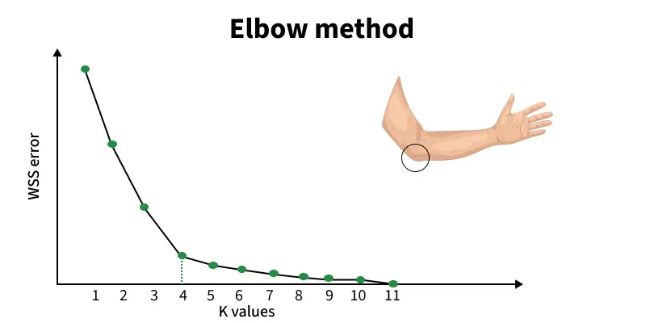
Statistical Methods for Selecting k (cont.)
Elbow Method: In Elbow Method we draw a graph showing the error rate or accuracy for different k values. As k increases the error usually drops at first. But after a certain point error stops decreasing quickly. The point where the curve changes direction and looks like an "elbow" is usually the best choice for k.

Slide 8
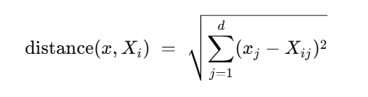
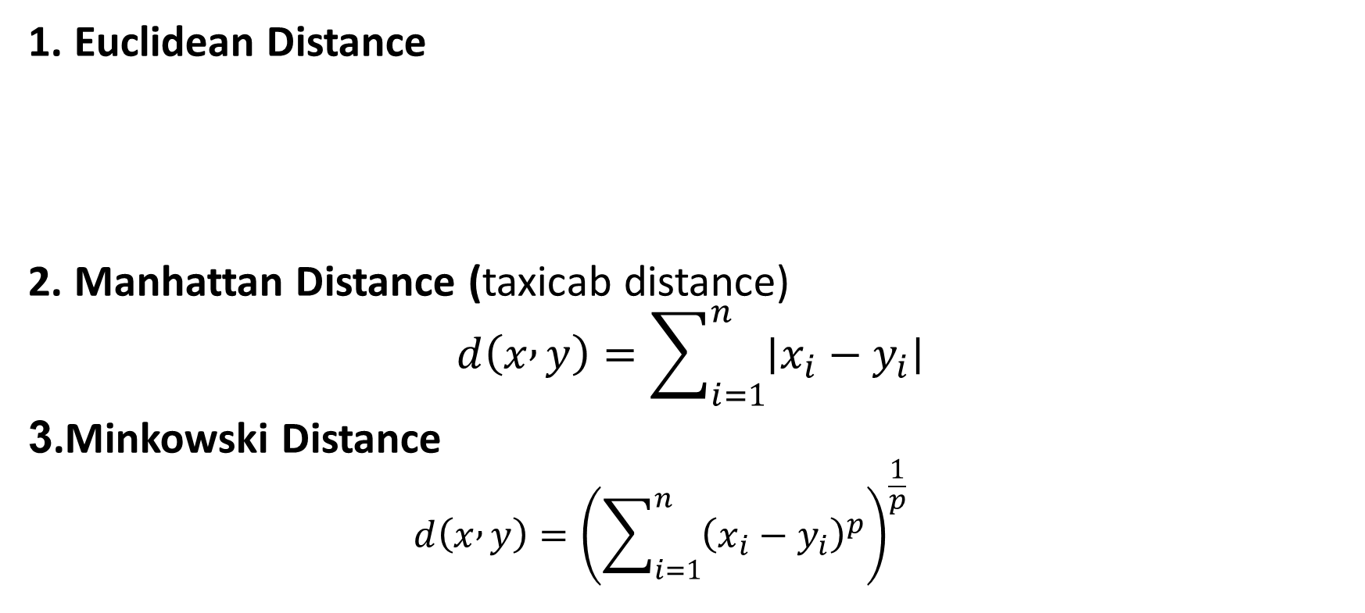
Distance Metrics Used in KNN Algorithm
1. Euclidean Distance
2. Manhattan Distance (taxicab distance)
$$d\left(x , y\right)=\sum_{i=1}^{n}{∣x_{i}−y_{i}∣}$$
3.Minkowski Distance
$$d\left(x , y\right)={\left(\sum_{i=1}^{n}{{\left(x_{i}−y_{i}\right)}^{p}}\right)}^{\frac{1}{p}}$$

Slide 9
Working of KNN algorithm
Step 1: Selecting the optimal value of K
Step 2: Calculating distance
Step 3: Finding Nearest Neighbors
Step 4: Voting for Classification or Taking Average for Regression

Slide 10
Sample code snippet
from sklearn.neighbors import KNeighborsClassifier
from sklearn.model_selection import train_test_split
from sklearn.preprocessing import StandardScaler
from sklearn.metrics import accuracy_score
# Sample feature matrix X and target y
# X = features, y = labels
# Split data
X_train, X_test, y_train, y_test = train_test_split(
X, y, test_size=0.2, random_state=42
)

Slide 11
Sample code snippet (cont.)
# Feature scaling (important for KNN)
scaler = StandardScaler()
X_train = scaler.fit_transform(X_train)
X_test = scaler.transform(X_test)
# Create KNN model
knn = KNeighborsClassifier(n_neighbors=5, metric='euclidean')
# Train model
knn.fit(X_train, y_train)
# Predictions
y_pred = knn.predict(X_test)
# Model accuracy
accuracy = accuracy_score(y_test, y_pred)
print("Accuracy:", accuracy)

Slide 12
Reference Links
K-Nearest Neighbor(KNN) Algorithm – GeeksforGeeks
K-Nearest Neighbors (KNN) in Machine Learning
Python Machine Learning - K-nearest neighbors (KNN)

