Slide 1
Logistic Regression

Slide 2
Introduction
Logistic Regression is a supervised machine learning algorithm used for classification problems.
It is used for binary classification where the output can be one of two possible categories such as Yes/No, True/False or 0/1.
It uses sigmoid function to convert inputs into a probability value between 0 and 1.

Slide 3
Understanding Sigmoid Function
1. The sigmoid function is an important part of logistic regression which is used to convert the raw output of the model into a probability value between 0 and 1.
2. This function takes any real number and maps it into the range 0 to 1 forming an "S" shaped curve called the sigmoid curve or logistic curve. Because probabilities must lie between 0 and 1, the sigmoid function is perfect for this purpose.
3. In logistic regression, we use a threshold value usually 0.5 to decide the class label.
If the sigmoid output is same or above the threshold, the input is classified as Class 1.
If it is below the threshold, the input is classified as Class 0.

Slide 4
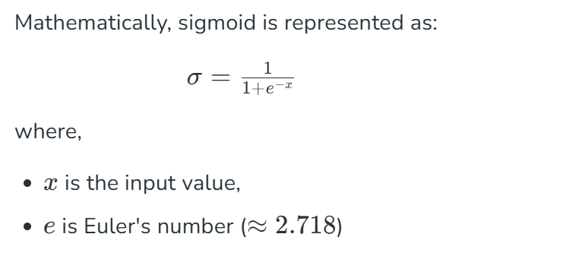
Mathematical representation of Sigmoid Activation Function

Slide 5
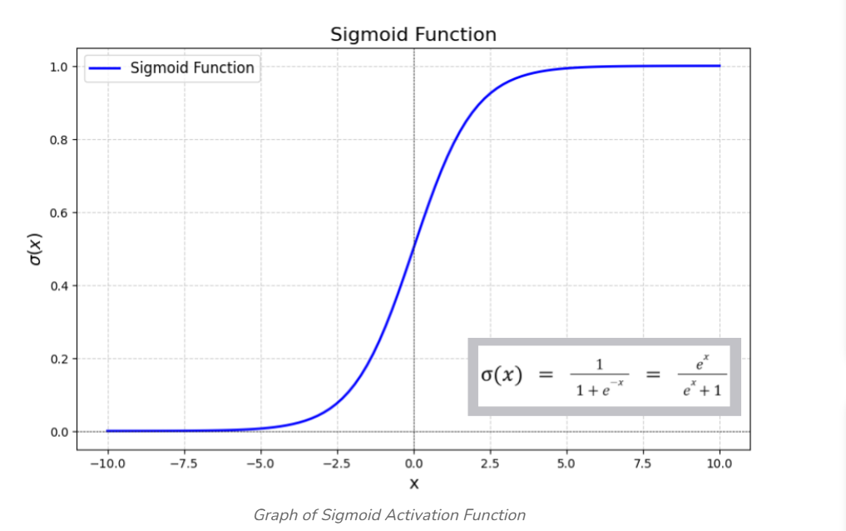
Graph of Sigmoid Activation Function

Slide 6
Properties of Sigmoid
Domain: (-∞, +∞)
Range: (0, +1)
σ(0) = 0.5
The function is monotonically increasing.
The function is continuous everywhere.
The function is differentiable everywhere in its domain.

Slide 7
Working of Logistic Regression
Logistic regression model transforms the linear regression function continuous value output into categorical value output using a sigmoid function which maps any real-valued set of independent variables input into a value between 0 and 1.
This function is known as the logistic function.

Slide 8
The Logistic Regression Model
Looks at input features (marks, age, income, words in email…)
Calculates a score
Converts the score into a probability between 0 and 1
Makes decision
If probability ≥ 0.5 then class 1 (YES) If probability < 0.5 then class 0 (NO)

Slide 9

It uses Sigmoid Function for calculating the probabilities
$$P=\frac{1}{1+e^{−z}}$$
Where:
$$z=w_{1}x_{1}+w_{2}x_{2}+...+b$$

Slide 10
Types of Logistic Regression
Binomial Logistic Regression
Multinomial Logistic Regression
Ordinal Logistic Regression

Slide 11
Assumptions of Logistic Regression
Independent observations
Binary dependent variables
Linearity relationship between independent variables and log odds
No outliers
Large sample size

Slide 12
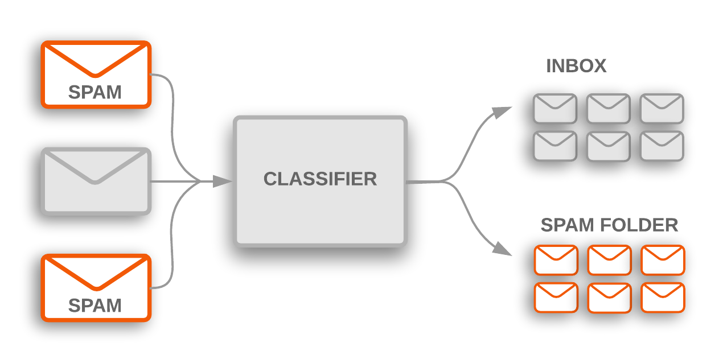
Application of Logistic Regression – Spam or Not Spam

Slide 13
Advantages of Logistic Regression
Very fast
Easy to implement
Requires less data
Highly interpretable
Gives probability

Slide 14
References
Logistic Regression in Machine Learning – GeeksforGeeks
Logistic Regression in Machine Learning
A Gentle Introduction To Sigmoid Function - MachineLearningMastery.com
Logistic Regression (MLU-Explain)

