Slide 1
K-means Clustering

Slide 2
K-Means Clustering
K-Means is an unsupervised machine learning algorithm used to group data into K distinct clusters based on similarity.
K-Means clustering partitions a dataset into K non-overlapping clusters such that the within-cluster variance is minimized and data points in the same cluster are more similar to each other than to those in other clusters.

Slide 3
K-means Algorithm
Choose K (number of clusters).
Initialize K centroids randomly.
Assign each data point to the nearest centroid (usually using Euclidean distance).
Recalculate centroids as the mean of all points in each cluster.
Repeat steps 3 and 4 until centroids do not change (convergence).

Slide 4
Expectation-Maximization
K-means follows Expectation-Maximization approach to solve the problem.
The Expectation-step is used for assigning the data points to the closest cluster.
The Maximization-step is used for computing the centroid of each cluster.

Slide 5
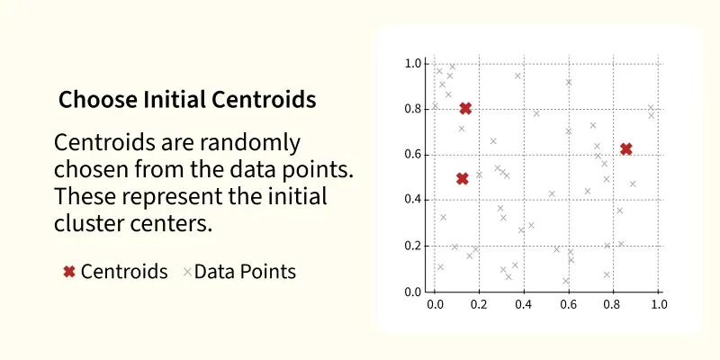
Step 1 and 2
Choose K (number of clusters).

Slide 6
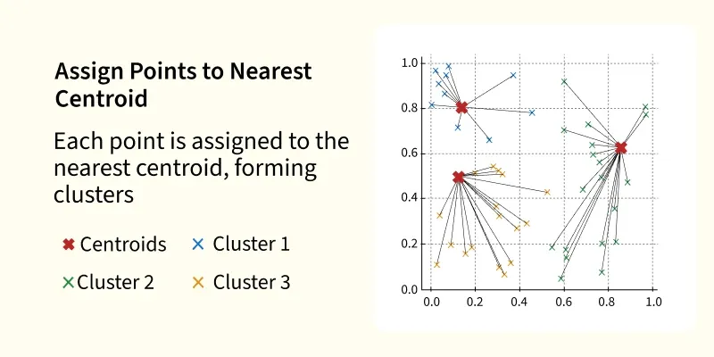
Step 3

Slide 7
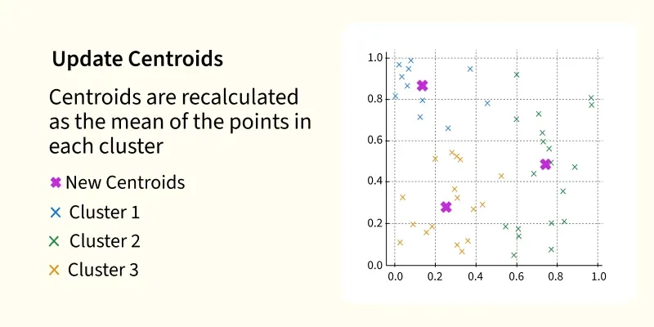
Step 4

Slide 8
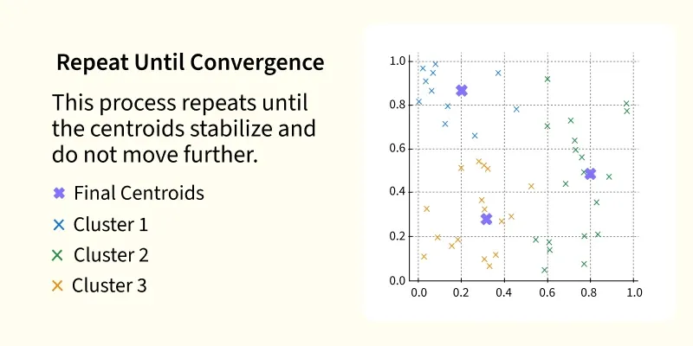
Step 5

Slide 9

Distance Measure
Most commonly used:

Slide 10
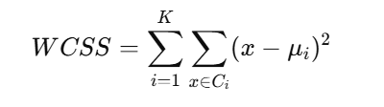
Objective Function
K-Means minimizes Within-Cluster Sum of Squares (WCSS):

Slide 11
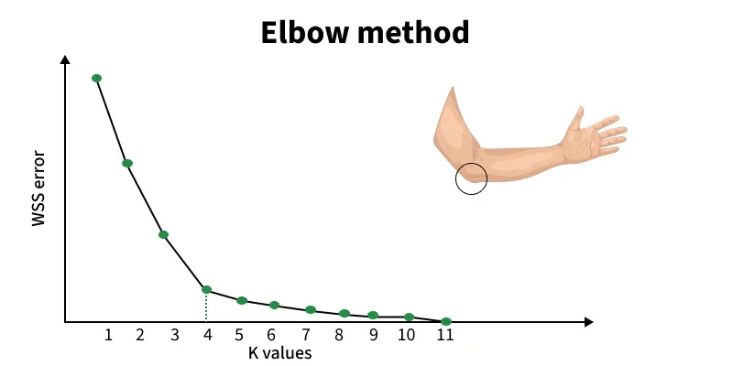
Statistical Methods for Selecting k (cont.)
Elbow Method: In Elbow Method we draw a graph showing the error rate or accuracy for different k values. As k increases the error usually drops at first. But after a certain point error stops decreasing quickly. The point where the curve changes direction and looks like an "elbow" is usually the best choice for k.

Slide 12
Sample code snippet
from sklearn.cluster import KMeans
kmeans = KMeans(n_clusters=3, random_state=42)
kmeans.fit(X)
labels = kmeans.labels_

Slide 13
Advantages
Simple and easy to implement
Fast and scalable for large datasets
Works well when clusters are clearly separated

Slide 14
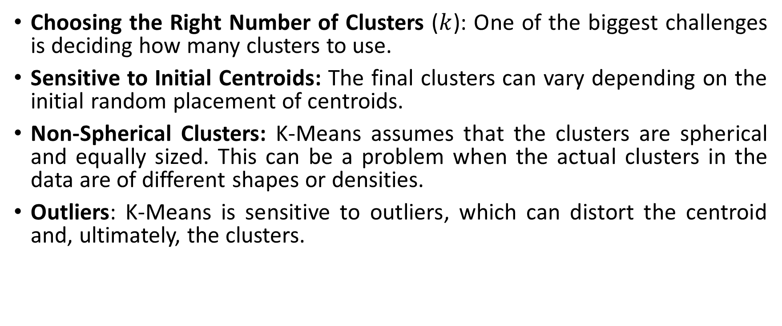
Challenges with K-Means Clustering
Choosing the Right Number of Clusters ($k$): One of the biggest challenges is deciding how many clusters to use.
Sensitive to Initial Centroids: The final clusters can vary depending on the initial random placement of centroids.
Non-Spherical Clusters: K-Means assumes that the clusters are spherical and equally sized. This can be a problem when the actual clusters in the data are of different shapes or densities.
Outliers: K-Means is sensitive to outliers, which can distort the centroid and, ultimately, the clusters.

Slide 15
Applications
Customer segmentation
Market basket analysis
Image compression
Document clustering
Recommendation systems

Slide 16
Reference Links
K means Clustering – Introduction – GeeksforGeeks
K-Means Clustering Algorithm in Machine Learning
K-Means Clustering Algorithm
Dataset Link
Mall_Customers

