Slide 2
Support vector machine (SVM)
Support vector machine (SVM in short) is a Discriminant based classification method where the task is to find a decision boundary separating sample in one class from the other. it is a binary in nature; means it considers two classes.

Slide 3
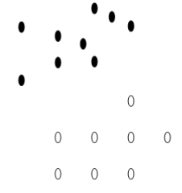
Support vector machine
Let us say, we have samples in two different classes as shown in the figure. Black samples are in +ve class and white samples are in –ve class.

Slide 4
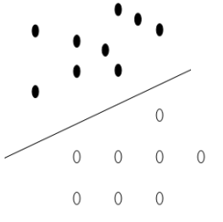
Support vector machine
The task is to find best possible line separating samples in one class from the samples other class.

Slide 5
Support vector machine
In the 2D space, the decision boundary is a line,

Slide 6
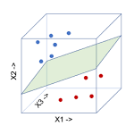
Support vector machine
In the 3D space, the decision boundary is a hyperplane

Slide 7
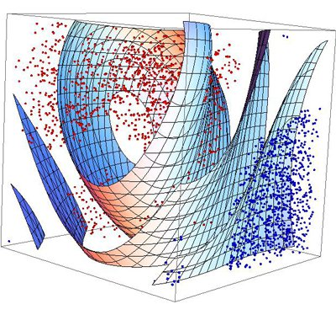
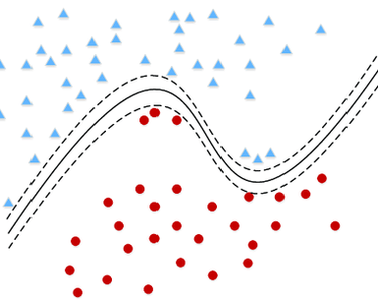
Support vector machine – Linear or Non-linear
Linear SVM
Non-Linear SVM
Depending on the nature of the samples, the decision boundary can be linear or non-linear, resulting to linear SVM or non-linear SVM.

Slide 8
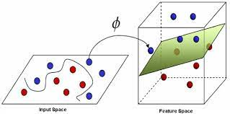
Non-Linear to Linear
Finding a non-linear decision boundary is complex. Further, non-linear problems can be transformed to a linear problem.

Slide 9
Linear Support vector machine

Slide 10
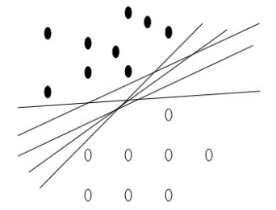
Linear Support vector machine
However, there are infinite number of lines which can separate the +ve samples from the –ve samples. Which one of them will be selected as the separating line.

Slide 11

Linear Support vector machine
For all the points on the hyper plane, g(x) = 0
$$g\left(x\right)=ω^{T}x+ω_{0}=0$$
To understand the process, let us begin with as separating hyperplane defined by the linear function g(x).

Slide 12

Linear Support vector machine
For all the points above the hyper plane, g(x) > 0
$$g\left(x\right)=ω^{T}x+ω_{0}>0$$

Slide 13

Linear Support vector machine
$$g\left(x\right)=ω^{T}x+ω_{0}<0$$
For all the points below the hyper plane, g(x) < 0

Slide 14

Linear Support vector machine
$$g\left(x\right)=ω^{T}x+ω_{0}>0$$
We choose the hyperplane that has the maximum separating margin
$$g\left(x\right)=ω^{T}x+ω_{0}=0$$
$$g\left(x\right)=ω^{T}x+ω_{0}<0$$

Slide 15
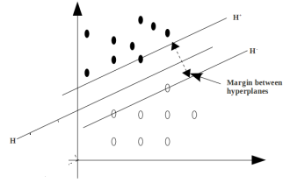
What is Separating Margin?
H is the separating hyperplane
H⁺ is the plane parallel to H and passing through the nearest +ve points to H
H⁻ is the plane parallel to H and passing through the nearest -ve points to H
Separating margin is the distance between H⁺ and H⁻
We choose H that has the maximum margin.

Slide 16
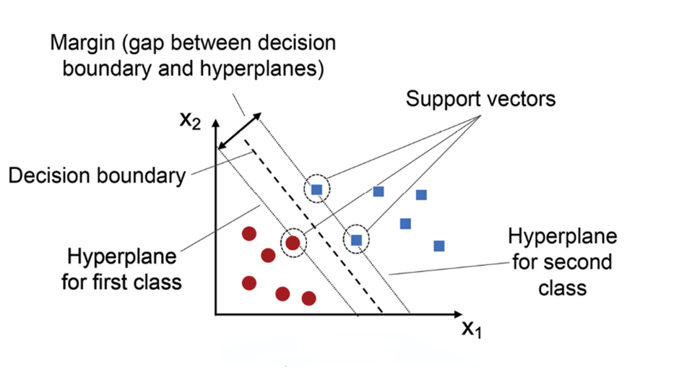
SVM

Slide 17
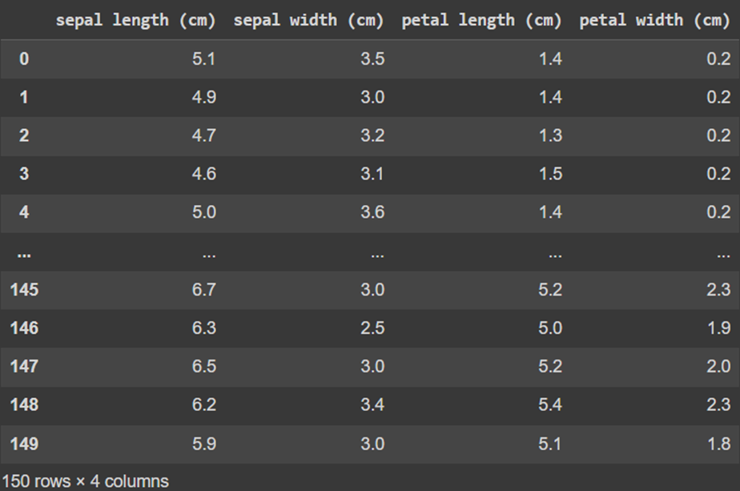
IRIS Dataset

Slide 18
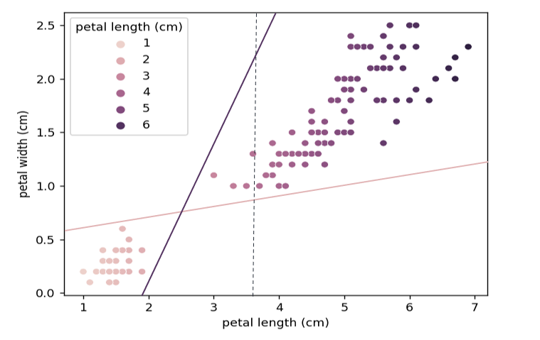
Example: IRIS Dataset
Iris dataset separated by three lines (linear classifiers) represent by dark, light and dotted lines.

Slide 19
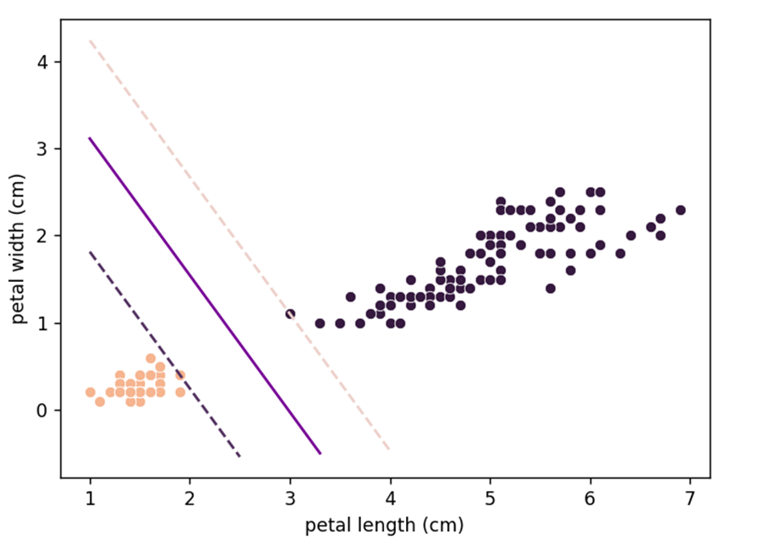
Iris dataset separated by a hyperplane obtained by an SVM model.

Slide 20
Finding Separating Hyperplane with maximum Margin?
$$g\left(x\right)=ω^{T}x+ω_{0}=0$$

Slide 21


Finding Separating Hyperplane with maximum Margin?
Let us take two points x₁ and x₂ lying on g(x)
$g(x_{1})=g(x_{2})$=0
$$g\left(x\right)=ω^{T}x+ω_{0}=0$$

Slide 22


Finding Separating Hyperplane with maximum Margin?
Let us take two points x₁ and x₂ lying on g(x)
$g(x_{1})=g(x_{2})$=0
$$g\left(x\right)=ω^{T}x+ω_{0}=0$$
$$⇒ω^{T}x_{1}+ω_{0}=ω^{T}x_{1}+ω_{0}$$
$⇒ω^{T}\left(x_{1}−x_{1}\right)=$0

Slide 23

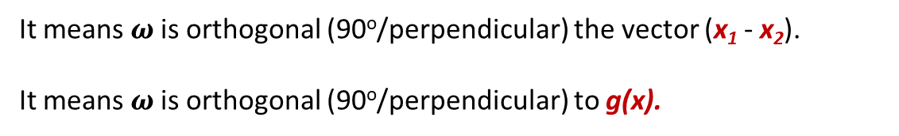
Finding Separating Hyperplane with maximum Margin?
Let us take two points x₁ and x₂ lying on g(x)
$g(x_{1})=g(x_{2})$=0
$$g\left(x\right)=ω^{T}x+ω_{0}=0$$
$$⇒ω^{T}x_{1}+ω_{0}=ω^{T}x_{1}+ω_{0}$$
$⇒ω^{T}\left(x_{1}−x_{1}\right)=$0
It means $ω$is orthogonal (90º/perpendicular) the vector (x₁ - x₂).
It means $ω$is orthogonal (90º/perpendicular) to g(x).

Slide 24
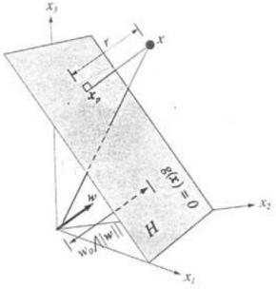
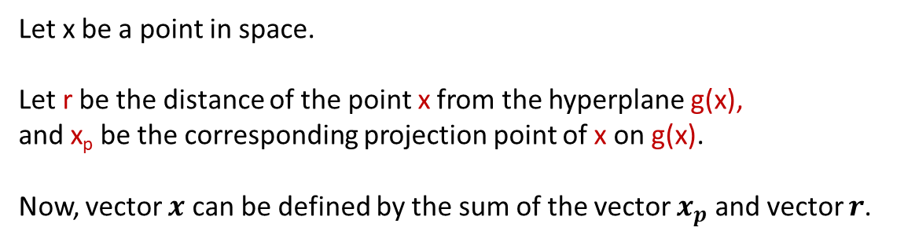


Finding Separating Hyperplane with maximum Margin?
Let x be a point in space.
Let r be the distance of the point x from the hyperplane g(x),
and x_{p} be the corresponding projection point of x on g(x).
Now, vector $x$ can be defined by the sum of the vector $x_{p}$ and vector $r$.
$$x=x_{p}+r$$
$$⇒x=x_{p}+r\frac{ω}{\left\|ω\right\|}$$

Slide 25




Finding Separating Hyperplane with maximum Margin?
Let x be a point in space.
Let r be the distance of the point x from the hyperplane g(x),
and x_{p} be the corresponding projection point of x on g(x).
Now, vector $x$ can be defined by the sum of the vector $x_{p}$ and vector $r$.
$$x=x_{p}+r$$
$$⇒x=x_{p}+r\frac{ω}{\left\|ω\right\|}$$
If you substitute $x$ in g($x$).
$$⇒g\left(x\right)=ω^{T}x_{p}+r\frac{ω^{T}ω}{\left\|ω\right\|}+ω_{0}$$
$$⇒g\left(x\right)=ω^{T}x_{p}+ω_{0}+r\frac{ω^{T}ω}{\left\|ω\right\|}$$
$$⇒g\left(x\right)=r\frac{ω^{T}ω}{\left\|ω\right\|}$$
$$⇒r=\frac{g(x)}{\left\|ω\right\|}$$

Slide 26




Finding Separating Hyperplane with maximum Margin?
$$r=\frac{g(x)}{\left\|ω\right\|}$$
$$r=\frac{g(x)}{\left\|ω\right\|}$$
Distance of $x_{p}$ from g(x)=0 is
So, the distance of origin from g(x)=0 is
$$⇒r_{0}=\frac{ω^{T}0+ω_{0}}{\left\|ω\right\|}$$
$$⇒r_{0}=\frac{ω_{0}}{\left\|ω\right\|}$$

Slide 27
Finding Separating Hyperplane with maximum Margin?
What is the Margin between H+ and H-?

Slide 28
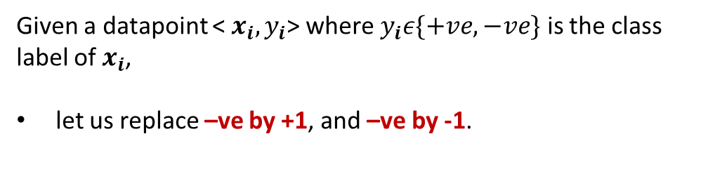
Finding Separating Hyperplane with maximum Margin?
To define the expression for H+ and H-, let us make the following assumptions.
Given a datapoint < $x_{i},y_{i}$> where $y_{i}ε\{+ve,−ve\}$ is the class label of $x_{i}$,
let us replace –ve by +1, and –ve by -1.

Slide 29


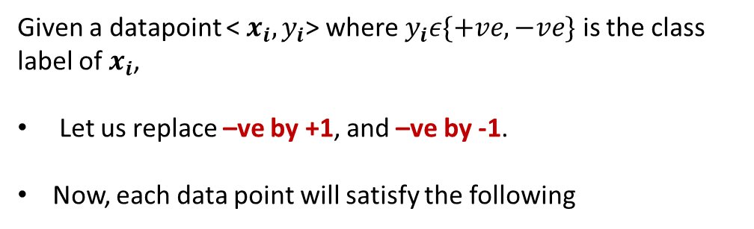
Finding Separating Hyperplane with maximum Margin?
To define the expression for H+ and H-, let us make the following assumptions.
Given a datapoint < $x_{i},y_{i}$> where $y_{i}ε\{+ve,−ve\}$ is the class label of $x_{i}$,
Let us replace –ve by +1, and –ve by -1.
Now, each data point will satisfy the following
$${ω^{T}x_{i}+ω}_{0}≥1, ∀y_{i}=+1$$
$${ω^{T}x_{i}+ω}_{0}≤−1, ∀y_{i}=−1$$

Slide 30


Finding Separating Hyperplane with maximum Margin?
To define the expression for H+ and H-, let us make the following assumptions.
Given a datapoint < $x_{i},y_{i}$> where $y_{i}ε\{+ve,−ve\}$ is the class label of $x_{i}$,
let us replace –ve by +1, and –ve by -1.
Now, each data point will satisfy the following
$${ω^{T}x_{i}+ω}_{0}≥1, ∀y_{i}=+1$$
$${ω^{T}x_{i}+ω}_{0}≤−1, ∀y_{i}=−1$$
The above two expression can be merged to form a single expression
$${{y_{i}(ω}^{T}x_{i}+ω}_{0})≥1, ∀x_{i}$$

Slide 31

Finding Separating Hyperplane with maximum Margin?
To define the expression for H+ and H-, let us make the following assumptions.
Given a datapoint < $x_{i},y_{i}$> where $y_{i}ε\{+ve,−ve\}$ is the class label of $x_{i}$,
let us replace –ve by +1, and –ve by -1.
Now, each data point will satisfy the following
$${ω^{T}x_{i}+ω}_{0}≥1, ∀y_{i}=+1$$
$${ω^{T}x_{i}+ω}_{0}≤−1, ∀y_{i}=−1$$
The above two expression can be merged to form a single expression
$${{y_{i}(ω}^{T}x_{i}+ω}_{0})≥1, ∀x_{i}$$
$${{y_{i}(ω}^{T}x_{i}+ω}_{0})−1≥0, ∀x_{i}$$

Slide 32
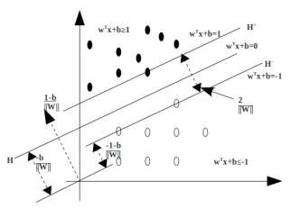



Finding Separating Hyperplane with maximum Margin?
H:
${{g\left(x\right)= ω}^{T}x+ω}_{0}=$0
$${{g\left(x\right)= ω}^{T}x+ω}_{0}=1$$
H+:
H-:
$${{g\left(x\right)= ω}^{T}x+ω}_{0}=−1$$

Slide 33




Finding Separating Hyperplane with maximum Margin?
H:
${{g\left(x\right)= ω}^{T}x+ω}_{0}=$0
$${{g\left(x\right)= ω}^{T}x+ω}_{0}=1$$
H+:
H-:
$${{g\left(x\right)= ω}^{T}x+ω}_{0}=−1$$
$$Margin=r_{H^{+}}−r_{H^{−}}$$
$$=\frac{ω_{0}−1}{\left\|ω\right\|}−\frac{ω_{0}+1}{\left\|ω\right\|}$$
$$=\frac{ω_{0}−1{−ω}_{0}−1}{\left\|ω\right\|}$$
$$⇒Margin=\frac{−2}{\left\|ω\right\|}$$

Slide 34




Finding Separating Hyperplane with maximum Margin?
H:
${{g\left(x\right)= ω}^{T}x+ω}_{0}=$0
$${{g\left(x\right)= ω}^{T}x+ω}_{0}=1$$
H+:
H-:
$${{g\left(x\right)= ω}^{T}x+ω}_{0}=−1$$
$$Margin=r_{H^{+}}−r_{H^{−}}$$
$$=\frac{ω_{0}−1}{\left\|ω\right\|}−\frac{ω_{0}+1}{\left\|ω\right\|}$$
$$=\frac{ω_{0}−1{−ω}_{0}−1}{\left\|ω\right\|}$$
As we are interested in the absolute value, we consider the margin as $\frac{2}{\left\|ω\right\|}$
$$⇒Margin=\frac{−2}{\left\|ω\right\|}$$

Slide 35

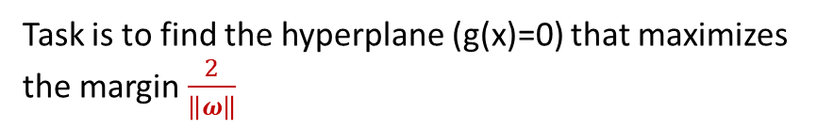
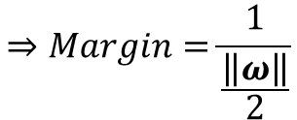
Finding Separating Hyperplane with maximum Margin?
Task is to find the hyperplane (g(x)=0) that maximizes the margin $\frac{2}{\left\|ω\right\|}$
$$Margin=\frac{2}{\left\|ω\right\|}$$
$$⇒Margin=\frac{1}{\frac{\left\|ω\right\|}{2}}$$

Slide 36

Finding Separating Hyperplane with maximum Margin?
Task is to find the hyperplane (g(x)=0) that maximizes the margin $\frac{2}{\left\|ω\right\|}$
$$Margin=\frac{2}{\left\|ω\right\|}$$
$$⇒Margin=\frac{1}{\frac{\left\|ω\right\|}{2}}$$
Maximizing $\frac{2}{\left\|ω\right\|}$ is equivalent to minimizing $\frac{\left\|ω\right\|}{2}$
Minimizing $\frac{\left\|ω\right\|}{2}$ is equivalent to minimizing $\frac{ω^{T}ω}{2}$

Slide 37


Finding Separating Hyperplane with maximum Margin?
Now, we need to solve the following optimization
Minimize objective function $\frac{ω^{T}ω}{2}$
Subject to the constraint
$${{y_{i}(ω}^{T}x_{i}+ω}_{0})≥1, ∀x_{i}$$

Slide 38
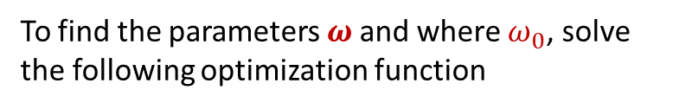

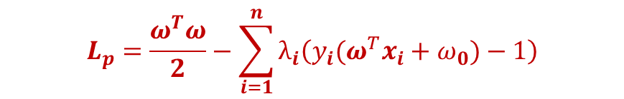


Finding Separating Hyperplane with maximum Margin?
Objective function is to minimize $\frac{ω^{T}ω}{2}$
Subject to
$${{y_{i}(ω}^{T}x_{i}+ω}_{0})≥1, ∀x_{i}$$
To find the parameters $ω$and where $ω_{0}$, solve the following optimization function
$$L_{p}=\frac{ω^{T}ω}{2}−\sum_{i=1}^{n}{λ_{i}\left({{y_{i}(ω}^{T}x_{i}+ω}_{0})−1\right)}$$
where $λ_{i} are$ Lagrange multipliers

Slide 39

What are the support vectors?
$$L_{p}=\frac{ω^{T}ω}{2}−\sum_{i=1}^{n}{λ_{i}\left({{y_{i}(ω}^{T}x_{i}+ω}_{0})−1\right)}$$
[
In order to find the parameters, we need to solve this objective function.
]

Slide 40
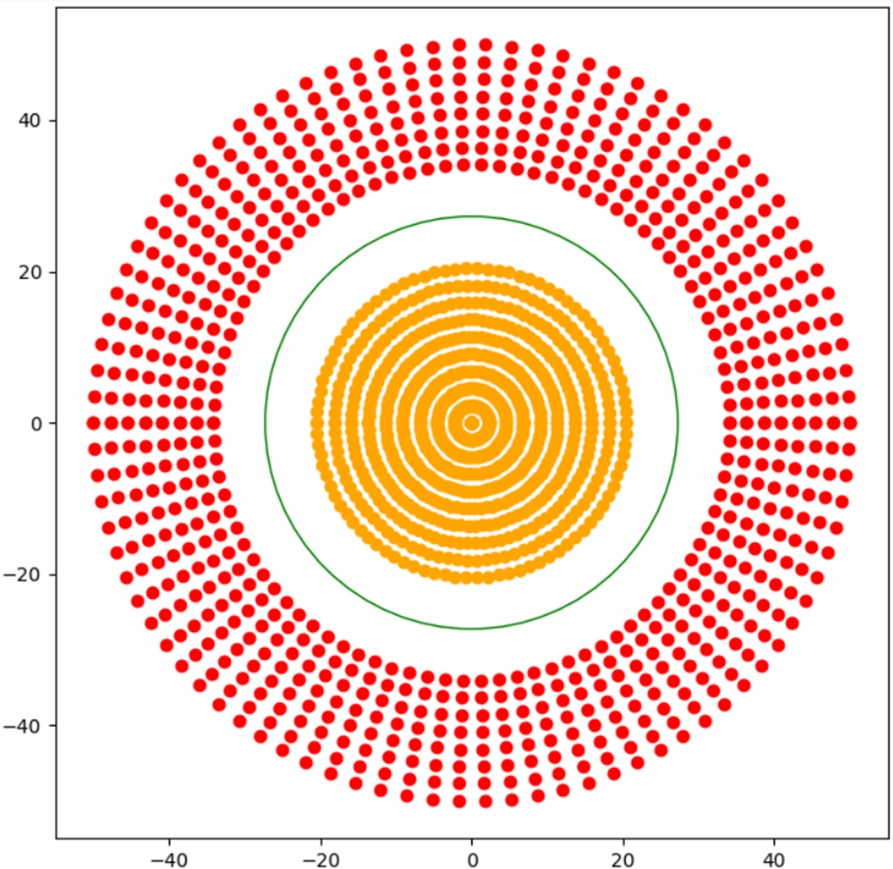
A dataset which is not linearly separable

Slide 41
We take the third feature Z = f(x,y); f representing a function on X and Y.
Here the Radial Basis Function(RBF) (measuring Euclidean distance) from the origin is enough.
Z = (X²+ Y²)^(1/2)

Slide 42
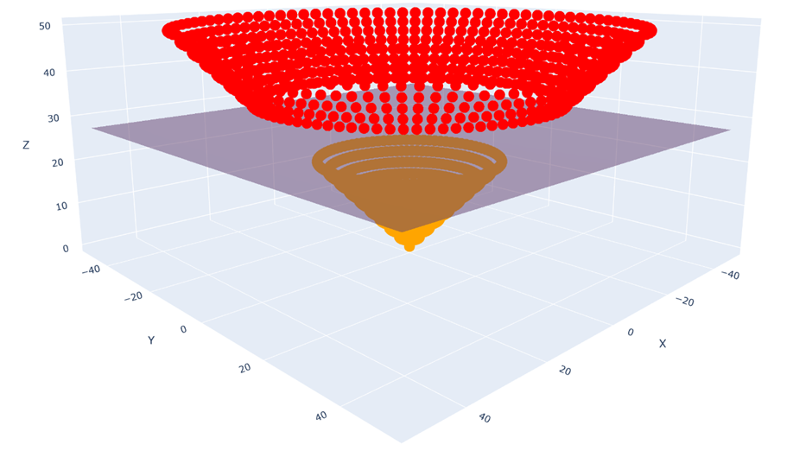
The points, plotted in 3-D with a hyperplane dividing them

Slide 43
Complexity Analysis
We would need to calculate n*(n-1)/2 distances.
Time Complexity
The time complexity of a square root is O(log(n)) and for power, addition is O(1).
Thus, to do n*(n-1)/2 total calculations we would need O(n²log(n)) time complexity.
But as our goal is to separate the classes and not find the distance, we can do away with the square root. (Z = X²+ Y²)
In that case, we would get a time complexity of O(n²).

Slide 44
The Kernel Trick
Instead of finding f(x,y) directly, it computes the similarity of the image of these points. In other words, instead of finding f(x1,y1) and f(x2,y2) we take the points (x1,y1) and (x2,y2) and compute how similar would their outputs be using a function f(x,y); where f can be any function on x,y.
Thus, we don’t need to find a suitable set of features here. We find similarity in such a way that it is valid for all sets of features. To calculate the similarity, we use the Gaussian function.
f(x) = ae^(-(x-b)²/2c²)
a : represents the height of the peak of the curve
b : represents the position of the center of the peak
c : is the standard deviation of the data
For RBF Kernel we use:
K(X,X’) = e^-γ(|X-X’|²) = (1/ e^|X-X’|²) γ
γ : is a hyperparameter which represents the linearlity of the model (γ ∝ 1/c²)
X,X’ :represents the position vectors of the two points

Slide 45
Time Complexity
Since we need to find the similarity of each point with respect to all other points we need a total of n*(n-1)/2 calculations.
Exponent has a time complexity of O(1) and thus we get a total time complexity of O(n²).

Slide 46
Types of Kernel
Polynomial Kernel
Gaussian Kernel
Gaussian RBF Kernel
Laplace RBF Kernel
Hyperbolic Tangent Kernel
Sigmoid Kernel
Bessel function of first kind Kernel
ANOVA radial basis Kernel
Linear Splines Kernel

Slide 47
Key Applications of SVM
Image Classification
Text Classification
Bioinformatics
Financial Forecasting
Handwriting Recognition

Slide 48
Advantages of Using SVM
Effective in High-Dimensional Spaces
Robust to Overfitting
Versatile Kernel Functions

Slide 49
Summary
What is separating hyperplane?
How to define separating hyperplane?
What are Support Vector Machine?
How to classify a new example using SVM

