Slide 1

Bus Ticket Booking System
Group Members:
1) Lasya (2510030346)
2) Hansika (2510030330)
3) Hansarya (2510030342)
Guided by: Faculty

Slide 2
Project Overview
This project implements a Bus Booking System using Java.
It allows users to book and cancel tickets, manage waiting lists, search passengers, and sort passenger records.
The system uses data structures like Linked List, Queue, and Stack to efficiently manage operations and simulate real-time booking.

Slide 3
Technologies Used
• Java Programming Language
• Linked List (for storing passengers)
• Queue (for waiting list)
• Stack (for undo cancellation)
• File Handling (to store booking records)
• Scanner (for user input handling)

Slide 4
System Features
• Ticket Booking with seat allocation
• Ticket Cancellation and auto-fill from waiting list
• Undo Cancellation using Stack
• Search Passenger by name
• Sort Passengers alphabetically
• File storage for persistent records

Slide 5
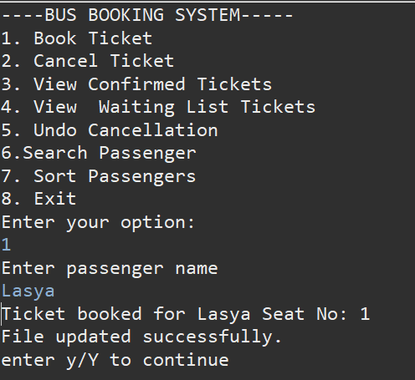
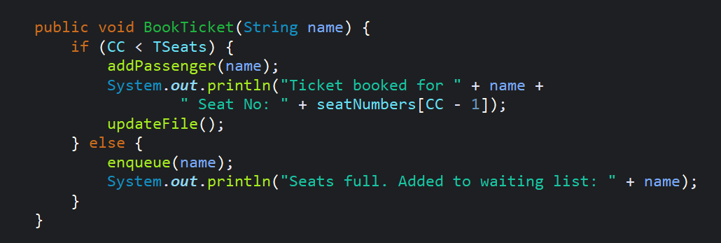
Booking Operation (Code & Output)

Slide 6
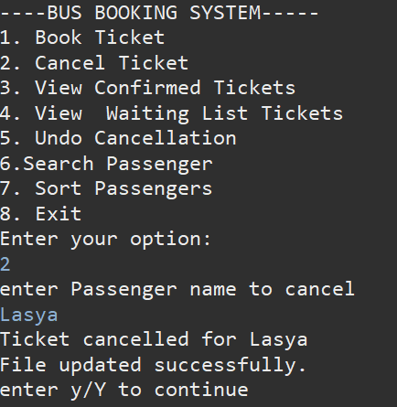
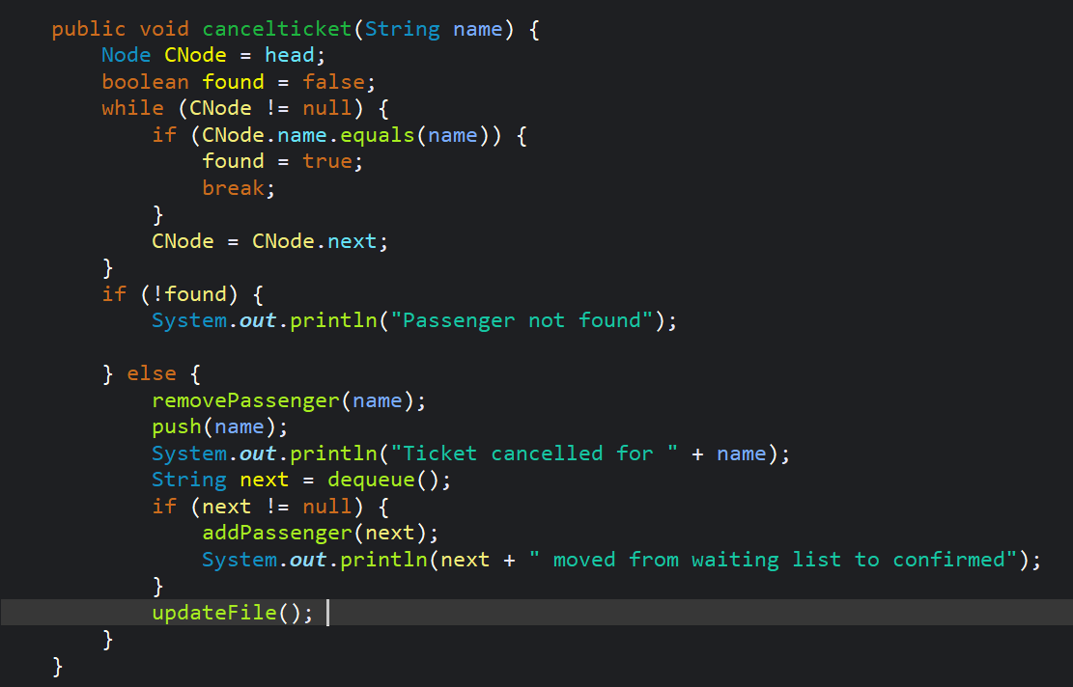
Cancellation Operation (Code & Output)

Slide 7
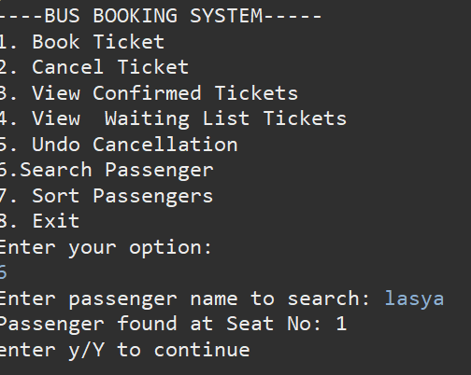
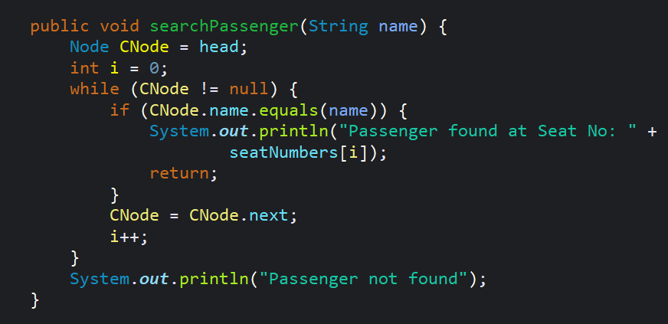
Search Operation (Code & Output)

Slide 8
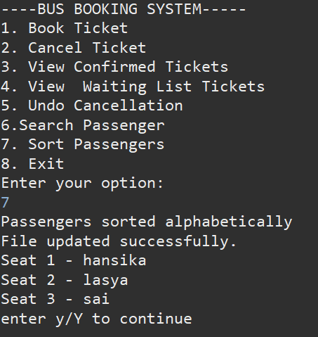
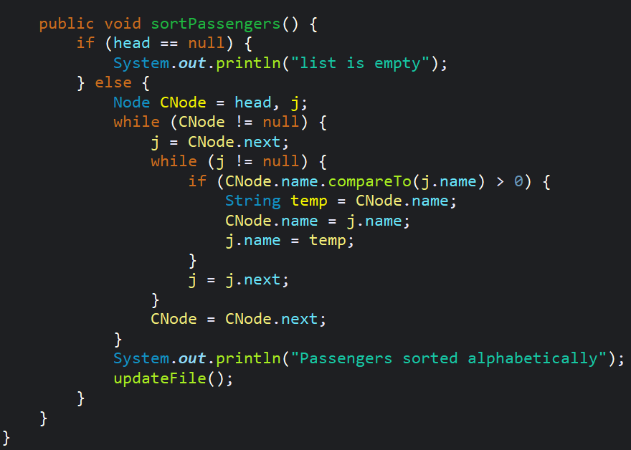
Sorting Operation (Code & Output)

