Slide 1
Bioplastic
By: Izzy and Laszlo

Slide 2
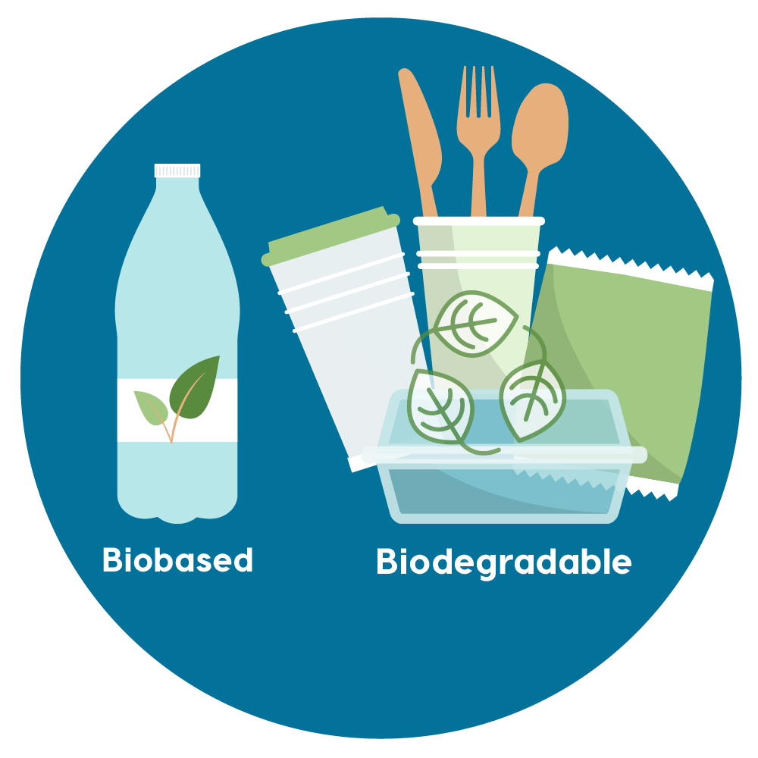
Overview
History
Purpose
How it works
Two Types
Compared
Pros and Cons
Summary
Resources

Slide 3
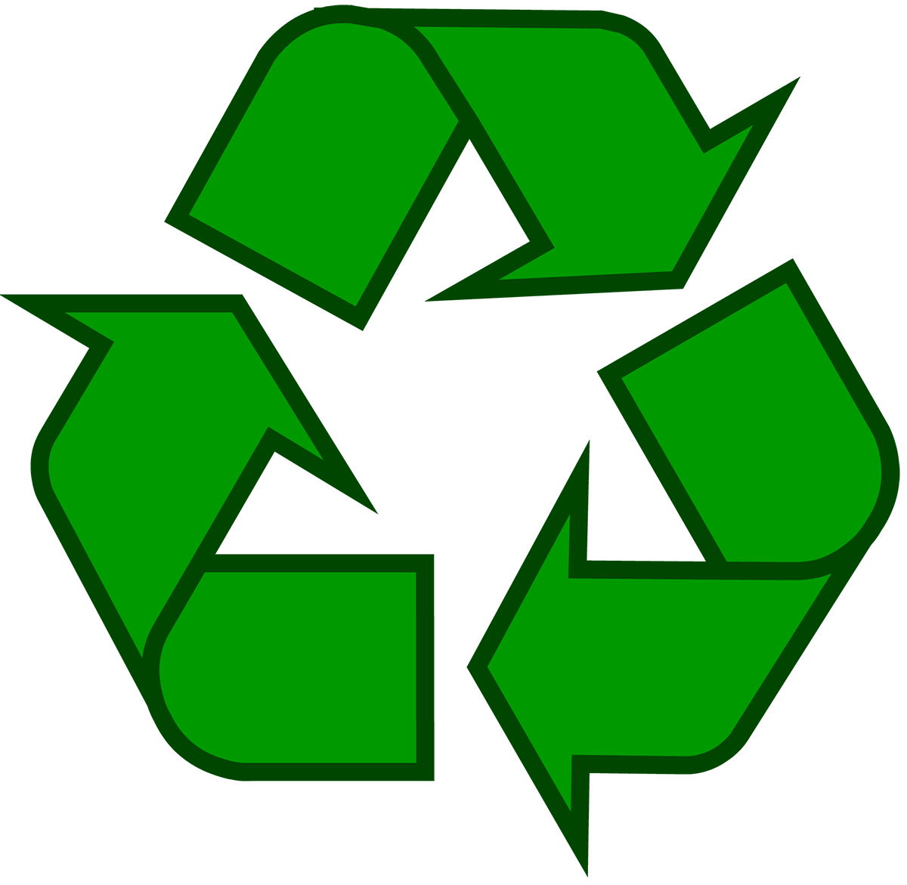
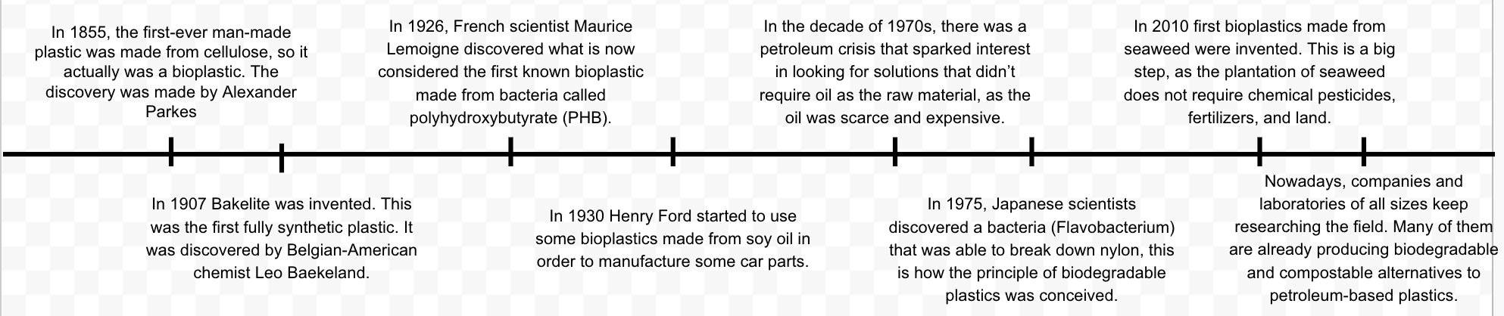
History
During the 1920s, Maurice Lemoigne, a French researcher, discovered the first biodegradable plastic (Polyhydroxybutyrate) from his work with the bacterium
In the 1990s, the research again became popular, this time in the biomedical industry. Between medical applications and fluctuating oil prices, research in biodegradable plastics has become steady and profitable. So far, researchers have invented several different types of plastics and a variety of manufacturing methods.
Notes:
Decades later, microbiologists in the United States and Great Britain independently discovered PHB in 1957 and 1958, respectively (2). However, research into biodegradable plastics slowed until the oil crisis of the 1970s (3). As nations faced the reality of rising oil prices, they encouraged research for synthesizing alternatives to petroleum-based products. However, when the oil crisis died down, interest in biodegradable plastics research decreased once more.

Slide 4
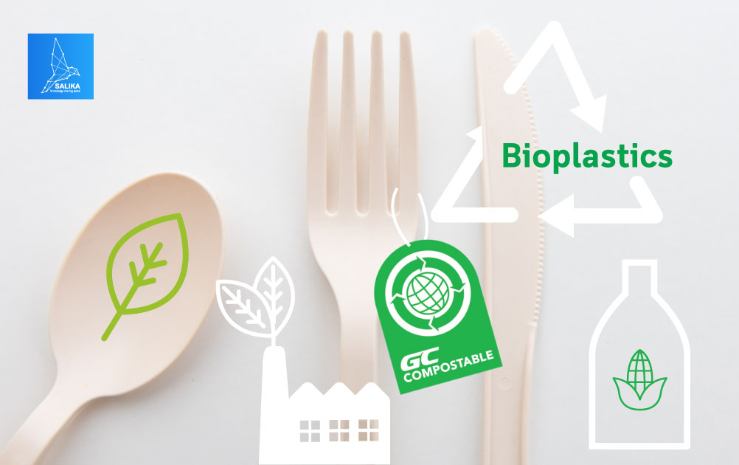
Purpose
Broadly speaking, so-called "environmentally friendly" plastics fall into three types:
Bioplastics
Biodegradable plastics
Eco/recycled plastics,
The purpose of bioplastic is to make plastics from kinder chemicals to start with,
Find a material that will break down more quickly and easily when we got rid of them.
Reduce the problem of plastic waste that is polluting the environment
As well as reduce dependence on fossil resources whilst improving a products carbon footprint
Notes:
Bioplastics made from natural materials such as corn starch
Biodegradable plastics made from traditional petrochemicals, which are engineered to break down more quickly
Eco/recycled plastics, which are simply plastics made from recycled plastic materials rather than raw
petrochemicals.
The most familiar bioplastics are made from natural materials such as corn starch and sold under such names as EverCorn™ and NatureWorks—with a distinct emphasis on environmental credentials.
Some bioplastics look virtually indistinguishable from traditional petrochemical plastics. Polylactide acid (PLA) looks and behaves like polyethylene and polypropylene and is now widely used for food containers.
Biodegradable plastics allow enhanced end-of-life scenarios for disposal and recycling. This may lessen the burden on our existing waste systems and also the environment.

Slide 5
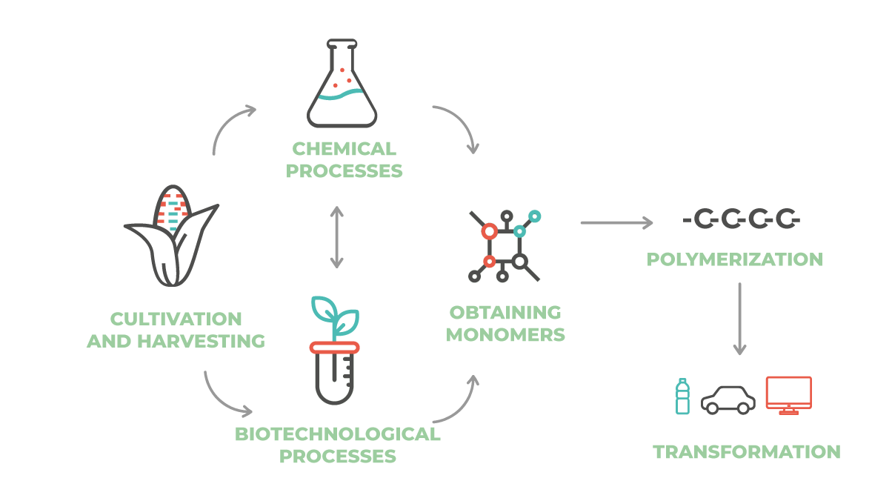
How does it work?
Most Bioplastics are made from renewable biomass energy sources, such as corn and sugarcane.
Production involves processing, fermenting, and synthesizing natural biopolymers from starch and cellulose.
Then the materials go through a forming process
Bioplastics can also be biodegradable
In recent years Bioplastics have exploded in popularity
Notes:
Most Bioplastics are made from renewable biomass energy sources, such as corn and sugarcane.
Production involves processing, fermenting, and synthesizing natural biopolymers from starch and cellulose.
Then the materials go through a forming process via injection molding to take shape. After use, bioplastics can decompose via UV light, oxygen, and heat over a few months.
Bioplastics can also be biodegradable, meaning microorganisms can completely break them down into water and carbon dioxide.
In recent years Bioplastics have exploded in popularity
Bioplastics have become an increasingly popular form of plastic, used today for everything from cups and food production packaging materials to bottles and cutlery. The bioplastic market has exploded in popularity because of its green benefits. Many cities are banning single-use plastic, looking to transition from traditional plastics to biodegradable plastics.

Slide 6
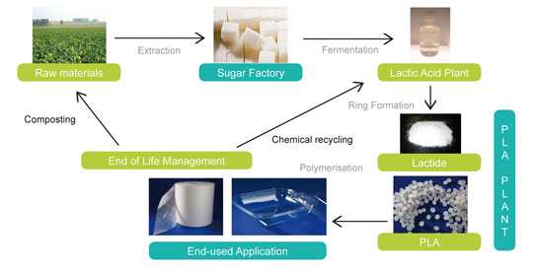
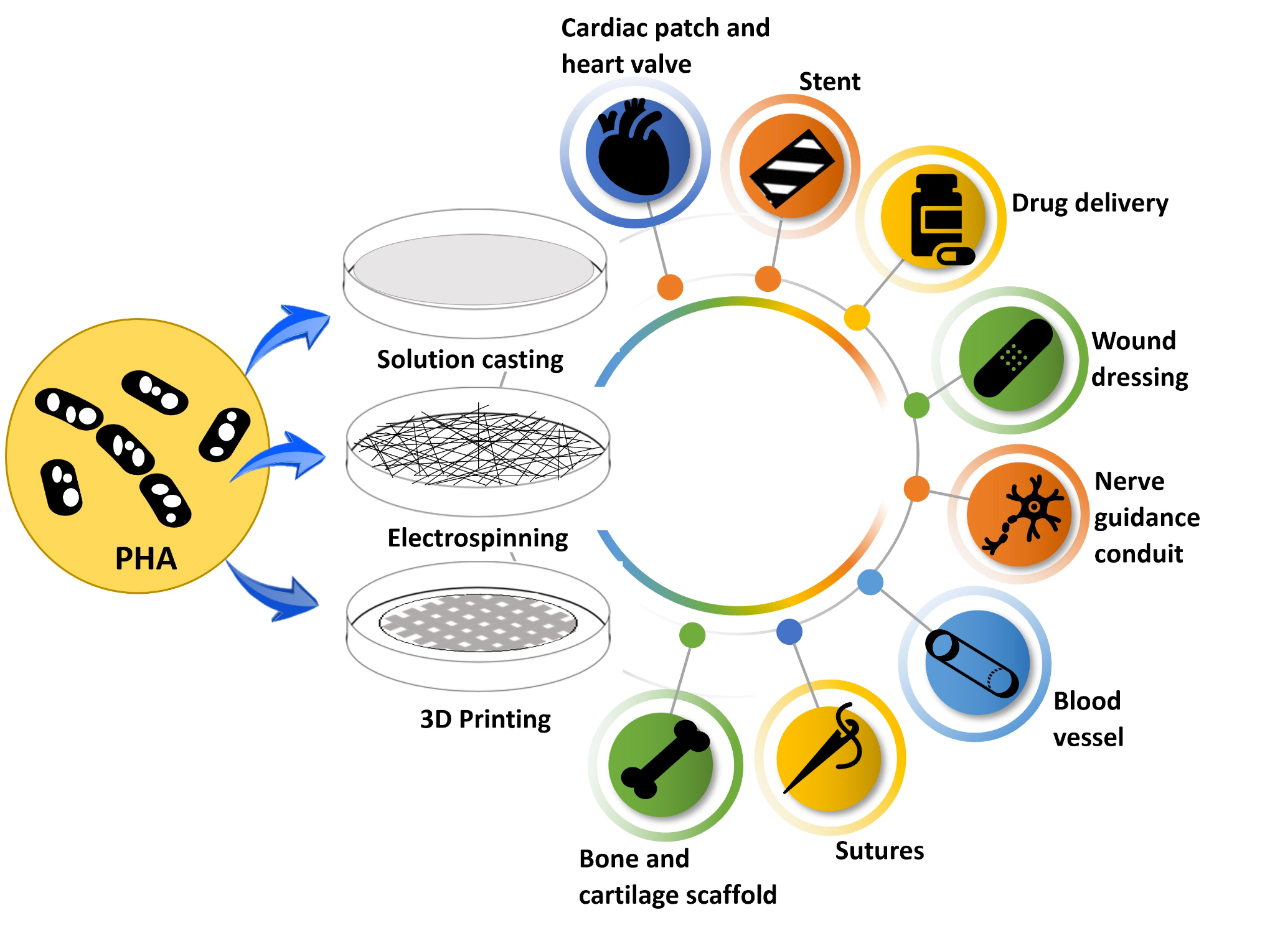
Two Types
Polylactic acid (PLA)
PLA bioplastics are made from the sugar in cornstarch and sugar cane.
Polyhydroxyalkanoate (PHA)
PHA bioplastics are made from bio-feedstock and microorganisms.
Notes:
Polylactic acid (PLA)
. These biodegradable and edible plastics are made by mixing corn kernels with sulfur dioxide and hot water. The kernels break down into starch, fiber, and protein, which then combine with citric acid to form a long-chain polymer that forms the building blocks for plastic.
Polyhydroxyalkanoate
PHA bioplastics are made from bio-feedstock and microorganisms.
Its microbes are deprived of nutrients but contain high levels of carbon, which produce carbon reserves to store in granules until they have enough to reproduce. PHA bioplastics are biodegradable and do not harm living tissue; thus, they are often used in creating medical equipment, such as slings and bone plates.

Slide 7
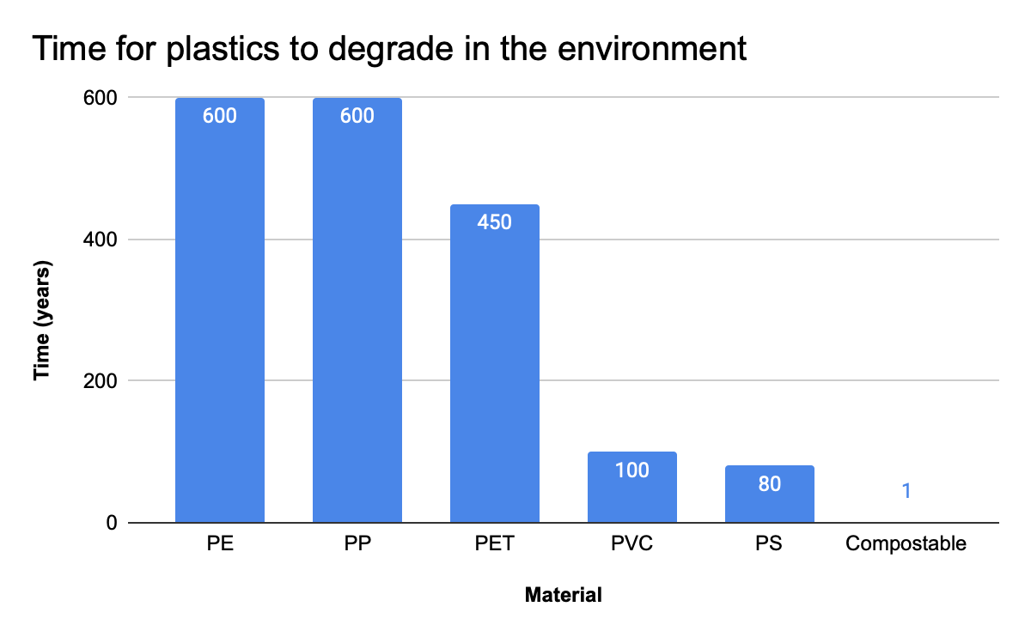
Compared to Normal Plastic
Bioplastics degrade much faster than conventional plastics making them much better for the environment.
Notes:
Conventional plastics, such as fossil-fuel plastics (also called petroleum-based polymers) are derived from petroleum or natural gas.
Bioplastics are plastics materials produced from renewable biomass sources, such as vegetable fats and oils, corn starch, straw, woodchips, recycled food waste, etc.
Conventional plastics, such as fossil-fuel plastics (also called petroleum-based polymers) are derived from petroleum or natural gas.
Bioplastics are plastics materials produced from renewable biomass sources, such as vegetable fats and oils, corn starch, straw, woodchips, recycled food waste, etc.

Slide 8
Compared to Normal Plastic
CONVENTIONAL PLASTIC
Materials: Finite resource. Linear. Extraction is causing severe health and environmental damages
Manufacturing: Plastic manufacturing facilities and plastic additive processing facilities, which can produce some significantly
harmful chemicals including phthalates and brominated flame retardants.
End of life: If contaminated with food: landfill or incineration. If not, at this stage, only a tiny portion of plastic packaging is actually recycled, especially after China’s National sword policy
Circularity: Depends on the plastic-type, but some plastics lose their functionality after a few cycles. It is also hard to guarantee food contact safety of recycled content.
BIOPLASTICS
Materials: Renewable, circular, carbon sequestration while the plants are growing.
Manufacturing: Natureworks claims that manufacturing Ingeo produces approximately 80% fewer greenhouse gases and uses approximately 52% less non-renewable energy (NREU) than traditional polymers like polystyrene
End of life: Composting by industrial compost facilities.
Circularity: Organic recycling: the loop is closed by producing a new resource (compost) that can be used to grow more plants.
Notes:
Plastics are a big part of our daily lives and an even bigger source of pollution. This is mainly because plastic is inexpensive to prodxuce and can be used in so many different applications in industry as well as in everyday life. To put it into perspective, the global plastic industry was worth about $579 billion in 2020 and is expected to be worth $750 billion by 2028! Today, bioplastics only have about 1% of the market share but this number is rising.

Slide 9
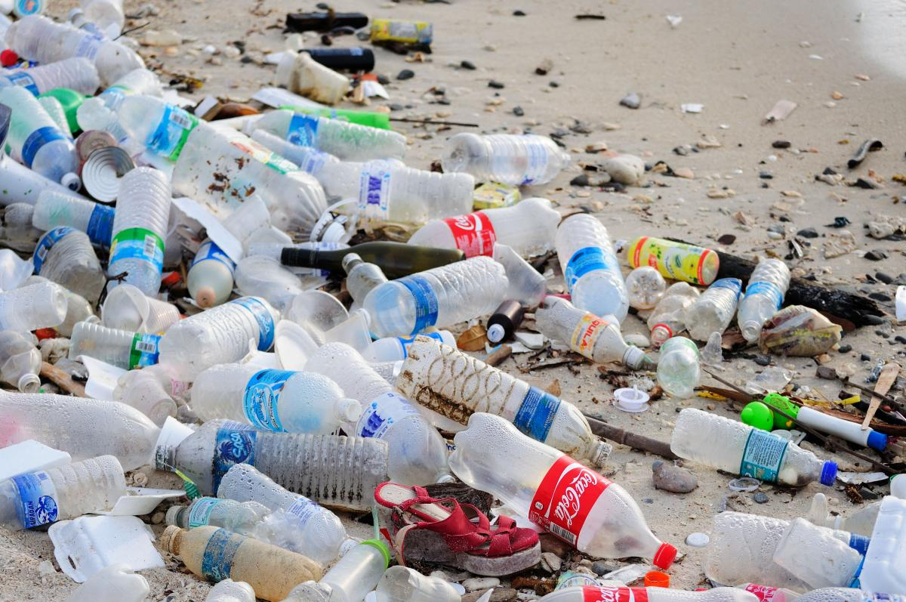
Pros and Cons
Pros:
Fewer Carbon Emissions
Enhanced biodegradability
Less plastic pollution
Make better use of natural resources
Improved food safety
They can be recycled
Cons:
Won’t biodegrade in landfills
Encourages littering
Contaminate plastic recycling systems
Bioplastics remain less than one percent of all plastics manufactured worldwide.
Most bioplastics do not yet save more carbon emissions than are required to manufacture them
Notes:
Pros: (extensions)
Bioplastics produce significantly fewer greenhouse gases than conventional plastics over their lifespan.
Bioplastics will naturally decompose in three to six months, but the average plastic takeaway container may take around 450 years to disintegrate.
Bioplastics are compostable at commercial facilities, meaning less recycling or general waste to manage. This also means that these items have no chemicals or toxins left behind.
There’s only so much crude oil left on earth. Based on current consumption levels, we can expect around 47 more years of oil before it’s all gone. After that, the world will have no other option but to switch to sustainable alternatives.
Biodegradable products are made using naturally occurring substances. As a result, they don’t contain harmful chemicals or pose any risks to intended users.
Bioplastics can be recycled before they start to degrade. This helps consumers dispose of their waste responsibly and extends the lifespan of the bioplastic packaging materials further, allowing them to be repurposed before they perish.

Slide 10
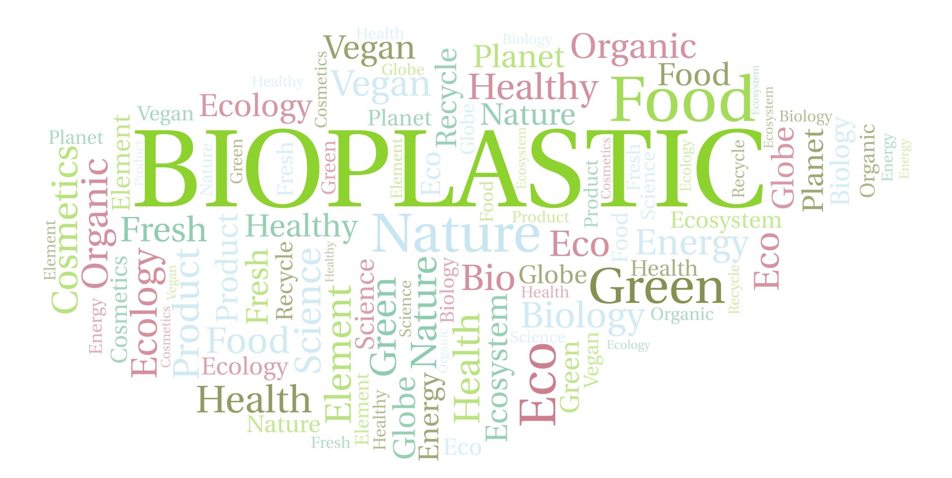
Summary
In conclusion:
Bioplastics are beneficial for the environment
Even though the are only a small percentage of the plastics being used and produced today, the more people that begin to use Bioplastic the more it will help our planet.
We are for this emerging technology because we believe that in the long run, it will help solve the immense problem of plastic contaminating our planet and oceans.
If we all make an effort to start using less conventional plastic and more bioplastic, then together we can help protect our environment

Slide 11
Resources
Bioplastics purpose - sciencedirect
Short History of Bioplastics - biopolylab
7 Advantages of Bioplastic Packaging for the Food and Drinks Industry- takeawaypackaging
The Pros and Cons of Bioplastics- greenhome
Making better plastic- explainthatstuff.com
Plastic v Bioplastic.- biopak
Picture - bioplasticsnews
Picture.- biopak.
Picture- carbiolice
The Truth About Bioplastics- news.climate.columbia.edu
GIF
Picture

Slide 12
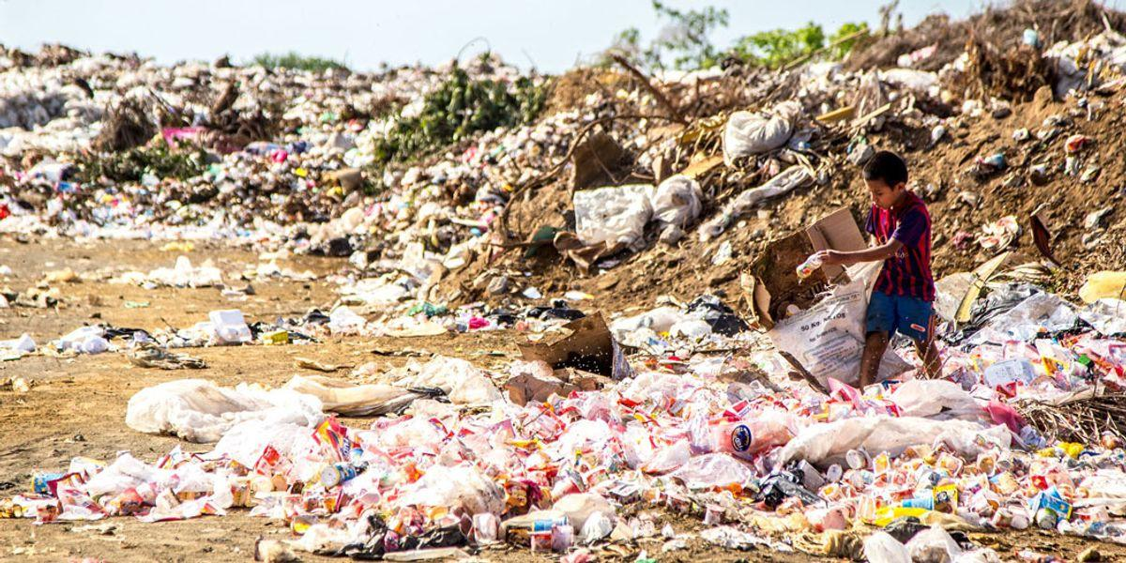
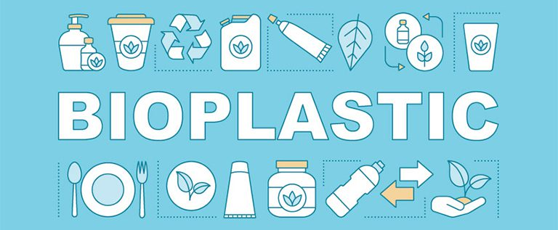
THANK YOU!

