Slide 1
Requirements for using AI in a nutshell. Good technologies, good data and an even better culture. Use of data-driven technologies and data analysis using generative or classic AI. Architectures and solutions.
Ferenczi László
Data-Driven Solutions Expert
Notes:
Slide 1:
Hello, everyone!
Good to see you here today.
I’m Ferenczi Laszlo, and I’m very excited to talk about AI and how it can make a big difference in manufacturing.
I think AI isn’t just a buzzword.
It’s a powerful tool that helps us make better decisions, faster.
But to make it work, we need to understand how it fits into our daily works.
So, today, we’ll go through how AI and data can be used to improve the way we work, making our jobs easier and more efficient.
When it comes to AI, there are three things that we absolutely need.
First, we need the right technology.
This includes the systems and tools that allow AI to do its job.
Second, we need good data.
Data that’s clean, accurate, and up to date.
AI is only as good as the data it uses, so if your data isn't reliable, the AI won't be.
Finally, and most importantly, we need a strong culture.
It's means all we need to be on the same page, when it speak about to using AI and data.
It’s not just the IT department’s responsibility.
Everyone in the company, from management to engineers to the people on the shop floor, needs to understand the value of data and how AI can help them in their day-to-day tasks.

Slide 2

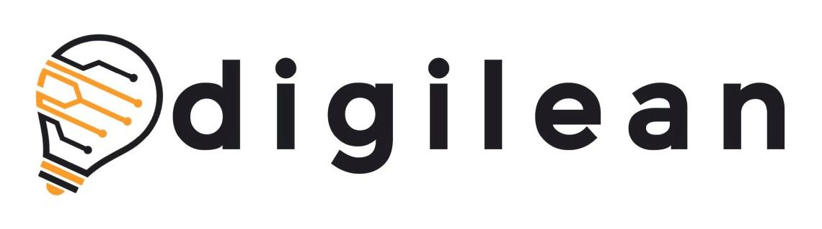
Define good objectives!
Objectives
Data
governance
Technology
Culture
Specific, Measurable, Accessable, Relevant and Time Specific
Notes:
Slide 2:
Before we start working with AI, it’s important to set clear goals.
What do we want AI to help us achieve?
For example, do we want to cut down on machine downtime by 10%?
Or maybe we want to improve product quality by reducing defects?
Whatever the goal is, it needs to be specific and measurable.
For example, use SMART framework for define goals!
These clear goals will help us stay focused and ensure that our AI projects are actually delivering value.
If we don’t set these goals from the start, we won’t know if the AI is helping or not.

Slide 3
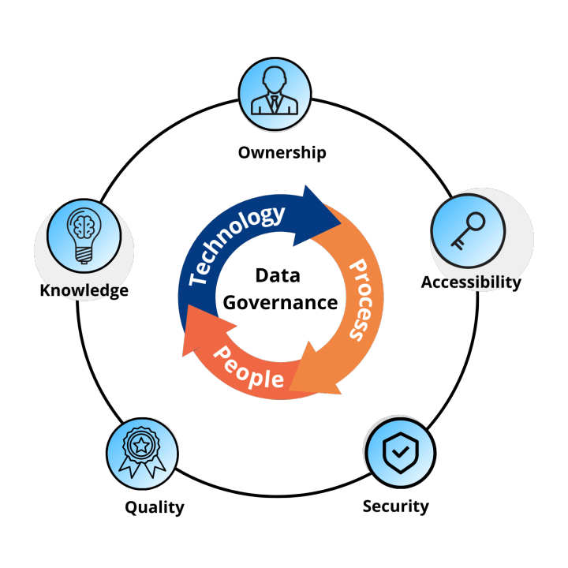
Use data governace!
Objectives
Data
governance
Technology
Culture
Notes:
Slide 3:
Next, let’s talk about data governance, which is all about how we manage our data.
The data is the fuel, that powers AI.
If the data is bad, the AI will give us bad results.
So, we need to make sure that our data is accurate, organized, and secure.
In manufacturing, data comes from many different sources like machines, sensors, production lines.
Managing all that data can be a challenge.
But if we set up good practices around data governance, we can ensure that our AI is always working with the best information possible.
This will lead to better decision making and fewer mistakes.

Slide 4

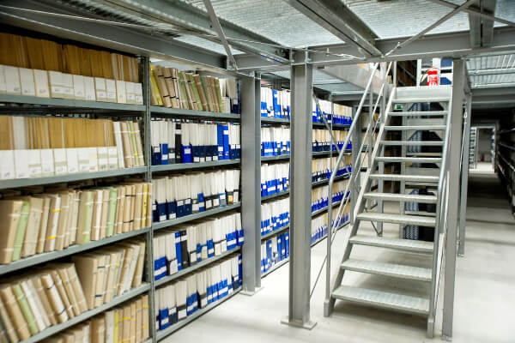
How is the health of your data?
Objectives
Data
governance
Technology
Culture
Notes:
Slide 4:
In the left side picture show how to see your data before data governance and right side is after.
What do you like?

Slide 5
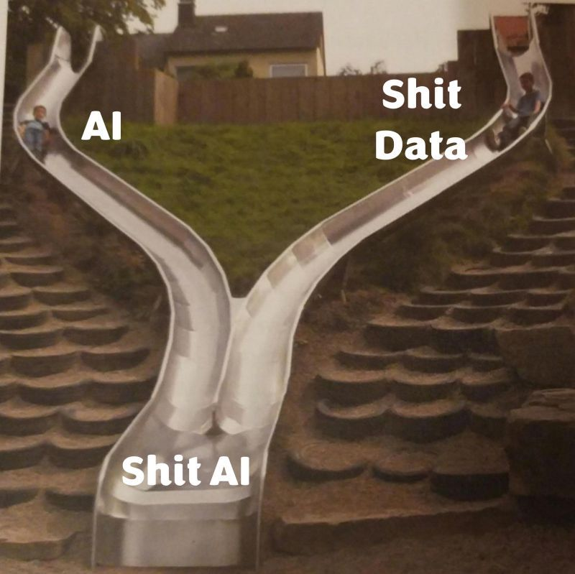
AI needs (very) good data!
Objectives
Data
governance
Technology
Culture
Notes:
Slide 5:
AI needs very good data to function effectively.
This is a fundamental truth in the world of AI.
Good data isn’t just a nice-to-have.
It’s essential for the success of any AI solutions.
When we talk about ‘good data,’ we’re referring to data that is accurate, complete, consistent, and timely.
If the data we feed into our AI models is flawed, the insights we gain from those models will also be flawed.
For instance, using inaccurate data for quality control can result in defective products reaching customers, leading to increased costs and damage to our brand reputation.
In addition, the type of data also matters.
In manufacturing, we collect various types of data, including numerical data from sensors, textual data from logs, and even image data from visual inspections.
Each type of data serves a different purpose and integrating them effectively is key to maximizing the capabilities of AI.
To ensure that our AI has the best possible data, we need to invest in strong data collection and management practices.
This might include implementing data validation processes, regularly auditing our data sources, and ensuring we have a robust data governance framework in place.
By doing this, we not only enhance the performance of our AI models but also support our business objectives and drive continuous improvement in our manufacturing processes.

Slide 6
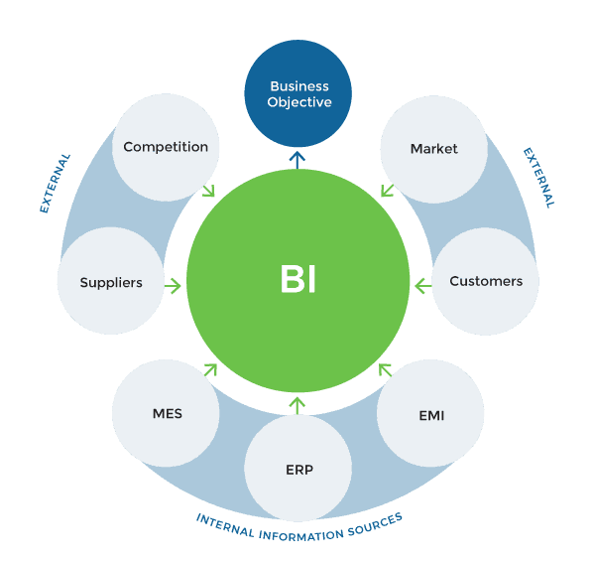
Use good data technologies!
Objectives
Data
governance
Technology
Culture
Notes:
Slide 6:
Using AI effectively also requires us to choose the right technologies.
In the next I speek about this technologies.

Slide 7
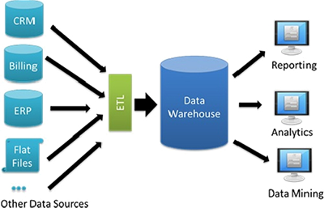
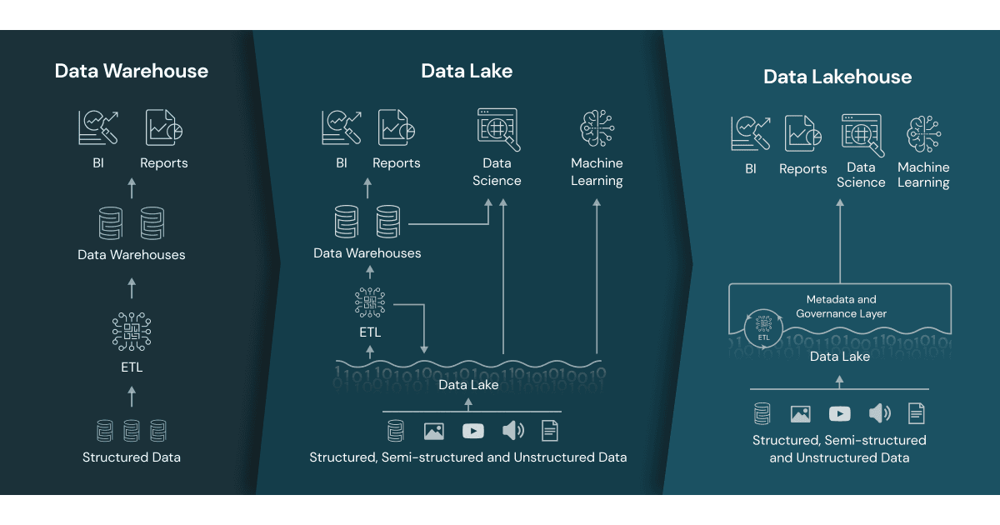
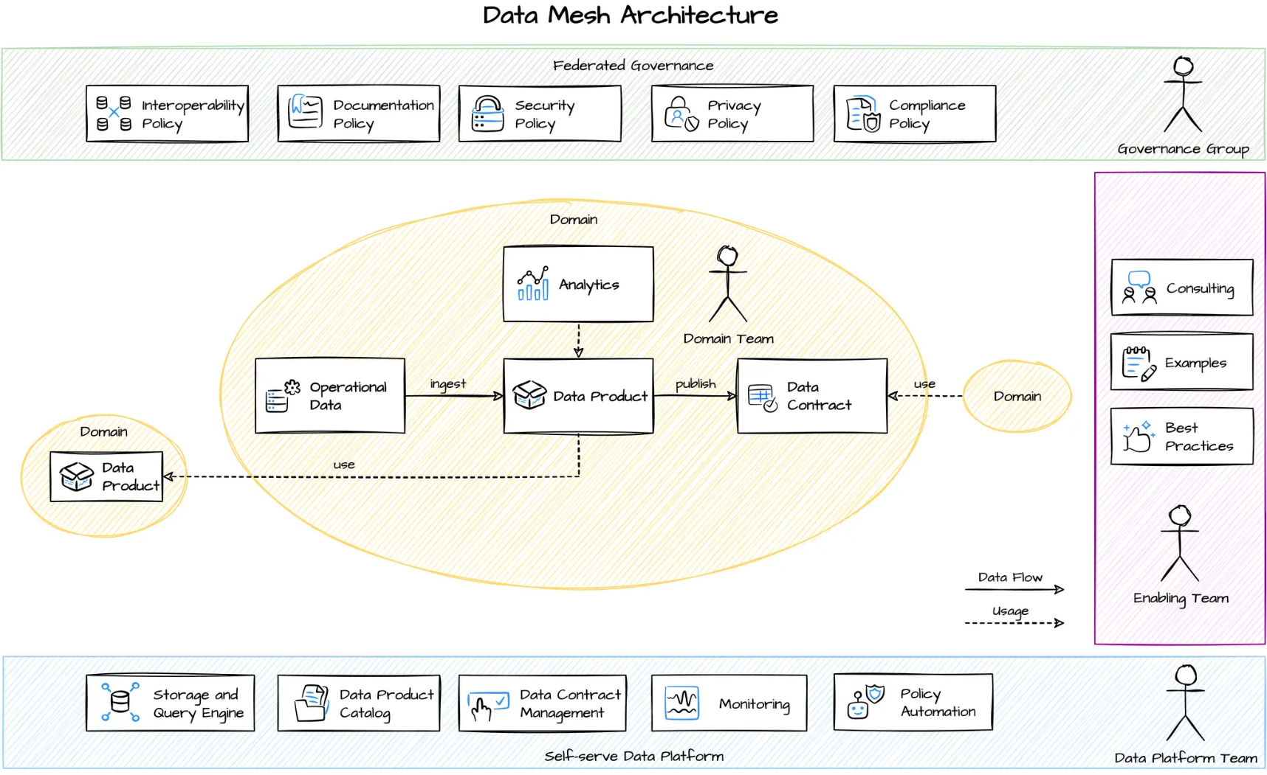
Data (any wheare) house
Objectives
Data
governance
Technology
Culture
PAST
PRESENT
FUTURE
A data warehouse is an enterprise system used for the analysis and reporting of structured and semi-structured data from multiple sources.
A data lake(house) is a centralized repository designed to store, process, and secure large amounts of structured, semistructured, and unstructured data. It can store data in its native format and process any variety of it, ignoring size limits.
A data mesh architecture is a decentralized approach that enables domain teams to perform cross-domain data analysis on their own. At its core is the domain with its responsible team and its operational and analytical data.
Notes:
Slide 7:
To make AI work, we also need to have the right technology infrastructure in place.
In manufacturing, we collect a lot of data every day, and we need to store and analyze that data effectively.
This is where things like data warehouses, data lakes, data meshes or cloud-based platforms come into play.
These technologies help us manage large amounts of data in real-time.
If we choose the right solution, it becomes much easier to implement AI at scale across our entire production process.
Without the right tech, even the best AI system won’t be able to deliver the results we’re hoping for.

Slide 8

PYTHON
Objectives
Data
governance
Most of AI and data solution in the last 10 year use PYTHON. PYTHON is a primary languange in data management and analysis field.
Some fact:
Python is on Mars
Python is older than Java
We can define infinite value in Python
Python can return multiple values
Python is named after a television show (Monty String Literal concatenation
Etc.
Technology
Culture
Source: https://afsalms7.medium.com/python-interesting-facts-3b2b77958dd0
Notes:
Slide 8:
One of the most popular tools for AI is Python.
Python is a programming language that has become a go-to for developing AI solutions.
It’s easy to use and incredibly powerful.
In manufacturing, we can use Python to automate routine tasks, like data analysis or machine monitoring.
For example, if we want to predict when a machine is about to break down, we can use Python to create an AI model that analyzes past data and predicts future problems.
Python is flexible and can handle large amounts of data, making it perfect for our needs in manufacturing.

Slide 9
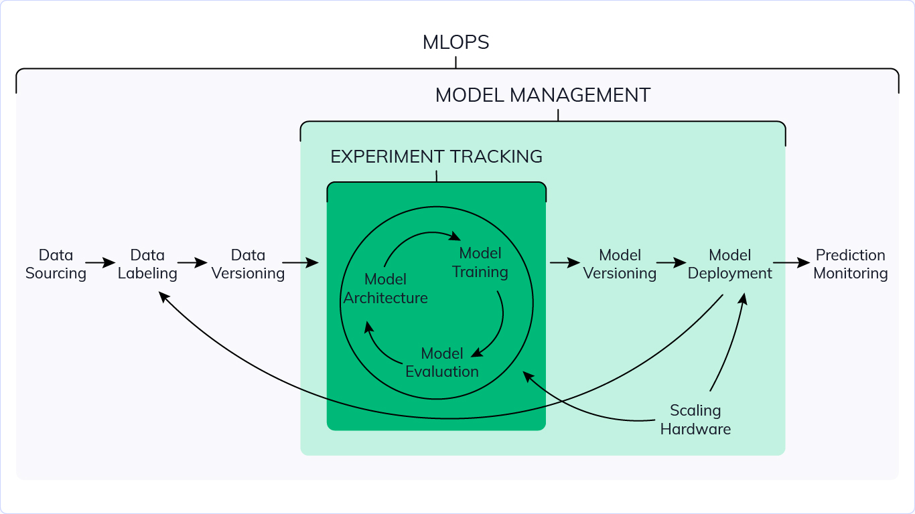
AI Development Workflow (AI/MLOps)
Objectives
Data
governance
Technology
Culture
MLOps (Machine Learning Operations) is a set of practices for collaboration and communication between data scientists and operations professionals.
Source: https://neptune.ai/blog/mlops
Notes:
Slide 9:
Now let’s talk about how we actually develop and deploy AI solutions.
This process is often referred to as the AI development workflow or MLOps.
The idea behind this workflow is to streamline collaboration between data scientists, engineers, and operations teams.
Ensuring that the AI models we build are not only effective but also integrated smoothly into our daily production processes.
The first step is data collection and preparation.
This is where we gather data from machines, sensors, and production lines, and clean it to make sure it’s usable for AI.
The next step is model development, where data scientists build and test AI models using tools like Python.
Once the model is ready, we move to deployment, where the model is integrated into our production environment, allowing it to make real-time decisions.
After deployment, it’s critical to continuously monitor and update the model to ensure it performs well over time.
This is where MLOps practices come in.
By automating much of the monitoring and updating, we ensure that the AI models stay effective without requiring constant manual intervention.
This workflow allows us to use AI in a reliable and scalable way, enabling us to apply machine learning to various parts of the manufacturing process, from predictive maintenance to quality control.

Slide 10
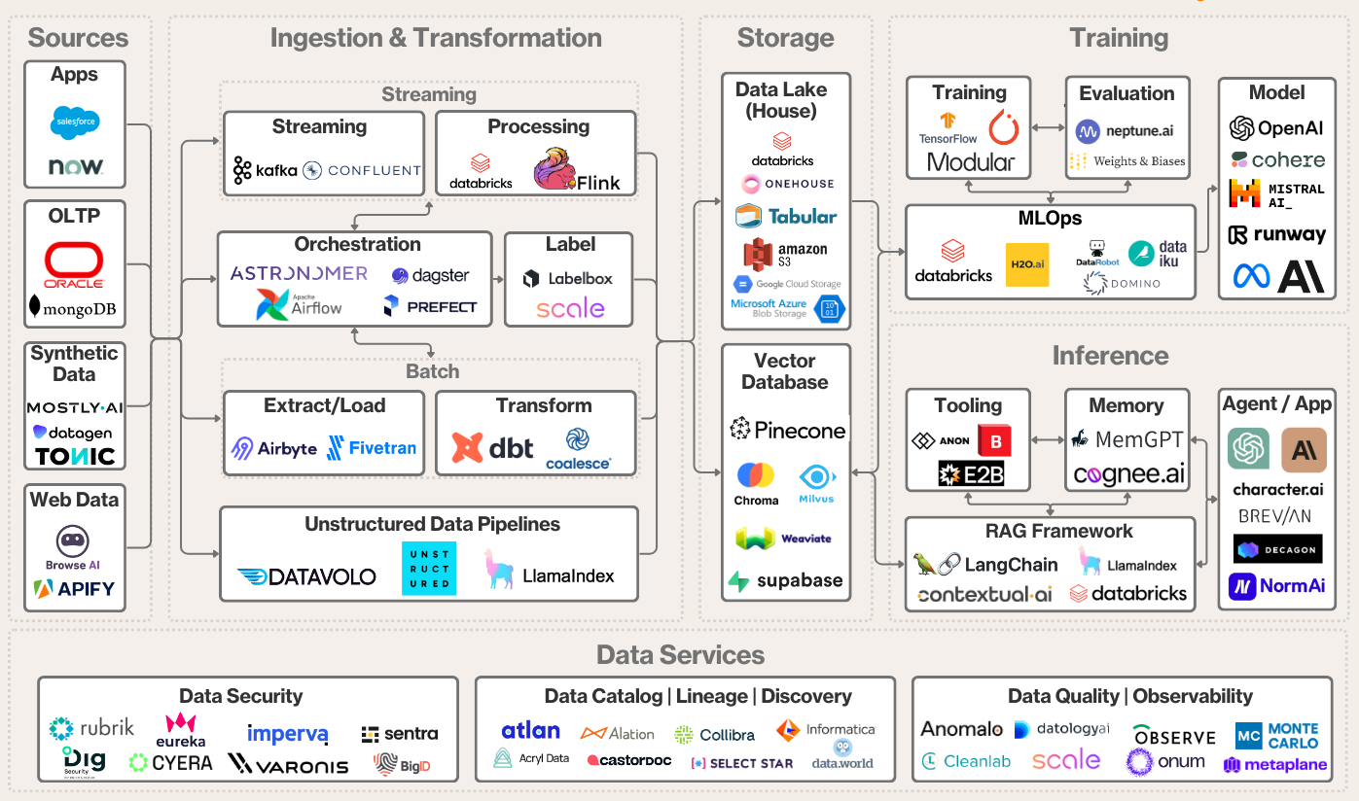
AI Data Infrastructure Value Chain
Objectives
Data
governance
Technology
Culture
Source: https://www.felicis.com/insight/ai-data-infrastructure
Notes:
Slide 10:
On this slide, we explore the AI Data Infrastructure Value Chain, which outlines the essential components needed to effectively leverage AI.
This value chain illustrates how data flows through different stages and the critical roles each component plays in maximizing the value we get from AI.
This point of view shows what kind of software component we can use in practice.
The previous slide showed the theory of this practical approach.
All stage of MLOps in this slide can we identify.
Note that almost all components are Python-based solutions. Database source is not.
This is the reason why I highlighted the importance of Python.

Slide 11
Type of AI: The Key Differences
Objectives
Data
governance
Focus and Output
Traditional AI: Its scope of operations is limited. The model uses data analysis to identify patterns, make predictions, and perform specific tasks. It's a highly efficient problem solver.
Generative AI: It creates original data based on human input and data analysis. This AI can be viewed as a creative assistant.
Applications
Traditional AI: Commonly used in tasks like spam filtering, fraud detection, and recommendation systems.
Generative AI: Employed in content creation like writing, music composition, and image generation.
Transparency
Traditional AI: Often operates on predefined rules, making its decision-making process more transparent and interpretable.
Generative AI: Can be less transparent due to the complex nature of its learning algorithms, making it challenging to understand how it arrives at specific outputs.
Technology
Culture
Source: https://www.ourcrowd.com/learn/generative-ai-vs-traditional-ai
Notes:
Slide 12:
Let’s take a closer look at the key differences between the two main types of AI: Traditional AI and Generative AI.
Understanding these differences will help us know when and how to use each in our manufacturing processes.
Traditional AI, sometimes called Narrow AI, is designed to perform specific tasks based on patterns in data.
It’s programmed with a set of rules or algorithms to solve problems in a structured way.
For example, in manufacturing, we use Traditional AI for tasks like fault detection, quality inspections, or predictive maintenance.
It better fit in areas where we have a lot of historical data and clear patterns to follow.
Traditional AI is efficient and reliable for tasks that are repetitive and predictable.
On the other hand, Generative AI is more flexible.
Instead of just following rules, it can create new data or solutions based on what it learns from existing information.
In manufacturing, Generative AI can help us optimize processes or even come up with new product designs by analyzing large datasets.
It’s like having a creative assistant that can suggest improvements or solutions that we might not have thought of ourselves.
One important differennce is transparency.
With Traditional AI, the decision-making process is often easier to understand because it follows predefined rules.
Generative AI, while powerful, can be more complex and less transparent.
It’s harder to know exactly how it arrives at a particular solution, which can sometimes make it difficult to fully trust its outputs.
Think about halucinations of Generative AI.
In summary, Traditional AI is great for automating specific tasks, while Generative AI is better for creating new solutions.
Both types have their place in manufacturing, and by using them together, we can maximize efficiency and innovation.

Slide 12
Introduce Data and AI Driven Culture
Objectives
Data
governance
Technology
Culture
To have a data-driven business, all employees must be encouraged to speak the same language.
This requires helping them understand the importance of that data and encouraging them to absorb the new culture.
The biggest obstacle to becoming a data-driven company is a lack of culture, not technology.
Notes:
Slide 12:
Finally, let’s talk about culture.
To really get the most out of AI, we need to build a culture that include data.
This means that everyone in the company should feel comfortable using data in their daily work.
Whether it’s the engineers, the production managers, or the people running the machines, everyone needs to understand how AI can help them do their jobs better.
The biggest challenge in becoming a data-driven company isn’t the technology it’s getting everyone on board and comfortable with using data and AI.
When we do that, we open up a lot of new opportunities for innovation and improvement.

Slide 13
Questions
Ferenczi László
Data-Driven Solutions Expert
Open-Tech Informatika Kft.
+36(20)947-48-84
laszlo.ferenczi@opentech.hu
Notes:
Slide 14:
To wrap things up, AI and data-driven solutions offer a lot of exciting possibilities for manufacturing.
But it’s important to remember that AI is not a magic fix.
It requires the right technology, good data, clear goals, and a supportive culture to work.
If we can bring all these elements together, we’ll be able to unlock new levels of efficiency, reduce waste, and improve the quality of our products.
I hope today’s presentation has given you some useful insights.
And if you have any questions, I will answer them.
Thank you.

