Slide 1
MDW Final Presentation
Keremcan CAKAR
Lyubomir Atanasov
Yohandi Widjaja
Yingkai Yu

Slide 2
Introduction
This is the final presentation of the MDW battleship project

Slide 3
Architecture Design
ILobbyCallBack
IChatCallback
Client 1
Server
IBattleShip
ILobby
IChat
Client 2
IBattleshipCallback

Slide 4
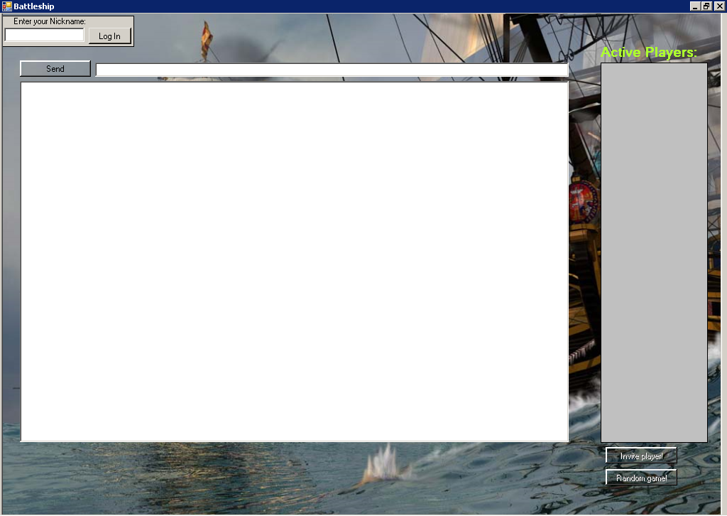
Lobby Interface

Slide 5
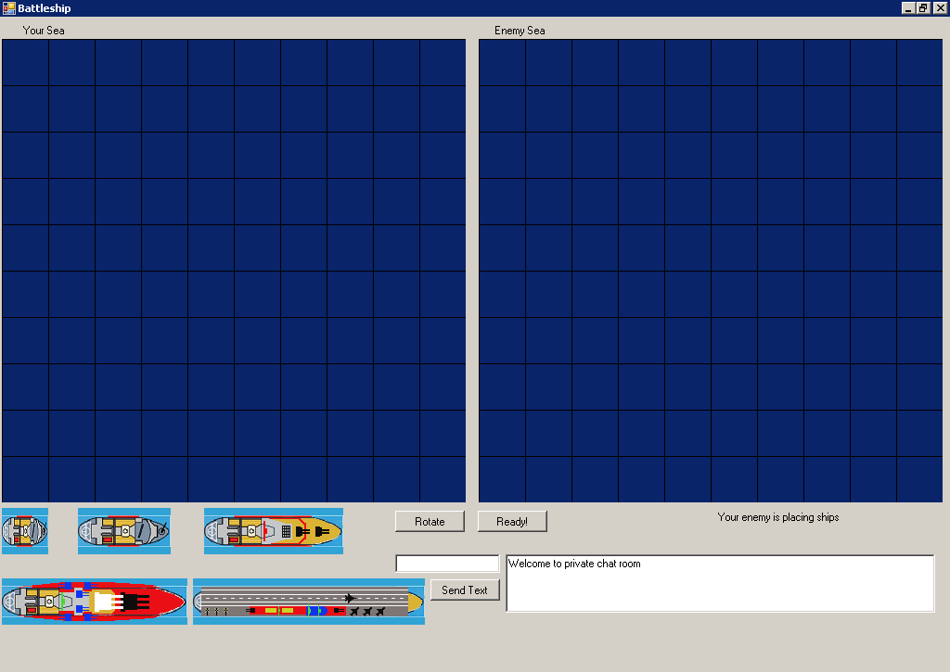
Client Interface

Slide 6
Main Functionality - Lobby
Log in
Chat in the lobby
Invite other player for a battle
Start a random battle

Slide 7
Main Functionality - Client
Chat in the game session
Rotate ship before placing
Place a ship
Remove a ship
Attacking enemy
Receiving hit
Determine end game

Slide 8
Demonstration Time

