Slide 1
Exception Handling ,File IO And Serialization, Collections & Generics
By Lata Verma

Slide 2
Exception Handling in Java
The exception handling in java is one of the powerful mechanism to handle the runtime errors so that normal flow of the application can be maintained.
In this page, we will learn about java exception, its type and the difference between checked and unchecked exceptions.
What is exception
Dictionary Meaning: Exception is an abnormal condition.
In java, exception is an event that disrupts the normal flow of the program. It is an object which is thrown at runtime.
What is exception handling
Exception Handling is a mechanism to handle runtime errors such as ClassNotFound, IO, SQL, Remote etc.

Slide 3
Advantage of Exception Handling
The core advantage of exception handling is to maintain the normal flow of the application. Exception normally disrupts the normal flow of the application that is why we use exception handling. Let's take a scenario:
statement 1;
statement 2;
statement 3;
statement 4;
statement 5;//exception occurs
statement 6;
statement 7;
statement 8;
statement 9;
statement 10;

Slide 4
Suppose there is 10 statements in your program and there occurs an exception at statement 5, rest of the code will not be executed i.e. statement 6 to 10 will not run. If we perform exception handling, rest of the exception will be executed. That is why we use exception handling in java.

Slide 5
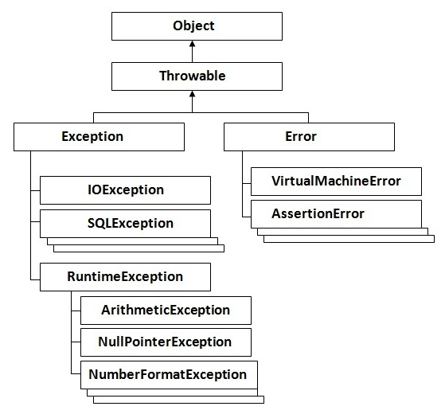
Hierarchy of Java Exception classes

Slide 6
Types of Exception
There are mainly two types of exceptions: checked and unchecked where error is considered as unchecked exception. The sun microsystem says there are three types of exceptions:
Checked Exception
Unchecked Exception
Error

Slide 7
Difference between checked and unchecked exceptions
1) Checked Exception
The classes that extend Throwable class except RuntimeException and Error are known as checked exceptions e.g.IOException, SQLException etc. Checked exceptions are checked at compile-time.
2) Unchecked Exception
The classes that extend RuntimeException are known as unchecked exceptions e.g. ArithmeticException, NullPointerException, ArrayIndexOutOfBoundsException etc. Unchecked exceptions are not checked at compile-time rather they are checked at runtime.
3) Error
Error is irrecoverable e.g. OutOfMemoryError, VirtualMachineError, AssertionError etc.

Slide 8
1) Scenario where ArithmeticException occurs
f we divide any number by zero, there occurs an ArithmeticException.
int a=50/0;//ArithmeticException
2) Scenario where NullPointerException occurs
If we have null value in any variable, performing any operation by the variable occurs an NullPointerException.
String s=null;
System.out.println(s.length());//NullPointerException
3) Scenario where NumberFormatException occurs
The wrong formatting of any value, may occur NumberFormatException. Suppose I have a string variable that have characters, converting this variable into digit will occur NumberFormatException.
String s="abc";
int i=Integer.parseInt(s);//NumberFormatException

Slide 9
Java Exception Handling Keywords
Java Exception Handling Keywords
try
catch
finally
throw
throws

Slide 10
The try-catch blocks and flow of programs

Slide 11
Java try-catch
Java try block
Java try block is used to enclose the code that might throw an exception. It must be used within the method.
Java try block must be followed by either catch or finally block.
Syntax of java try-catch
try{
//code that may throw exception
}catch(Exception_class_Name ref){}
Syntax of try-finally block
try{
//code that may throw exception
}finally{}

Slide 12
Java catch block
Let's try to understand the problem if we don't use try-catch block.
public class Testtrycatch1{
public static void main(String args[]){
int data=50/0;//may throw exception
System.out.println("rest of the code...");
}
}
Output:
Exception in thread main java.lang.ArithmeticException:/ by zero
As displayed in the above example, rest of the code is not executed (in such case, rest of the code... statement is not printed).
There can be 100 lines of code after exception. So all the code after exception will not be executed.

Slide 13
Solution by exception handling
Let's see the solution of above problem by java try-catch block.
public class Testtrycatch2{
public static void main(String args[]){
try{
int data=50/0;
}catch(ArithmeticException e){System.out.println(e);}
System.out.println("rest of the code...");
}
}
Output:-
Exception in thread main java.lang.ArithmeticException:/ by zero
rest of the code...

Slide 14
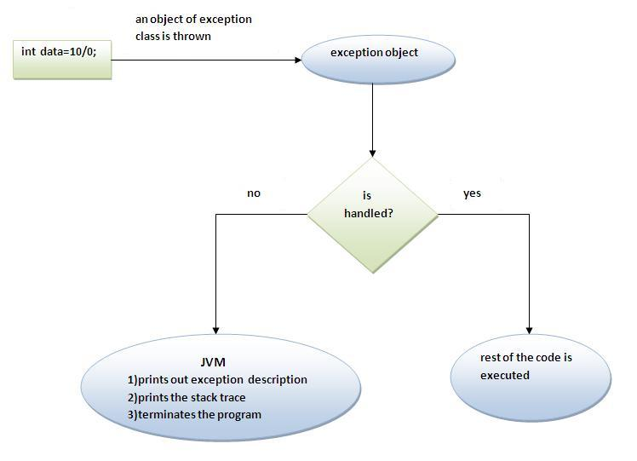
Internal working of java try-catch block

Slide 15
The JVM firstly checks whether the exception is handled or not. If exception is not handled, JVM provides a default exception handler that performs the following tasks:
Prints out exception description.
Prints the stack trace (Hierarchy of methods where the exception occurred).
Causes the program to terminate.
But if exception is handled by the application programmer, normal flow of the application is maintained i.e. rest of the code is executed.

Slide 16
Java catch multiple exceptions
Java catch multiple exceptions
public class TestMultipleCatchBlock{
public static void main(String args[]){
try{
int a[]=new int[5];
a[5]=30/0;
}
catch(ArithmeticException e){System.out.println("task1 is completed");}
catch(ArrayIndexOutOfBoundsException e){System.out.println("task 2 completed");}
catch(Exception e){System.out.println("common task completed");}
System.out.println("rest of the code...");
}
}

Slide 17
Output:task1 completed
rest of the code...
Rule: At a time only one Exception is occured and at a time only one catch block is executed.
Rule: All catch blocks must be ordered from most specific to most general i.e. catch for ArithmeticException must come before catch for Exception .

Slide 18
class TestMultipleCatchBlock1{
public static void main(String args[]){
try{
int a[]=new int[5];
a[5]=30/0;
}
catch(Exception e){System.out.println("common task completed");}
catch(ArithmeticException e){System.out.println("task1 is completed");}
catch(ArrayIndexOutOfBoundsException e){System.out.println("task 2 completed");}
System.out.println("rest of the code...");
}
} //Output:-compile Time Error

Slide 19
Java Nested try block
The try block within a try block is known as nested try block in java.
Why use nested try block
Sometimes a situation may arise where a part of a block may cause one error and the entire block itself may cause another error. In such cases, exception handlers have to be nested.

Slide 20
Syntax:
....
try
{
statement 1;
statement 2;
try
{
statement 1;
statement 2;
}
catch(Exception e)
{
}
}
catch(Exception e)
{
}
....

Slide 21
Java nested try example
class Excep6{
public static void main(String args[]){
try{
try{
System.out.println("going to divide");
int b =39/0;
}catch(ArithmeticException e){System.out.println(e);}
try{
int a[]=new int[5];
a[5]=4;
}catch(ArrayIndexOutOfBoundsException e){System.out.println(e);}
System.out.println("other statement);
}catch(Exception e){System.out.println("handeled");}
System.out.println("normal flow..");
}
}

Slide 22
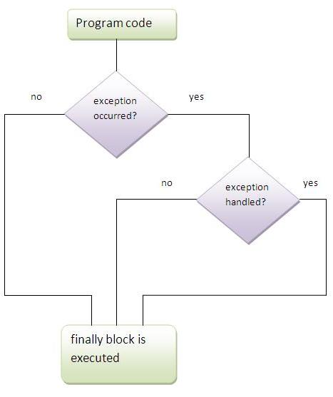
Java finally block
ava finally block is a block that is used to execute important code such as closing connection, stream etc.
Java finally block is always executed whether exception is handled or not.
Java finally block must be followed by try or catch block.

Slide 23
Note: If you don't handle exception, before terminating the program, JVM executes finally block(if any).
Rule: For each try block there can be zero or more catch blocks, but only one finally block.
Note: The finally block will not be executed if program exits(either by calling System.exit() or by causing a fatal error that causes the process to abort).

Slide 24
Java throw exception
Java throw keyword
The Java throw keyword is used to explicitly throw an exception.
We can throw either checked or uncheked exception in java by throw keyword. The throw keyword is mainly used to throw custom exception. We will see custom exceptions later.
The syntax of java throw keyword is given below.
throw exception;
Let's see the example of throw IOException.
throw new IOException("sorry device error);

Slide 25
java throw keyword example
In this example, we have created the validate method that takes integer value as a parameter. If the age is less than 18, we are throwing the ArithmeticException otherwise print a message welcome to vote.
public class TestThrow1{
static void validate(int age){
if(age<18)
throw new ArithmeticException("not valid");
else
System.out.println("welcome to vote");
}
public static void main(String args[]){
validate(13);
System.out.println("rest of the code...");
}
}

Slide 26
Java Exception propagation
An exception is first thrown from the top of the stack and if it is not caught, it drops down the call stack to the previous method,If not caught there, the exception again drops down to the previous method, and so on until they are caught or until they reach the very bottom of the call stack.This is called exception propagation.
Rule: By default Unchecked Exceptions are forwarded in calling chain (propagated).

Slide 27
Program of Exception Propagation
class TestExceptionPropagation1{
void m(){
int data=50/0;
}
void n(){
m();
}
void p(){
try{
n();
}catch(Exception e){System.out.println("exception handled");}
}
public static void main(String args[]){
TestExceptionPropagation1 obj=new TestExceptionPropagation1();
obj.p();
System.out.println("normal flow...");
}
}
Output :- Excepton Handled normal flow

Slide 28
In the above example exception occurs in m() method where it is not handled,so it is propagated to previous n() method where it is not handled, again it is propagated to p() method where exception is handled.
Exception can be handled in any method in call stack either in main() method,p() method,n() method or m() method.
Rule: By default, Checked Exceptions are not forwarded in calling chain (propagated).

Slide 29
Java throws keyword
The Java throws keyword is used to declare an exception. It gives an information to the programmer that there may occur an exception so it is better for the programmer to provide the exception handling code so that normal flow can be maintained.
Exception Handling is mainly used to handle the checked exceptions. If there occurs any unchecked exception such as NullPointerException, it is programmers fault that he is not performing check up before the code being used.
Syntax of java throws
return_type method_name() throws exception_class_name{
...
}

Slide 30
Which exception should be declared
Ans) checked exception only, because:
unchecked Exception: under your control so correct your code.
error: beyond your control e.g. you are unable to do anything if there occurs VirtualMachineError or StackOverflowError.
Advantage of Java throws keyword
Now Checked Exception can be propagated (forwarded in call stack).
It provides information to the caller of the method about the exception.

Slide 31
Java throws example
Let's see the example of java throws clause which describes that checked exceptions can be propagated by throws keyword.
import java.io.IOException;
class Testthrows1{
void m()throws IOException{
throw new IOException("device error");//checked exception
}
void n()throws IOException{
m();
}
void p(){
try{
n();
}catch(Exception e){System.out.println("exception handled");}
}
public static void main(String args[]){
Testthrows1 obj=new Testthrows1();
obj.p();
System.out.println("normal flow...");
}
} Output:-Exception Handled normal flow

Slide 32
Difference between throw and throws in Java
No. | throw | throws
1) | Java throw keyword is used to explicitly throw an exception. | Java throws keyword is used to declare an exception.
2) | Checked exception cannot be propagated using throw only. | Checked exception can be propagated with throws.
3) | Throw is followed by an instance. | Throws is followed by class.
4) | Throw is used within the method. | Throws is used with the method signature.
5) | You cannot throw multiple exceptions. | You can declare multiple exceptions e.g.

Slide 33
Java throw example
void m(){
throw new ArithmeticException("sorry");
}
Java throws example
void m()throws ArithmeticException{
//method code
}
Java throw and throws example
void m()throws ArithmeticException{
throw new ArithmeticException("sorry");
}

Slide 34
Difference between final, finally and finalize
No. | final | finally | finalize
1) | Final is used to apply restrictions on class, method and variable. Final class can't be inherited, final method can't be overridden and final variable value can't be changed. | Finally is used to place important code, it will be executed whether exception is handled or not. | Finalize is used to perform clean up processing just before object is garbage collected.
2) | Final is a keyword. | Finally is a block. | Finalize is a method.

Slide 35
Java Custom Exception
If you are creating your own Exception that is known as custom exception or user-defined exception. Java custom exceptions are used to customize the exception according to user need.
By the help of custom exception, you can have your own exception and message.
Let's see a simple example of java custom exception.
class InvalidAgeException extends Exception{
InvalidAgeException(String s){
super(s);
}
}

Slide 36
class TestCustomException1{
static void validate(int age)throws InvalidAgeException{
if(age<18)
throw new InvalidAgeException("not valid");
else
System.out.println("welcome to vote");
}
public static void main(String args[]){
try{
validate(13);
}catch(Exception m){System.out.println("Exception occured: "+m);}
System.out.println("rest of the code...");
}
}

Slide 37
Assignment
Create a class Customer having following members:
privateStringcustNo
private String custName
private String category
Parameterized constructor to initialize all instance variables
Getter methods for all instance variables
Perform following validations in the constructor
custNo must start with ‘C’ or ‘c’
custNamemust be atleast of 4 characters
category must be either ‘Platinum’, ‘Gold’ or ‘Silver‘
When any of these validations fail, then raise a user defined exceptionInvalidInputException
Create a class TestCustomer having main method. Ask user to enter customer details. Create an object of Customer and perform validations. Print details of customer.

Slide 38
JAVA IO

Slide 39
Java Input Output
Java I/O (Input and Output) is used to process the input and produce the output based on the input.
Java uses the concept of stream to make I/O operation fast. The java.io package contains all the classes required for input and output operations.
We can perform file handling in java by java IO API.

Slide 40
Streams
Stream
A stream is a sequence of data.In Java a stream is composed of bytes. It's called a stream because it's like a stream of water that continues to flow.
In java, 3 streams are created for us automatically. All these streams are attached with console.
1) System.out: standard output stream
2) System.in: standard input stream
3) System.err: standard error stream
Let's see the code to print output and error message to the console.

Slide 41
Input Stream/OutPut Stream
OutputStream:-
Java application uses an output stream to write data to a destination, it may be a file,an array,peripheral device or socket.
InputStream:-
Java application uses an input stream to read data from a source, it may be a file,an array,peripheral device or socket.

Slide 42
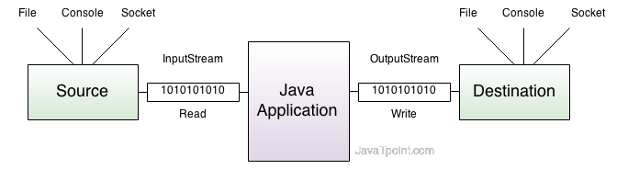
Java IO

Slide 43
InputStream class
Commonly used methods of InputStream class
Method Description
1) public abstract int read()throws IOException: reads the next byte of data from the input stream.It returns -1 at the end of file.
2) public int available()throws IOException: returns an estimate of the number of bytes that can be read from the current input stream.
3) public void close()throws IOException: is used to close the current input stream.

Slide 44
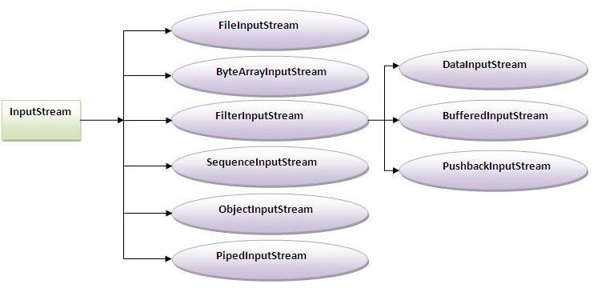
InputStream Hierarchy

Slide 45
OutputStream class
OutputStream class is an abstract class.It is the superclass of all classes representing an output stream of bytes. An output stream accepts output bytes and sends them to some sink.
Commonly used methods of OutputStream class
Method | Description
1) public void write(int)throws IOException: | is used to write a byte to the current output stream.
2)Public void write(byte[])throws IOException: | is used to write an array of byte to the current output stream.
3) public void flush()throws IOException: | flushes the current output stream.
4) public void close()throws IOException: | is used to close the current output stream.

Slide 46
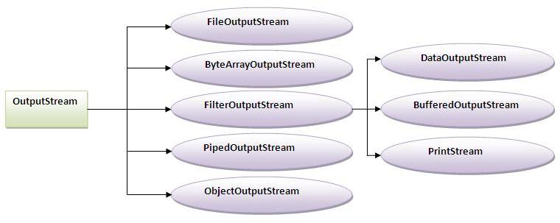

Slide 47
Java FileWriter and FileReader (File Handling in java)
Java FileWriter and FileReader classes are used to write and read data from text files. These are character-oriented classes, used for file handling in java.
Java has suggested not to use the FileInputStream and FileOutputStream classes if you have to read and write the textual information.
Java FileWriter class
Java FileWriter class is used to write character-oriented data to the file.
Constructors of FileWriter class
Constructor Description
FileWriter(String file) creates a new file. It gets file name in string.
FileWriter(File file) creates a new file. It gets file name in File object.

Slide 48
Methods of FileWriter class
Method Description
1) public void write(String text) writes the string into FileWriter.
2) public void write(char c) writes the char into FileWriter.
3) public void write(char[] c) writes char array into FileWriter.
4) public void flush() flushes the data of FileWriter.
5) public void close() closes FileWriter.

Slide 49
Java FileWriter Example
In this example, we are writing the data in the file abc.txt.
import java.io.*;
class Simple{
public static void main(String args[]){
try{
FileWriter fw=new FileWriter("abc.txt");
fw.write("my name is sachin");
fw.close();
}catch(Exception e){System.out.println(e);}
System.out.println("success");
}
}

Slide 50
FileReader class
java FileReader class is used to read data from the file. It returns data in byte format like FileInputStream class.
Constructors of FileWriter class:-
FileReader(String file):-It gets filename in string. It opens the given file in read mode. If file doesn't exist, it throws FileNotFoundException.
FileReader(File file):- It gets filename in file instance. It opens the given file in read mode. If file doesn't exist, it throws FileNotFoundException.
Methods of FileReader class:-
1) public int read() returns a character in ASCII form. It returns -1 at the end of file.
2) public void close() closes FileReader.

Slide 51
FileReader Example
import java.io.*;
class Simple{
public static void main(String args[])throws Exception{
FileReader fr=new FileReader("abc.txt");
int i;
while((i=fr.read())!=-1)
System.out.println((char)i);
fr.close();
}
}

Slide 52
BufferedReader class
BufferedReader class can be used to read data line by line by readLine() method.
import java.io.*;
class G5{
public static void main(String args[])throws Exception{
InputStreamReader r=new InputStreamReader(System.in);
BufferedReader br=new BufferedReader(r);
System.out.println("Enter your name");
String name=br.readLine();
System.out.println("Welcome "+name);
}
}

Slide 53
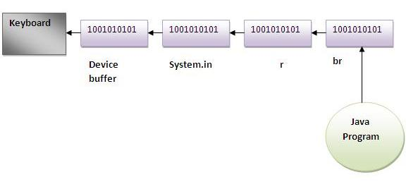

Slide 54
Example of reading data from keyboard by InputStreamReader and BufferdReader class until the user writes stop
import java.io.*;
class G5{
public static void main(String args[])throws Exception{
InputStreamReader r=new InputStreamReader(System.in);
BufferedReader br=new BufferedReader(r);
String name="";
while(!name.equals("stop")){
System.out.println("Enter data: ");
name=br.readLine();
System.out.println("data is: "+name);
}
br.close();
r.close();
}
}

Slide 55
Java BufferedOutputStream and BufferedInputStream
Java BufferedOutputStream class
Java BufferedOutputStream class uses an internal buffer to store data. It adds more efficiency than to write data directly into a stream. So, it makes the performance fast.
Example of BufferedOutputStream class:-
In this example, we are writing the textual information in the BufferedOutputStream object which is connected to the FileOutputStream object. The flush() flushes the data of one stream and send it into another. It is required if you have connected the one stream with another.

Slide 56
import java.io.*;
class Test{
public static void main(String args[])throws Exception{
FileOutputStream fout=new FileOutputStream("f1.txt");
BufferedOutputStream bout=new BufferedOutputStream(fout);
String s="Sachin is my favourite player";
byte b[]=s.getBytes();
bout.write(b);
bout.flush();
bout.close();
fout.close();
System.out.println("success");
}
}

Slide 57
Java BufferedInputStream class
import java.io.*;
class SimpleRead{
public static void main(String args[]){
try{
FileInputStream fin=new FileInputStream("f1.txt");
BufferedInputStream bin=new BufferedInputStream(fin);
int i;
while((i=bin.read())!=-1){
System.out.println((char)i);
}
bin.close();
fin.close();
}catch(Exception e){system.out.println(e);}
}
}

Slide 58
Serialization
Serialization in java is a mechanism of writing the state of an object into a byte stream.
It is mainly used in Hibernate, RMI, JPA, EJB, JMS technologies.
The reverse operation of serialization is called deserialization.
The String class and all the wrapper classes implements java.io.Serializable interface by default.
Advantage of Java Serialization
It is mainly used to travel object's state on the network (known as marshaling).

Slide 59
java.io.Serializable interface
Serializable is a marker interface (has no body). It is just used to "mark" java classes which support a certain capability.
It must be implemented by the class whose object you want to persist. Let's see the example given below:
import java.io.Serializable;
public class Student implements Serializable{
int id;
String name;
public Student(int id, String name) {
this.id = id;
this.name = name;
}
}

Slide 60
ObjectOutputStream class:-
The ObjectOutputStream class is used to write primitive data types and Java objects to an OutputStream. Only objects that support the java.io.Serializable interface can be written to streams.
Constructor:-
1) public ObjectOutputStream(OutputStream out) throws IOException {}creates an ObjectOutputStream that writes to the specified OutputStream.
Important Methods
1) public final void writeObject(Object obj) throws IOException {} writes the specified object to the ObjectOutputStream.
2) public void flush() throws IOException {} flushes the current output stream.
3) public void close() throws IOException {} closes the current output stream.

Slide 61
Example of Java Serialization
In this example, we are going to serialize the object of Student class. The writeObject() method of ObjectOutputStream class provides the functionality to serialize the object. We are saving the state of the object in the file named f.txt.
import java.io.*;
class Persist{
public static void main(String args[])throws Exception{
Student s1 =new Student(211,"ravi");
FileOutputStream fout=new FileOutputStream("f.txt");
ObjectOutputStream out=new ObjectOutputStream(fout);
out.writeObject(s1);
out.flush();
System.out.println("success");
}
}

Slide 62
Deserialization in java
is the process of reconstructing the object from the serialized state.It is the reverse operation of serialization.

Slide 63
ObjectInputStream class
An ObjectInputStream deserializes objects and primitive data written using an ObjectOutputStream.
Constructor
public ObjectInputStream(InputStream in) throws IOException {}
creates an ObjectInputStream that reads from the specified InputStream.
Method Description
1) public final Object readObject() throws IOException, ClassNotFoundException{} reads an object from the input stream.
2) public void close() throws IOException {} closes ObjectInputStream.

Slide 64
Deserilization:-
import java.io.*;
class Depersist{
public static void main(String args[])throws Exception{
ObjectInputStream in=new ObjectInputStream(new FileInputStream("f.txt"));
Student s=(Student)in.readObject();
System.out.println(s.id+" "+s.name);
in.close();
}
}

Slide 65
Serial version UID
During object serialization, the default Java serialization mechanism writes the metadata about the object, which includes the class name, field names and types, and superclass. This class definition is stored as a part of the serialized object. This stored metadata enables the deserialization process to reconstitute the objects and map the stream data into the class attributes with the appropriate type.

Slide 66
The suid is set in one of two ways, with the first being the default mechanism described above. The Java serialization mechanism automatically computes a hash value. ObjectStreamClass's computeSerialVersionUID method passes the class name, sorted member names, modifiers, and interfaces to the secure hash algorithm (SHA), which returns a hash value. This computation technique ensures that most changes in an object's "shape" and attribute types result in different hash values. I elaborate on the significance of this default suid generation later when I discuss release compatibility.

Slide 67
Java Serialization Caveats
Inheritance and Composition
When a class implements the java.io.Serializable interface, all its sub-classes are serializable as well. On the contrary, when an object has a reference to another object, these objects must implement the Serializable interface separately, or else a NotSerializableException will be thrown:
public class Person implements Serializable {
private int age;
private String name;
private Address country; // must be serializable too
}
If one of the fields in a serializable object consists of an array of objects, then all these objects must be serializable as well, or else a NotSerializableException will be thrown.

Slide 68
Serial Version UID
The JVM associates a version (long) number with each serializable class. It is used to verify that the saved and loaded objects have the same attributes and thus are compatible on serialization.
This number can be generated automatically by most IDEs and is based on the class name, its attributes and associated access modifiers. Any changes result in a different number and can cause an InvalidClassException.
If a serializable class doesn’t declare a serialVersionUID, the JVM will generate one automatically at run-time. However, it is highly recommended that each class declares its serialVersionUID as the generated one is compiler dependent and thus may result in unexpected InvalidClassExceptions.

Slide 69
Changes to a serializable class can be either compatible or incompatible. A compatible change results in the evolved class being able to deserialize objects serialized by the class of a prior release. Conversely, the object serialized by the evolved class can be deserialized by the class's prior version. Compatible changes typically result from adding fields or objects to the object graph. With the addition of fields or objects, the default Java serialization read-mechanism simply provides default values for the corresponding attribute types. Examples of compatible changes are the following:
Add fields
Change a field from static to non-static
Change a field from transient to non-transient
Add classes to the object tree
Incompatible changes typically result from the removal of fields or objects from the object tree. As the default read-mechanism traverses the byte stream, it raises an exception when the target field no longer exists to accept the data. For example, when a class found in the prior version no longer exists in the evolved version, the default read-mechanism raises a ClassNotFound exception, whereas on a missing field, the InvalidArgumentException is raised.

Slide 70
Custom Serialization in Java
Java specifies a default way in which objects can be serialized. Java classes can override this default behavior. Custom serialization can be particularly useful when trying to serialize an object that has some unserializable attributes. This can be done by providing two methods inside the class that we want to serialize:
private void writeObject(ObjectOutputStream out) throws IOException;
and
private void readObject(ObjectInputStream in)
throws IOException, ClassNotFoundException;

Slide 71
With these methods, we can serialize those unserializable attributes into other forms that can be serialized:
public class Employee implements Serializable {
private static final long serialVersionUID = 1L;
private transient Address address;
private Person person;
// setters and getters
private void writeObject(ObjectOutputStream oos)
throws IOException {
oos.defaultWriteObject();
oos.writeObject(address.getHouseNumber());
}

Slide 72
private void readObject(ObjectInputStream ois)
throws ClassNotFoundException, IOException {
ois.defaultReadObject();
Integer houseNumber = (Integer) ois.readObject();
Address a = new Address();
a.setHouseNumber(houseNumber);
this.setAddress(a);
}
}
public class Address {
private int houseNumber;
// setters and getters
}
The following unit test tests this custom serialization:
@Test

Slide 73
public void whenCustomSerializingAndDeserializing_ThenObjectIsTheSame()
throws IOException, ClassNotFoundException {
Person p = new Person();
p.setAge(20);
p.setName("Joe");
Address a = new Address();
a.setHouseNumber(1);
Employee e = new Employee();
e.setPerson(p);
e.setAddress(a);
FileOutputStream fileOutputStream
= new FileOutputStream("yourfile2.txt");
ObjectOutputStream objectOutputStream
= new ObjectOutputStream(fileOutputStream);
objectOutputStream.writeObject(e);

Slide 74
objectOutputStream.flush();
objectOutputStream.close();
FileInputStream fileInputStream
= new FileInputStream("yourfile2.txt");
ObjectInputStream objectInputStream
= new ObjectInputStream(fileInputStream);
Employee e2 = (Employee) objectInputStream.readObject();
objectInputStream.close();
assertTrue(
e2.getPerson().getAge() == e.getPerson().getAge());
assertTrue(
e2.getAddress().getHouseNumber() == e.getAddress().getHouseNumber());
}
In this code, we see how to save some unserializable attributes by serializing Address with custom serialization. Note that we must mark the unserializable attributes as transient to avoid the NotSerializableException.

Slide 75
Assignment
Create a class DirectoryList having main method. Read a directory name from user. Search the existence of the directory. If exists, display all files and subdirectories present in that. Otherwise, display a message Directory does not exists.
Create a class Employee having members as follows:
private int empNo
private String empName
private int empBasic
Parameterized constructor to initialize members.
Getter methods for all instance variables
Create a class WriteEmployee having main method. Ask user to enter details of an employee and set them in an Employee object. Store details of this object in a file emp.txt.
Read employee details from the file and display those details.

Slide 76
Collections

Slide 77
Collections
Collections in java is a framework that provides an architecture to store and manipulate the group of objects.
It provides a system for organizing and handling collections
It belong to java.util package.

Slide 78
What is Collection in java
Collection represents a single unit of objects i.e. a group.

Slide 79
What is framework in java
provides readymade architecture.
represents set of classes and interface.

Slide 80
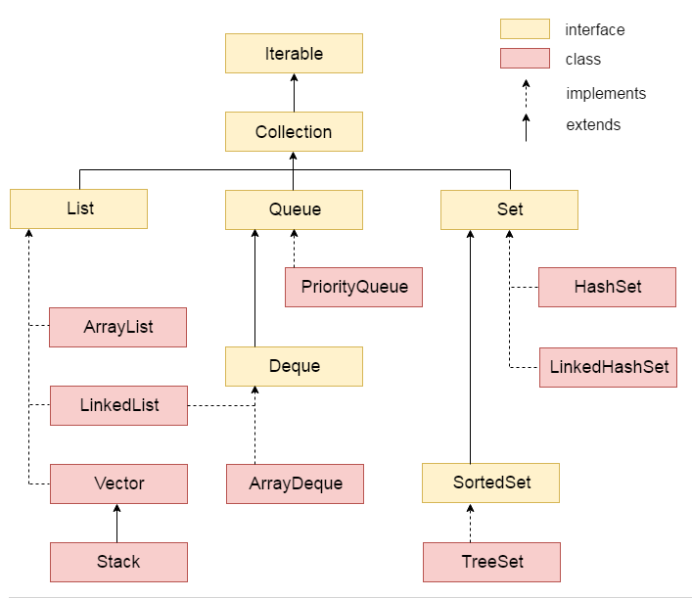
Collections Hierarchy

Slide 81
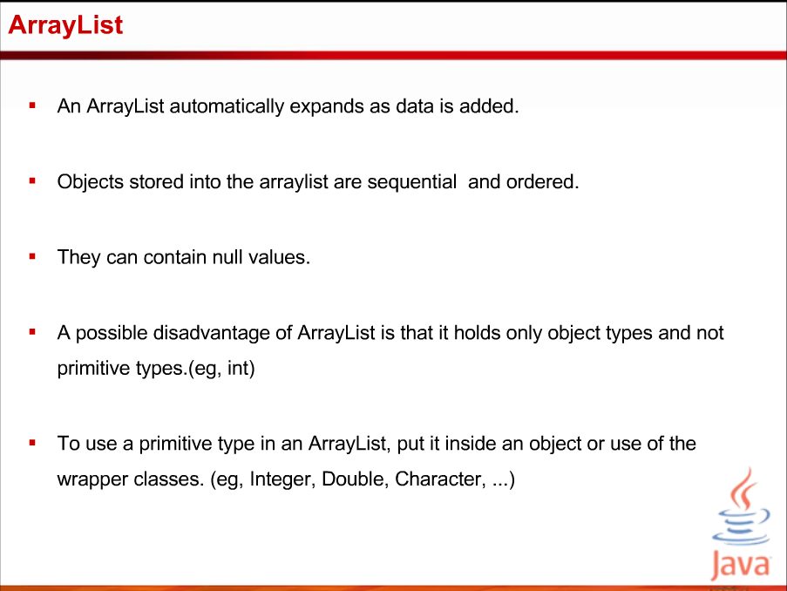

Slide 82
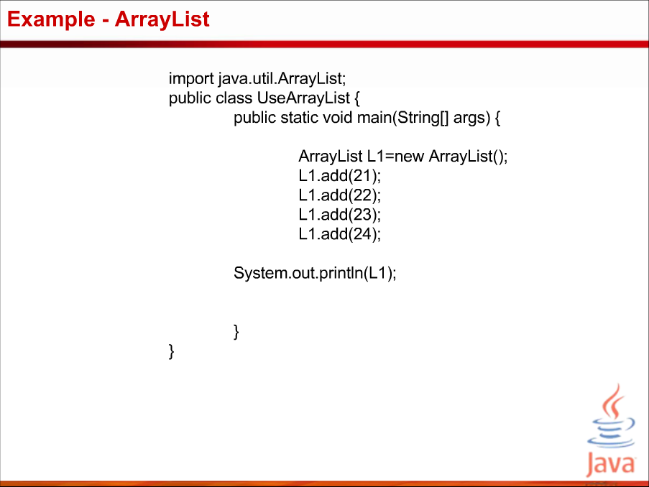

Slide 83
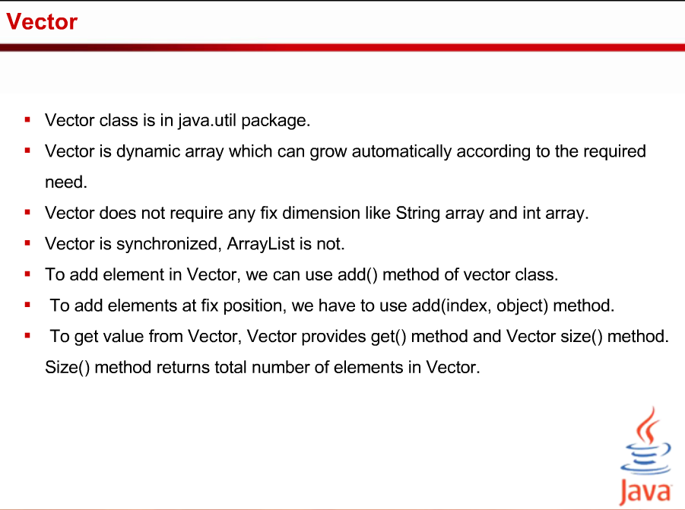

Slide 84
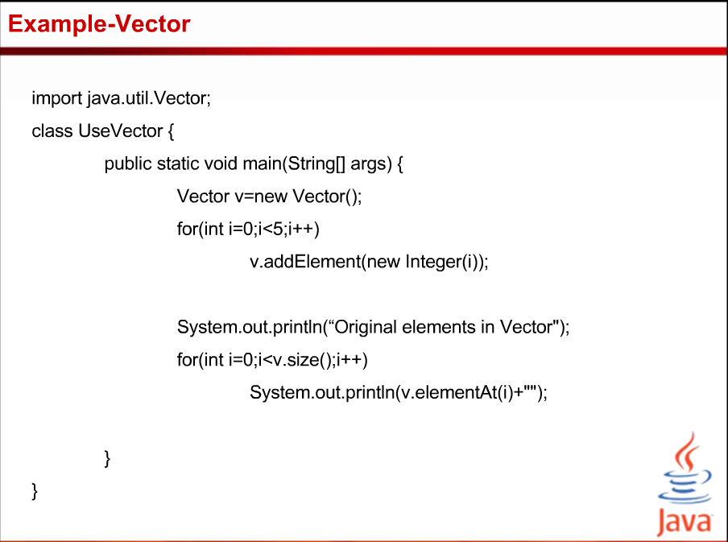

Slide 85
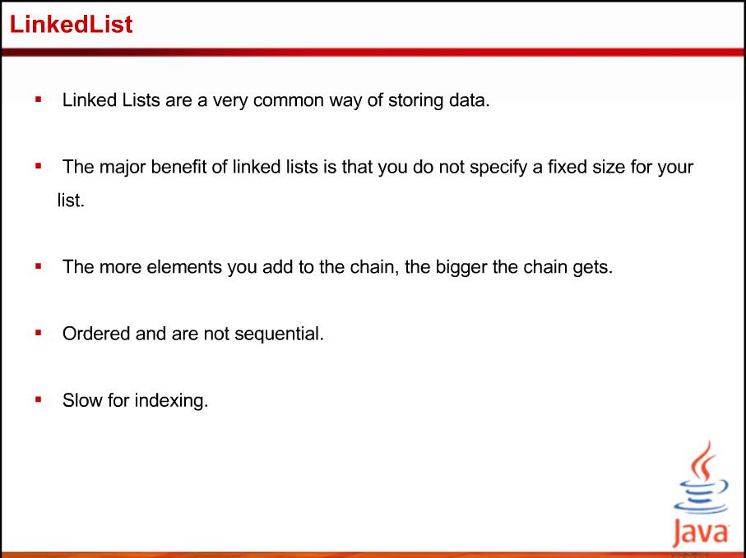

Slide 86
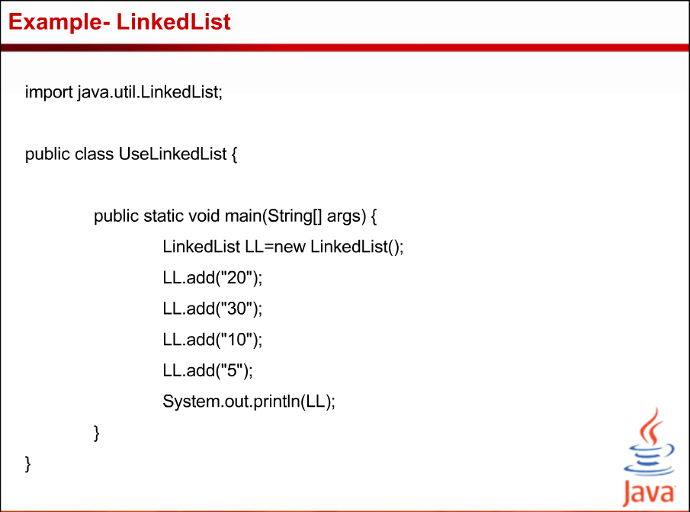

Slide 87
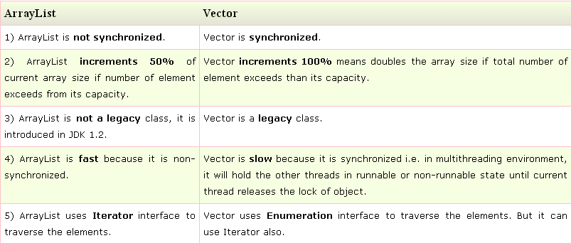
Difference between ArrayList and Vector

Slide 88
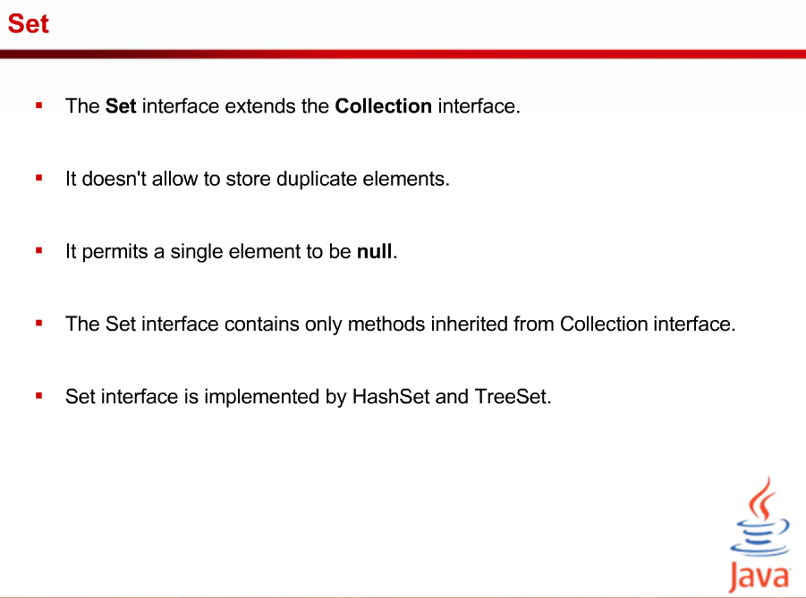

Slide 89
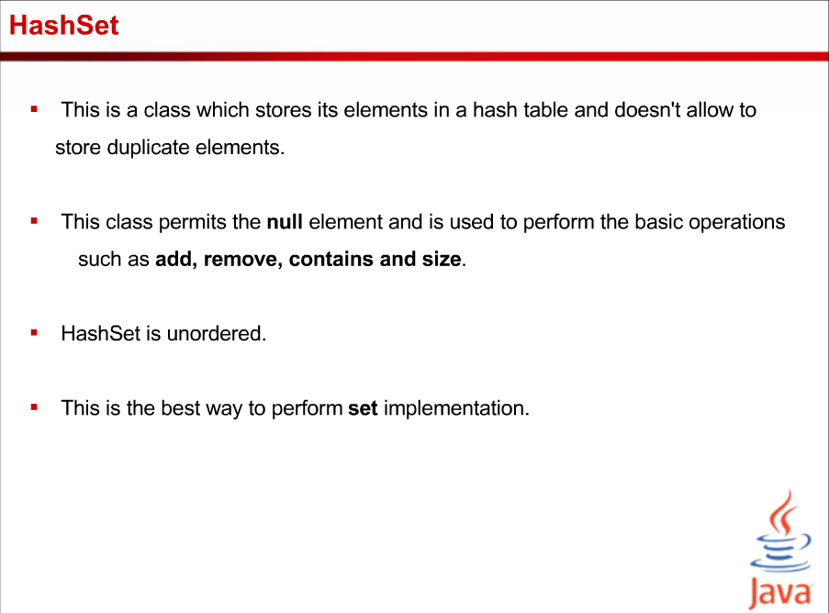

Slide 90
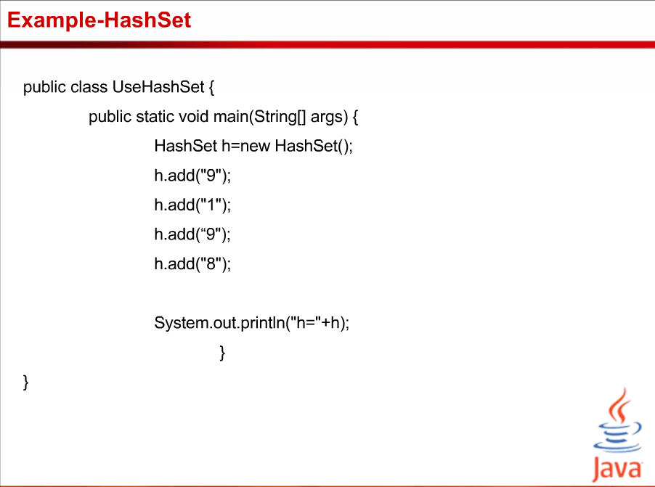

Slide 91
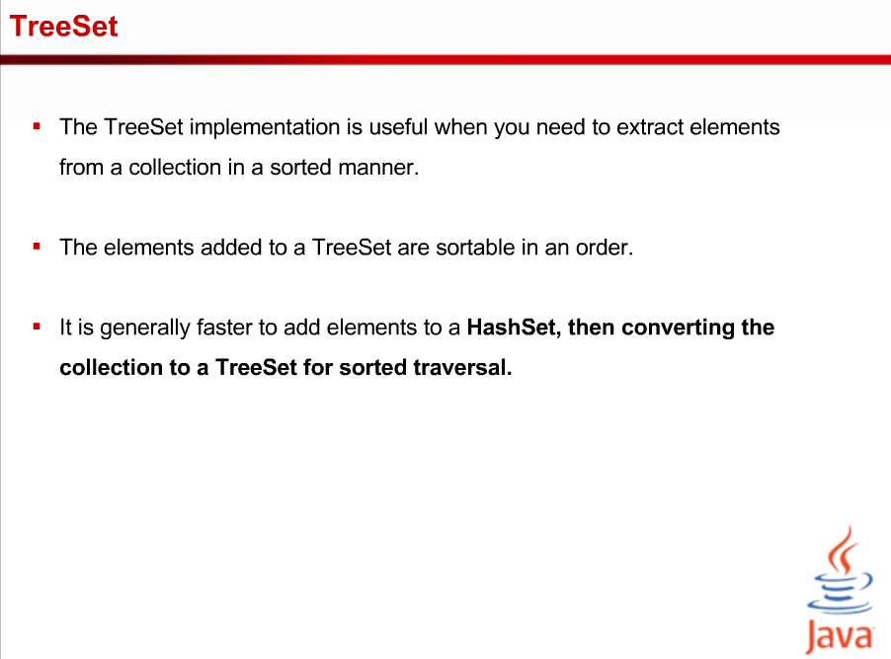

Slide 92
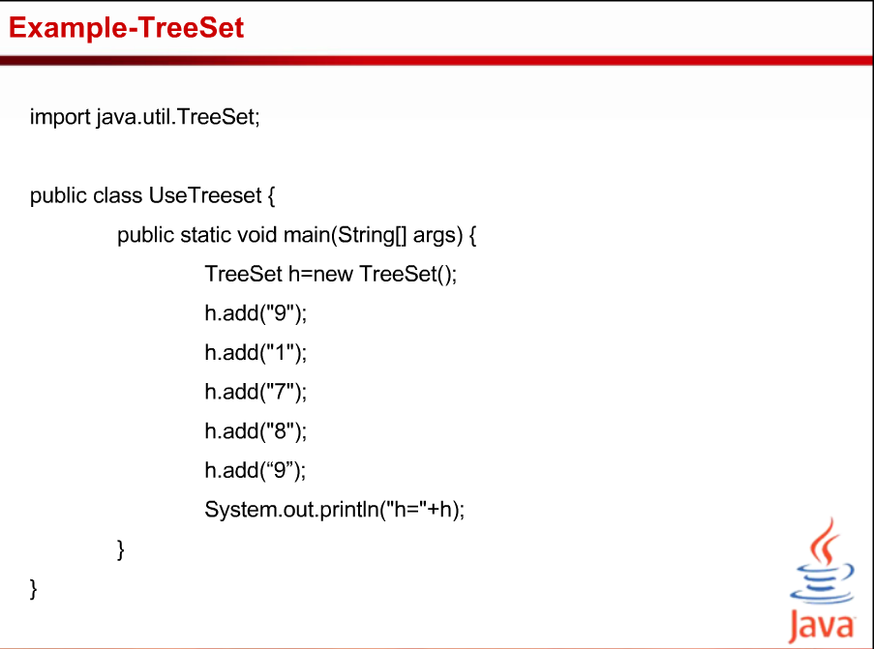

Slide 93
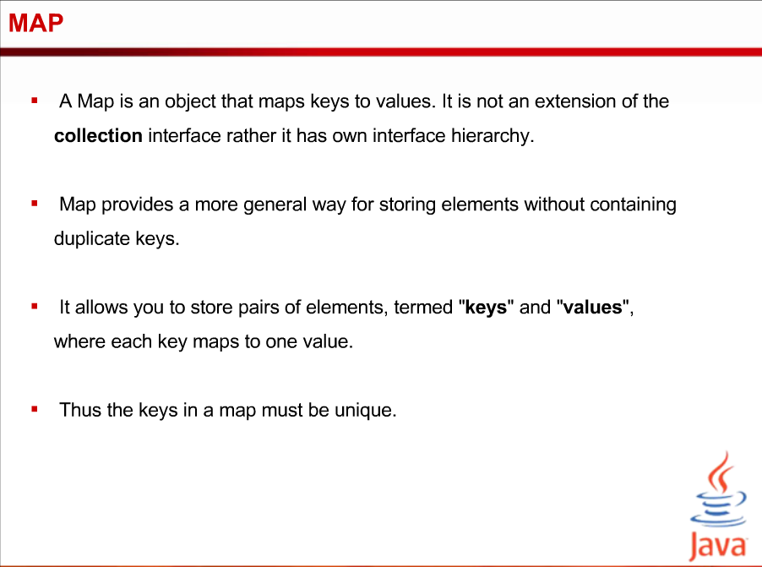

Slide 94
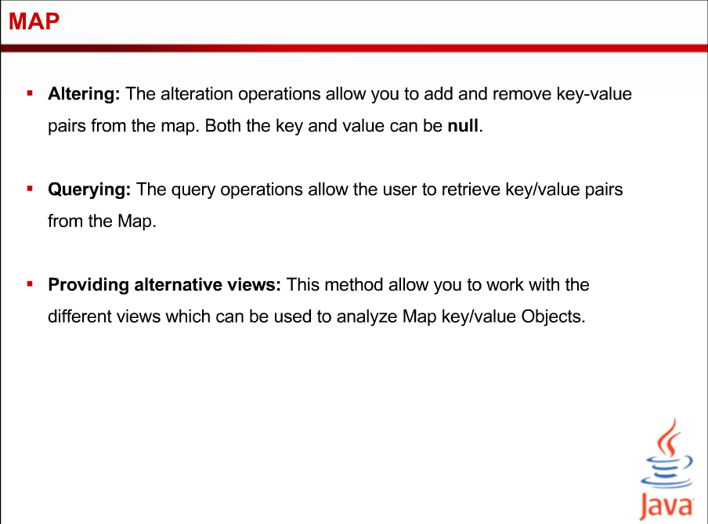

Slide 95
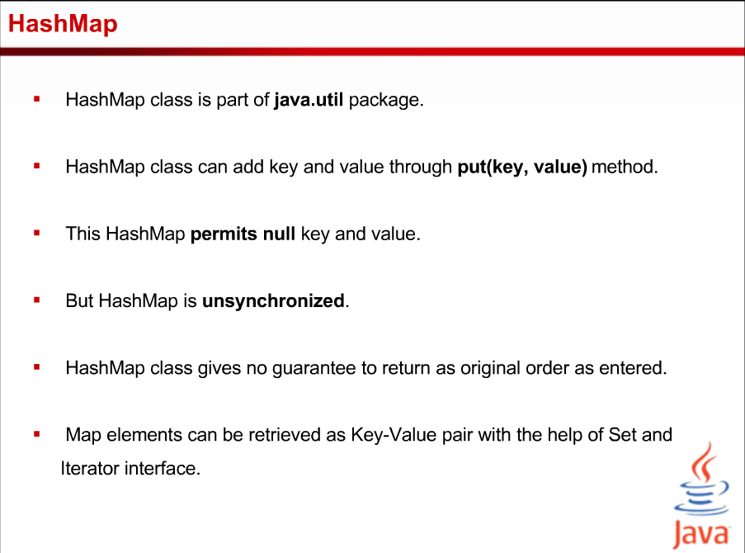

Slide 96
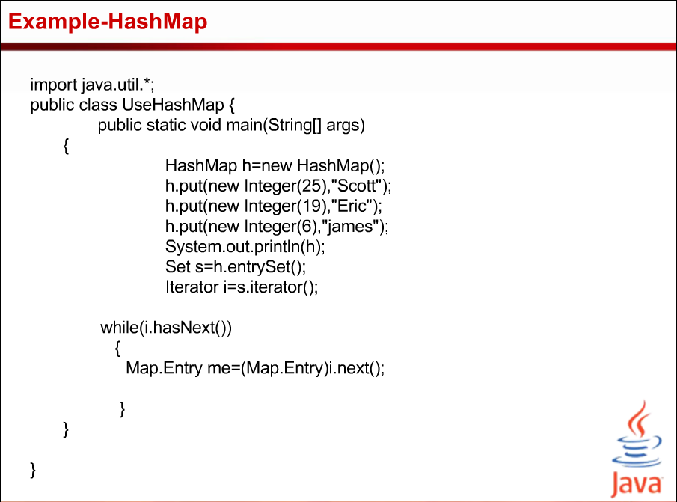

Slide 97
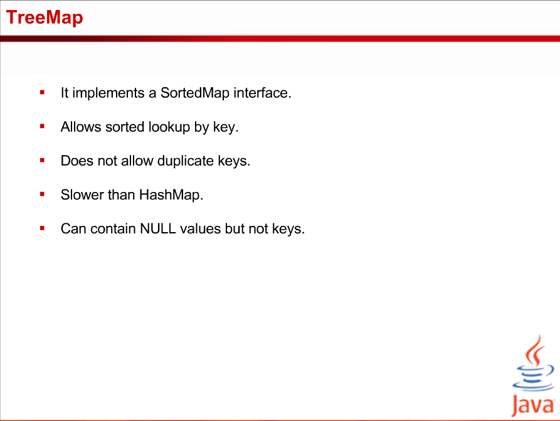

Slide 98
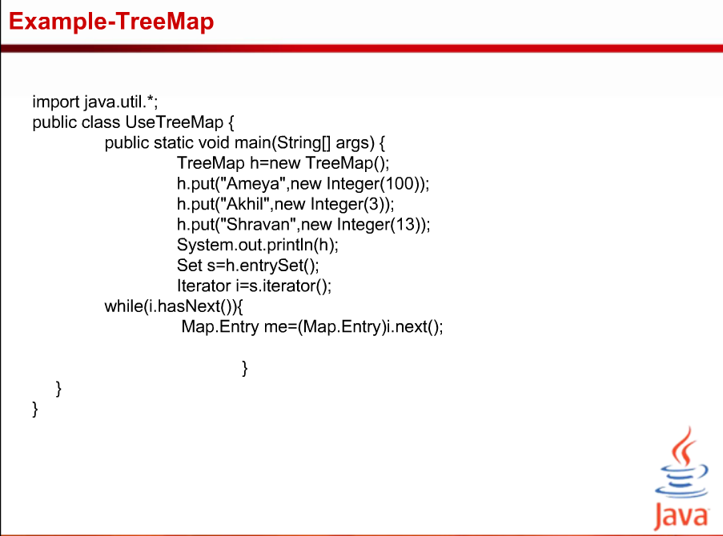

Slide 99
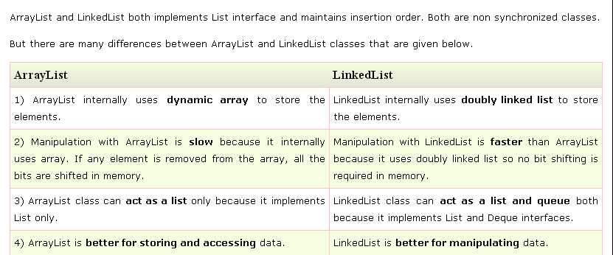
Difference between ArrayList and LinkedList

Slide 100
List Interface
List Interface is the subinterface of Collection.It contains methods to insert and delete elements in index basis.It is a factory of ListIterator interface.
Syntax:-public interface List<E> extends Collection<E>

Slide 101
LinkedHashSet class
LinkedHashSet class is a Hash table and Linked list implementation of the set interface. It inherits HashSet class and implements Set interface.
The important points about Java LinkedHashSet class are:
Contains unique elements only like HashSet.
Provides all optional set operations, and permits null elements.
Maintains insertion order.

Slide 102
LinkedHashSet class
Syntax:-Public class LinkedHashSet<E> extends HashSet<E> implements Set<E>, Cloneable, Serializable

Slide 103
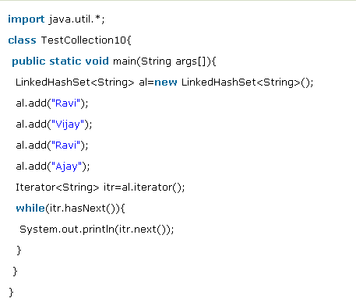
Example of LinkedHashSet class

Slide 104
HashTable class
Java Hashtable class implements a hashtable, which maps keys to values. It inherits Dictionary class and implements the Map interface.
The important points about Java Hashtable class are:
A Hashtable is an array of list. Each list is known as a bucket. The position of bucket is identified by calling the hashcode() method. A Hashtable contains values based on the key.
It contains only unique elements.
It may have not have any null key or value.
It is synchronized.

Slide 105
Declaration HashTable
public class Hashtable<K,V> extends Dictionary<K,V> implements Map<K,V>, Cloneable, Serializable

Slide 106
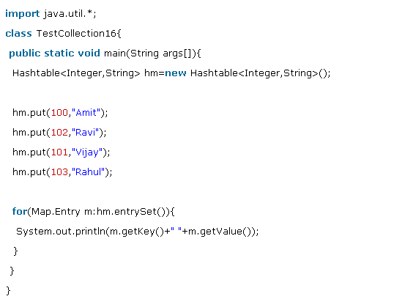
HashTable Example

Slide 107
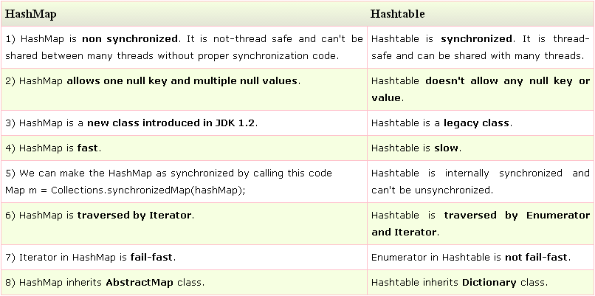
Difference between HashMap and Hashtable

Slide 108
Comparable interface
Java Comparable interface is used to order the objects of user-defined class.This interface is found in java.lang package and contains only one method named compareTo(Object). It provide single sorting sequence only i.e. you can sort the elements on based on single data member only. For example it may be rollno, name, age or anything else.

Slide 109
Comparator interface
Comparator interface is used to order the objects of user-defined class.
This interface is found in java.util package and contains 2 methods compare(Object obj1,Object obj2) and equals(Object element).
It provides multiple sorting sequence i.e. you can sort the elements on the basis of any data member, for example rollno, name, age or anything else.

Slide 110
Collections Class
Java.util.Collections

Slide 111
Generics

Slide 112
Topics
background and goals of generic programming
basics of generic classes = parameterized types
generic methods for general algorithms
inheritance rules for generic types
bounded type parameters
generic code and the Java Virtual Machine
restrictions and limitations
wildcard types and wildcard type capture

Slide 113
Why generic programming
Background
old version 1.4 Java collections were Object-based and required the use of ugly casts
cannot specify the exact type of elements
must cast to specific classes when accessing
Java generics
lets you write code that is safer and easier to read
is especially useful for general data structures, such as ArrayList
generic programming = programming with classes and methods parameterized with types

Slide 114
Why generic programming (cont.)
generic types are a powerful tool to write reusable object-oriented components and libraries
however, the generic language features are not easy to master and can be misused
their full understanding requires the knowledge of the type theory of programming languages
especially covariant and contravariant typing
the following introduces the main aspects of Java generics and their use and limitations
we mostly inspect illustrative samples of what is and what is not allowed, with some short glimpses inside the JVM implementation

Slide 115
Why generic programming (cont.)
Java generics
in principle, supports statically-typed data structures
early detection of type violations
cannot insert a string into ArrayList <Number>
also, hides automatically generated casts
superficially resembles C++ templates
C++ templates are factories for ordinary classes and functions
a new class is always instantiated for given distinct generic parameters (type or other)
in Java, generic types are factories for compile-time entities related to types and methods

Slide 116
Definition of a simple generic class
class Pair <T> { public T first; public T second; public Pair (T f, T s) { first = f; second = s; } public Pair () { first = null; second = null; } }
you instantiate the generic class by substituting actual types for type variables, as: Pair <String>
you can think the result as a class with a constructor
public Pair (String f, String s), etc . .
you can then use the instantiated generic class as it were a normal class (almost):
Pair <String> pair = new Pair <String> ("1","2");

Slide 117
Multiple type parameters allowed
you can have multiple type parameters
class Pair <T, U> { public T first; public U second; public Pair (T x, U y) { first = x; second = y; } public Pair () { first = null; second = null; } }
to instantiate: Pair <String, Number>

Slide 118
Generic static algorithms
you can define generic methods both inside ordinary classes and inside generic classes
class Algorithms { // some utility class
public static <T> T getMiddle (T [ ] a) {
return a [ a.length / 2 ];
}
. . .
}
when calling a generic method, you can specify type
String s = Algorithms.<String>getMiddle (names);
but in most cases, the compiler infers the type:
String s = Algorithms. getMiddle (names);

Slide 119
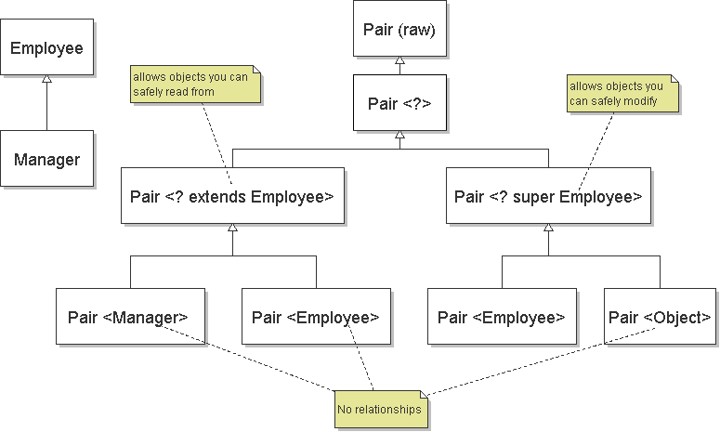
Inheritance rules for generic types

Slide 120
Comments on inheritance relations
Pair<Manager> matches Pair<? extends Employee> => subtype relation (covariant typing)
Pair<Object> matches Pair<? super Employee> => subtype relation (contravariant typing)
Pair<Employee> can contain only Employees, but Pair<Object> may be assigned anything (Numbers) => no subtype relation
also: Pair<T> <= Pair<?> <= Pair (raw)
List <String> sl = new LinkedList <String> (); List x = sl; // OK x.add (new Integer (5)); // type safety warning . . String str = sl.get (0); // throws ClassCast.

Slide 121
Bounds for type variables
consider the min algorithm: find the smallest item in a given array of elements
to compile this, must restrict T to implement the Comparable interface that provides compareTo
public static <T extends Comparable>
T min (T [ ] a) { // this is almost correct
if (a.length == 0) throw new InvalidArg.. (..);
T smallest = a [0];
for (int i = 1; i < a.length; i++)
if (smallest.compareTo (a [i]) > 0) // T constraint
smallest = a [i];
return smallest;
}

Slide 122
Bounds for type variables (cont.)
however, Comparable is itself a generic interface
moreover, any supertype of T may have extended it
public static <T extends Object & // bounding class Comparable <? super T>>
T min (T [ ] a) { . . . // the more general form
T smallest = a [0];
for (int i = 1; i < a.length; i++)
if (smallest.compareTo (a [i]) > 0) // T constraint
smallest = a [i];
return smallest;
}
cannot inherit multiple different instantiations of the same generic type (class or interface)
an inherited generic type is fixed for subtypes, too

Slide 123
Generic code and the JVM
the JVM has no instantiations of generic types
a generic type definition is compiled once only, and a corresponding raw type is produced
the name of the raw type is the same name but type variables removed
type variables are erased and replaced by their bounding types (or Object if no bounds); e.g.:
class Pair { // the raw type for Pair <T> public Object first; public Object second; public Pair (Object f, Object s) { . . } }
byte code has some generic info, but objects don't

Slide 124
Generic code and the JVM (cont.)
Pair <String> and Pair <Employee> use the same bytecode generated as the raw class Pair
when translating generic expressions, such as
Pair <Employee> buddies = new Pair < . .;
Employee buddy = buddies.first;
the compiler uses the raw class and automatically inserts a cast from Object to Employee:
Employee buddy = (Employee)buddies.first;
in C++, no such casts are required since class instantiations already use specific types
if multiple constraints (Object & Comparable. .) then the type parameter is replaced by the first one

Slide 125
Overriding of methods of generic type
consider a generic class with a non-final method:
class Pair <T> { // parameter T is erased from code
public void setSecond (T s) { second = s; } . .
to override such type-erased methods, the compiler must generate extra bridge methods:
class DateInterval extends Pair <Date> {
public void setSecond (Date high) { // override
if (high.compareTo (first) < 0) throw new . .
second = high; // otherwise OK
}
public void setSecond (Object s) { // bridge method
setSecond ((Date)s); // generated by compiler
} . .

Slide 126
Restrictions and limitations
in Java, generic types are compile-time entities
in C++, instantiations of a class template are compiled separately as source code, and tailored code is produced for each one
primitive type parameters (Pair <int>) not allowed
in C++, both classes and primitive types allowed
objects in JVM have non-generic classes:
Pair<String> strPair = new Pair<String> . .;
Pair<Number> numPair = new Pair<Number> . .;
b = strPair.getClass () == numPair.getClass ();
assert b == true; // both of the raw class Pair
but byte-code has reflective info about generics

Slide 127
Restrictions and limitations (cont.)
instantiations of generic parameter T are not allowed
new T () // ERROR: whatever T to produce?
new T [10]
arrays of parameterized types are not allowed
new Pair <String> [10]; // ERROR
since type erasure removes type information needed for checks of array assignments
static fields and static methods with type parameters are not allowed
class Singleton <T> {
private static T singleOne; // ERROR
since after type erasure, one class and one shared static field for all instantiations and their objects

Slide 128
Wildcard types
note that the raw class Pair is not equal Pair <?>
Pair pair1 = . .;
pair1.first = new Double (10.0); // WARNING
Pair <?> pair2 = . .;
pair2.first = new Double (10.0); // ERROR
but some operations have no type constraints:
public static boolean hasNulls (Pair <?> p) {
return p.first == null || p.second == null;
}
alternatively, you could provide a generic method
public static <T> boolean hasNulls (Pair <T> p)
generally, prefer wildcard types (but use generic method with type T when multiple parameters)

Slide 129
Wildcard capture
the wildcard type ? cannot be used as a declared type of any variables (as in the previous slide)
Pair <?> p = new Pair <String> ("one", "two"); . . p.first = p.second; // ERROR: unknown type
but, can sometimes use a generic method to capture the wildcard:
public static <T> void rotate (Pair <T> p) {
T temp = p.first; p.first = p.second;
p.second = temp;
}
the compile checks that such a capture is legal
e.g., the context ensures that T is unambiguous

Slide 130
Collections and algorithms
goal: design a minimal interface that you need
e.g., for max, implement to take any Collection
public static <T extends Object & Comparable <? super T>> T max (Collection <? extends T> c) { // a hypothetical implementation: Iterator <T> it = c.iterator (); T largest = it.next (); // or throws NoSuchElement while (it.hasNext ()) { T val = it.next (); if (largest.compareTo (val) < 0) largest = val; } return largest; }

Slide 131
Question Time

Slide 132
class Base extends Exception {}
class Derived extends Base {}
public class Main {
public static void main(String args[]) {
// some other stuff
try {
// Some monitored code
throw new Derived();
}

Slide 133
catch(Base b) {
System.out.println("Caught base class exception");
}
catch(Derived d) {
System.out.println("Caught derived class exception");
}
}}
A. Caught base class exception
B. Caught derived class exception
C. Compiler Error because derived is not throwable
D. Compiler Error because base class exception is caught before derived class

Slide 134
Which of these keywords must be used to monitor for exceptions? a) try b) finally c) throw d) catch

Slide 135
Which of these is a super class of all exceptional type classes?
A. String
B. RuntimeExceptions
C. Throwable
D. Cachable

Slide 136
Which of these class is related to all the exceptions that cannot be caught?
A. Error
B. Exception
C. RuntimeExecption
D. All of the mentioned

Slide 137
Which of these class is used to read characters in a file? a) FileReader b) FileWriter c) FileInputStream d) InputStreamReader

Slide 138
Quiz
1. Which of these standard collection classes implements a dynamic array? a) AbstractList b) LinkedList c) ArrayList d) AbstractSet
2. Which of these class can generate an array which can increase and decrease in size automatically? a) ArrayList b) DynamicList c) LinkedList d) DynamicList
3. Which of these method can be used to increase the capacity
of ArrayList object manually? a) Capacity() b) increaseCapacity() c) increasecapacity() d) ensureCapacity()
Q | A
1 | C
2 | A
3 | D

Slide 139
Quiz
1. What is the output of this program?
import java.util.*;
class Output {
public static void main(String args[]) {
ArrayList obj = new ArrayList();
obj.add("A");
obj.add(0, "B");
System.out.println(obj.size());
}
}
a) 0 b) 1 c) 2 d) Any Garbage Value
Q | A
1 | C

Slide 140
Hashtable allows null as Key.
A) True
B) False

