Slide 1
Java Basics
By Lata Verma

Slide 2
Java Language
Java was created by a team of members called "Green" led by James Arthur Gosling.
When Java was created in 1991, it was originally called Oak.
It is a free and open source software (FOSS) under GNU General Public License(GPL)
First version of Java was released in 1995.
Java is an Object oriented language, simple, portable, platform independent, robust and secure.
We will be focusing on Java 1.6.
Notes:
A group of engineers from Sun Microsystems, now acquired by Oracle Corporation, led by James Gosling created Java. It was released in 1995. The Language was originally called Oak (in 1991) after the Oak tree that could be seen in Gosling's office. They later found that Oak was a name already taken. So, popular story goes that after many hours of trying to come up with a new name, the development team went out for coffee and the name Java was born!
FOSS (GPL):
FOSS is a free and open source software and GNU General Public License
The GNU General Public License is a free, copy-left license for software and other kinds of works
Copyleft is used to describe the practice of using copyright law to offer the right to distribute copies and modified versions of a work and requiring that the same rights be preserved in modified versions of the work

Slide 3
Flavors Of Java
JSE
Java Standard Edition formerly known as J2SE.
This forms the core part of Java language.
JEE
Java Enterprise Edition formerly known as J2EE.
These are the set of packages that are used to develop distributed enterprise-scale applications.
These applications are deployed on JEE application servers.
JME
Java Micro Edition formerly known as J2ME.
These are the set of packages used to develop application for mobile devices and embedded systems.
Our focus
Notes:
Java also comes in several versions:
JDK 1.0 (1995)
JDK 1.1 (1997)
J2SE 1.2 (1998) ) →Playground
J2SE 1.3 (2000) → Kestrel
J2SE 1.4 (2002) → Merlin
The above 3 was called Java 2
J2SE 5.0 (2004) → Tiger
Java SE 6 ( 2006) → Mustang
Java SE 7 (2011) →Dolphin

Slide 4
Simple Hello World in Java
Hello.java
public class Hello{
public static void main(String args[])
{
System.out.println(“Hello World!”);
}}
Special statement used to display data on console. ‘println’ causes the next print statement to be printed in the next line.
main() is a method from where program execution begins.
Notes:
System.out.print prints in the same line.

Slide 5

Environment to compile and execute
Compile java programs
From command prompt
Through an IDE (Integrated development environment)
Eclipse →Apache
NetBeans →Oracle SDN
JBuilder → Borland
Integrated Development Environment → IBM
What is an IDE?

Slide 6
Compilation & execution: command prompt
Save the file as Hello.java. A public class must be saved in the same name as class name.
Compile
C:\MyJava>javac Hello.java
Byte code
Hello.class
javac
Hello.java
compilation
Source code
execution
java
Platform specific code
Execute
C:\MyJava>java Hello
Notes:
javac [ options ] [ sourcefiles ]
sourcefiles can also include relative or absolute path components
–d directory
Set the destination directory for class files.
D:\ javac –d bin Test.java places Test.class in D:\bin folder. Please note that the bin folder exist before giving this command
-nowarn
Disable warning messages.
-version
Displays the version used for compilation
-target
Generate class files for specific VM version

Slide 7
JRE and bytecode
Java Bytecode is produced when Java programs are compiled.
To execute Java program, JRE must be installed in the system
JRE or Java Runtime environment contains
Java Virtual Machine
Standard class libraries (APIs)
Java Plug-in
Java Webstart
JRE gets installed automatically when JDK is installed. JRE can be installed independent of JDK as well. This will mean that Java programs can be executed in that system.

Slide 8
Primitive Data types in Java
Primitive data types
Primitive data types are basic data types.
Integer type: byte, short, int, long
Floating point types: float, double
Character data types : char
Boolean data type: boolean

Slide 9
Ranges of Primitive Data Types
s of Primitive data types
Type | Size in Bytes | Min Range | Max Range
byte | 1 | -2⁷ | 2⁷-1
short | 2 | -2¹⁵ | 2¹⁵-1
int | 4 | -2³¹ | 2³¹-1
long | 8 | -2⁶³ | 2⁶³-1
char | 2 | 0 | 2¹⁶-1
float | 4
double | 8
boolean | JVM Specific (typically 1)
9
Notes:
Note that char is 16 bit Unicode character. Also, there no unsigned char in java.

Slide 10

Unicode Characters
Unicode Character
UNICODE is a 16 bit character.
They are generally represented in hexadecimal format.
‘\u’ in beginning of the character is used to represent hexadecimal character.
The characters represented include all basic English letters, numbers, special characters and characters from other languages also !
‘A’ → ‘\u0041’
The Unicode Standard encodes characters in the range U+0000..U+10FFFF
You could write the entire java code as
\u0069\u006e\u0074 \u0061;
This above code represents
int a;
What is Unicode for F?
10
Notes:
Why Unicode? Unicode is used to overcome the limitation of ASCII/Extended ASCII as ASCII has limited number of bits therefore does not have capability to represent multi-lingual characters. Unicode has 16 bits and therefore, has ability to represent multi-lingual characters. It has become an industry standard and is used for Internationalization. Unicode transformation format is character encoding form that assigns each Unicode scalar value to a unique code unit sequence. The Unicode Standard defines three Unicode encoding forms: UTF 8, UTF 16,UTF 32 . Java 6 char supports UTF 16.

Slide 11
Scanner Class
Java.util.Scanner
nextXXX() method

Slide 12
Introduction to Java IDEs
Eclipse, Netbeans, IntelliJ, BlueJ, Oracle JDeveloper…
Version
Name Date Platform Version
Luna 25 June 2014 4.4
Mars 24 June 2015 4.5
Neon 22 June 2016 4.6
Oxygen 28 June 2017 4.7
Photon 27 June 2018 4.8

Slide 13
Packages
Package is a grouping mechanism that holds a set of classes (or interfaces)
Packages are implemented using file system directories.
Package must be the first statement in the java source file.
Concept of packages also allows us to specify visibility of classes across packages.
Syntax for creating packages:
package package_name[.package_name];
Packages are named like variables except that they are all in lower case and can contain dots (.)

Slide 14
Some Packages in the Java API
java.util.ArrayList:
java.util is package and ArrayList is class inside the package
java.util.Scanner:
-java.util is package and Scanner is class inside the package
java.lang.String
java.lang is package and String is class inside the package
Notes:
We didn’t have to use full name for String because java.lang is implicitly imported by java compiler.
Classes inside the same package need not use the full qualified name to refer to each other.
You can draw a parallel to home. People in your house need not use your full name to call you. But when you are outside your home, say at the office, it is better if people identify you using your full name.

Slide 15
Example Scenarios
studentManagement
packages
Student
Fee
hostelManagement
infraManagement
Enrollment
Staff
Room
facultyManagement
Teacher
FoodCalendar
LabStaff
Professor
Classes / interfaces
Notes:
A college application will consist of automating several aspects. For example features related to
Student management
Faculty management
Hostel management
Payroll
It is easier to work with a set of classes that are grouped in accordance to shared / similar responsibilities. In other words, if we had a package called student, all the classes related to student, like Enrollment, Fee etc. can be placed in it.
Using packages also assists in organization of the code. Rather than have dozens of classes all around, a higher level view of a smaller number of packages would be simpler.
Work allocation could also be done in accordance with packages.
As we develop our application to include all the above features we will find that we have lots of classes, and sometimes we may find that we have difficulty finding unique names and therefore we end up with the class names becoming too big and complicated.

Slide 16
Benefits
It is easier to work with a set of classes that are grouped in accordance with shared / similar responsibilities.
Easy to locate the classes.
Eliminates name collision
You can restrict the access to your classes.
Work allocation could also be done in accordance with packages.

Slide 17
Access
student
teacher
Teacher
Student
Referred to as
student.Student
teacher. Teacher
Grade
Grade
Student
Teacher
Outside the student package, the Student class is now to be referred to as student.Student.
Notes:
We will create 2 packages with 2 classes each
student
Student
Grade
teacher
Teacher
Grade
Teacher can access Student using its fully qualified name student.Student.
Grade defined inside student package can access Student without using full qualified name.

Slide 18
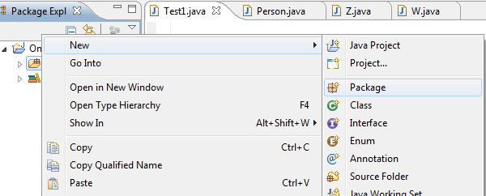
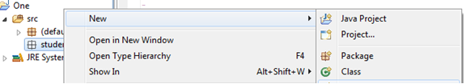
Create a Package in Eclipse
Create a package
Right click on the “src”
and click on New→Package.
Enter the package name
and click finish
Create a class inside the package
Right click on the newly created package and click on New→Class.
Rest is the same.
The IDE will automatically find the packages in the same project. Compilation and execution is simple and straight forward from IDE.

Slide 19
Imports
Java provides an easy way to access classes in other packages instead of using long names. This is done by using import statement.
The same is the case with static members of a class too. Static members of a class are accessed using ClassName.staticMemberName. This name also sometimes could be very long. Instead imports could be used such that only static member name can be used.
Two forms of imports:
Class imports
Static imports

Slide 20
Class Imports
Importing only a particular class.
Example:
import student.Student;
public class Tester{
…
Student s= new Student("John","M.C.A.");
}
Importing all the classes in a package.
Example:
import student.*;
public class Tester{
…
Student s= new Student("John","M.C.A.");
}

Slide 21
Static Imports
Makes the static members of a class available to code directly without explicitly specifying the class name.
Syntax:
import static packageName.ClassName.*;
(imports all the static members)
Or
import static packageName.ClassName.staticMember;
(imports only the particular ‘staticMember’)
Notes:
Added in Java 1.5

Slide 22
Example: Static Imports
Static member of System
import static java.lang.System.out;
import static teacher.Grade.*;
import teacher.*;
class GradeTest{
public static void main(String str[]){
Teacher f=new teacher.Teacher("Tom");
Grade gf= new Grade(f,new student.Student("Malini"),"001",B);
out.println("Grade "+ gf.getGrade());}
}
Instead of Grade.B
Instead of System.out.println

Slide 23
Tell me how?
If importing using * means all classes are imported, is it not better to import the required class to avoid loading of all classes?
Java loads the classes on demand. This is feature called Dynamic Linking.
Only the classes whose members are invoked in some are loaded.
Hence both using * or explicitly specifying class, will not impact class loading.
One advantage of using an explicitly specified class name is for better code comprehension.

Slide 24
Access Modifiers
Private
Default
Protected
Public

Slide 25
Example: Variable Declarations
public class Student {
public String name;
public int rollno;
public void display(){
String title=“ABC” ;
System.out.print(title);
System.out.println(name);
title=“Roll No.:”;
System.out.print(title);
System.out.println(rollno);
}}}
Or String name=“ab”;
Class declarations
Local declaration
Must be initialized otherwise you get a compilation error !
25

Slide 26
Types of Variables
Variable Declarations
Local declarations
Class declarations
Instance declaration
Static declaration
More on this in classes session
26
Notes:
Local declarations
Declarations made inside a method
A local variable must always be initialized to a value before it can be used in calculations or display.
If a variable is used without initialization, compiler will flag an error.
Class declarations
Declarations made outside a method and inside class
A class variable is automatically assigned a default value if it is not initialized.
There are two types of class declarations
Instance declaration
Static declaration

Slide 27

Encapsulation through access Specifiers
public access modifier can be used with class declarations and member declaration.
private access modifier can be used only with inner class declarations and all member declarations ( variable and methods).
Name
Registration number
Name of the degree
Current Semester
Student
What will you declare as private among the above attributes?
Generally a class is responsible for the integrity of its data. Therefore exposing the data within the class may prove to be dangerous.
But if you make all data private, how can other classes use them?
Notes:
Let us take an example of a Student object. This object represents a student in a college.
Now, it is the responsibility of Student class to make sure that
Name should not be null.
Registration number is automatically generated. Every new student gets a new registration number that is unique.
Name of the degree and current semester should always have proper values.
In other words, it is the student object’s responsibility to ensure that the data associated with it is valid.

Slide 28
Getter(Accessor) and Setter (Mutators)
public class Student{
private String name;
private int regNo;
private String degreeName;
private int currentSemester;
public String getName()
public void setName(String nm)
public int getRegNo()
regNo cannot be set by any other class
public String getDegreeName()
public void setDegreeName(String dnm)
public int getCurrentSemester()
public void setCurrentSemester(int i)
Instance variables of Student class
Instance methods of Student class
Notes:
Accessor
Getter method
Used to return the value of the attribute
Sometimes values may be same as the value of attribute, sometimes logic could be written to return the value expected by other classes. (Example coming up)
They are named beginning with “get” followed by the name of the variable beginning with upper case
They have no arguments
They return the value of type which usually is same as that of the variable
Mutator
Setter method
Used to assign a value of the attribute
Logic to check the sanity of the value assigned to the attribute is written in the method
They are named beginning with “set” followed by the name of the variable beginning with upper case
They have no return value (void)
They take an argument, usually of the same type as that of the attribute.

Slide 29
Activity
Complete the Student code in the previous slide. Add Logic to check the sanity of the values before assigning to the attribute.
Did you notice the way the methods are named?
Java’s recommendation is to use these naming conventions.

Slide 30
Creating and accessing attributes using .
The new keyword is used to create objects.
Student s= new Student();
Access any member of a class, use . operator
s.name or s.getCurrentSemester();
The code listed below prints null, why?
public class Test{
public static void main(String str[]){
Student s= new Student();
System.out.println(s.getName());
}

Slide 31
Constructor
The constructor is a special method for every class that helps initialize the object members at the time of creation.
It is a special method because
it has the same name as the class name
does not have a return type.
Can be called only using ‘new’ keyword when object gets created.
There can be more than one constructor for a class.
Space is allocated for an object only when the constructor is called. Declaring a variable of class and not calling new does not consume any memory!
Notes:
public class Student{
private String name;
private int regNo;
private String degreeName;
private int currentSemester;
/*Constructor 1 for student who has decided the degree he/she is going to enroll into */
public Student(String nm, String d){
setName(nm);
regNo=generateRegno();
setDegreeName(d);
setCurrentSemester(1);}
/*Constructor 2 for student who has not decided the degree he/she is going to enroll into */
public Student(String nm){
setName(nm);
regNo=generateRegno();
setCurrentSemester(1);}
private int generateRegno(){
int nextNo=1;
//logic to generate regNo will be written later
return nextNo;}
// add setter and getters
}
public class StudentTest{
public static void main(String args[]){
//Creating object using constructor 1
Student student1=
new Student(“John”, “M.C.A.”);
//Creating object using constructor 2
Student student2= new Student(“Mary”);
}}

Slide 32
No argument constructor
new Student() will try to invoke a constructor similar to the one below
class Student{
public Student(){..} }
An error will be generated because a no-argument constructor is not defined.
When no constructors are defined for a class, compiler automatically inserts a constructor that takes no argument
Compiler generated constructor
public class Teacher{
public String name;
}
public Teacher()
{
super();
}
Compiler inserts
Learn about this in inheritance
Notes:
If we want Student objects to be created using new Student(), then we must provide a constructor. In reality, can we have a student without name and registration number? No. The application must be build close to the real life. Hence we have not provided a default constructor, because, then we may end up having students with no name or registration number.
Note that constructors can be private as well. We will see that this is useful for creating classes for which we need only one object- popular design pattern called Singleton uses this approach.

Slide 33
Memory allocations
Stack – for Local variables
Heap – for references
public void test(){
int i;
Student s=new Student(“Mary”);
s.setCurrentSemester(2);
}
HEAP
name:Mary
regNo:1
currentSemester:2
degreeName:null
STACK
i
s
Notes:
Local variables are created in Stack.
Objects are created in Heap. It is like allocating memory using malloc.
What is returned back to the program on invoking new is a reference that is again in Stack.
C++ programmers can compare this with the reference in C++. Sort of alias name for an variable.
For C programmers, reference is like constant pointer to a that is, using a pointer the value of the variable can be changed but pointer itself cannot be changed to point to some other variable. The variable here is an object.
In Java, all variables that are created for objects are references.

Slide 34
Activity: Multiple references to an object
Student student1= new Student(“Mary”);
Student student2=student1;
student1.setName(“Merry Mary”);
System.out.println(student2.getName());
HEAP
Complete the diagram. What will the code snippet print?
STACK

Slide 35
null
Just declaration of a variable for a class does not create an object.
Student s;
STACK
s
s reference points to nothing or null.
Default value of an object reference is null.
Notes:
Based on the scope of the declaration (local or class) either compile-time or run-time error is generated on invoking a method on a reference which is null .
Calling an instance method on a null object gives runtime error called NullPointerException

Slide 36
Local vs Class declarations for an reference
public class Test{
Student student;
public void test(){
student.display();
}
On executing the code above, an error occurs at runtime java.lang.NullPointerException
public class Test{
public void test(){
Student student;
student.display();
}
On executing the code above , a compile time error occurs.
Can you figure out why we get compile time error?

Slide 37
Static Initializer
Order of initializations
class Order {
int i;
static {
System.out.println("Order class static block ");
}
Order(){
i=10;
System.out.println("Order class constructor,i= " + i);
}
{
System.out.println("Order class instance block,i= " + i);
}
}
Notes:
Static initializations of super class: Static variables are initialized and static blocks are executed in the order of their appearance in the code.
Static initializations of subclass class : Static variables are initialized and static blocks are executed in the order of their appearance in the code.
Instance initializations of super class : Instance variables are initialized and instance blocks are executed in the order of their appearance in the code.
Super class constructor is executed.
Instance initializations of subclass class : Instance variables are initialized and instance blocks are executed in the order of their appearance in the code.
Subclass class constructor is executed.
Only after the super class part, sub class part happens.

Slide 38
this
this is a keyword used only inside a constructor or instance method and is used to refer to the current object.
this is like a hidden reference that compiler provides to refer to current object.
From the programmer’s point of view this comes handy in two places
To distinguish between local and class variables when they are the same.
public class Student{
String name;
…
Student(String name){
this.name=name;
…
}}

Slide 39
Methods of Arrays class
static int binarySearch(byte[] a, byte key)Searches the specified array of bytes for the specified value using the binary search algorithm.
static <T> List<T>asList(T... a)
static byte[]copyOf(byte[] original, int newLength)Copies the specified array, truncating or padding with zeros (if necessary) so the copy has the specified length.
static byte[]copyOfRange(byte[] original, int from, int to)Copies the specified range of the specified array into a new array.
static booleanequals(byte[] a, byte[] a2)Returns true if the two specified arrays of bytes are equal to one another.
static voidfill(byte[] a, byte val)Assigns the specified byte value to each element of the specified array of bytes.
static voidsort(byte[] a)Sorts the specified array into ascending numerical order.
static voidsort(byte[] a, int fromIndex, int toIndex)Sorts the specified range of the array into ascending order.
static StringtoString(byte[] a)Returns a string representation of the contents of the specified array.

Slide 40
Java String

Slide 41
Java String
Java String provides a lot of concepts that can be performed on a string such as compare, concat, equals, split, length, replace, compareTo, intern, substring
In java, string is basically an object that represents sequence of char values.

Slide 42
What is String in java
Generally, string is a sequence of characters. But in java, string is an object that represents a sequence of characters. String class is used to create string object.
1) String Literal
Java String literal is created by using double quotes. For Example:
String s="welcome";
Each time you create a string literal, the JVM checks the string constant pool first. If the string already exists in the pool, a reference to the pooled instance is returned. If string doesn't exist in the pool, a new string instance is created and placed in the pool. For example:
String s1="Welcome";
String s2="Welcome";//will not create new instance

Slide 43
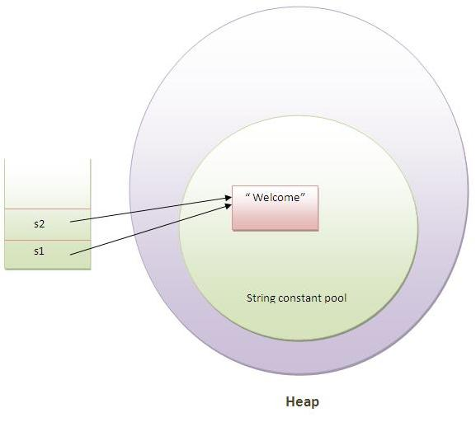
String constant Pool
In the above example only one object will be created. Firstly JVM will not find any string object with the value "Welcome" in string constant pool, so it will create a new object. After that it will find the string with the value "Welcome" in the pool, it will not create new object but will return the reference to the same instance.

Slide 44
By new keyword
String s=new String("Welcome");//creates two objects and one reference variable
In such case, JVM will create a new string object in normal(non pool) heap memory and the literal "Welcome" will be placed in the string constant pool. The variable s will refer to the object in heap(non pool)

Slide 45
Immutable String in Java
In java, string objects are immutable. Immutable simply means unmodifiable or unchangeable.
Once string object is created its data or state can't be changed but a new string object is created.
Let's try to understand the immutability concept by the example given below:
class Testimmutablestring{
public static void main(String args[]){
String s="Sachin";
s.concat(" Tendulkar");//concat() method appends the string at the end
System.out.println(s);//will print Sachin because strings are immutable objects
}
}
Output-Sachin

Slide 46
class Testimmutablestring1{
public static void main(String args[]){
String s="Sachin";
s=s.concat(" Tendulkar");
System.out.println(s);
}
}
Output:-SachinTendulkar

Slide 47
Java StringBuffer class
java StringBuffer class is used to created mutable (modifiable) string. The StringBuffer class in java is same as String class except it is mutable i.e. it can be changed.
Note: Java StringBuffer class is thread-safe i.e. multiple threads cannot access it simultaneously. So it is safe and will result in an order.
What is mutable string:-A string that can be modified or changed is known as mutable string. StringBuffer and StringBuilder classes are used for creating mutable string

Slide 48
1) StringBuffer append() method
The append() method concatenates the given argument with this string.
class A{
public static void main(String args[]){
StringBuffer sb=new StringBuffer("Hello ");
sb.append("Java");//now original string is changed
System.out.println(sb);//prints Hello Java
}
}

Slide 49
2) StringBuffer insert() method
The insert() method inserts the given string with this string at the given position.
class A{
public static void main(String args[]){
StringBuffer sb=new StringBuffer("Hello ");
sb.insert(1,"Java");//now original string is changed
System.out.println(sb);//prints HJavaello
}
}

Slide 50
Java StringBuilder class
Java StringBuilder class is used to create mutable (modifiable) string. The Java StringBuilder class is same as StringBuffer class except that it is non-synchronized. It is available since JDK 1.5.
Important Constructors of StringBuilder class
StringBuilder(): creates an empty string Builder with the initial capacity of 16.
StringBuilder(String str): creates a string Builder with the specified string.
StringBuilder(int length): creates an empty string Builder with the specified capacity as length.

Slide 51
Java StringBuilder Examples
class A{
public static void main(String args[]){
StringBuilder sb=new StringBuilder("Hello ");
sb.append("Java");//now original string is changed
System.out.println(sb);//prints Hello Java
}
}

Slide 52
Inheritance Definition
Inheritance defines relationship among classes, wherein one class shares structure or behavior defined in one or more classes.
Grady Booch
Approach:
Common properties of related classes can be defined in a generic class.
This generic class can then be used by more specific classes through inheritance.
Each of these specific classes can add things that are unique to it.
As a result of inheritance, a hierarchy of classes is formed.
The class that is inherited is called super class and the class that is inheriting is called a subclass.
Java does not support inheritance from more than one class. That is, you can extend only from one class.
Notes:
Other names of super class – parent class, base class
Other names of subclass – child class, derived class

Slide 53
Example scenarios for inheritance
Student and Teacher are Person. Person can be a super class and Student and Teacher can be subclass of Person class. Student is-a Person, Teacher is-a Person
HOD is-a Teacher. Since Teacher is-a Person, HOD is also a Person
Written_Test and Viva are Test
Theory and Lab are ClassRoomSession
SeminarHall is a ClassRoom

Slide 54
Syntax and symbols
extends keyword is used to indicate inheritance relationship.
Syntax:
Class-name2 extends Class-name1
public class HOD extends Teacher{
/*Features of Teacher class automatically available.
add additional members */
}
Teacher
getFactId()
getName()
setFactID()
setName()
HOD
getDateOfJoining
viewGrade()

Slide 55
Members that are not accessible
Super class members that cannot be accessed from subclass are
private members
Default members (if subclasses are in the different packages).
For example, HOD class cannot access factId, name or the static variable id of the Teacher class since they are private but can access all the other methods since they are public
Notes:
All the features that are there in super class are there in subclass as well. But there are some restrictions with respect to which of the super class features (members) can be accessed from subclass.
HOD has dateofAppointment and viewGrade as additional features.
package teacher;
public class HOD extends Teacher{
private String dateOfAppointment;
public HOD(String nm, String dt){
super(nm);
dateOfAppointment=dt; }
public void viewGrade(Grade[] grades){
System.out.println(getName()+ " HOD viewing appraisal ");
for(Grade g:grades){
System.out.println("Faculty :"+ g.getFaculty().getName());
System.out.println("Student ID : "+ g.getStudent().getRegNo());
System.out.println("Grade: "+ g.getGrade());
}
}
public static void main(String str[]){
student.Student s1= new student.Student("Ravi");
student.Student s2= new student.Student(“Kumar");
HOD h=new HOD("Maverick","1.1.2006");
Teacher f= new Teacher("Sam");
System.out.println(“HOD Name "+ h.getName());
Grade g[]=new Grade[2];
g[0]=new Grade(f,s1,"CS-001", Grade.A);
g[1]=new Grade(f,s2,"CS-001", Grade.B);
h.viewGrade(g);
}
}

Slide 56
super
Keyword super() or super(<parameters)>) is used to call the super class constructor.
super() can be called only from the constructor.It must be the first statement of the constructor.
Compiler inserts a super() statement in all constructor if subclass constructor does not explicitly call some form of super() that calls super class constructor.
This is to ensure initialization of super class members because they are also part of subclass.
public HOD(String nm, String dt){
//super(nm);
dateOfAppointment=dt;}
…}
super();
Compiler inserts
Compilation error: cannot resolve symbol constructor Teacher()
Notes:
super() like this() can be called only from the constructor. Therefore, super() and this() cannot be used together.
If the super class does not have a no-argument constructor, a compile-time error occurs.
Therefore, for classes where super class does not have no-argument constructor, all subclass constructors must explicitly call appropriate super class constructor

Slide 57
Calling super class methods
The super keyword can also be used to invoke super class methods from the subclass method.
super.getName()
This becomes necessary only when the subclass has redefined the method in super class.

Slide 58
class SubOrder extends Order{
int j=9;
static {
System.out.println("SubOrder class static block");
}
SubOrder(){
j=15;
System.out.println("SubOrder class constructor,j= "+ j);
}
{
System.out.println("SubOrder class instance block,j= " + j);
}
public static void main(String str[]){
new SubOrder(); }}

Slide 59
And this is the result of executing the code…
Order class static block
SubOrder class static block
Order class instance block,i= 0
Order class constructor,i= 10
SubOrder class instance block,j= 9
SubOrder class constructor,j= 15

Slide 60
Conversion and casting
A subclass object reference can be converted to super class object reference automatically. But for the reverse, casting is required.
Automatic conversion example
Only members of Teacher class are accessible
Teacher f= new HOD();
f.getFactId(); //ok
f.viewGrade(); //error
Casting conversion example
We cast it back to HOD
HOD h=(HOD) f;
h.viewGrade(); //ok
Dangers of casting: if the original object is not of subclass type then a runtime exception will be thrown on accessing subclass methods.
HOD h= (HOD) new Teacher(“x”));
// Runtime error-ClassCastException
Notes:
But why do we need to convert ? This will be clear when we do polymorphism.

Slide 61
protected access
protected access specifier for a member of class A allows access to the members of the classes in the same package as class A (same as default access specifier)
+
allows access to the members of the child classes of class A which are in different package.
Notes:
Therefore for classes inside the same package, protected access specifier is same as that of default access specifier.
protected access specifier makes sense only for subclasses which are in a package different from that of the super class.

Slide 62
Example scenario for protected
teacher
admin
Teacher
protected int factId;
HOD
HOD(Teacher t, String dt)
Complete HOD and Teacher class are pasted at the end of the slide.
Notes:
Let us move the HOD class to a new package called admin.
If an existing teacher is made HOD, then our HOD class misfires. Why?
Because HOD constructor creates a new factId every time we call HOD constructor , but for our scenario factId for existing teacher must be assigned.
To get around it, we create another constructor in HOD that takes factId and dateOfAppointment.
We need to set factId. Since factId is private we cannot access it from HOD.
None of the public, private and default access specifiers will be appropriate here. But protected access specifier for factId is appropriate here. We need the variable "Name" also be set to access specifier protected .
We will also add a no argument constructor in Teacher class which has protected access.

Slide 63
Overriding
Redefinition of an inherited method declared in the super class by the subclass is called Overriding.
Rules
The signature of the method( method name + argument list) must exactly match.
The return type must be same or a subtype of the return type of super class method (covariant returns)
The access can be same or be increased.
(List of access specifiers in order of their increasing accessibility: private→default→protected→public)
Instance methods can be overridden only if they are inherited/visible by the subclass.
Exception thrown cannot be new exceptions or parent class exception.
Notes:
Many times we may have to redefine some of the existing features of a class in a subclass.
For example, a big car inheriting from a small car may retain its features like steering wheel but needs to have interiors like seats, seat cover etc of bigger size.
When a method is redefined there is some flexibility in terms of not having exactly same method declaration as the super class method.
They are defined by a set of 5 rules.
For now let us ignore the 5th rule.

Slide 64
Covariant Returns
The overridden method’s return type can also be a subtype of the original method return class’ subtype.
For example1:
public class Teacher{
public Teacher getInstance()
{
return new Teacher();}
}
public class HOD extends Teacher{
public HOD getInstance()
{
return new HOD();
}}

Slide 65
Access specifier rule
package admin;
public class HOD extends Teacher{
..
public void display(){
super.display();
System.out.println(
"Date of appointment "+dateOfAppointment);
}
}
package teacher;
public class Teacher{
..
protected void display(){
System.out.println(
"Name "+getName());
System.out.println("ID :"+factId) ;
}
}
Cannot have private or default access specifier for display()

Slide 66
Visibility rule
package teacher;
public class Teacher{
..
void display(){
System.out.println(
"Name "+getName());
System.out.println("ID :"+factId) ;
}
}
package admin;
public class HOD extends Teacher{
..
private void display(){
System.out.println(
"Name "+getName()); System.out.println(
"Date of appointment "+dateOfAppointment);
}
}
Can have any access specifier here. Since private and default methods are not inherited/visible !

Slide 67
Polymorphism
Recall what is Polymorphism with an example.
Notes:
Polymorphism is an object-oriented language feature.
Polymorphism refers to an object’s ability to use a single method name to invoke one of different methods at run time – depending on where it is in the inheritance hierarchy.
It exists only when there is inheritance and the compiler uses dynamic binding to implement it.

Slide 68
Activity
Flower
protected Flower fragrance()
Rose
______ _______fragrance()
Sunflower
______ _______fragrance()
Fill the possible valid access specifies and the return types.

Slide 69
Static and dynamic binding
Compiler resolves methods called on an object using
Static binding/Early binding: Compiler resolves the call at the compile time
HOD h = new HOD();
h.viewGrade();
h.getName();
Overloading is resolved at compile-time. Sometimes this is also referred to as compile-time polymorphism.
Dynamic binding: Compiler resolves the call at the runtime.
Overriding uses run-time polymorphism or simply polymorphism.
Notes:
Since the HOD type of object is known at compile time, compiler knows which method to call and so can statically bind the method.
Example of Polymorphism
package teacher;
public class Teacher{
..
public void display(){
System.out.println("Name "+getName()) ;
System.out.println("ID :"+factId) ;} }
package admin;
public class HOD extends Teacher{
@Override
public void display(){
System.out.println(
"Name "+getName());
System.out.println("Date of appointment "+dateOfAppointment);}
}
package teacher;
public class Test{
public static void print(Teacher f){
for(int j=0;j<f.length;j++)
f.display();}
public static void main(String str[]){
admin.HOD h =new admin.HOD(“Ned”,”1.1.2006”);
print(h);
Teacher f= new Teacher(“Sam”);
print(f);
}}
Output:
Name :Ned
ID :1
Date of appointment 1.1.2006
Name :Sam
ID :2

Slide 70
Activity
What happens if you re-declare a private method in your subclass and call it using super class reference?
Can we still expect polymorphic behavior?
Notes:
Since the private and static methods are not inherited, they are not overridden.
As they are not overridden, there is no polymorphic behavior.

Slide 71
Hiding .Vs. Overriding
A method is said to be overridden only if it can take the advantage of runtime polymorphism!.
Otherwise it is only hidden.
The static methods of the super class are hidden when they are redefined in the sub class.
The static methods of the super class cannot be redefined as non-static method in subclass or vice-versa.
Notes:
While instance methods are overridden, class methods are only hidden.
Also, instance method cannot be overridden to be a class method and vice versa.
class ClassRoom{
static int capacity=50;
public static void printCapacity(){
System.out.println("Class Room seating capacity "+ capacity); }
}
class SeminarHall extends ClassRoom{
static int capacity =500;
public static void printCapacity(){
System.out.println("Seminar Hall seating capacity "+ capacity); }
public static void main(String str[]){
ClassRoom examHall= new SeminarHall ();
examHall.printCapacity();
}
}
//Prints :Class Room seating capacity 50.

Slide 72
Final Keyword
final method
A method that is declared as final prevents an inheriting class from overriding that method.
package student;
public class Grade{
public final String getGrade(){…}
}
public class MyGrade extends Grade{
public final String getGrade(){…} // error
}

Slide 73
final class
A class that is declared as final prevents other classes from inheriting from it.
System, Scanner, String class and all the wrapper classes (Boolean, Double, Integer etc.) are final.
package student;
public final class Grade{
…
}}
public class MyGrade extends Grade{
…
}}
error

Slide 74
Object
All classes in java, by default, inherit from a predefined java class called Object.
Object class is defined in java.lang package.
This class is the root of the class hierarchy.
Object class is a concrete class and has a no-argument constructor.
java.lang.Object
Multi-level inheritance
general.Person
teacher.Teacher
student.Student
teacher.HOD
Notes:
All classes, including arrays, directly or indirectly inherit the methods of this class.
Even if we do not explicitly write code to inherit from Object, the compiler inserts extends Object to our class if it finds no extends clause specified in our class definition.

Slide 75
Object class - important methods
public String toString()
public boolean equals(Object obj)
public int hashCode()
protected void finalize() throws Throwable
// ignore throws Throwable for now

Slide 76
toString()
toString() method of the Object class prints class name and the unique hashcode of the object. (Hashcode is an integer value that is associated with an object. )
If this is not desirable, then we should override toString() method.
package teacher;
public class Teacher{
…
@Override
public String toString(){
return getName()+" (" +factId+ ")“; }}
public static void main(String str[]){
Teacher f=new Teacher ("Tom");
System.out.println(f);
}}
Notes:
What will happen when we try to print objects like primitives?
Teacher f=new Teacher ("Tom");
System.out.println(f);
It prints: teacher.Teacher@f4a24a
This is because print methods (and many more methods) call toString() method on the Object to get the string representation of the object. It displays whatever the toString() method returns.
Object class toString() implementation
public String toString() {
return getClass().getName() + '@' + Integer.toHexString(hashCode()) ;
}

Slide 77
equals()
== compares the addresses
equals() method was added to compare if two objects are equal based on some or all of their attribute values.
Object class defines an equals() method but the implementation compares two references using == operator.
Therefore, invariably, this is overridden by the classes that are interested in providing correct implementation of equals.
Usually equals() implementation should not throw any exception in case classes being compared are not of same type. In such case false is returned.
Also note that syntactically == requires the objects of same type to be compared while equals() can be used to compare any two objects.
Notes:
When will you say that two objects are same? When they point to the same location or if some or all of the data members have same values?
The answer depends on the kind of object and business logic of our application. So let us take Grade object. We will call two Grade objects same if their grade attributes match.

Slide 78
Overriding equals()
package student;
public class Grade{
@Override
public boolean equals(Object o){
if(o instanceof Grade){
Grade g=(Grade)o;
return g.getGrade().equals(getGrade())
}
else return false;
}
…}
getGrade() returns string and since String class has overridden the equals method so we get the desired result here
Notes:
import student.*;
class Test{
public static void main(String str[]){
Grade g=new Grade(new Student("Raja"),new int[]{ 80,85, 91,86, 82});
Grade g1=new Grade(new Student("Rani"),new int[]{ 90,70, 89,78, 92});
if(g.equals(g1))
System.out.println("Same");
else
System.out.println("Differnt");
}
} }}

Slide 79

hashCode()
This method returns a hash code value for the object. The implementation in Object class returns unique identifier for each object.
If you override equals, you must override hashCode.
HashCode values for equal objects must be same.
equals and hashCode must use the same set of fields.
Collection classes like Hashtable. HashSet etc depend on this method heavily.
Look for Object class in Java API. Locate hashCode() methods and read hashCode()contract
Notes:
hashCode() contract by javadoc
Whenever it is invoked on the same object more than once during an execution of a Java application, the hashCode method must consistently return the same integer, provided no information used in equals comparisons on the object is modified. This integer need not remain consistent from one execution of an application to another execution of the same application.
If two objects are equal according to the equals(Object) method, then calling the hashCode method on each of the two objects must produce the same integer result.
It is not required that if two objects are unequal according to the equals(Object) method, then calling the hashCode method on each of the two objects must produce distinct integer results. However, the programmer should be aware that producing distinct integer results for unequal objects may improve the performance of hashtables.
package student;
public class Grade{
@Override
public boolean equals(Object o){..}
@Override
public int hashCode(){
return g.getGrade().hashCode();
}
}

Slide 80
finilize()
This methods is called just before the object is going to get garbage collector.
A subclass will have to overrides the finalize method to dispose of system resources or to perform other cleanup.
The finalize method is never invoked more than once by a Java virtual machine for any given object.
public class Test{
public void finalize() throws Throwable{
}
}

Slide 81
ProcessBuilder
This class is used to create operating system processes. Each ProcessBuilder instance manages a collection of process attributes. The start() method creates a new Process instance with those attributes. The start() method can be invoked repeatedly from the same instance to create new subprocesses with identical or related attributes.
ProcessBuilder can be used to help create an operating system process.
It extends the class Object.
This class is not synchronized.

Slide 82
List<String> list=new ArrayList<>();
list.add("notepad.exe");
list.add("abc.txt");
ProcessBuilder pb=new ProcessBuilder(list);
/*try {
pb.start();
} catch (IOException e) {
// TODO Auto-generated catch block
e.printStackTrace();
}*/
System.out.println(pb.command());

Slide 83
Runtime Class
The JVM, which stands for ‘Java Virtual Machine’ normally shutdowns if the program exits normally when last non-daemon thread exists. Also in case of a user interruption or a system-wide event such as user logging off from the system or system getting shutdown, JVM gets terminated.
This method of Runtime class registers a new virtual-machine shutdown hook. This method has no return type and its argument type method which accepts thread hook as an argument. A shutdown hook is just an initialized but unbegun thread. This method gives permission to developer to insert a section of code to be executed while JVM is shutting down. Also, we can remove previously registered shutdown hook by using removeShutdownHook(Thread) method of Runtime class.

Slide 84
Exception :
This method can throw the following Exceptions :
IllegalArgumentException : When the hook has been already registered.
IlleagalStateException : When the virtual machine is previously in the operation of shutting down.
SecurityException : When a security manager denies ShutdownHooks.

Slide 85
class Helper extends Thread
{
public void run()
{
System.out.println("Shutting down");
}
}
public class MyMain
{
public static void main(String[] args)
{
Helper h1=new Helper();
//Registering Helper as an Shutdown hook
Runtime.getRuntime().addShutdownHook(h1);
System.out.println("Program started...");
System.out.println("Program running...");
System.out.println("Program ended...");
Runtime.getRuntime().removeShutdownHook(h1);
}
}

Slide 86
System Class
Fields:
public static final InputStream in
public static final PrintStream out
public static final PrintStream err
Methods:
static long currentTimeMillis()
static long nanoTime()
static void gc()

Slide 87
Abstract Class

Slide 88
Abstract class and methods
Declaring a class as an abstract class prevents you from creating instances of that class.
Abstract methods are the methods that don’t have the method body. They are just declarations
While an abstract class can have abstract methods, it could also NOT have any abstract methods.
The whole class must be declared abstract, even if a single method is abstract.
An abstract method must not be static.
A class can inherit from abstract class either by complete or partial Implementation. In the case of partial implementation, the class should be marked abstract.
Notes:
Please note that the classes that we have created so far are called concrete classes (classes from which we can create instances).
A class can inherit from abstract class in two ways
By Complete Implementation
A class that inherits from the abstract class and override all the abstract methods by providing implementations specific to that class.
This results in a concrete class
By Partial Implementation
A class that inherits from the abstract class and does NOT override one or more abstract methods.
Such class must be marked as an abstract class.

Slide 89
Example scenario for abstract class
Person
<<abstract>>
Teacher
…
getName()
getAddress()
…
Student
…
new Person()
package general;
public abstract class Person{
//getters and setters
}
package student;
public class Student extends general.Person{
…}
Notes:
College needs to maintain information a student or a faculty or a principal or a HOD.
If we notice carefully, most of the common information about all these entities are name, address, date of birth, unique id.
Imagine writing getters and setter for all these in all the classes (even if it were copy paste, it is not easy !)
Instead a generic class called Person with all common attributes can be created and have Teacher class, Student class and others inherit from Person.
But we don’t want anybody to create Person objects. In other words, a college needs not just a person but Teachers, Students etc.
To prevent instance creation we can mark Person as abstract.

Slide 90
Example scenario for abstract method
Each person must have a unique id.
Teacher
Person
<<abstract>>
getUID()
…
getName()
getAddress()
<<abstract >>
getUID()
…
Student
getUID()
…
Since the implementation of id is dependent on the individual classes, we make the getUID() method abstract.
Notes:
package general;
public abstract class Person{
private String name;
private String address;
protected Person(){}
public void setName(String name){
if(name==null)
System.out.println("Invalid name");
else
this.name=name;}
public String getName(){
return name;}
public void setAddress(String address){
if(address==null)
System.out.println("Invalid name");
else
this.address=address;}
public String getAddress(){return address;}
public abstract int getUID();
public Person(String name, String address){
setName(name); setAddress(address);}
public Person(String name){
setName(name);
} }
package student;
public class Student extends general.Person{
//remove getters and setter for name attribute
public int getUID(){return regNo;}
public Student(String nm, String d){
super(nm);
…}}
package teacher;
public class Teacher extends general.Person{
//remove getters and setter for name attribute
public int getUID(){return factId;}
etc…}

Slide 91
Test your understanding
What will this code print?
Person s1= new Student(“Mary”);
System.out.println(s1 instanceof Teacher );

Slide 92
Abstract method in Abstract class
An abstract method cannot be contained in a nonabstract class. If a subclass of an abstract superclass does not implement all the abstract methods, the subclass must be defined abstract. In other words, in a nonabstract subclass extended from an abstract class, all the abstract methods must be implemented, even if they are not used in the subclass.

Slide 93
object cannot be created from abstract class
An abstract class cannot be instantiated using the new operator, but you can still define its constructors, which are invoked in the constructors of its subclasses. For instance, the constructors of GeometricObject are invoked in the Circle class and the Rectangle class.

Slide 94
Abstract class without Abstract method
A class that contains abstract methods must be abstract. However, it is possible to define an abstract class that contains no abstract methods. In this case, you cannot create instances of the class using the new operator. This class is used as a base class for defining a new subclass.

Slide 95
superclass of abstract class may be concrete
A subclass can be abstract even if its superclass is concrete. For example, the Object class is concrete, but its subclasses, such as GeometricObject, may be abstract.
95

Slide 96
concrete method overridden to be abstract
A subclass can override a method from its superclass to define it abstract. This is rare, but useful when the implementation of the method in the superclass becomes invalid in the subclass. In this case, the subclass must be defined abstract.

Slide 97
Abstract class as type
You cannot create an instance from an abstract class using the new operator, but an abstract class can be used as a data type. Therefore, the following statement, which creates an array whose elements are of GeometricObject type, is correct.
GeometricObject[] geo = new GeometricObject[10];
97

Slide 98
INTERFACE

Slide 99
Definition
Like class, interface is also used to define a new type.
An interface is a special type of construct that may have
some constants : static and final
some methods listed but with no implementations: abstract
All the members of interface are public
The modifiers (public, abstract static and final) need not be explicitly specified.
Interface cannot be instantiated.
They don’t automatically inherit from Object class.
They cannot have any java statements except declarations.
A class can inherit from more than one interface.
Notes:
A class inheriting from an interface is of interface type.
Any class that inherits from an interface must provide implementation for all the methods of the interface if it has to be a concrete class.
Hence, interface serves as a mechanism to bind a class contractually to implement methods specified in the interface.
Usually project design at a very high level define interfaces to create a framework.

Slide 100
Syntax
Interface definition:
interface interface_name
{
[datatype variable_name=value; ]
[returntype method_name();]
}
Class implementing interface:
class class_name [extends class] implements interface_name_1 [, interface_name_2 … interface_name_n]
{
// implements methods in the interface_name
}
Like classes, interfaces can also be defined inside packages.
Therefore, they have public or package access.

Slide 101
Interface Example
public interface Shape {
double PI=3.14;
void area();
}
class Circle implements Shape {
private double radius;
Circle(double r){radius=r;}
@Override
public void area(){
System.out.println(PI* radius* radius);
}
public static void main(String a[]){
Shape s= new Circle(10);//or Circle c= new Circle (10);
s.area();
System.out.println(Shape.PI+ “ “+ Circle.PI);
}}
Compiler automatically inserts public, static and final
Compiler automatically inserts public and abstract
If public is omitted, a compilation error occurs.
Why?

Slide 102
Interface and casting
A class implementing an interface is automatically converted to the interface type.
Shape s= new Circle(10);//
To convert an interface reference back to the original class type requires explicit casting
Circle c =(Circle)s;
Any reference can be converted to interface type by explicit casting.
Student s= new Student(“Meera”);
Shape s1=(Shape) s; //no error
But Circle c=(Circle)s; // error

Slide 103
Extending interface
interface X {void x();}
interface Y extends X{void y();}
class Z implements Y{
public void x(){}
public void y(){}
}
What is the difference between abstract class and interface?
Notes:
Interfaces themselves can inherit from one another using extends clause.
In such cases, the implementing class must implement all the methods of the interface including those from the inherited interface.
For example, when we come to collection framework we will find that root of the framework has Collection interface and then we have a list of interfaces that inherit from Collection like List, Set etc.
These type of scenarios are common in framework implementation where top of the hierarchy consists significantly of interfaces. This will be clearer once we understand the use of interface.
Difference between abstract class and interface
Abstract class can have any type of member variables
Abstract class can even have all methods implemented or can have partial implementation or no implementation at all.
Interface does not fall into Object hierarchy.
Class can inherit only from one abstract class but from many interfaces

Slide 104
Tell me why?
We can incorporate the same logic using abstract class.
public abstract class Shape {
double PI=3.14;
void area();}
Then why do we need interfaces?
Yes abstract classes can be used instead of interfaces. But one drawback of abstract class is once a class extends abstract class, it cannot extend from any other class since Java does not support multiple inheritance.
That is, if you replace Shape interface with the above class, then Circle class cannot inherit from any other class.
If you have to reuse some implementation, then use inheritance via class.
But what other use does inheritance have?
Hint: What does polymorphism offer?

Slide 105
Uses
Interfaces are used to
share constants
set standards/define contracts
tag a class, so objects of its class can represent another type
overcome the issues that arise because Java does not support multiple inheritance.

Slide 106
Shared constants
public interface TeachingStaff {
int RETIREMENT_AGE=60;
int MAX_SUBJECTS=2;
}
class AnyClass{
void f(){
System.out.println(TeachingStaff.RETIREMENT_AGE); }
}
Notes:
A large application may have lot of constants that will be used by many or all parts of the application. Java does not provide a specific feature to have global variables. But this disadvantage can be overcome by using interface that serves as a convenient place to put all the shared constants.

Slide 107
Marker class
Interfaces that do not have any methods or constants are called Marker interfaces.
Marker interfaces are used to tag a class so that the class is of the interface type.
Some examples of marker interface in JSE are:
Cloneable
Serializable
Remote
Read and understand the need of Cloneable interface.
Notes:
Serializable will be done in IO.
clone() method of Object class
protected Object clone() throws CloneNotSupportedException{}
clone() method in the Object class is intended to create copies of an object.
clone() method works appropriately for other classes that do not contain any object references as their attributes because the Object class implementation is just a bit-wise-copy .
If classes contain references then clone() method must be overridden.
For example , the clone() method works fine for Student and Teacher object but is not logically correct for the Grade class.
Diagrams
clone()- protected method
What we observe is that the implementation of clone() in Object class works for the class that contains only primitive fields or references to immutable objects. If the class has other types than these then it needs to be override the clone() method.
That is the reason why Object class has made clone() protected. All classes that want to expose clone()must override the method to be public. This is true even for the classes for which the implementation of clone()by Object class is fine.
Cloneable interface
clone() method throws CloneNotSupportedException if a class that implements clone() method is not of type Cloneable
Classes overriding this method can choose to ignore this exception by removing it from declaration. However this is not recommended. By convention, classes overriding clone() must return object that is returned by calling super.clone. If this is done then x.clone().getClass() == x.getClass() will be true. If super.clone() is called then the method must either catch exception explicitly or must have this exception list . (We will understand this in exception class)
Classes that are interested in calling clone() method can check if the object is Cloneable. If so , it is sure that the object has implemented the clone() method appropriately.
public class Student extends general.Person implements Cloneable{
public Object clone()throws CloneNotSupportedException{
return super.clone();}
…
}
public class Teacher extends general.Person implements Cloneable{
public Object clone()throws CloneNotSupportedException{
return super.clone();}
…
}
public class Grade implements Cloneable{ {
private Teacher faculty;
private Student student;
private String subjectCode;
private String grade;
public Object clone()throws CloneNotSupportedException{
Grade g=(Grade)super.clone();
// explicitly deep copy
g.faculty= (Teacher)faculty.clone();
g.student = (Student ) student.clone();
return g;
}
}

Slide 108
Implementing multiple inheritance
A teacher who is also a student
Student
Step 1
StudentTeacher
…
Indirect relationship through the interface
Step 2
<<interface>> TeachingStaff
Teacher
int getFactId()
void display()
…
int getFactId()
void display()
<<interface>> TeachingStaff
Step 3
StudentTeacher
Notes:
How can we represent a teacher who is also a student? Many universities offer programs that allow Ph.D students to teach while they pursue their doctoral programs. Java does not have multiple inheritance. So, we need a way around it.
Though java does not support multiple inheritance using classes, it allows multiple inheritance using interfaces.
Idea here is to
reuse the methods written in Student class and Teacher class
Also represent the object as instance of both Student and Teacher when need be.
Interface and composition could be used together to achieve this.
The problem that we have to represent a Teacher who is also a Student can be solved in the following way:
StudentTeacher class will extend from Student class→ no problem.
Since we cannot extend Teacher class, we will create an interface which will act as intermediary between StudentTeacher and Teacher class. We shall call this a TeachingStaff . This interface will have all the methods that are in Teacher class.
We shall have both StudentTeacher and Teacher implement this interface. So any object that is of type TeachingStaff represents is a teacher and will have to provide implementation for all the methods.
To make sure that we reuse the code written in the Teacher class in StudentTeacher also, we create a private Teacher object inside StudentTeacher class. The interface methods will indirectly call the methods on this teacher object.
Example
package teacher;
public interface TeachingStaff{
// important methods of Teacher class}
package teacher;
public class Teacher implements TeachingStaff{
/* implement all the methods of TeachingStaff */ }
package student;
import teacher.*;
public class StudentTeacher extends Student implements TeachingStaff{
/*implement all the methods of TeachingStaff*/
}
package teacher;
public interface TeachingStaff{
int getFactId();
String getName();
// and other methods of teacher class
}
------------------------------------------
package teacher;
public class Teacher extends general.Person implements TeachingStaff{
public int getFactId(){return factId;}
…
}
package student;
import teacher.*;
public class StudentTeacher extends Student implements TeachingStaff{
private Teacher t;
public StudentTeacher(String name) {
super(name); t= new Teacher(name); }
public int getFactId()
{return t.getFactId();}
public String getName(){
return t.getName(); }
// and other methods
}
import teacher.*;
import student.*;
import admin.*;
class Test{
static void listInvigilators(TeachingStaff s[]){
for(int i=0;i<s.length;i++){
if(!(s[i] instanceof StudentTeacher))
System.out.println(s[i].getName());
else
System.out.println(“*”+s[i].getName());
}}
public static void main(String str[]){
TeachingStaff f[]=new TeachingStaff[3];
f[0]=new HOD("Ned","1.3.2006");
f[1]=new Teacher("Sam");
f[2]= new StudentTeacher("Rohit");
listInvigilators(f);
}}

Slide 109
Exercise
Create a package called bank with the following Interfaces.
<Interface> Account
<Interface>DepositAcc <Interface>LoanAcc
<Interface> Interest
<Interface>CreditInterest <Interface>DebitInterest
(…Contd)

Slide 110
<Interface> Account
Data members: Four String variables to hold the account type “Savings, Fixed,
PersonalLoan,HousingLoan”
Methods: createAcc()
<Interface>DepositAcc
Methods: withdraw (), deposit (),getBalance()
<Interface>LoanAcc
Methods: repayPrincipal (),payInterest (),payPartialPrincipal ()
<Interface>Interest
Data members: Four double variables to hold the interest percentage of Savings
account, Fixed deposit account, PersonalLoan account and
HousingLoan account.
Methods: calcInt()
<Interface>CreditInterest
Methods: addMonthlyInt(),addHalfYrlyInt(),addAnnualInt()
<Interface>DebitInterest
Methods: deductMonthlyInt(),deductHalfYrlyInt(),deductAnnualInt()
(…Contd)

Slide 111
Create a package called BankImpl and create the following classes in it.
SavingsAcc which implements DepositAcc and CreditInterest
FDAcc which implements DepositAcc and CreditInterest
PersonalLoanAcc which implements LoanAcc and DebitInterest
HousingLoanAcc which implements LoanAcc and DebitInterest
Now create a class called MyAccount and create instances of all the accounts
and generate appropriate output.
( 1 hour)

Slide 112
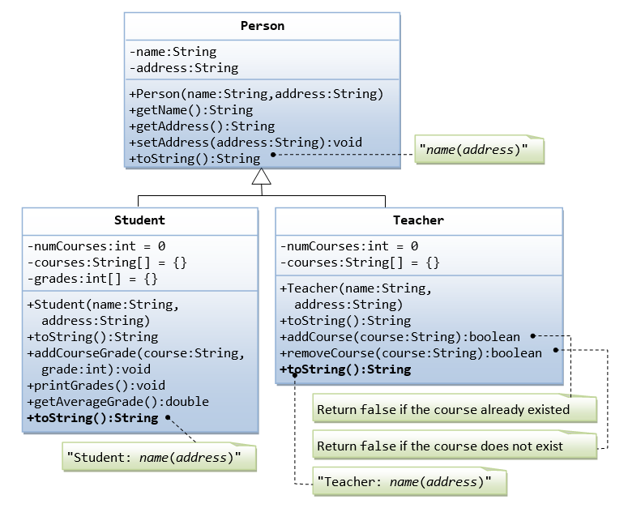
Assignment

Slide 113
Java 8 Features
Java 8 Interface Changes – default method and static method.
Java 8 allows the interfaces to have default and static methods.
The reason we have default methods in interfaces is to allow the developers to add new methods to the interfaces without affecting the classes that implements these interfaces.

Slide 114
Default Methods
Java interface default methods will help us in extending interfaces without having the fear of breaking implementation classes.
Java interface default methods has bridge down the differences between interfaces and abstract classes.
Java 8 interface default methods will help us in avoiding utility classes, such as all the Collections class method can be provided in the interfaces itself.
Java interface default methods will help us in removing base implementation classes, we can provide default implementation and the implementation classes can chose which one to override.

Slide 115
One of the major reason for introducing default methods in interfaces is to enhance the Collections API in Java 8 to support lambda expressions.
If any class in the hierarchy has a method with same signature, then default methods become irrelevant. A default method cannot override a method from java.lang.Object. The reasoning is very simple, it’s because Object is the base class for all the java classes. So even if we have Object class methods defined as default methods in interfaces, it will be useless because Object class method will always be used. That’s why to avoid confusion, we can’t have default methods that are overriding Object class methods.
Java interface default methods are also referred to as Defender Methods or Virtual extension methods.
Diamond Problem!!!

Slide 116
Interface Static Method
Java interface static method is part of interface, we can’t use it for implementation class objects.
Java interface static methods are good for providing utility methods, for example null check, collection sorting etc.
Java interface static method helps us in providing security by not allowing implementation classes to override them.
We can’t define interface static method for Object class methods, we will get compiler error as “This static method cannot hide the instance method from Object”. This is because it’s not allowed in java, since Object is the base class for all the classes and we can’t have one class level static method and another instance method with same signature.
We can use java interface static methods to remove utility classes such as Collections and move all of it’s static methods to the corresponding interface, that would be easy to find and use.

Slide 117
Java Functional Interfaces
An interface with exactly one abstract method is known as Functional Interface.
A new annotation @FunctionalInterface has been introduced to mark an interface as Functional Interface.
@FunctionalInterface annotation is a facility to avoid accidental addition of abstract methods in the functional interfaces. It’s optional but good practice to use it.

Slide 118
Collections

Slide 119
Collections
Collections in java is a framework that provides an architecture to store and manipulate the group of objects.
It provides a system for organizing and handling collections
It belong to java.util package.

Slide 120
What is Collection in java
Collection represents a single unit of objects i.e. a group.

Slide 121
What is framework in java
provides readymade architecture.
represents set of classes and interface.

Slide 122
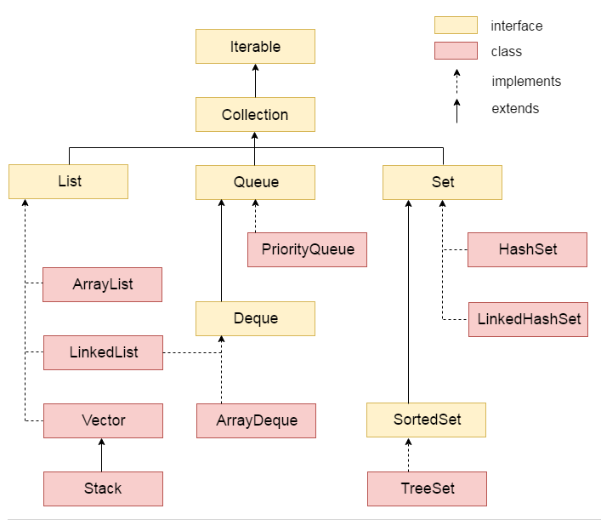
Collections Hierarchy

Slide 123
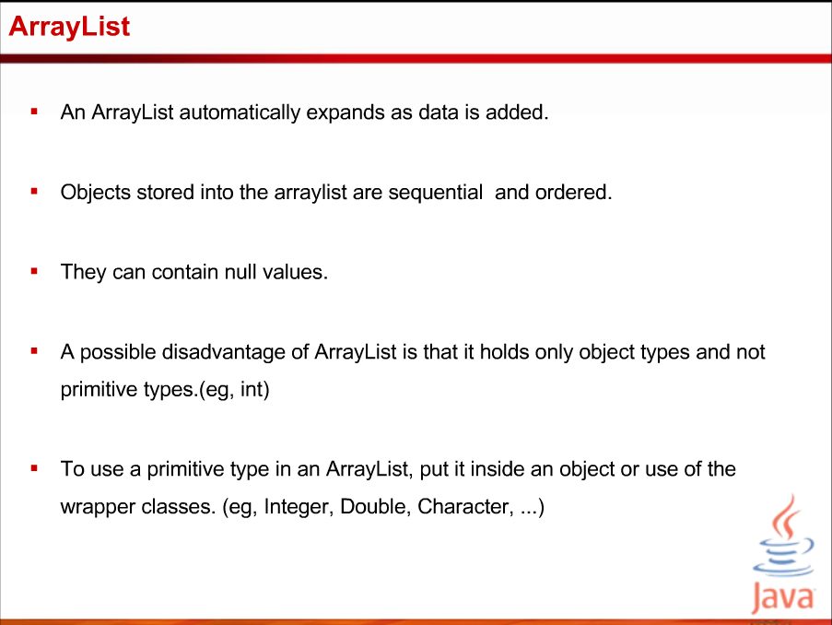

Slide 124
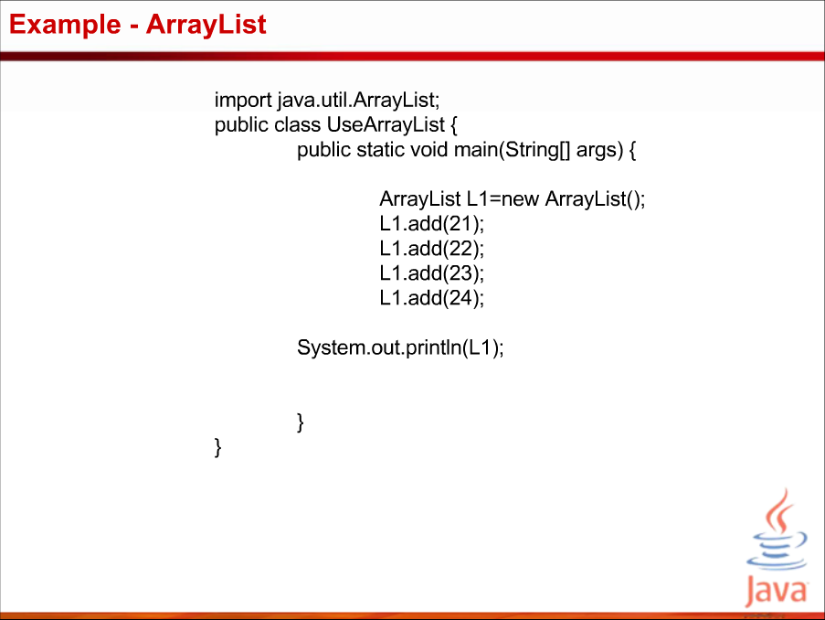

Slide 125
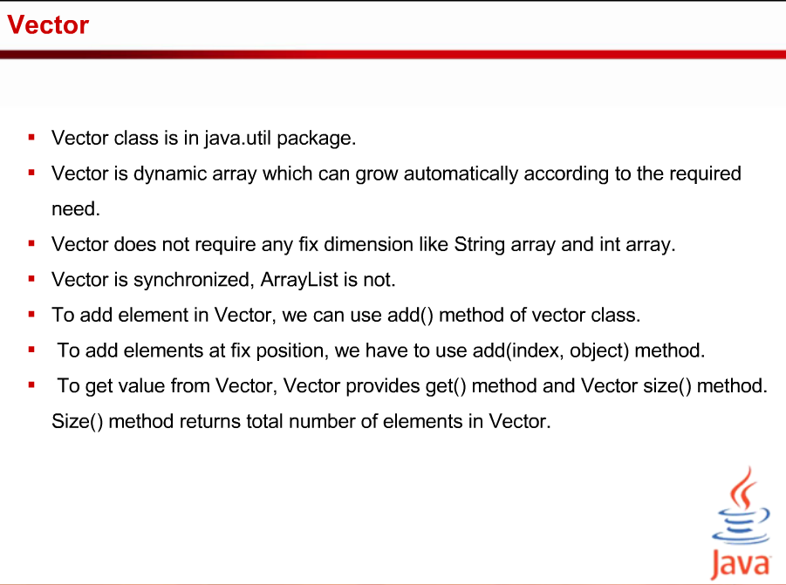

Slide 126
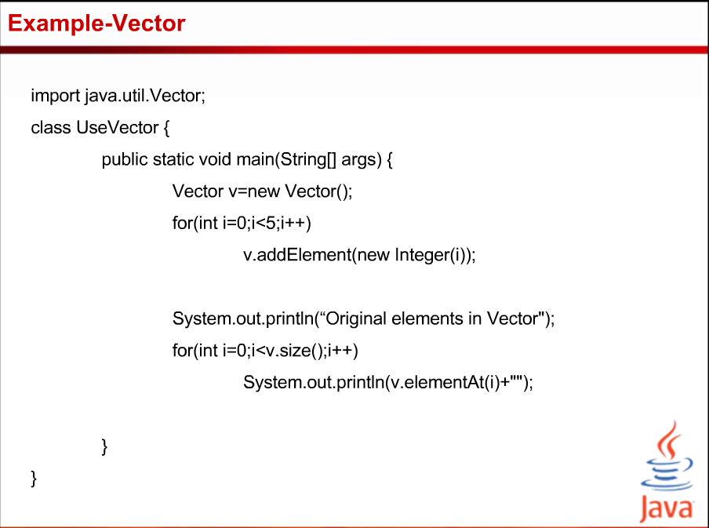

Slide 127
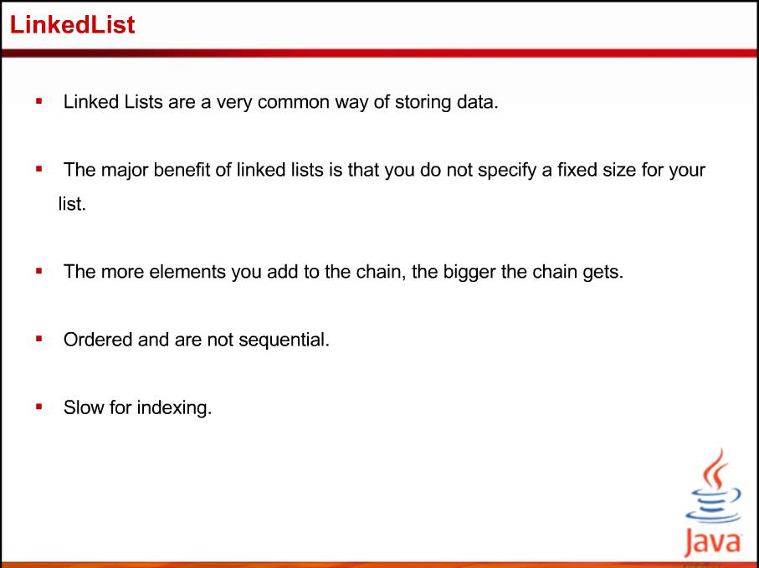

Slide 128
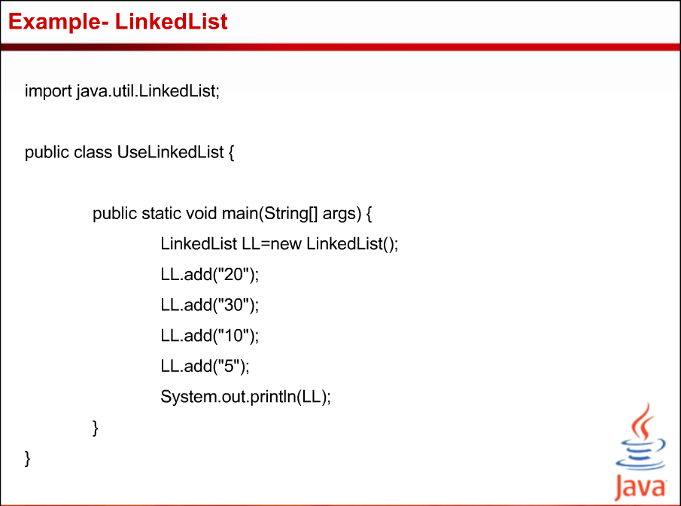

Slide 129
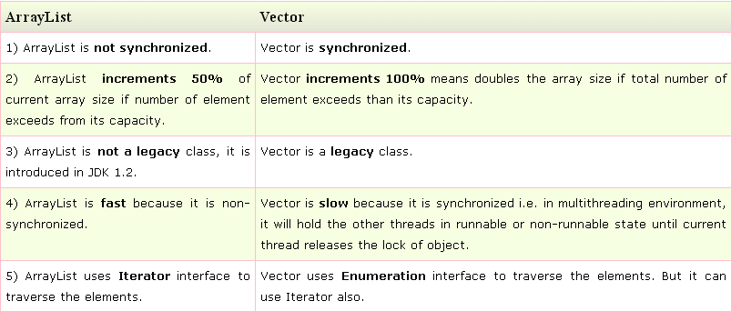
Difference between ArrayList and Vector

Slide 130
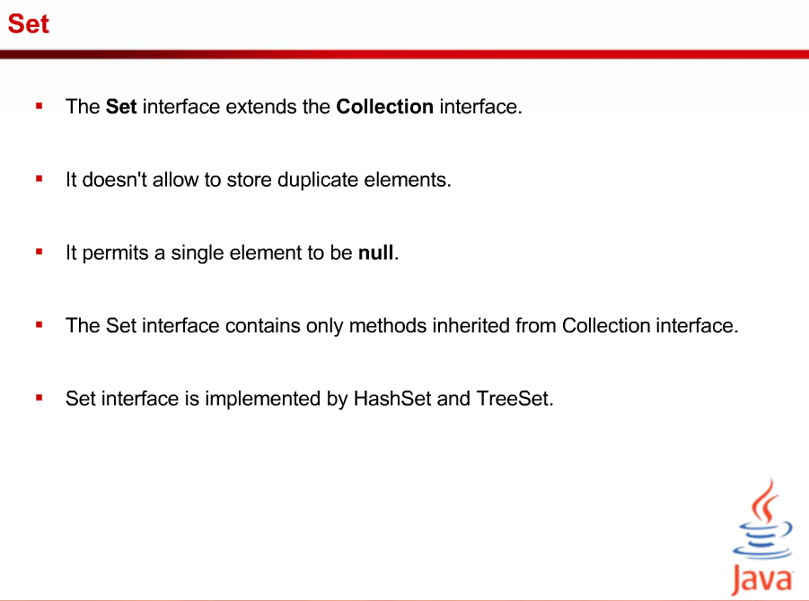

Slide 131
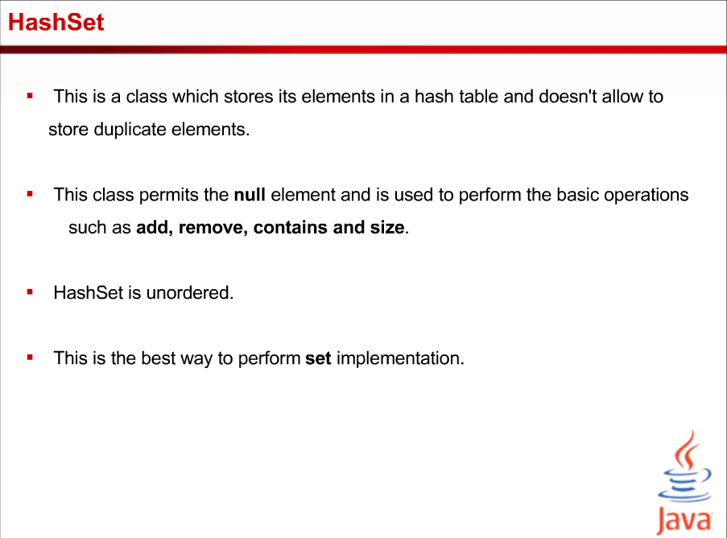

Slide 132
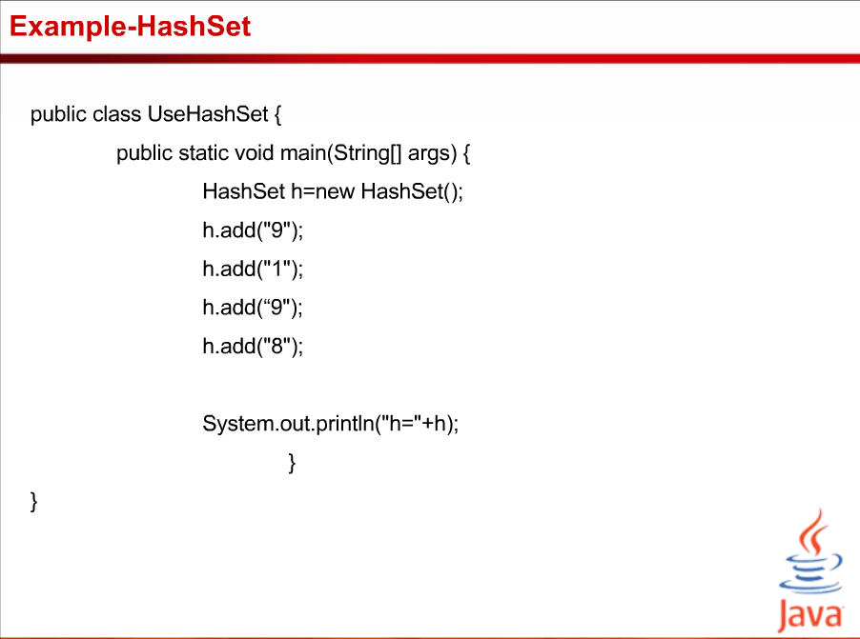

Slide 133
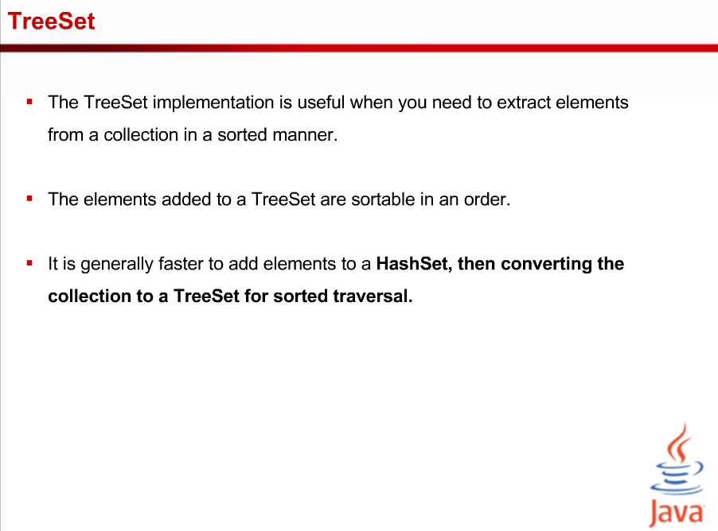

Slide 134
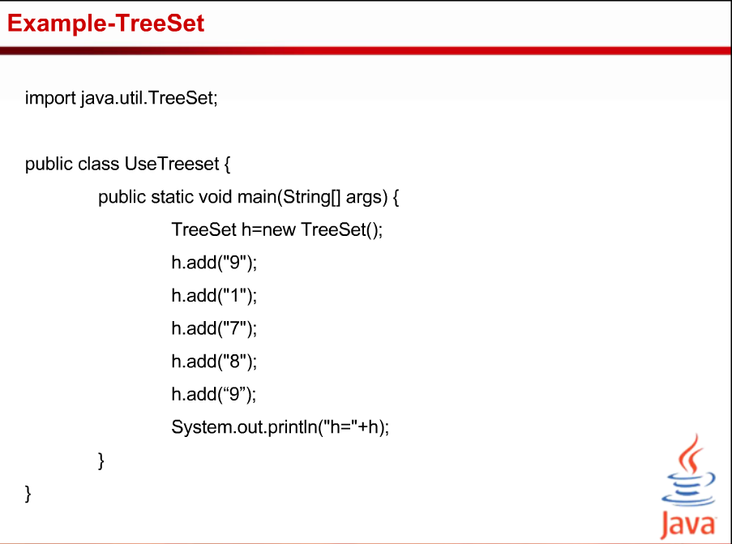

Slide 135
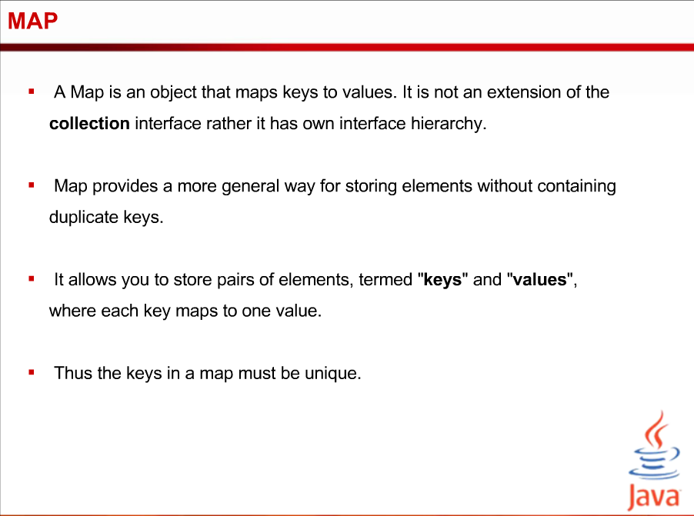

Slide 136
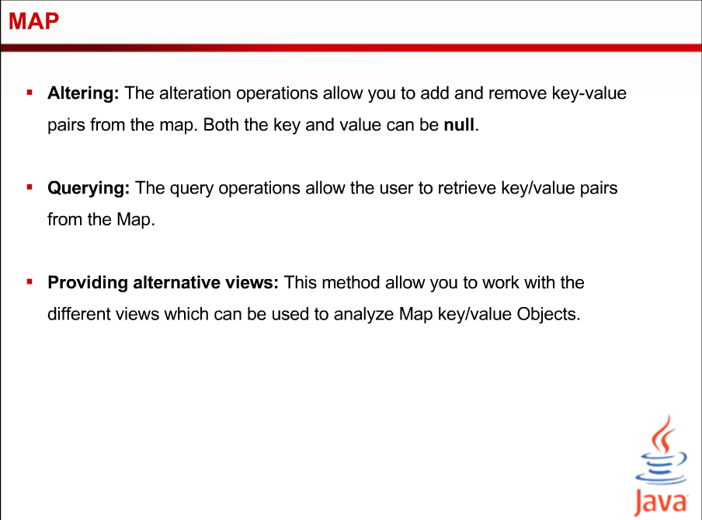

Slide 137
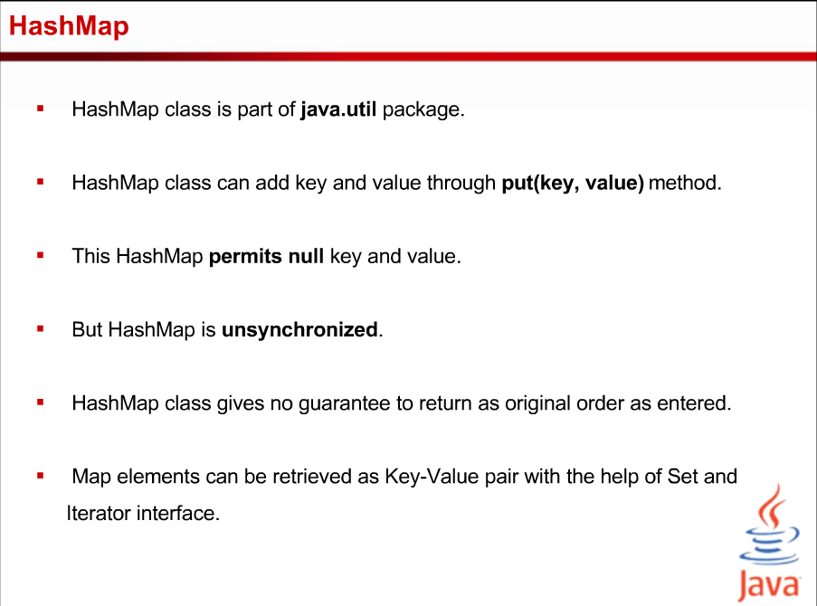

Slide 138
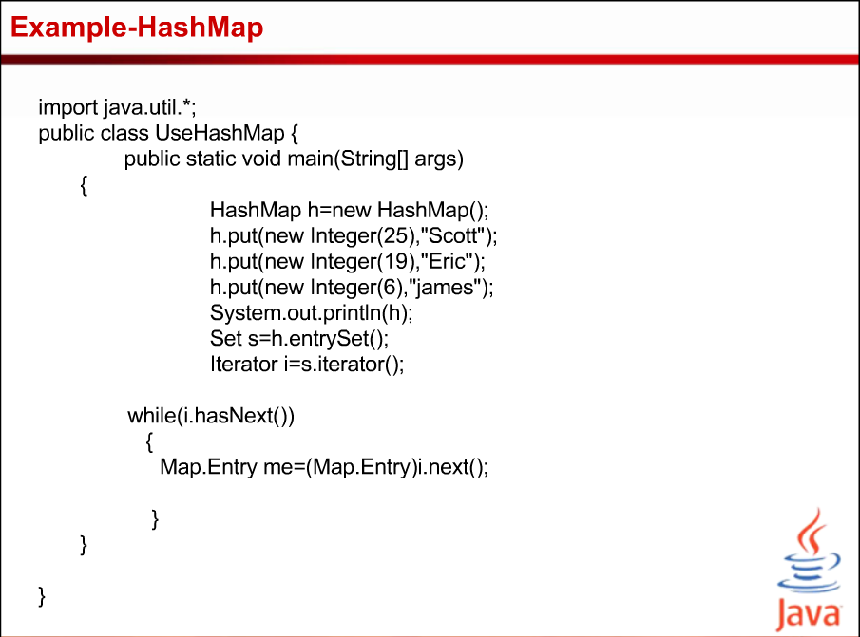

Slide 139
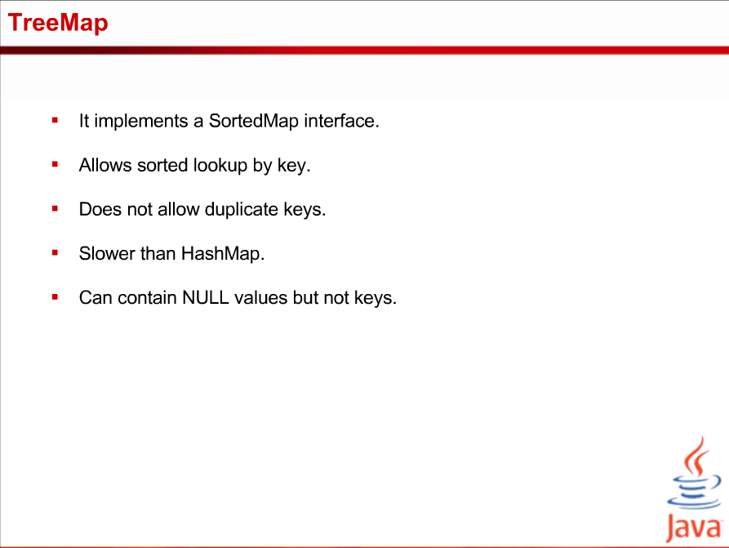

Slide 140
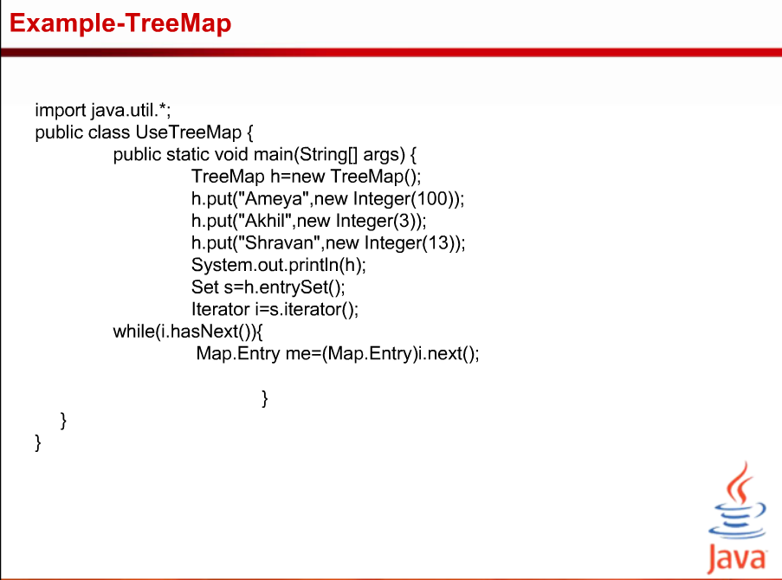

Slide 141
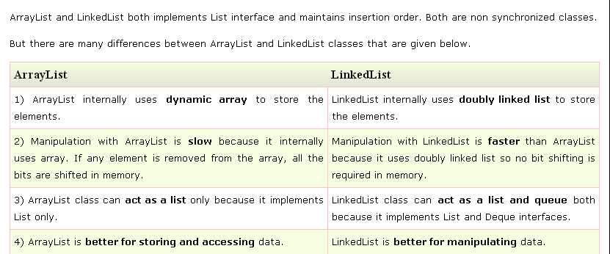
Difference between ArrayList and LinkedList

Slide 142
List Interface
List Interface is the subinterface of Collection.It contains methods to insert and delete elements in index basis.It is a factory of ListIterator interface.
Syntax:-public interface List<E> extends Collection<E>

Slide 143
LinkedHashSet class
LinkedHashSet class is a Hash table and Linked list implementation of the set interface. It inherits HashSet class and implements Set interface.
The important points about Java LinkedHashSet class are:
Contains unique elements only like HashSet.
Provides all optional set operations, and permits null elements.
Maintains insertion order.

Slide 144
LinkedHashSet class
Syntax:-Public class LinkedHashSet<E> extends HashSet<E> implements Set<E>, Cloneable, Serializable

Slide 145
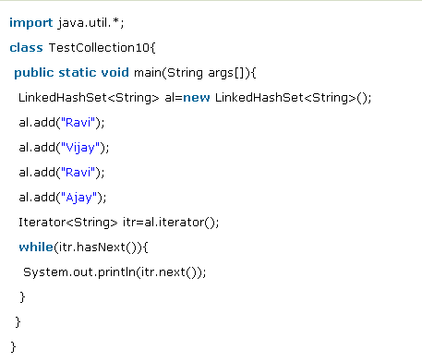
Example of LinkedHashSet class

Slide 146
HashTable class
Java Hashtable class implements a hashtable, which maps keys to values. It inherits Dictionary class and implements the Map interface.
The important points about Java Hashtable class are:
A Hashtable is an array of list. Each list is known as a bucket. The position of bucket is identified by calling the hashcode() method. A Hashtable contains values based on the key.
It contains only unique elements.
It may have not have any null key or value.
It is synchronized.

Slide 147
Declaration HashTable
public class Hashtable<K,V> extends Dictionary<K,V> implements Map<K,V>, Cloneable, Serializable

Slide 148
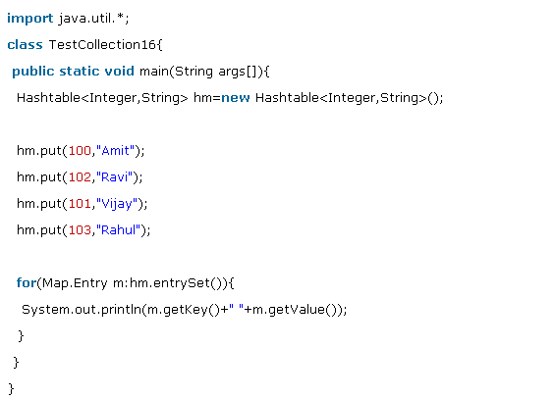
HashTable Example

Slide 149
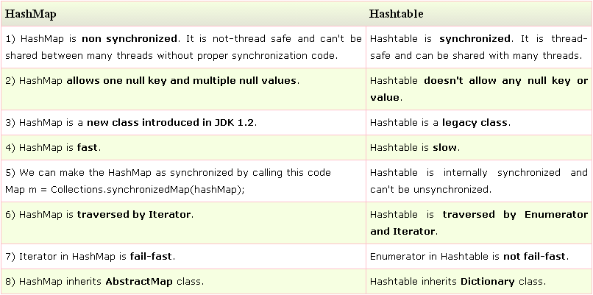
Difference between HashMap and Hashtable

Slide 150
Comparable interface
Java Comparable interface is used to order the objects of user-defined class.This interface is found in java.lang package and contains only one method named compareTo(Object). It provide single sorting sequence only i.e. you can sort the elements on based on single data member only. For example it may be rollno, name, age or anything else.

Slide 151
Comparator interface
Comparator interface is used to order the objects of user-defined class.
This interface is found in java.util package and contains 2 methods compare(Object obj1,Object obj2) and equals(Object element).
It provides multiple sorting sequence i.e. you can sort the elements on the basis of any data member, for example rollno, name, age or anything else.

Slide 152
Collections Class
Java.util.Collections

Slide 153
Generics

Slide 154
Topics
background and goals of generic programming
basics of generic classes = parameterized types
generic methods for general algorithms
inheritance rules for generic types
bounded type parameters
generic code and the Java Virtual Machine
restrictions and limitations
wildcard types and wildcard type capture

Slide 155
Why generic programming
Background
old version 1.4 Java collections were Object-based and required the use of ugly casts
cannot specify the exact type of elements
must cast to specific classes when accessing
Java generics
lets you write code that is safer and easier to read
is especially useful for general data structures, such as ArrayList
generic programming = programming with classes and methods parameterized with types

Slide 156
Why generic programming (cont.)
generic types are a powerful tool to write reusable object-oriented components and libraries
however, the generic language features are not easy to master and can be misused
their full understanding requires the knowledge of the type theory of programming languages
especially covariant and contravariant typing
the following introduces the main aspects of Java generics and their use and limitations
we mostly inspect illustrative samples of what is and what is not allowed, with some short glimpses inside the JVM implementation

Slide 157
Why generic programming (cont.)
Java generics
in principle, supports statically-typed data structures
early detection of type violations
cannot insert a string into ArrayList <Number>
also, hides automatically generated casts
superficially resembles C++ templates
C++ templates are factories for ordinary classes and functions
a new class is always instantiated for given distinct generic parameters (type or other)
in Java, generic types are factories for compile-time entities related to types and methods

Slide 158
Definition of a simple generic class
class Pair <T> { public T first; public T second; public Pair (T f, T s) { first = f; second = s; } public Pair () { first = null; second = null; } }
you instantiate the generic class by substituting actual types for type variables, as: Pair <String>
you can think the result as a class with a constructor
public Pair (String f, String s), etc . .
you can then use the instantiated generic class as it were a normal class (almost):
Pair <String> pair = new Pair <String> ("1","2");

Slide 159
Multiple type parameters allowed
you can have multiple type parameters
class Pair <T, U> { public T first; public U second; public Pair (T x, U y) { first = x; second = y; } public Pair () { first = null; second = null; } }
to instantiate: Pair <String, Number>

Slide 160
Generic static algorithms
you can define generic methods both inside ordinary classes and inside generic classes
class Algorithms { // some utility class
public static <T> T getMiddle (T [ ] a) {
return a [ a.length / 2 ];
}
. . .
}
when calling a generic method, you can specify type
String s = Algorithms.<String>getMiddle (names);
but in most cases, the compiler infers the type:
String s = Algorithms. getMiddle (names);

Slide 161
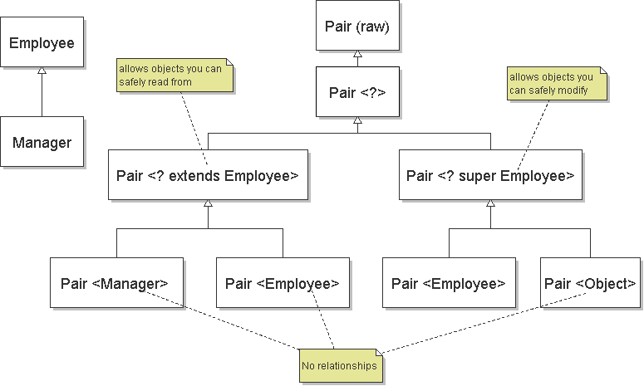
Inheritance rules for generic types

Slide 162
Comments on inheritance relations
Pair<Manager> matches Pair<? extends Employee> => subtype relation (covariant typing)
Pair<Object> matches Pair<? super Employee> => subtype relation (contravariant typing)
Pair<Employee> can contain only Employees, but Pair<Object> may be assigned anything (Numbers) => no subtype relation
also: Pair<T> <= Pair<?> <= Pair (raw)
List <String> sl = new LinkedList <String> (); List x = sl; // OK x.add (new Integer (5)); // type safety warning . . String str = sl.get (0); // throws ClassCast.

Slide 163
Bounds for type variables
consider the min algorithm: find the smallest item in a given array of elements
to compile this, must restrict T to implement the Comparable interface that provides compareTo
public static <T extends Comparable>
T min (T [ ] a) { // this is almost correct
if (a.length == 0) throw new InvalidArg.. (..);
T smallest = a [0];
for (int i = 1; i < a.length; i++)
if (smallest.compareTo (a [i]) > 0) // T constraint
smallest = a [i];
return smallest;
}

Slide 164
Bounds for type variables (cont.)
however, Comparable is itself a generic interface
moreover, any supertype of T may have extended it
public static <T extends Object & // bounding class Comparable <? super T>>
T min (T [ ] a) { . . . // the more general form
T smallest = a [0];
for (int i = 1; i < a.length; i++)
if (smallest.compareTo (a [i]) > 0) // T constraint
smallest = a [i];
return smallest;
}
cannot inherit multiple different instantiations of the same generic type (class or interface)
an inherited generic type is fixed for subtypes, too

Slide 165
Generic code and the JVM
the JVM has no instantiations of generic types
a generic type definition is compiled once only, and a corresponding raw type is produced
the name of the raw type is the same name but type variables removed
type variables are erased and replaced by their bounding types (or Object if no bounds); e.g.:
class Pair { // the raw type for Pair <T> public Object first; public Object second; public Pair (Object f, Object s) { . . } }
byte code has some generic info, but objects don't

Slide 166
Generic code and the JVM (cont.)
Pair <String> and Pair <Employee> use the same bytecode generated as the raw class Pair
when translating generic expressions, such as
Pair <Employee> buddies = new Pair < . .;
Employee buddy = buddies.first;
the compiler uses the raw class and automatically inserts a cast from Object to Employee:
Employee buddy = (Employee)buddies.first;
in C++, no such casts are required since class instantiations already use specific types
if multiple constraints (Object & Comparable. .) then the type parameter is replaced by the first one

Slide 167
Overriding of methods of generic type
consider a generic class with a non-final method:
class Pair <T> { // parameter T is erased from code
public void setSecond (T s) { second = s; } . .
to override such type-erased methods, the compiler must generate extra bridge methods:
class DateInterval extends Pair <Date> {
public void setSecond (Date high) { // override
if (high.compareTo (first) < 0) throw new . .
second = high; // otherwise OK
}
public void setSecond (Object s) { // bridge method
setSecond ((Date)s); // generated by compiler
} . .

Slide 168
Restrictions and limitations
in Java, generic types are compile-time entities
in C++, instantiations of a class template are compiled separately as source code, and tailored code is produced for each one
primitive type parameters (Pair <int>) not allowed
in C++, both classes and primitive types allowed
objects in JVM have non-generic classes:
Pair<String> strPair = new Pair<String> . .;
Pair<Number> numPair = new Pair<Number> . .;
b = strPair.getClass () == numPair.getClass ();
assert b == true; // both of the raw class Pair
but byte-code has reflective info about generics

Slide 169
Restrictions and limitations (cont.)
instantiations of generic parameter T are not allowed
new T () // ERROR: whatever T to produce?
new T [10]
arrays of parameterized types are not allowed
new Pair <String> [10]; // ERROR
since type erasure removes type information needed for checks of array assignments
static fields and static methods with type parameters are not allowed
class Singleton <T> {
private static T singleOne; // ERROR
since after type erasure, one class and one shared static field for all instantiations and their objects

Slide 170
Wildcard types
note that the raw class Pair is not equal Pair <?>
Pair pair1 = . .;
pair1.first = new Double (10.0); // WARNING
Pair <?> pair2 = . .;
pair2.first = new Double (10.0); // ERROR
but some operations have no type constraints:
public static boolean hasNulls (Pair <?> p) {
return p.first == null || p.second == null;
}
alternatively, you could provide a generic method
public static <T> boolean hasNulls (Pair <T> p)
generally, prefer wildcard types (but use generic method with type T when multiple parameters)

Slide 171
Wildcard capture
the wildcard type ? cannot be used as a declared type of any variables (as in the previous slide)
Pair <?> p = new Pair <String> ("one", "two"); . . p.first = p.second; // ERROR: unknown type
but, can sometimes use a generic method to capture the wildcard:
public static <T> void rotate (Pair <T> p) {
T temp = p.first; p.first = p.second;
p.second = temp;
}
the compile checks that such a capture is legal
e.g., the context ensures that T is unambiguous

Slide 172
Collections and algorithms
goal: design a minimal interface that you need
e.g., for max, implement to take any Collection
public static <T extends Object & Comparable <? super T>> T max (Collection <? extends T> c) { // a hypothetical implementation: Iterator <T> it = c.iterator (); T largest = it.next (); // or throws NoSuchElement while (it.hasNext ()) { T val = it.next (); if (largest.compareTo (val) < 0) largest = val; } return largest; }

Slide 173
PECS
Producer extends Consumer Super
PE- <? extends T> - Only to retrieve
CS- <? super T> - Only to Add, Retrieve will be for Object Type

Slide 174
Question Time

Slide 175
Q-1
Which statement is true regarding an object?
(a) An object is what classes instantiated are from (b) An object is an instance of a class (c) An object is a variable (d) An object is a reference to an attribute (e) An object is not an instance of a class.

Slide 176
Q-2
Which component is used to compile, debug and execute java program? a) JVM b) JDK c) JIT d) JRE

Slide 177
Q-3
The concept of multiple inheritances is implemented in Java by
I. Extending two or more classes. II. Extending one class and implementing one or more interfaces. III. Implementing two or more interfaces.
(a) Only (II)
(b) (I) and (II)
(c) (II) and (III)
(d) Only (I)
(e) Only (III).

Slide 178
Q-4
What is the error in the following class definitions?
Abstract class xy { abstract sum (int x, int y) { } }
(a) Class header is not defined properly. (b) Constructor is not defined. (c) Method is not defined properly (d) Method is defined properly (e) No error.

Slide 179
Q-5
Can we have constructor in abstract class
A) Yes
B) No

Slide 180
Q-6
Which of these field declarations are legal within the body of an interface?
(a) Private final static int answer = 42
(b) public static int answer=42 (c) final static answer =42 (d) int answer (e) No error.

Slide 181
Q-7
A method within a class is only accessible by classes that are defined within the same package as the class of the method. Which one of the following is used to enforce such restriction?
(a) Declare the method with the keyword public (b) Declare the method with the keyword private (c) Declare the method with the keyword protected (d) Do not declare the method with any accessibility modifiers (e) Declare the method with the keyword public and private.

Slide 182
Q-8
Given the code
String s1 = ” yes” ; String s2 = ” yes ” ; String s3 = new String ( s1);
Which of the following would equate to true?
(a) s1 == s2
(b) s1 = s2
(c) s3 == s1
(d) s3=s1
(e) s1!=s2.

Slide 183
Q-9
Which access specifier makes the member private in its child class outside the package
A) private
B) No Access Specifier
C) protected
D) public

Slide 184
Q-10
What is the output of this program?
class A
{int i;
public void display()
{System.out.println(i);}
}
class B extends A
{
int j;
public void display()
{
System.out.println(j);
}
}

Slide 185
class Dynamic_dispatch
{
public static void main(String args[])
{
B obj2 = new B();
obj2.i = 1;
obj2.j = 2;
A r;
r = obj2;
r.display();
}
}
a) 1
b) 2
c) 3
d) 4

Slide 186
Q-11
Can we make an abstract method as private?
A) Yes
B) No

Slide 187
Quiz
1. Which of these standard collection classes implements a dynamic array? a) AbstractList b) LinkedList c) ArrayList d) AbstractSet
2. Which of these class can generate an array which can increase and decrease in size automatically? a) ArrayList b) DynamicList c) LinkedList d) DynamicList
3. Which of these method can be used to increase the capacity
of ArrayList object manually? a) Capacity() b) increaseCapacity() c) increasecapacity() d) ensureCapacity()
Q | A
1 | C
2 | A
3 | D

Slide 188
Quiz
1. What is the output of this program?
import java.util.*;
class Output {
public static void main(String args[]) {
ArrayList obj = new ArrayList();
obj.add("A");
obj.add(0, "B");
System.out.println(obj.size());
}
}
a) 0 b) 1 c) 2 d) Any Garbage Value
Q | A
1 | C

Slide 189
Hashtable allows null as Key.
A) True
B) False

Slide 190
Thank You

