Slide 1
Multithreading
By Lata Verma

Slide 2
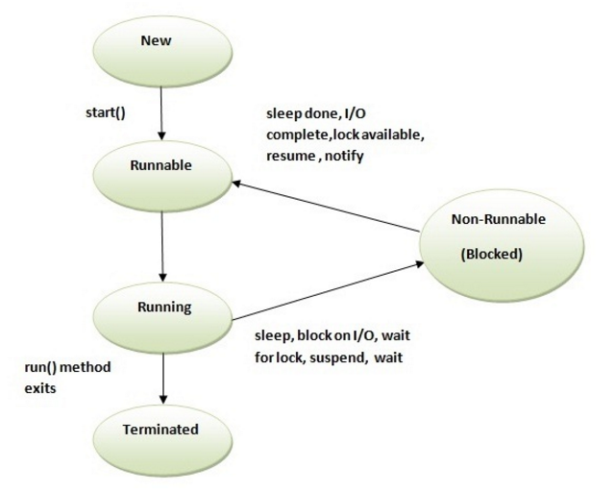
Life Cycle of Threads
A thread can be in one of the five states.
According to sun, there is only 4 states in thread life cycle in java.
New, Runnable, Non-Runnable and Terminated.
There is no running state.
But for better understanding the threads, we are explaining it in the 5 states.
The life cycle of the thread in java is controlled by JVM. The java thread states are as follows:
New
Runnable
Running
Non-Runnable (Blocked)
Terminated

Slide 3
Lamda Expression
-By Lata Verma

Slide 4
What is Lambda Expression?
Java lambda expressions are new in Java 8.
Java lambda expressions are Java's first step into functional programming.
A Java lambda expression is thus a function which can be created without belonging to any class.
A Java lambda expression can be passed around as if it was an object and executed on demand.

Slide 5
Java lambda expressions are commonly used to implement simple event listeners / callbacks, or in functional programming with the Java Streams API.
Hence we can use Lambda Expression for those interfaces which have only one abstract method i.e Functional Interface.

Slide 6
Check these conditions for Lambda
Does the interface have only one abstract (unimplemented) method?
Does the parameters of the lambda expression match the parameters of the single method?
Does the return type of the lambda expression match the return type of the single method?

Slide 7
Points to consider
Interfaces With Default and Static Methods
Lambda Expressions vs. Anonymous Interface Implementations
State oriented and stateless
Lambda Type Inference
Lambda Parameters
Zero Parameters
One Parameter

Slide 8
Multiple Parameters
Parameter with Types
Lambda Function Body
Returning a Value From a Lambda Expression
Lambdas as Objects
Variable Capture
Local variables
Instance variables
Static variables

Slide 9
Best Practices to use Lambdas
Don’t Treat Lambda Expressions as Inner Classes
Instantiate Functional Interfaces with Lambda Expressions
Keep Lambda Expressions Short And Self-explanatory
Don’t Overuse Default Methods in Functional Interfaces
Use the @FunctionalInterface Annotation

Slide 10
Stream API
By Lata Verma

Slide 11
Stream
Stream is the flow of data.
Stream API helps in doing Functional Programming.
It is always used with Collections.
Streams are of two types
Sequential Stream
Parallel Stream

Slide 12
Every collection class can be used to get stream
collection.stream()
Collection.parallelStream()
Streams provide so many methods
Filter() ---Intermediate(lazyEvaluation)
Map() ---Intermediate
findFirst() ---Terminate
forEach() ---Terminate

Slide 13
orElse() method
Streams cannot be reused.
Example:
Stream<Integer> s=list.stream();
s.forEach(System.out::println); //Works
s.forEach(System.out::println); //Exception

Slide 14
filter() method
Filter () is used to filter some data from the stream on the basis of the criteria written in the paramater.
Filter forces stream to keep only that data which is according to the defined condition no to throw those elements.
Filter method can take lambdas

Slide 15
Example
list.stream().filter(obj->obj.getAnyMember()>anyValue)

Slide 16
map() method
It is used to convert returned value of stream into another type.
Example:-
list.stream().map(obj::getParticularMember()).forEach(System.out::println);

Slide 17
Distinct()
It is to get only distinct values.
list.stream().map(obj::getParticularMember()).distinct().forEach(System.out::println);

Slide 18
limit() method
Limit is used to set limit of values to be there in the stream
list.stream().map(obj::getParticularMember()).distinct().limit(3).forEach(System.out::println);

Slide 19
collect() method
It is used for giving all the items of a stream into a Collection
list.stream().map(obj::getParticularMember()).distinct().limit(3).collect(Collectors.toList())forEach(System.out::println);

Slide 20
Concurrency Framework

Slide 21
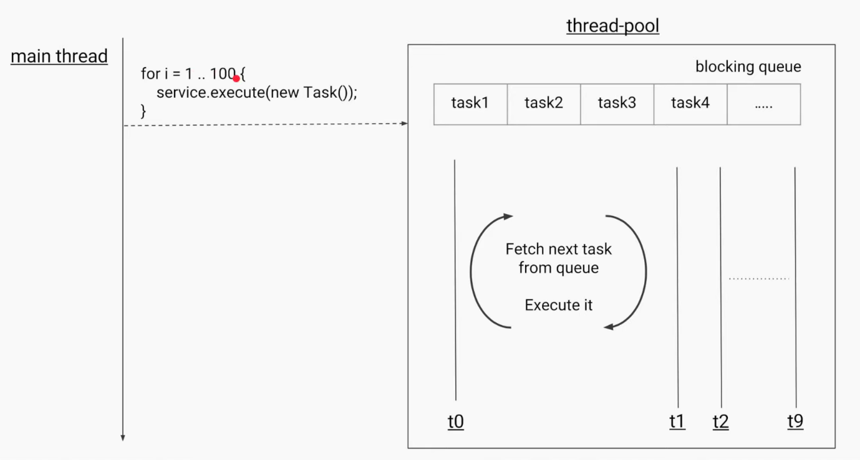
Thread Pool

Slide 22
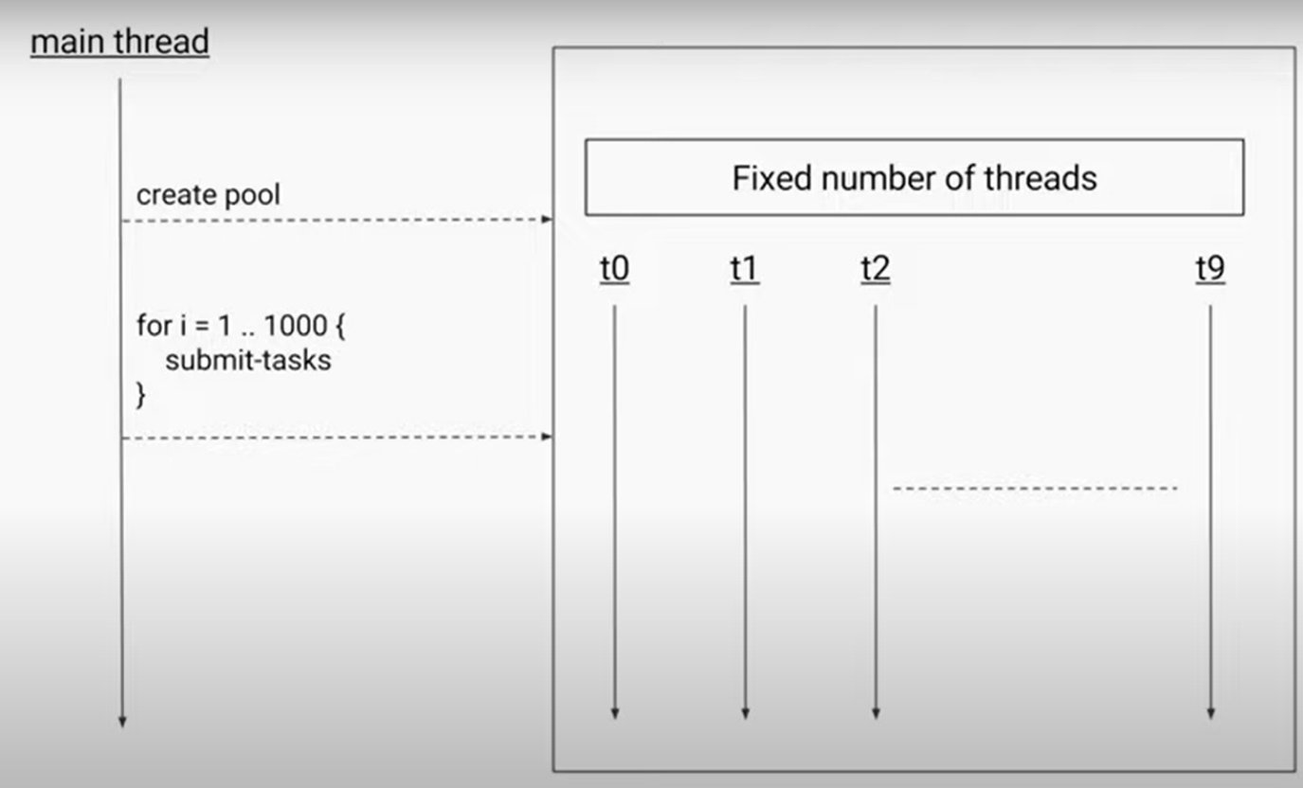
Fixed Thread Pool

Slide 23
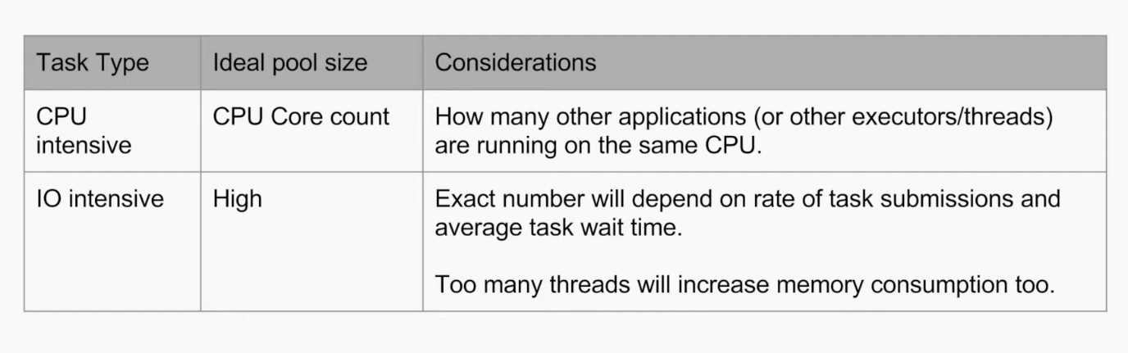
Total No of Threads

Slide 24
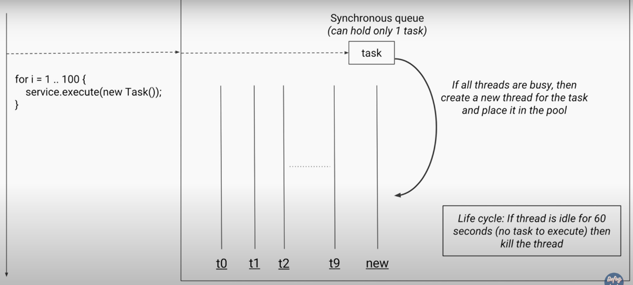
Cached Thread Pool

Slide 25
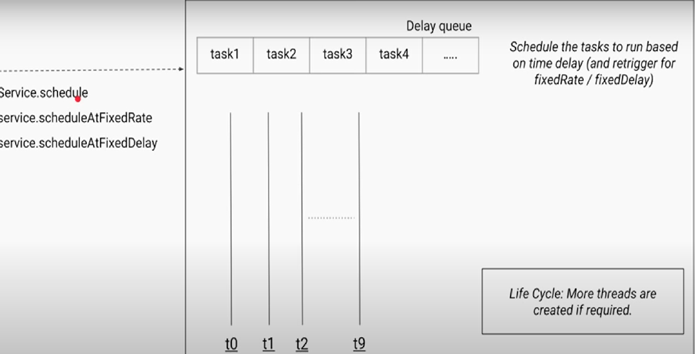
Scheduled Thread Pool

Slide 26
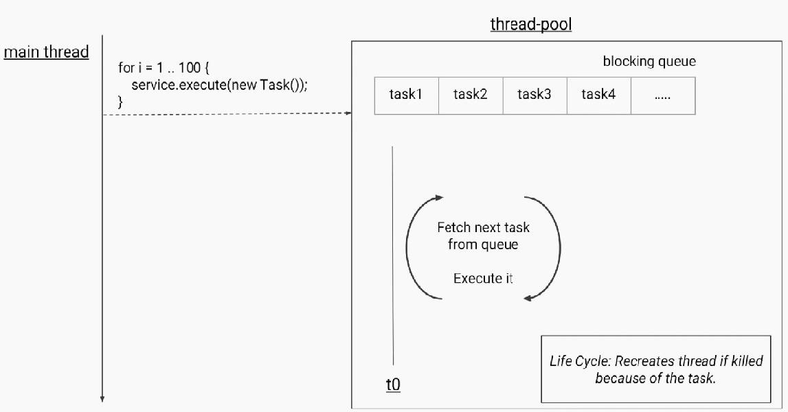
Single Thread Pool

Slide 27
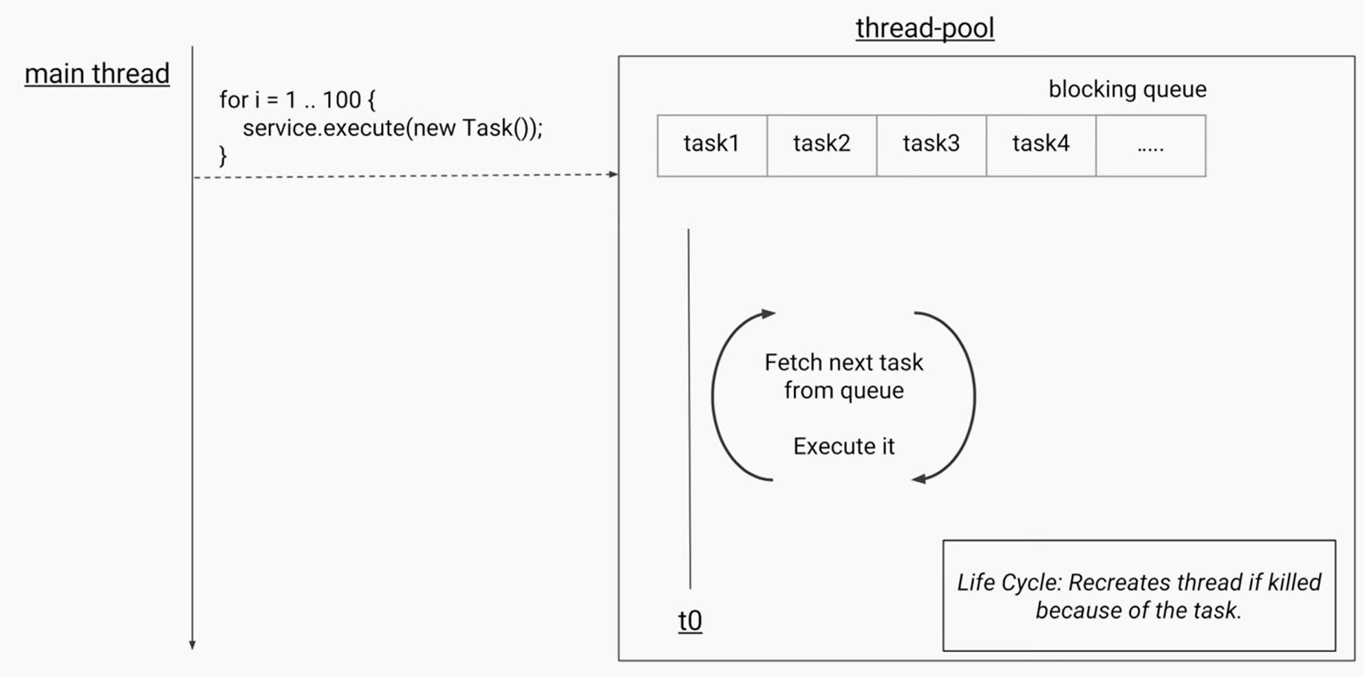

Slide 28
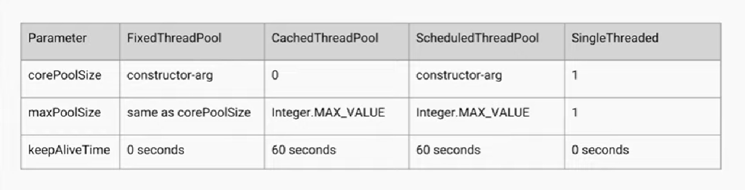

Slide 29
Fork/Join, Work Stealing Thread Pool
Fork/Join framework uses work-stealing algorithm. Work Stealing is a scheduling strategy where worker threads that have finished their own tasks can steal pending tasks from other threads. In parallel execution, tasks are divided among multiple processors/cores. When a core has no work, it should be assigned a task from another processor's overloaded queue rather than being idle.

Slide 30
In fork/join thread pool, each task monitors whether it has to work for a long time. If yes it forks it's own task. 'Fork' is splitting/decomposing of a task and pushing the half (ideally) of it to the parent pool so that other threads can take up (steal) that split task. The term 'join' is combining of results of the tasks submitted to the pool. Tasks are recursively split into smaller parts, run in parallel and recombined.

Slide 31
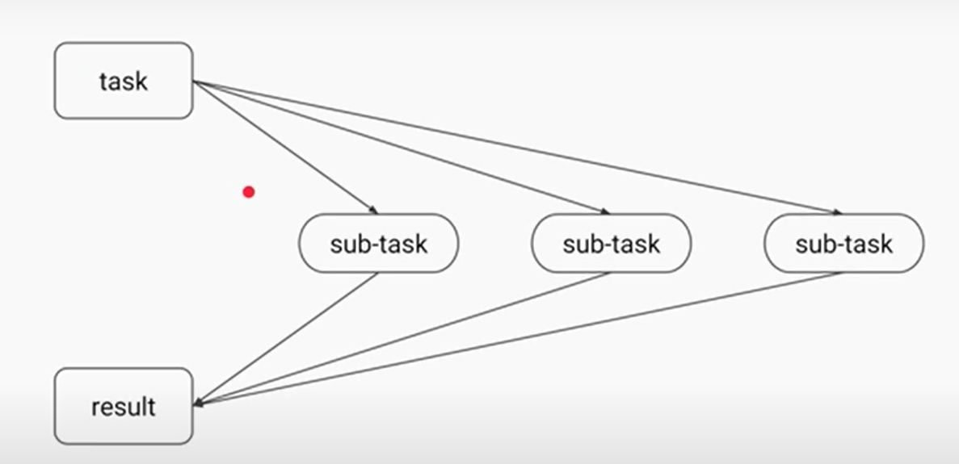
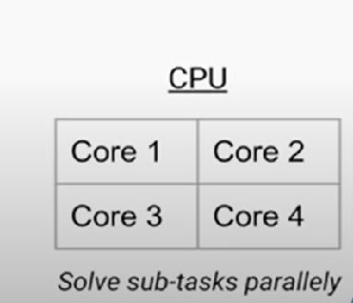
Fork/Join Mechanism

Slide 32
Fork/Join Algorithm
Result solve(Problem problem)
{
if (problem is small)
directly solve problem
else
{
split problem into independent parts fork new subtasks to solve each part join all subtasks
compose result from subresults
}
}

Slide 33
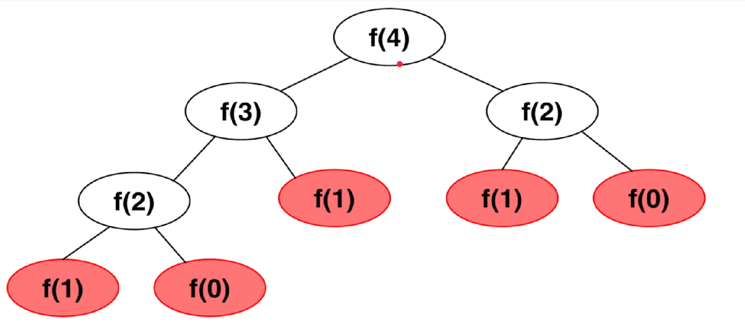
Example of Fork/Join for Fibonacci Series

Slide 34
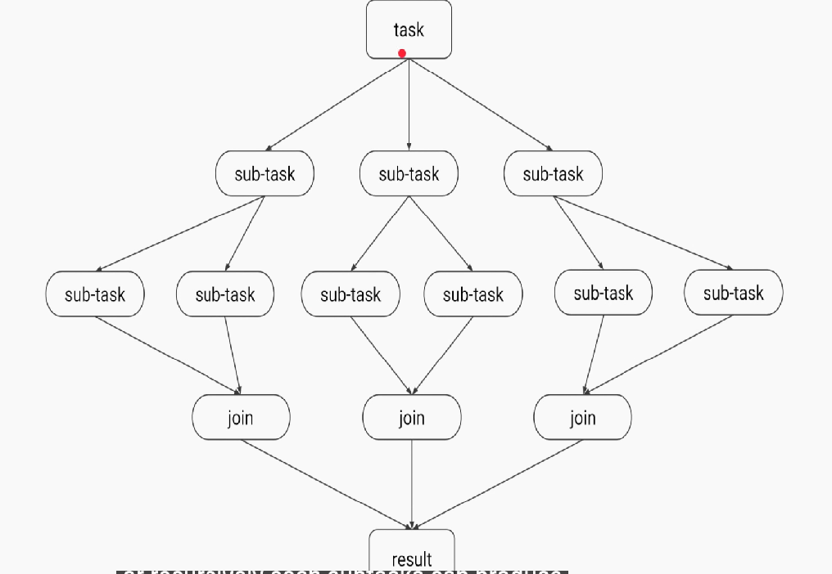
Divide/Conquer in Fork/Join

Slide 35
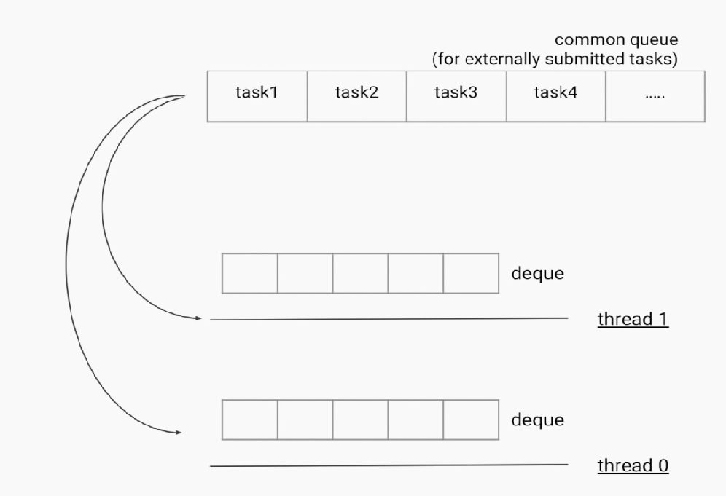
Work Stealing Pool

Slide 36
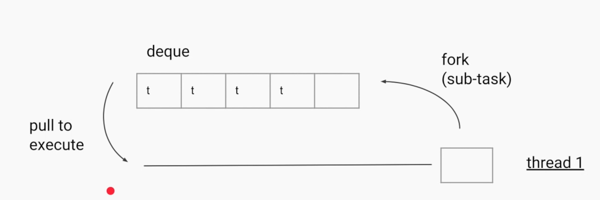

Slide 37
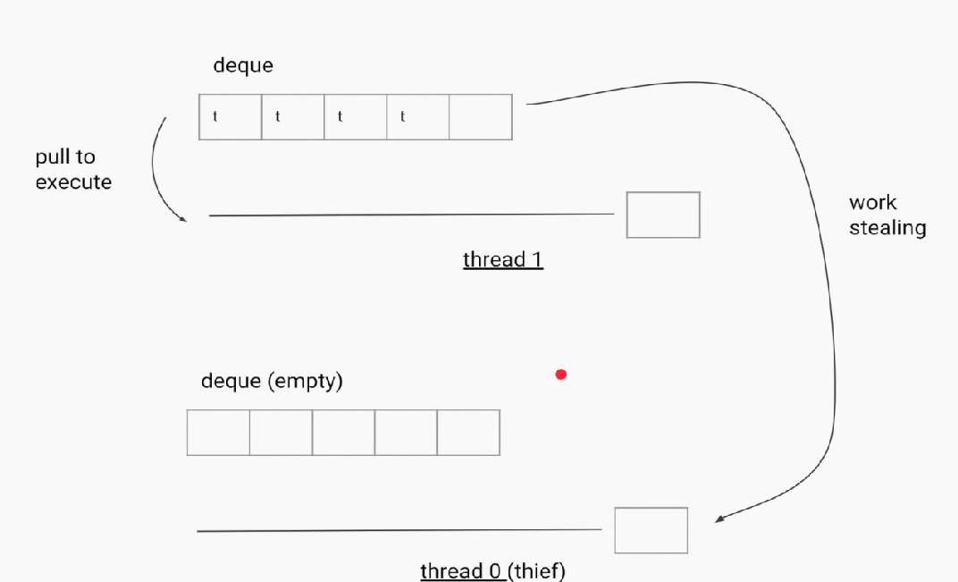
Work Stealing

Slide 38
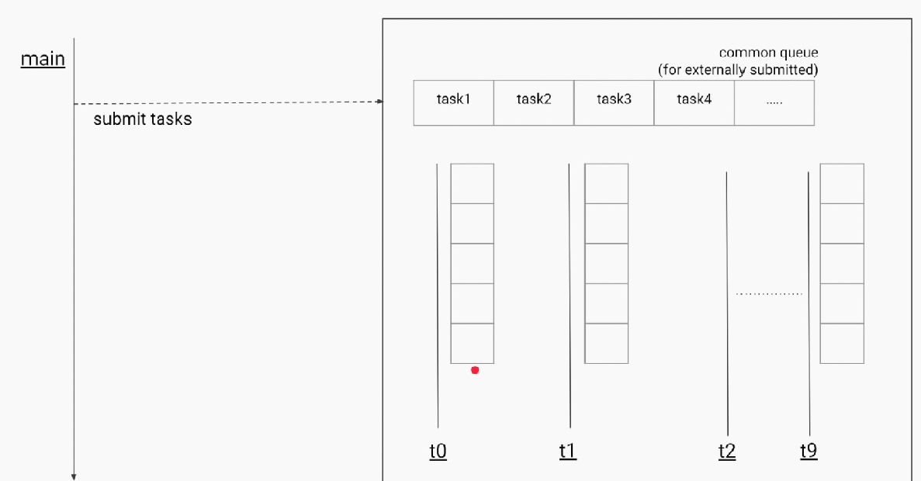
Final Diagram for Work Stealing

Slide 39
Question Time

Slide 40
What is the priority of the thread in output of this program?
class multithreaded_programing
{
public static void main(String args[])
{
Thread t = Thread.currentThread();
System.out.println(t);
}
}
a) 4 b) 5 c) 0 d) 1

Slide 41
Deadlock is a situation when thread is waiting for other thread to release acquired object. a) True b) False

Slide 42
What is true about threading? a) run() method calls start() method and runs the code b) run() method creates new thread c) run() method can be called directly without start() method being called d) start() method creates new thread and calls code written in run() method

Slide 43
Which of the following is not introduced with Java 8? a) Stream API b) Serialization c) Spliterator d) Lambda Expression

Slide 44
What is the return type of lambda expression? a) String b) Object c) void d) Function

Slide 45
Which is the new method introduced in java 8 to iterate over a collection? a) for (String i : StringList) b) foreach (String i : StringList) c) StringList.forEach() d) List.for()

