Slide 1

CipherShield: Pioneering Multi-Key Cryptographic approach for File Encryption Using Dynamic Keys
-A Comprehensive Approach to Protecting Video based data
Mohammed Abdul Lateef
M. Tech - CFIS - II Yr
22011DA802
JNTUH
Dissertation Project Review
Under the guidance of:
Dr. P. Swetha
Professor of Computer Science
Deputy Director, Directorate of Academic Audit
JNTUH

Slide 2
Agenda:
Introduction
Current System
Literature Review
Objectives
Use Cases
Proposed system
List of System Modules
System Architecture
Performance Evaluation
Conclusion

Slide 3
The incessant threats of data theft pose significant risks to creators, industries, and the integrity of digital content.
In response to this imperative, our attempt presents a groundbreaking approach to video encryption, tailored to the unique characteristics of end user system information.
1. Introduction:
Dynamic Key Generation Based System To Handle Video File Encryption

Slide 4
2. Current Challenges in Fortifying Digital Assets
Dynamic system can adaptively generate and manage keys.
System enables the use of a hybrid approach, such as combining RSA with ECC and AES
Adaptability and responsiveness, allowing for a robust defense against contemporary cryptographic threats

Slide 5
The cryptographic solution proposed aims to elevate the data security by implementing a system that uses the encryption models as per the file types.
3. Literature Review
A Novel Hybrid Multikey Cryptography Technique for Video Communication
Yousef Fouzar and et. al. , ‘‘A Novel Hybrid Multikey Cryptography Technique for Video Communication’’ IEEE Access, vol. 11, Jan. 2023.
Each encryption iteration for next chunk of video data adds an additional layer of security, contributing to enhanced data protection.

Slide 6

4. Objectives: Implementing a Dynamic Software System for Real-Time Encryption
Develop a comprehensive file encryption approach.
Tailor cryptographic strategies for text and video content.
Realize a dynamic software system with dedicated modules.

Slide 7
The cryptographic solution proposed aims to elevate the data security by implementing a system that uses the encryption models as per the file types.
5. Use Case
A multinational corporation regularly conducts sensitive board meetings and strategy sessions via video conferencing. Given the confidential nature of these discussions, ensuring the security and privacy of the video stream is paramount
Implementation:
Encryption:
Video stream divided into encrypted chunks using a hybrid of RSA and other cryptographic algorithms.
Dynamic encryption keys generated for each chunk, enhancing security.
Transmission:
Encrypted video chunks securely transmitted to all participants.
Even if intercepted, content remains unreadable.
Decryption:
Participants' devices decrypt chunks in real-time using appropriate keys.
Only authorized participants access decrypted video content.

Slide 8
The cryptographic solution proposed aims to elevate the data security by implementing a system that uses the encryption models as per the file types.
6. Proposed Solution and Highlights
The cryptographic solution proposed aims to elevate the data security by implementing a system that uses the encryption models as per the file types.
File types focused: - Text and Video
Adaptive Encryption based on Content Characteristics: Adaptive approach for text and video content.
Dynamic Key Generation: Enhanced Real-time key generation for evolving data (based on streamed encrypted chunks).
Dedicated Software Modules: Tailored solutions for text and video encryption/decryption.

Slide 9
The cryptographic solution proposed aims to elevate the data security by implementing a system that uses the encryption models as per the file types.
7. Modules from proposed system
Following are the initial list of modules crafted for proposed system
User Interface
Unique attribute storage
Key param initialization
Key Management
File Chunking
Encryption
Decryption
File Concatenation
Metrics

Slide 10
8. Cryptographic Implementation
1. Video Encryption:
Video Data encrypted using an AES Key Derived from ECC Equation. AES Key secured using RSA encryption.

Slide 11
8.1
Approach used for Video input
1 . Generate ‘n’ Video Chunks from video input
2. Generate 128 bit AES key from ECC equation using GUID
3.Encrypt each video chunk with AES key and encrypt the AES key using RSA
4. Use the key generated by previous chunk for the next chunk. * First chunk gets the input from 128 bits(16bytes) of Video data
5. Concatenate encrypted AES key, GUID to the first encrypted video chunk

Slide 12


8.1 Key derivation from ECC Equation
ECC Equation
The proposed method considers
VID as a
GUID as b
x is the int value of the hash for VID/previous key generated as below
(1)
$$x=int\left(sha256\left(VID\right)\right)$$
$$K_{master}=\sqrt{\left(x^{3}+VID∗x+GUID\right)mod\left(2^{256}\right)}$$
(2)
(Used only for the first video chunk)
$$K_{i−1}^{∗}=\sqrt{\left(x^{3}+K_{Prev}∗x+GUID\right)mod\left(2^{256}\right)}$$
(3)
(For generating keys of remaining video chunks)

Slide 13
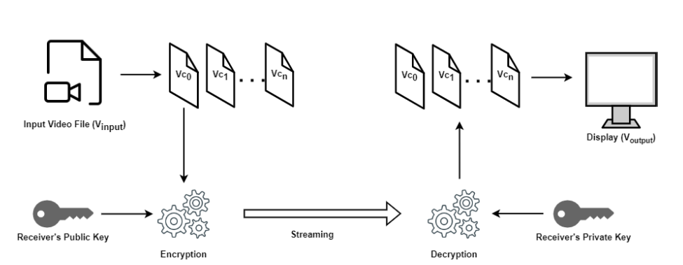
7.2.1. Video communication using public key cryptography
Figure 1: Implemenation of video chunking for securied communication

Slide 14
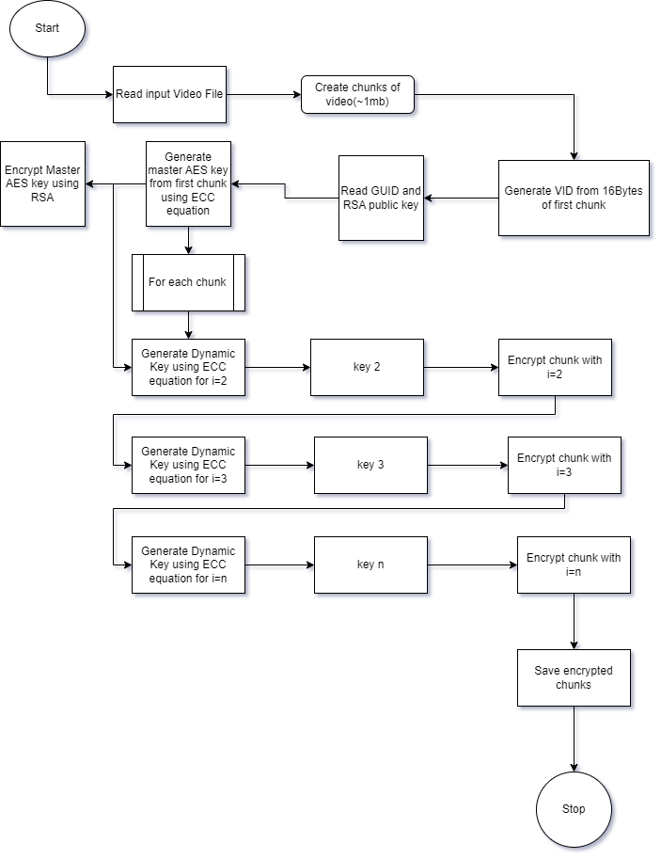
7.2.2 Architecture for Encryption
Figure 2: Encryption flow for algorithm

Slide 15
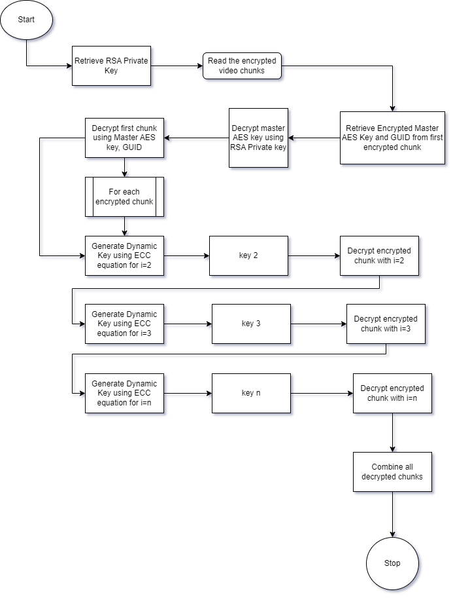
7.2.3 Architecture for Decryption
Figure 3: Decryption flow for algorithm

Slide 16
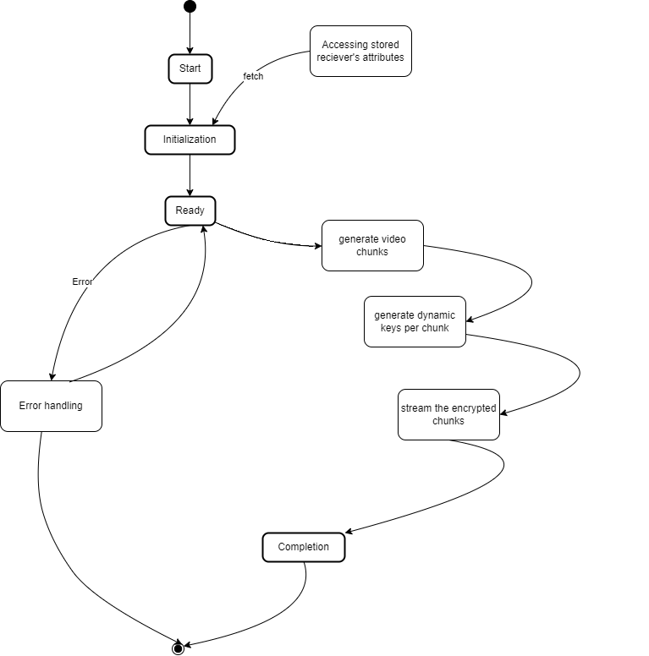
9. System Architecture
- State Diagram
Figure 4: State of system during encryption

Slide 17
10. Performance Evaluation
Time taken to Chunk the video
Time taken generate dynamic keys for the chunks created
Time taken to Encrypt the video file using dynamic keys generated.
Number of Keys Generated
Time taken to Decrypt the video chunks
Comparison of Results

Slide 18
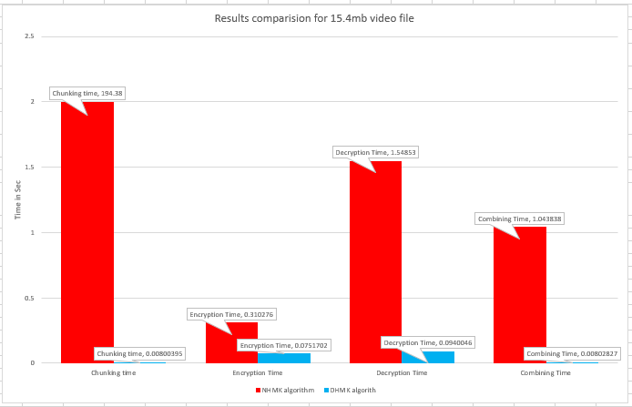

Slide 19
11. Conclusion
Adaptability: Exhibits a high degree of adaptability and future-proofing by incorporating dynamic key derivation mechanism
User-Focused Security: Real-time key generation based on unique identifiers provides dynamic protection for file chunks.

Slide 20
Reference
Y. Fouzar, A. Lakhssassi and M. Ramakrishna, "A Novel Hybrid Multikey Cryptography Technique for Video Communication," in IEEE Access, vol. 11, pp. 15693-15700, 2023, doi: 10.1109/ACCESS.2023.3242616.

Slide 21


