Slide 1

Elastic Search
Robin Hansma, Lars Lokhoff, Daan van Ingen

Slide 2
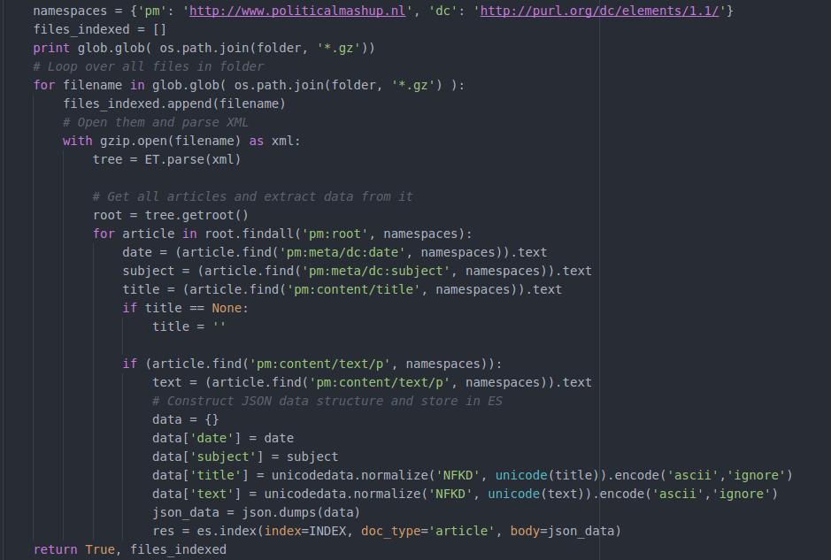
Building the data index

Slide 3
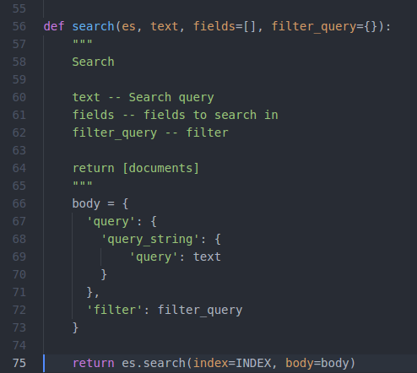
Searching the builded index

