Slide 1
SPRING BOOT PROJECT
By Madhuchhanda Das
under the Guidance of Amitava Chattopadhyay

Slide 2
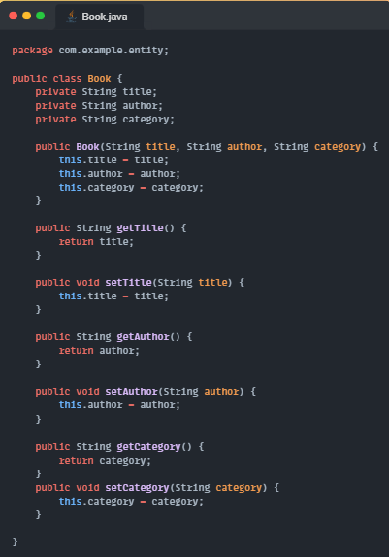
BOOK MANAGEMENT
Purpose: Simple in‑memory REST API that lets users list, filter, create, update, and delete books without a database.
Controller (BookController):
Annotated with @RestController and base path /api/books.
Maintains an ArrayList<Book> followed by initializeBooks() .
Entity (Book): Plain Java class with title, author, category fields + getters/setters;
HTTP Status Handling: Explicit @ResponseStatus(HttpStatus.CREATED) for the create endpoint; others rely on defaults

Slide 3
Spring Boot REST API Basics – Important Annotations
Create Simple Spring Boot REST API – @RestController and @GetMapping
Spring Boot REST API with Path Variable – @PathVariable
Spring Boot REST API with Request Param – @RequestParam
Spring Boot POST REST API – @PostMapping and @RequestBody
Spring Boot PUT REST API – @PutMapping and @RequestBody
Spring Boot DELETE REST API – @DeleteMapping
Using Spring ResponseEntity to Manipulate the HTTP Response
Define Base URL for REST API’s in Spring MVC Controller – @RequestMapping
@PathVariable annotation is used on a method argument to bind it to the value of the URL template Variable .
Query Parameters : Request Parameters that have been attached after a “ ? “ .They have name =value pairs and is used for filtering of data.

Slide 4
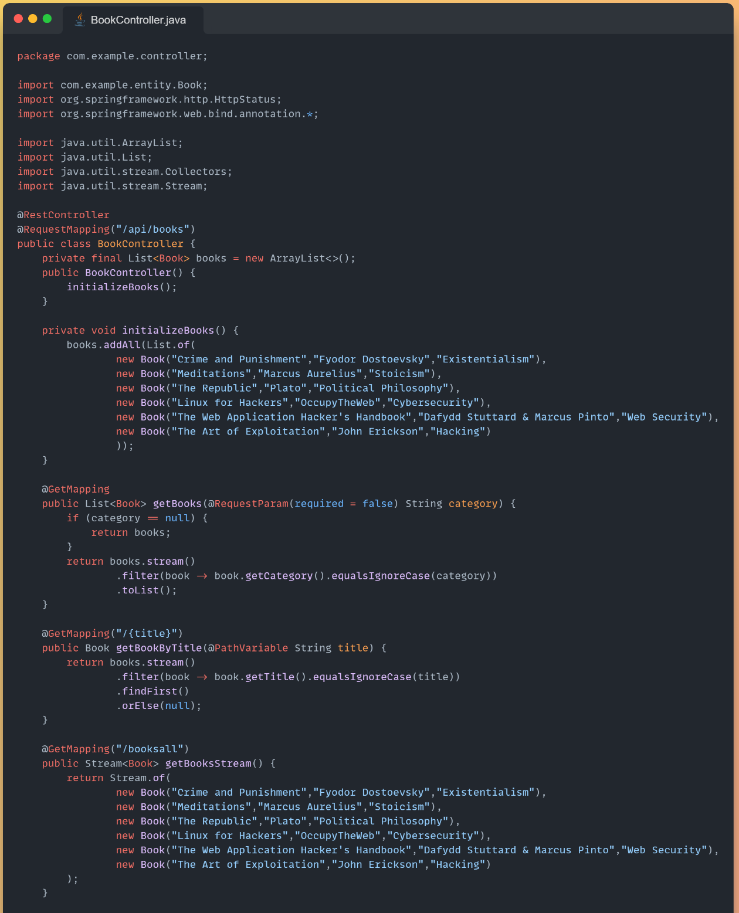
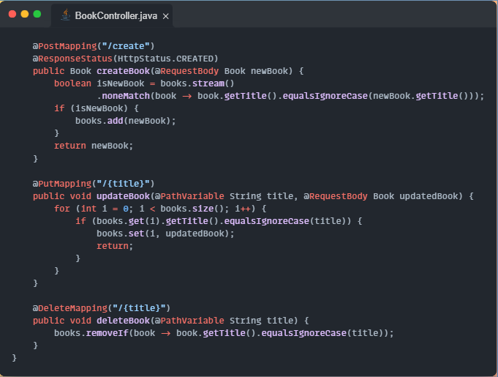

Slide 5
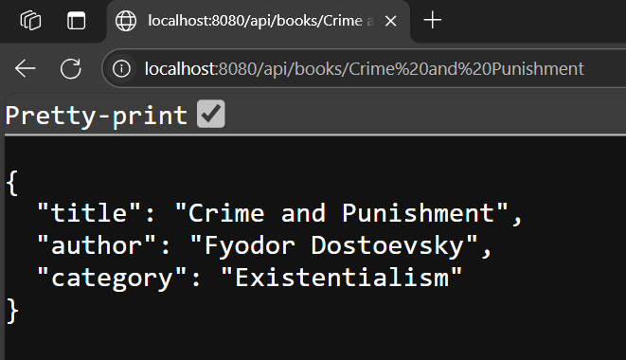
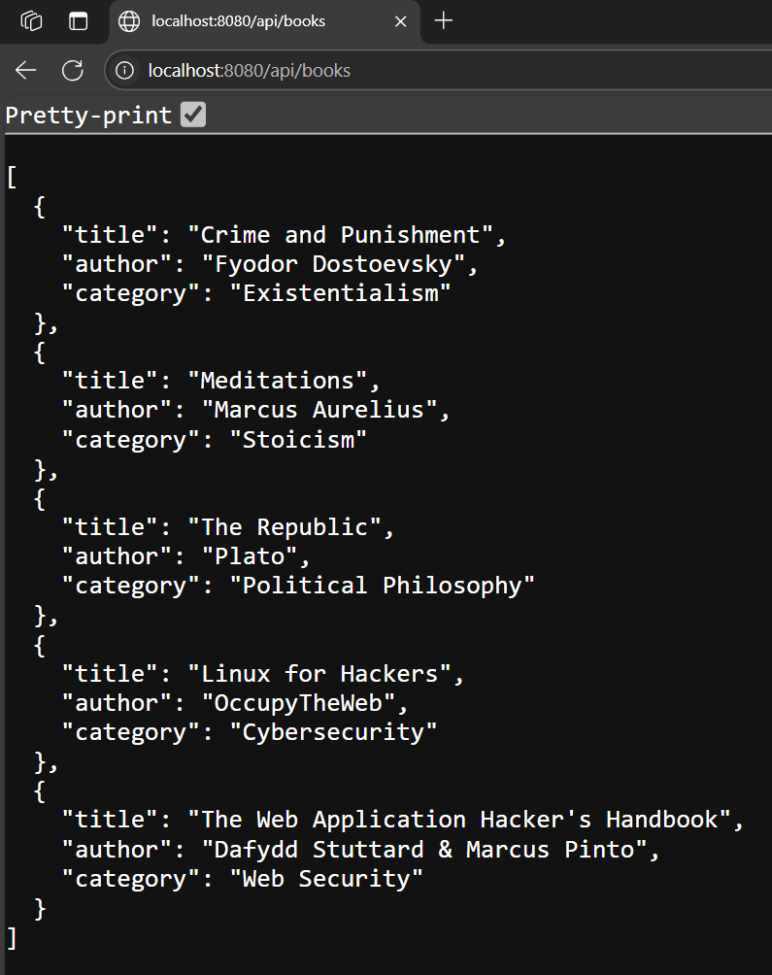

Slide 6
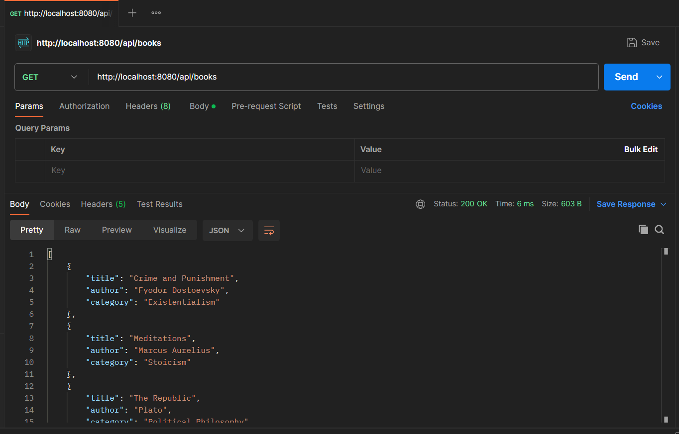
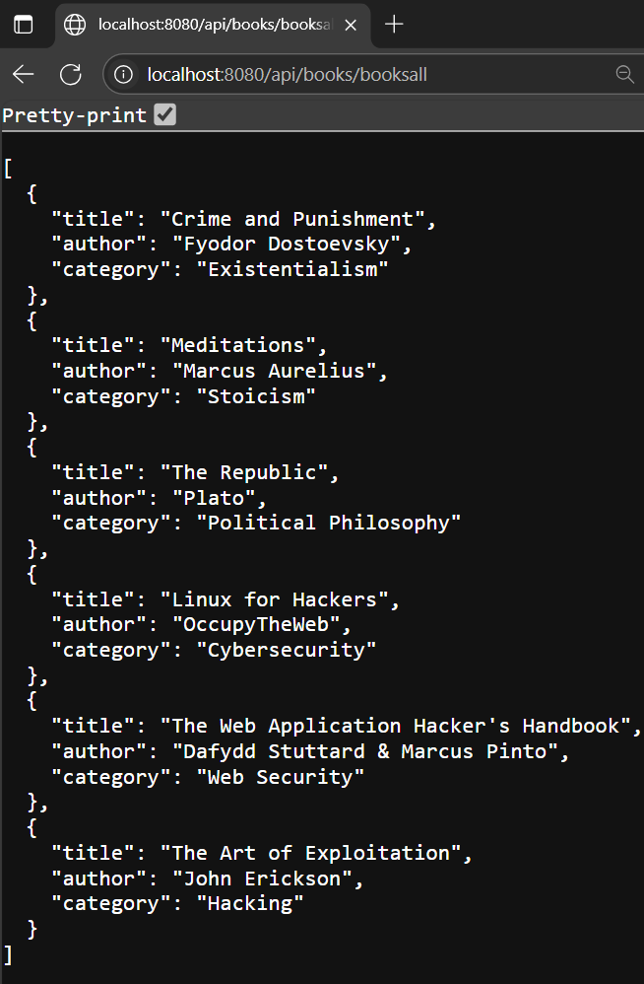

Slide 7
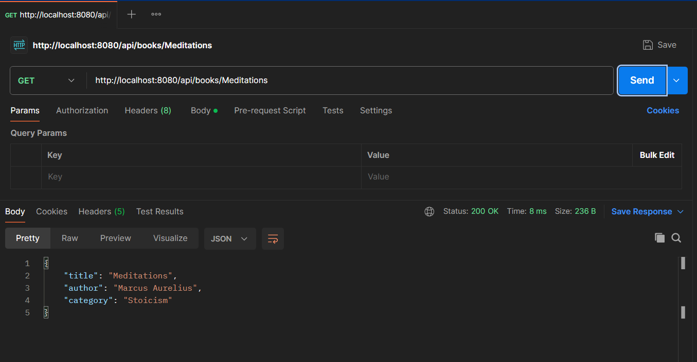
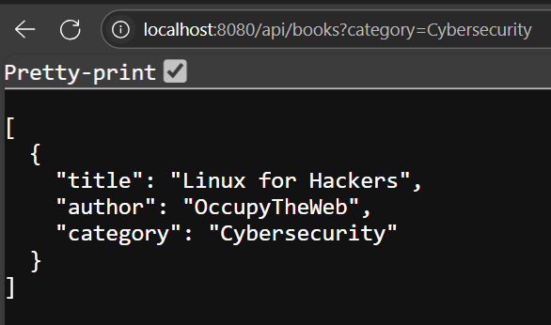

Slide 8
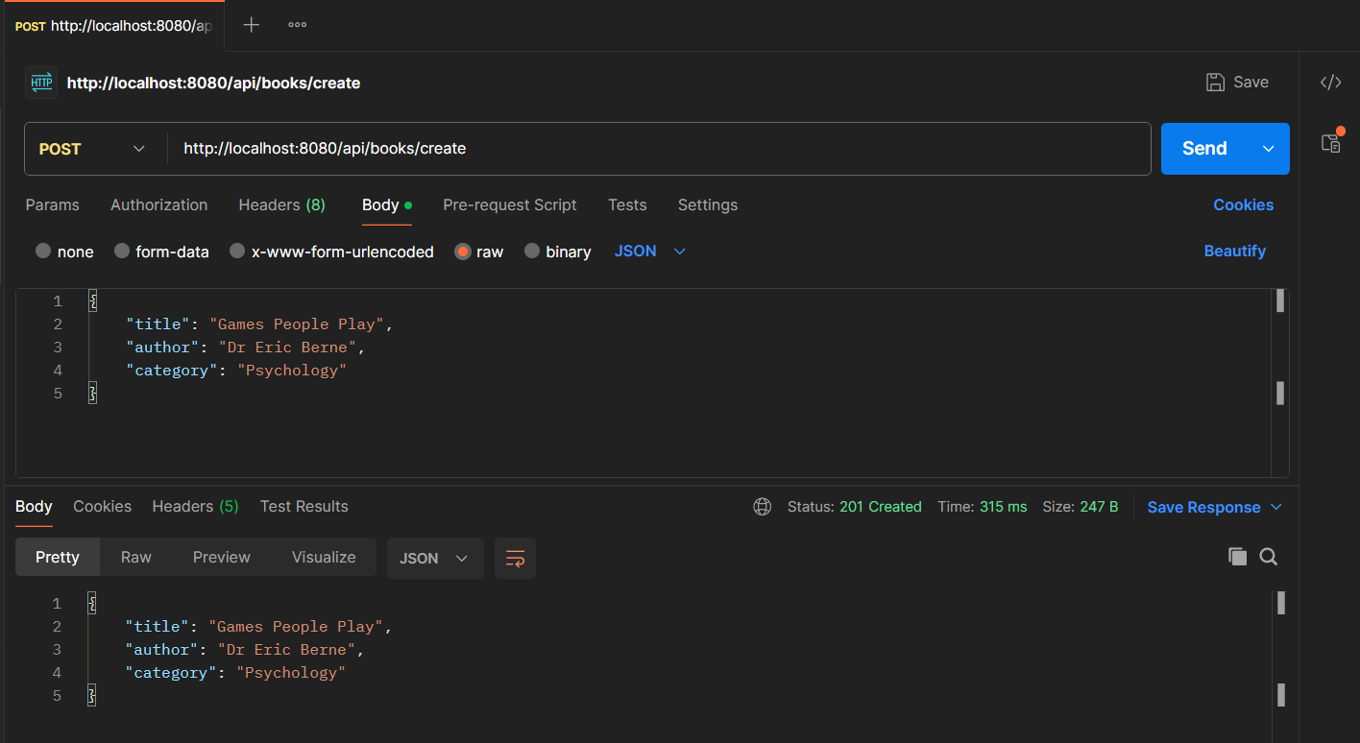
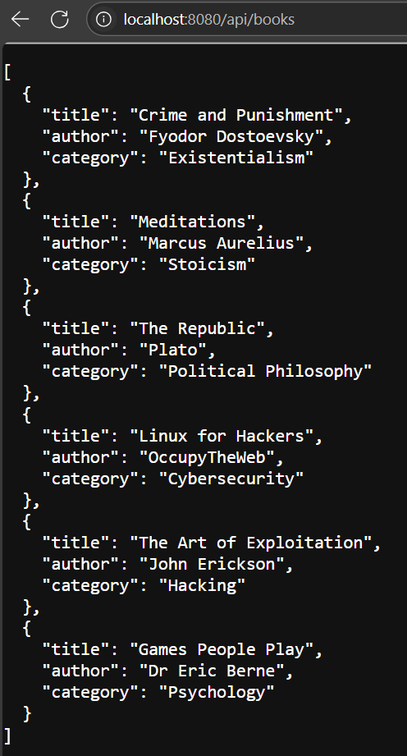

Slide 9
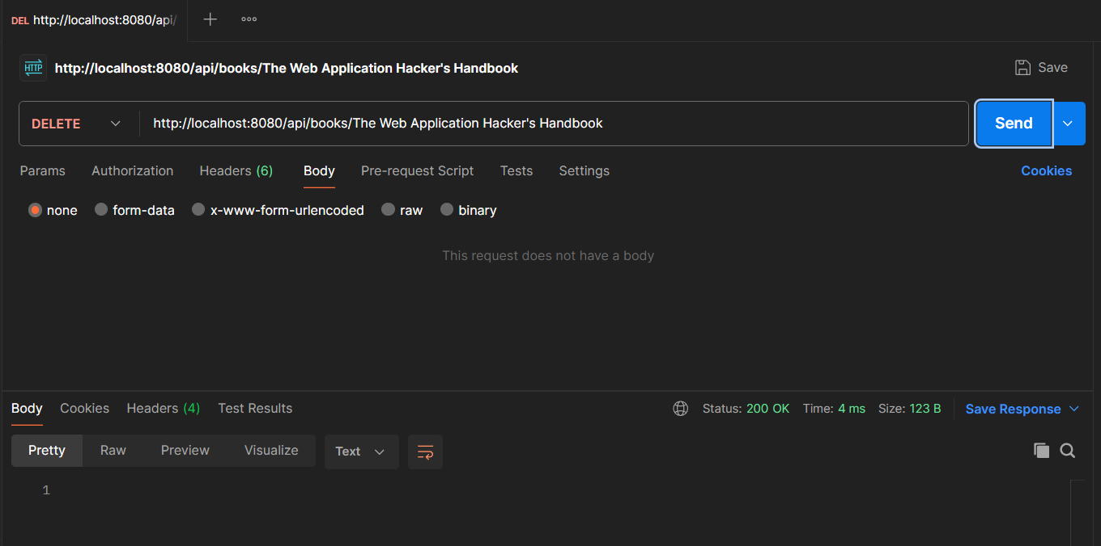
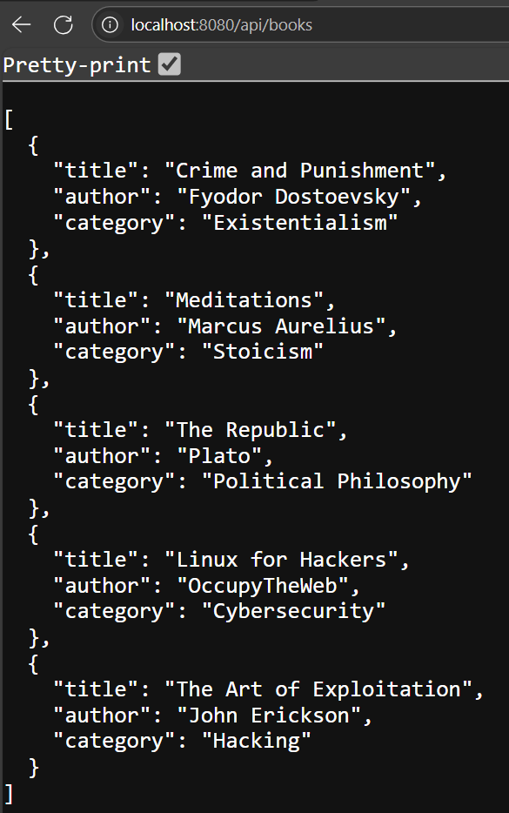

Slide 10
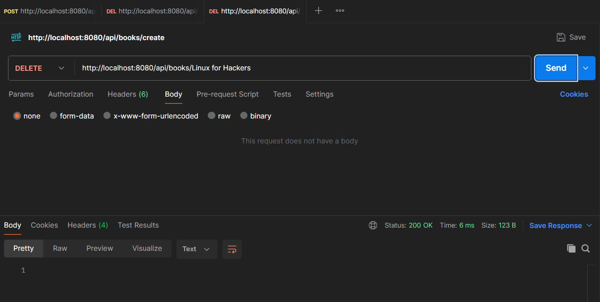
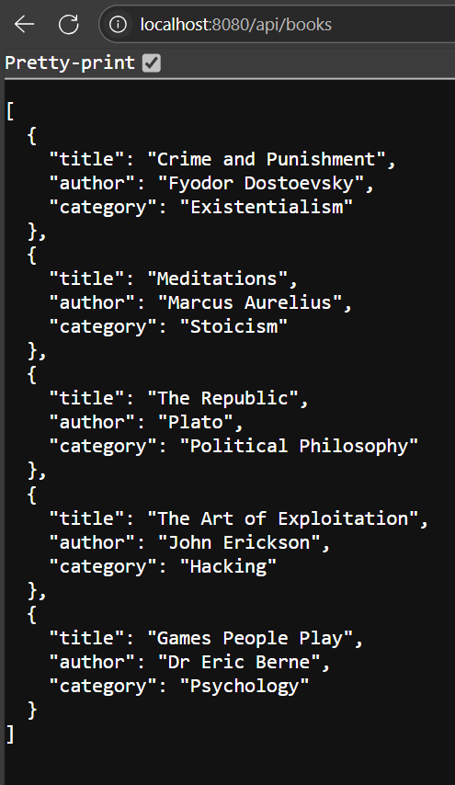

Slide 11
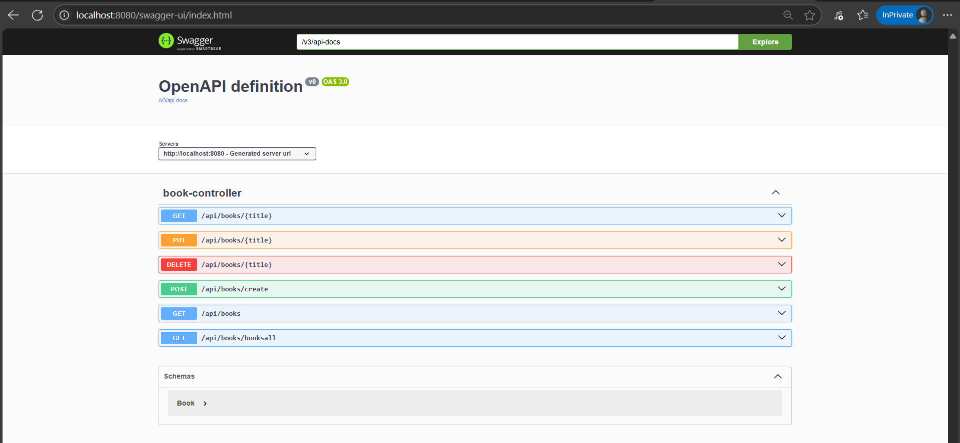
SWAGGER

Slide 12
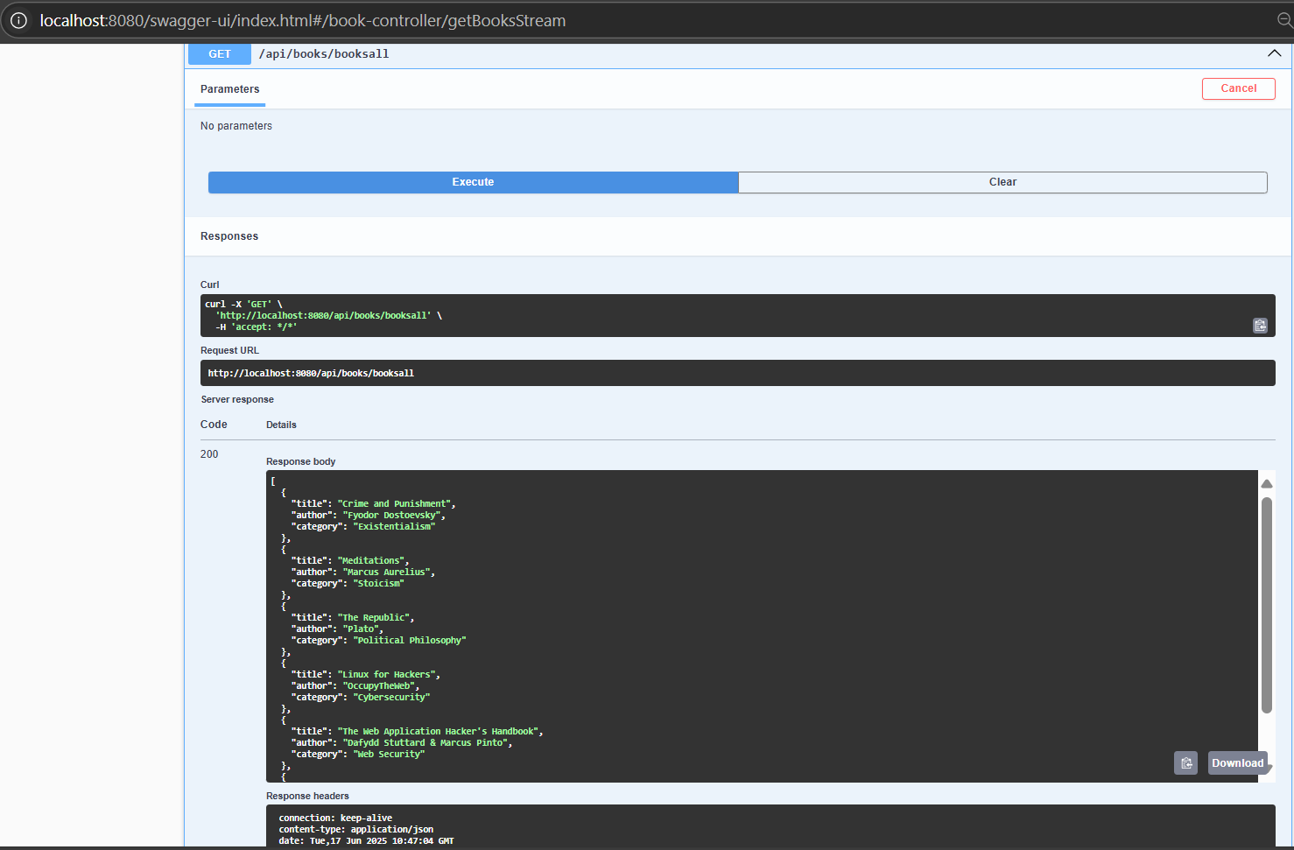

Slide 13
THANK YOU

