Slide 1
STUDENT MANAGEMENT SYSTEM
---PROJECT: Flask + MongoDB Atlas CRUD App
Goal: Build a beautiful student management system with full Create, Read, Update, Delete (CRUD) functionality using:
☁️ MongoDB Atlas (cloud database)
🐍 Flask (Python web framework)
🎨 Bootstrap frontend (dashboard-style UI)
🔐 Admin login to protect edits/deletes
🌒 Dark mode toggle
BY MADHUCHHANDA DAS
MENTOR : MR. AMITAVA CHATTOPADHYAY

Slide 2
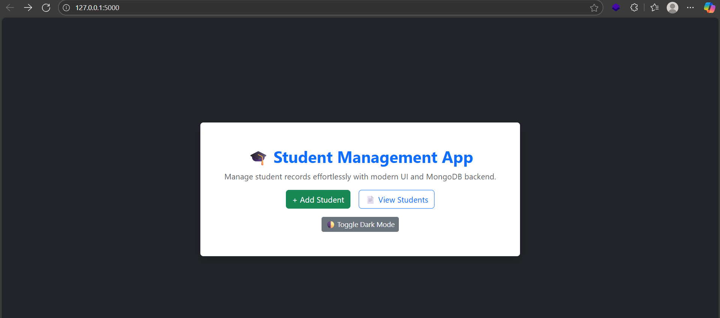
FRONT PAGE

Slide 3
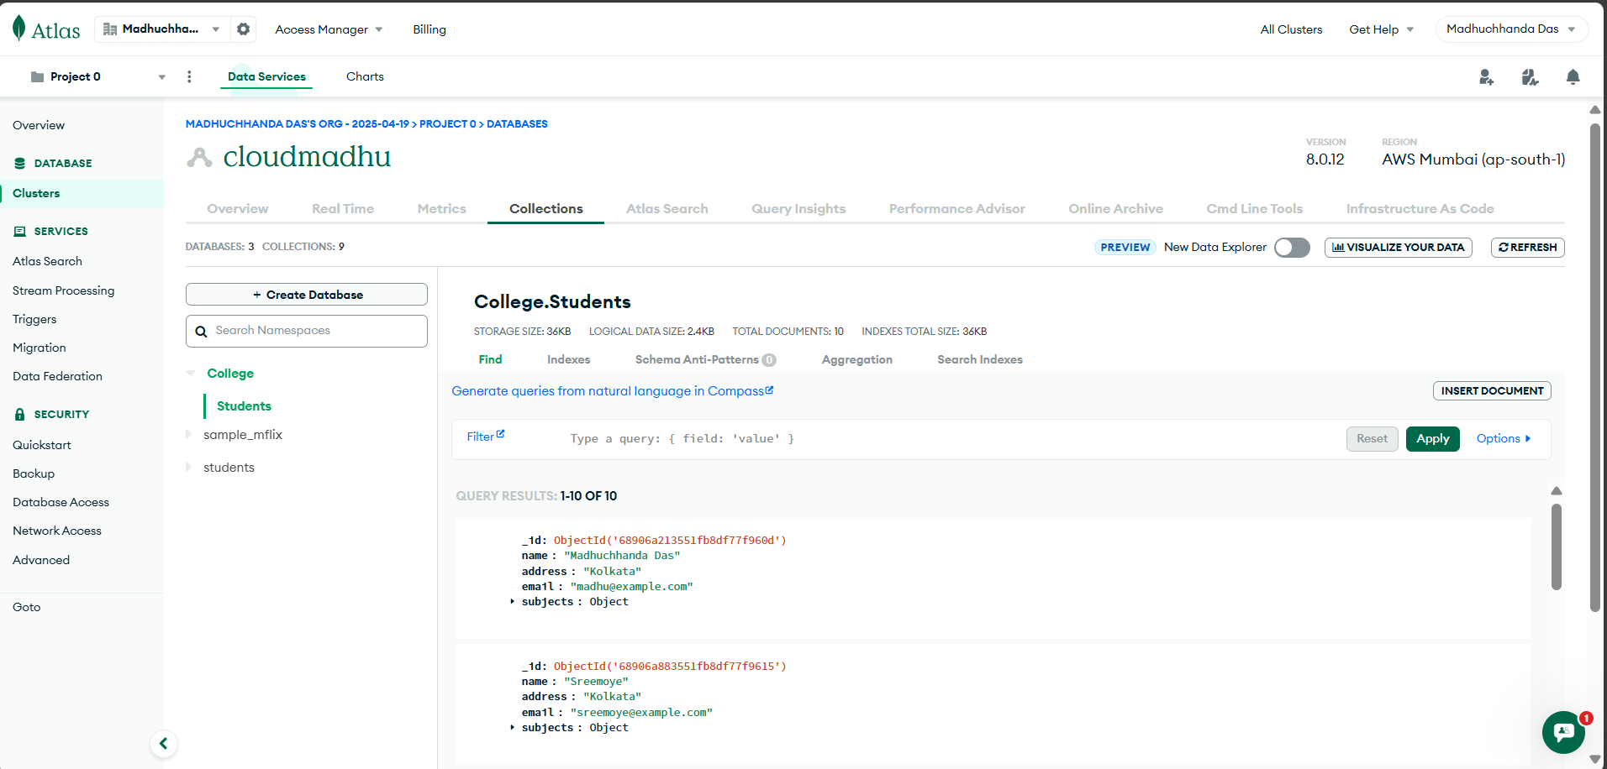
The student data is being fetched from our MongoDB Atlas cloud database…
From the College database and the Students collection. We are using MongoDB's flexible NoSQL document structure to store and query student information such as name, email, address, and subjects efficiently.

Slide 4
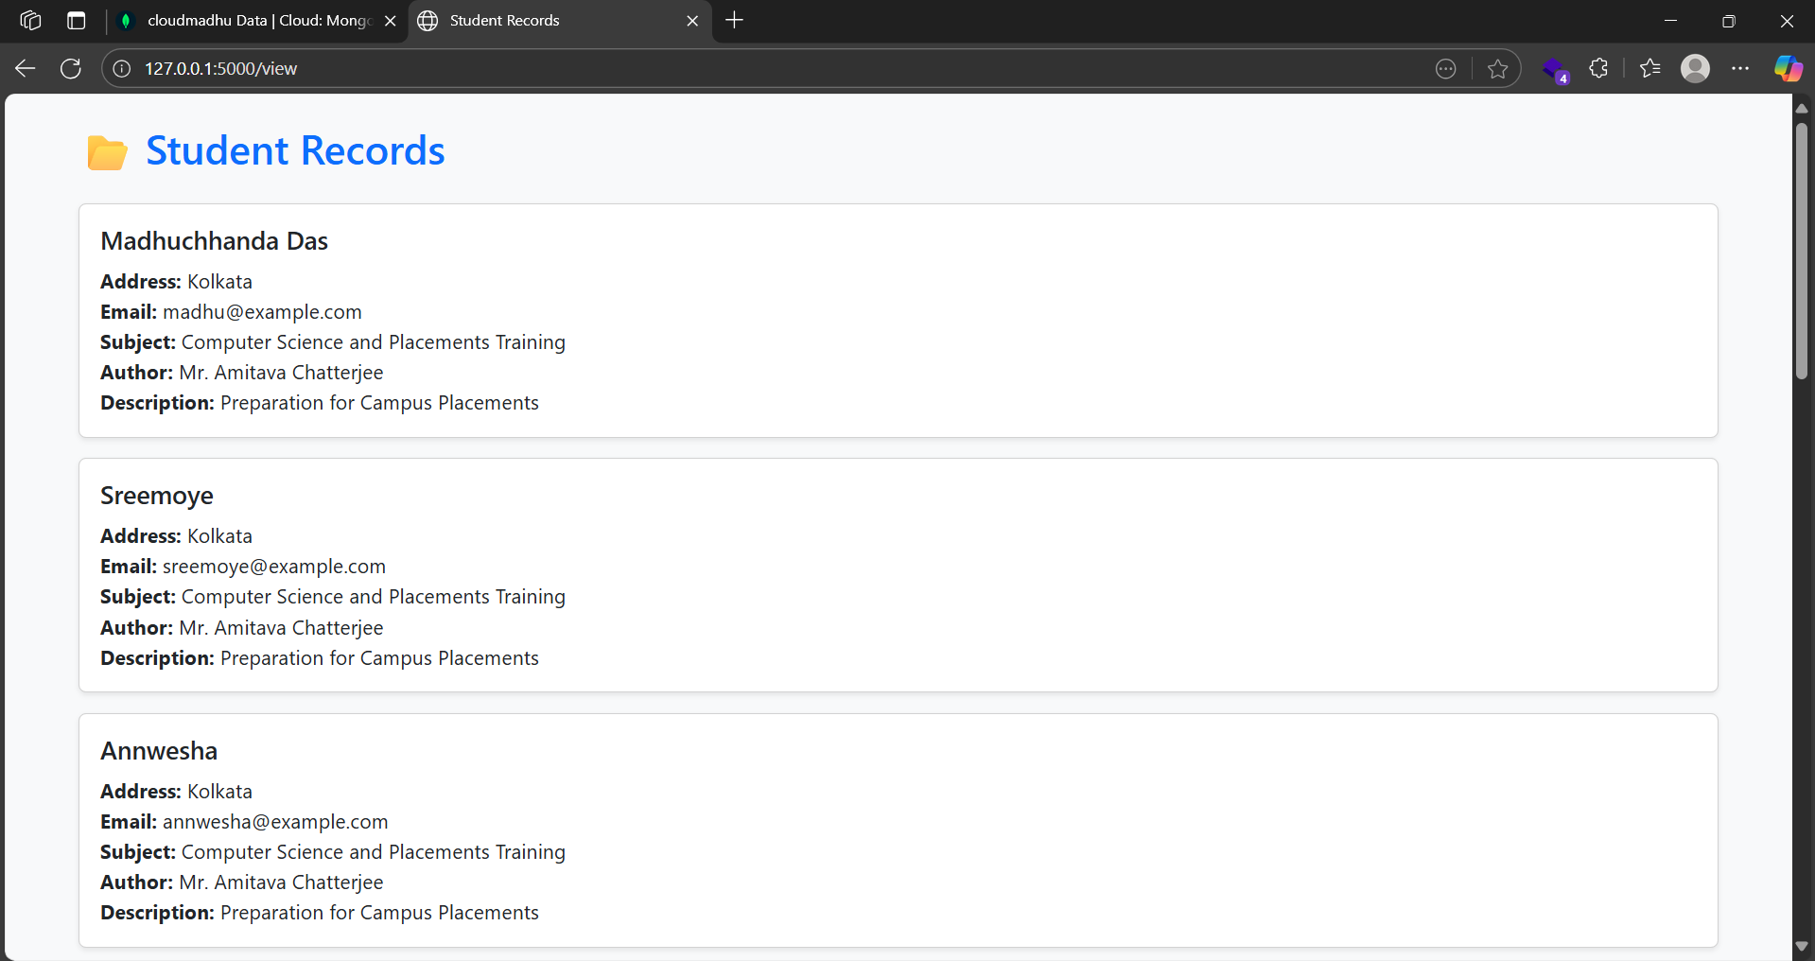

Slide 5
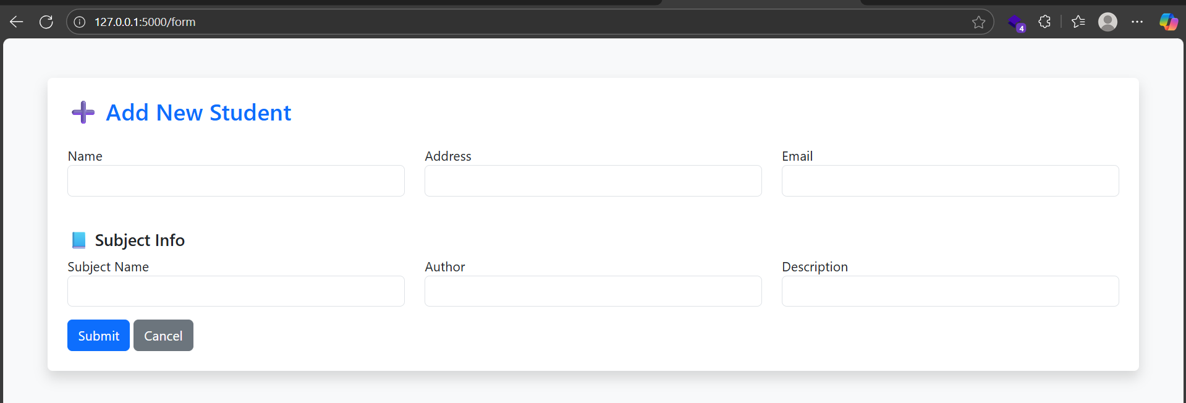
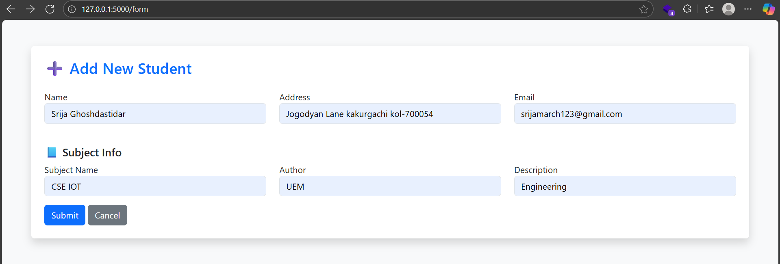

Slide 6
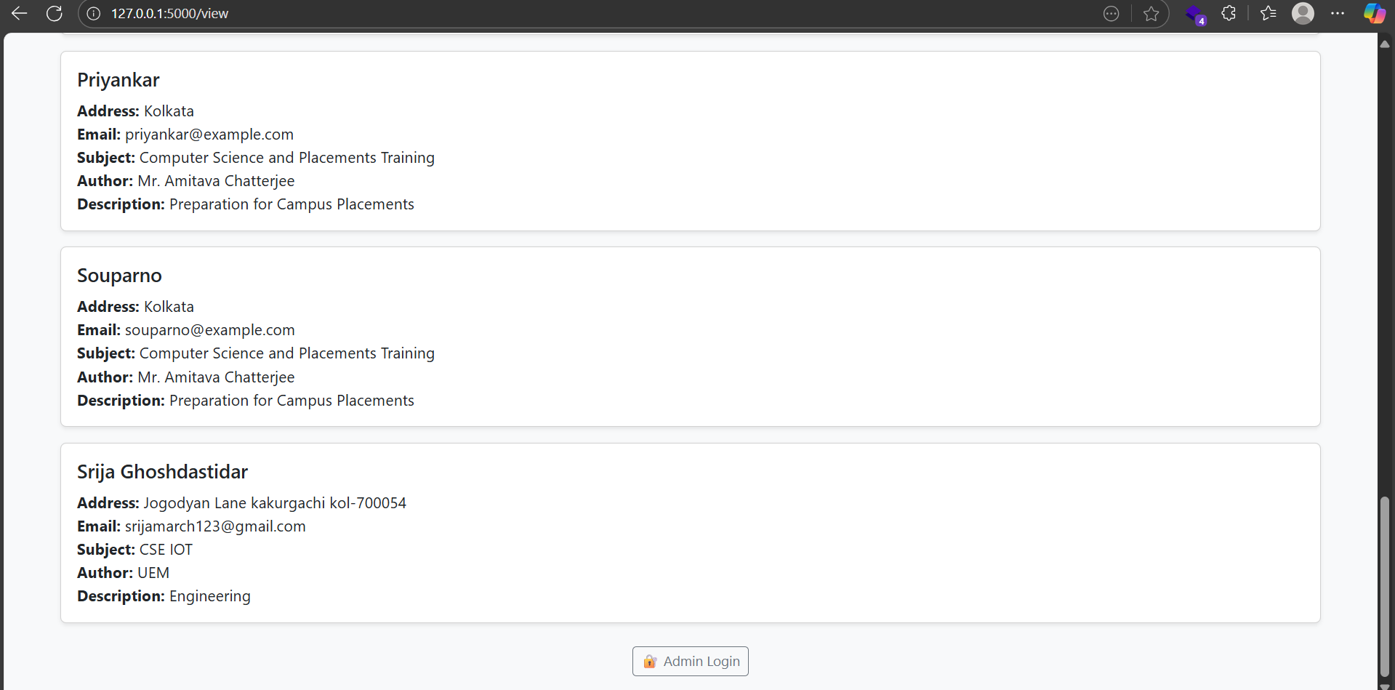

Slide 7
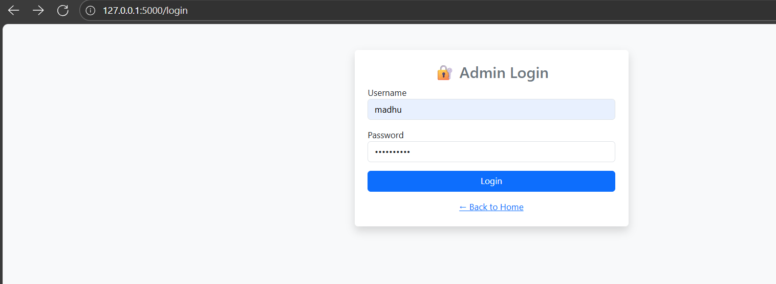
🔐 Admin login to protect edits/deletes

Slide 8
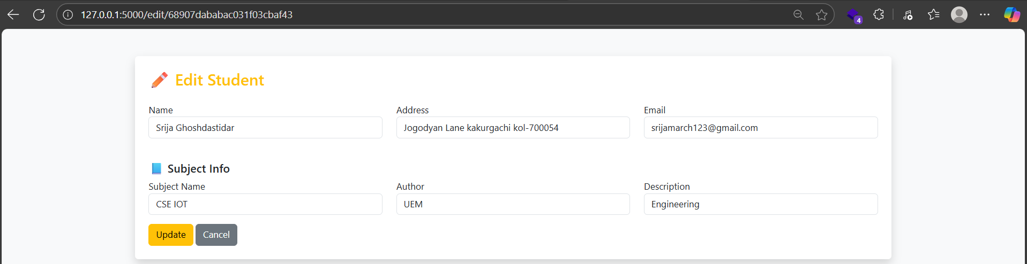
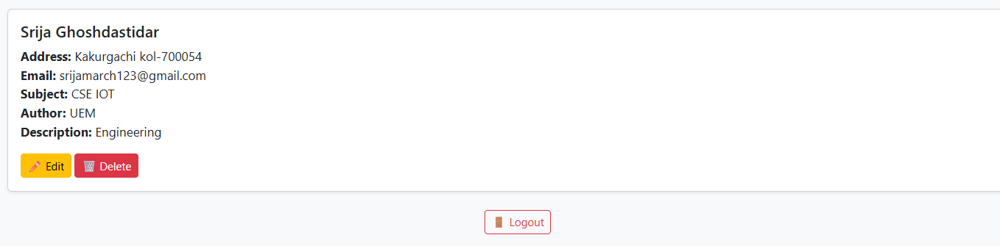

Slide 9
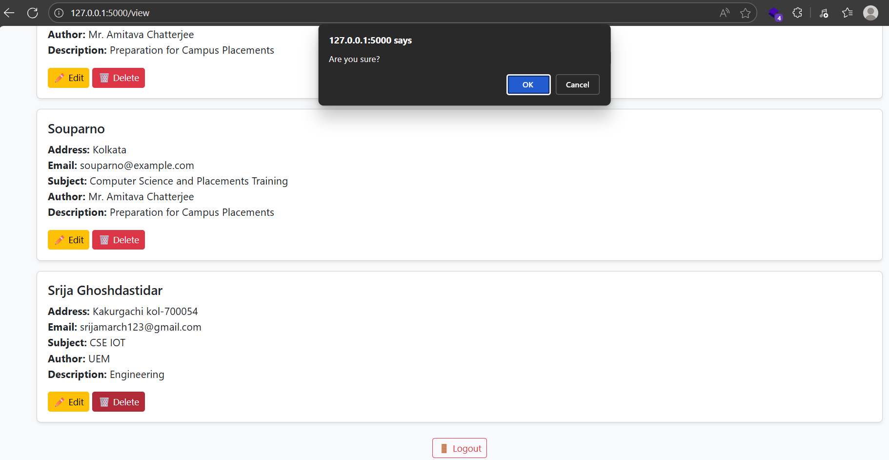
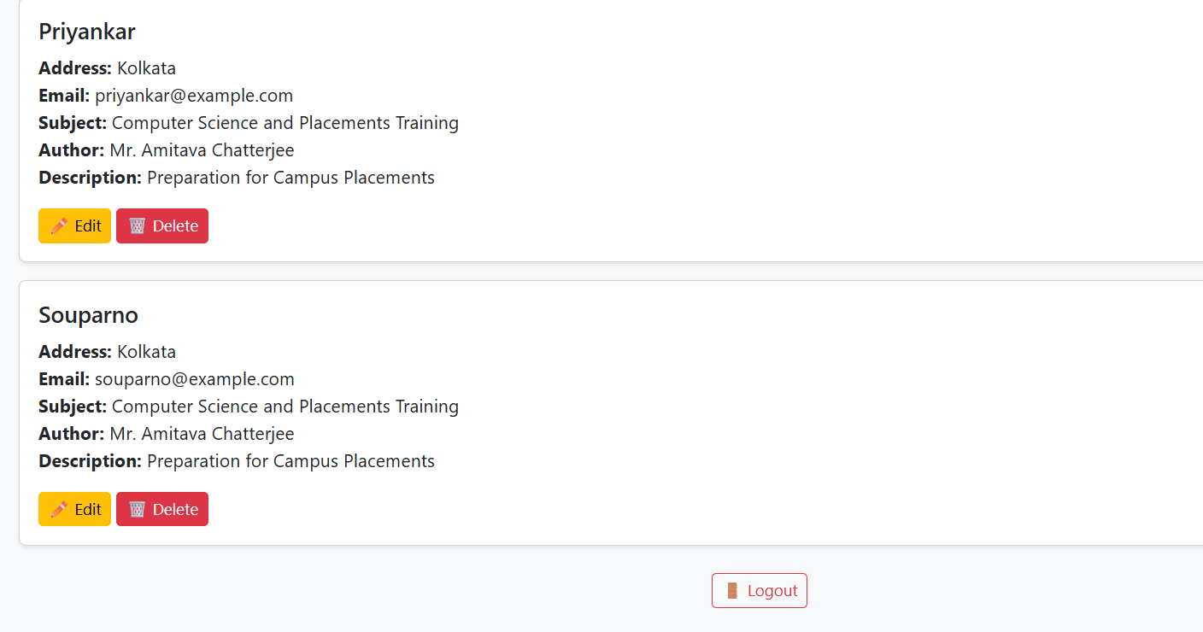
Deleting document from Admin Portal
Here we will delete record of Srija…
Document of Srija has been removed… →

Slide 10
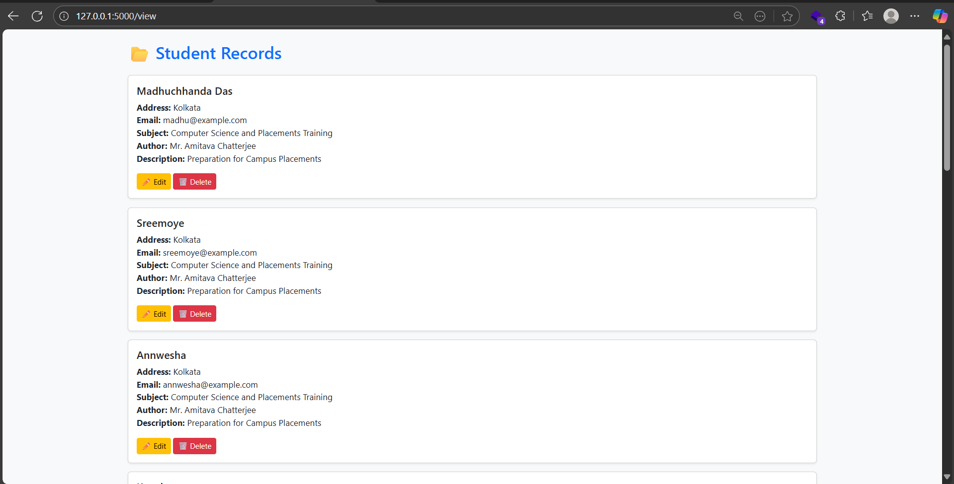
Student’s Records in Admin Portal after Admin Login for secured editing and management

Slide 11
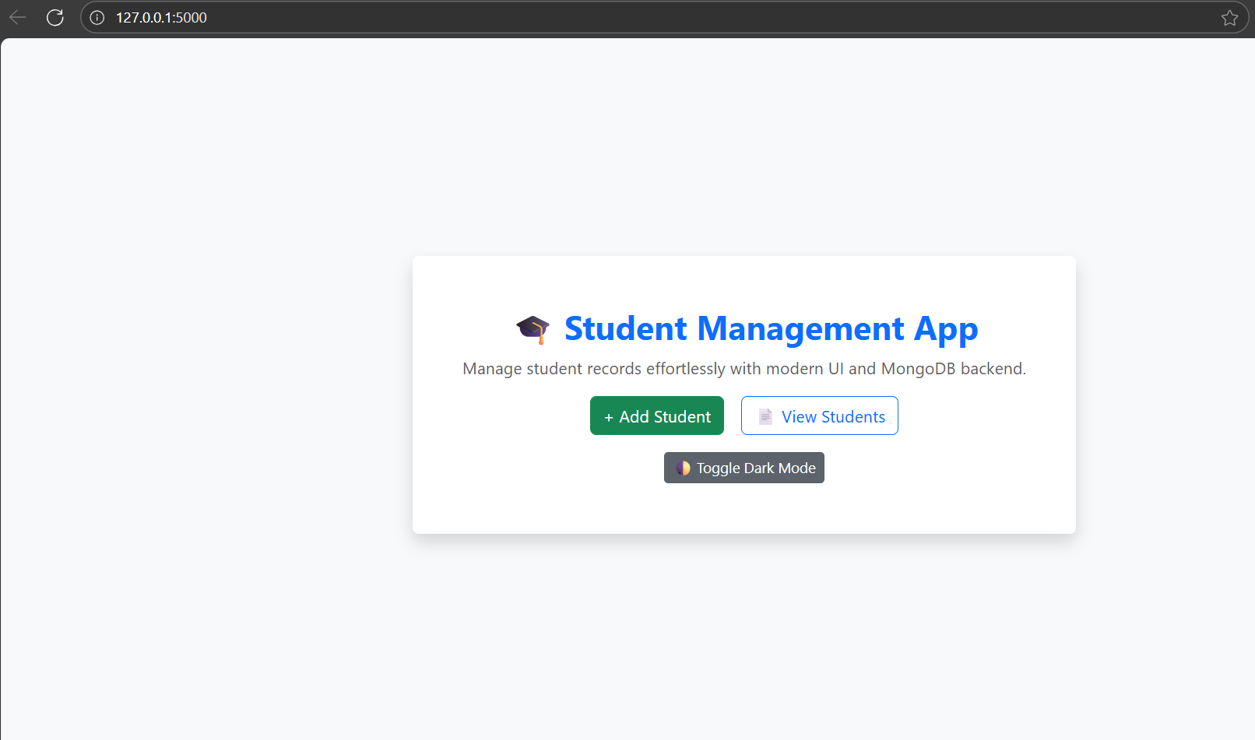
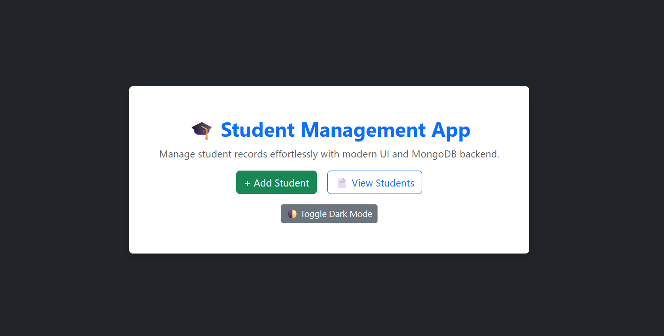
Also Available in both Light and Dark theme
Just click on Toggle Dark Mode…

