Slide 1
Leveling up: Detecting memory
Moving into the major league
#majorKeys

Slide 2
Memory maps
This may not seem intuitive, but it’s the way things are done on real hardware.
The OS accesses devices as if they were just regions in RAM.
  What actually happens behind the scenes is that the “Memory Controller” chip in the PC carves out portions of the RAM space and places devices in there. Roughly speaking.
  This is the gist of it, but it’s been simplified.

Slide 3
Memory maps
What I mean to say is that the same way that the OS writes to RAM is the same way it writes packets out to the network card, or images out to the graphics card.
And the same way that the OS reads data from RAM is the same way it reads incoming packets from the network card.

Slide 4
Memory maps
So how can the OS know when it’s writing to a region of RAM that is actually RAM, vs when it’s writing to a device pretending to be RAM?
This is what the “Memory map” is for.
  The memory map tells the OS which regions in RAM are actually RAM. It’s like a numerical table.
  It’s actually just a bunch of numbers, but the numbers are organized into a table.

Slide 5
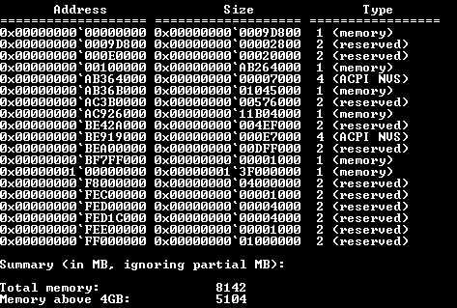
The memory map
It looks something like this if you try to print it out:

Slide 6
Let’s try to print it out
Look for the line in your core/main.c file which says this:
  /* Put your printf for the memory map in here! */
Substitute your printf in place of that line (or directly beneath it if you prefer).
The members of the memory map structure that you want to access, in order to print the memory map, are:
  mmap_current_entry->type, mmap_current_entry->addr, mmap_current_entry->len
  The results won’t look exactly as you expect – ask for help to get it to perfection.

Slide 7
Let’s try it out :
Hints:
  There is an underlying issue here because the memory map gives the addresses of the regions of RAM as 64-bit numbers.
  But we are writing a 32-bit OS, so there’s a bit of an issue there.
  Talk to you supervisor to get around the problem.
Again, modifying the -m <NUMBER_OF_MEGS_RAM> argument to ./run should produce different results for different values.

Slide 8
One small step for a man
But a giant leap for mankind…?
In the next lesson we’ll talk a bit about memory management and the various kinds of design and software abstractions it requires.

