Slide 1
Machine Learning (CSE-543)
Interim Project Presentation
Akshat Gupta 2021515
Rajorshi Mondal 2021187
Swati Sharma 2021568

Slide 2
Motivation

Slide 3
Problem Background
Cardiovascular Disease (CVD) remains one of the leading causes of mortality worldwide.
One of the most important aspects of managing CVD is identifying people with high associated risk, and diverting more attention towards this population.
This necessitates the need for a precise and effective risk scoring system.
Although various risk assessment systems exist, they often tend to cater to specific population demographics.
Consequently, there exists a significant opportunity for the enhancement of their performance and applicability.

Slide 4
Problem Overview
This inspiration prompted us to contemplate and potentially develop a novel system capable of forecasting individual patient risks related to CVD.
The ultimate goal of this study is to streamline the identification of patients at elevated risks of CVD.
Such an advancement would facilitate tailored interventions and precise treatment strategies, thus assisting healthcare professionals in potentially saving lives.

Slide 5
Literature Review

Slide 6
Survival Analysis
The problem statement concerned with this study is a Survival Analysis Problem.
Survival Analysis or time-to-event analysis is a statistical methodology used to predict the time or instant when a certain event will occur.
To achieve our objective, modelling the relationship between hitting times (time of occurrence) and the covariates (features) is important.
Especially in a medical setting, survival analysis is applied to identify risk factors affecting the survival, comparison among risks of different subjects at a certain time of interest, decision of a cost efficient sensing period.

Slide 7
Survival Analysis
Survival Function, s(t)
Probability that the event hasn’t occurred by time t.
Hazard Function, h(t)
Given that the event hasn’t occurred by time t, probability of event happening in a small time frame around time t.
Right-Censoring
In many real-world scenarios, not all individuals experience the event within the study period, or opt out of the study before the event has occurred. Censoring occurs when the exact event time is unknown but is known to be later than a certain point.
Survival Time
Time elapsed from a well-defined starting point to the occurrence of the event

Slide 8
Defining a Relation
Previous work in this domain attempted to predict survival times by assuming a specific stochastic function as a relationship between the distribution of hitting times (risk of event) and the covariates.
For example, the Cox Proportional Hazards Model, makes the assumption that the hazard ratio between two individuals remains constant with time or that under competing risks, the risks are individually independent (Proportional Hazards Assumption).
Formally, hazard rate is constant and that the log of the hazard rate is a linear function of covariates.

Slide 9
Competing Risks
Scenario where a person may be at risk of multiple events alongside a main illness (like cancer), in other words, when an individual is at risk of multiple events due to various different causes
In scenarios like these, an individual may experience one of these events while being at risk of others
In other words, the occurrence of one event "competes" with the occurrence of other events.
Competing risks introduce complexity because traditional survival analysis often assumes that individuals are at risk for a single event
Our problem though does not directly address competing risks, but the dataset being used for the purpose of this study is modelled with multiple events of interest

Slide 10
DeepHit
[DeepHit: A Deep Learning Approach to Survival Analysis with Competing Risks Changhee Lee, William R. Zame, Jinsung Yoon, Mihaela van der Schaar]

Slide 11
DeepHit
In this paper, a deep neural network is constructed which learns the distribution of the hitting times directly without making any assumptions about the underlying relationships between them and the covariates.
A key aspect of this method, is that it smoothly handles situations in which there is a single underlying risk (cause) and situations in which there are multiple competing risks (causes).
DeepHit employs a network architecture that consists of a single shared sub-network and a family of cause-specific sub-networks.

Slide 12
DeepHit
The goal is to train the network to learn Pˆ, the estimate of the joint distribution of the first hitting time and competing events.
It takes in the training data in three pieces, 1) patient's covariates, 2) time elapsed since covariates were first collected, and 3) a label indicating the type of event that occurred.
The network architecture included 4 layers - 1 layer for the shared sub-network, 2 fully-connected layers for the cause specific networks, and 1 softmax layer (the output layer) - activation function across layers 1, 2 and 3 was ReLU, and the network was trained through back propagation.

Slide 13
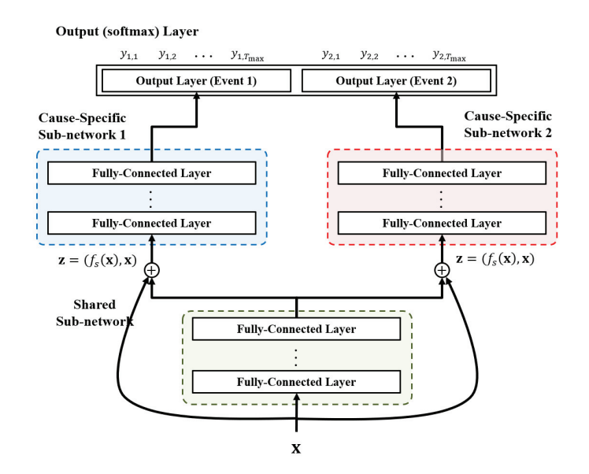
DeepHit - Model Architecture

Slide 14
DeepHit - Model Architecture
Output
Pˆ(s, k|x) - the probability of occurrence of event k at time s for a given set of covariates
This architecture drives the network to learn potentially non-linear, even non-proportional, relationships between covariates and risks.
Loss Function
Sum of two loss functions - log likelihood of the joint distribution of hitting times of the corresponding events, and a ranking loss function which adapts the idea that a patient who dies at time s should have a higher risk at time s than a patient who survived longer than s
This fine-tunes the network to each cause-specific event probability.

Slide 15
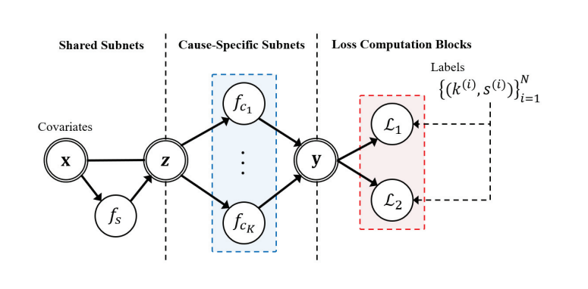
DeepHit - Model Architecture

Slide 16
DeepHit - Evaluation
The datasets used were the SEER, METABRIC, UNOS and a synthetically-created dataset of survival data.
The SYNTHETIC dataset included 30K patients (with 15K censored), 3 4-dimensional variables per patient and 2 hitting times, thus 2 events of interest.
The performance of the network was evaluated using the C^{td}-index, with 5-fold cross validation.
The data was split into a 64:16:20 split as Training : Validation : Testing sets.

Slide 17
DeepHit - Performance
In datasets like SEER and SYNTHETIC, where there are two competing risks, DeepHit outperformed conventional models such as Fine-Gray proportional subdistribution hazards model and deep multi-task Gaussian process (DMGP). The mean time-dependent concordance index (Ctd index) for DeepHit was 0.684.
In UNOS and METABRIC datasets (single-event scenarios), DeepHit outperformed traditional survival models (Cox Proportional Hazards, Threshold Regression, and Random Survival Forests) and machine-learning models except for MP-AdaBoost in UNOS and Random Survival Forests in METABRIC.

Slide 18
CVD Risk Prediction
[Prediction of cardiovascular risk factors from retinal fundus photographs via deep learning Ryan Poplin, Avinash V Varadarajan, Katy Blumer, Yun Liu, Michael V McConnell, Greg S Corrado, Lily Peng, and Dale R Webste]

Slide 19
CVD Risk Prediction
This research paper explores the potential use of phenotypic information, particularly regarding vascular health, to identify individuals at a high risk of cardiovascular disease.
The authors propose using retinal images to extract additional signals for risk assessment, and applying deep learning techniques, specifically deep convolutional neural networks, on those images for cardiovascular risk assessment.
Deep learning techniques, specifically deep convolutional neural networks, are suggested as a means to extract and quantify cardiovascular risk factors from retinal images.

Slide 20
CVD Risk Prediction
This study employed two datasets: the UK Biobank, consisting of health measurements from 500,000 participants aged 40-69, and the EyePACS dataset, a collection of retinal images from diabetic eye disease screenings.
The development set consisted of retinal images from EyePACS and the clinical validation set (EyePACS-2K) included a subset of macula-centered images along with HbA1c measurements, short for glycated hemoglobin.
The UK Biobank dataset was divided into a development set (80%) and a validation set (20%). Retinal images from EyePACS were used for the development set, while a subset of macula-centered images with HbA1c measurements from EyePACS comprised the clinical validation set, EyePACS-2K.

Slide 21
CVD Risk Prediction
Based on the Inception-v3 architecture, a deep neural network model was employed to predict various cardiovascular risk factors, including age, gender, smoking status, BMI, blood pressure, and HbA1c, from retinal images.
Two sets, "train" and "tune," constitute the development dataset for the neural network model.
During training, the model's parameters start with random values and are iteratively adjusted using stochastic gradient descent to minimize errors compared to known labels. To prevent overfitting, training halts when the model's performance on a "tuning dataset" plateaus.
Ensembling: Results from ten models were averaged (ensembling) to enhance accuracy and reliability.

Slide 22
CVD Risk Prediction
Continuous Predictions: Mean absolute error was used for evaluating continuous predictions.
Binary Classification: Area under the receiver operating curve (AUC) was employed.
Multiclass Classification: Simple Cohen’s kappa served as the evaluation metric.

Slide 23
CVD Risk Prediction
The average value of cardiovascular risk factors such as Age, Gender, Smoking status, BMI, Blood Pressure, and HbA1c were was used as a baseline for continuous predictions while AUC measured binary classification.
The algorithm’s performance was evaluated against specific error margins and outperformed baseline accuracy, especially for Age and Blood Pressure predictions.
The model successfully inferred Ethnicity as a potential risk factor.
Additionally, the study examined the impact of Diabetic Retinopathy on algorithm performance and found no significant differences between the groups of EyePACS-2K dataset.

Slide 24
CVD Risk Prediction
Despite a limited number of events, the model achieved an AUC of 0.70, comparable to established risk calculators.
Combining multiple risk factors was more effective in predicting Major Adverse Cardiovascular Events (MACE) than individual factors alone.
Soft attention was used to identify anatomical regions influencing predictions. Blood Vessels were highlighted for Age, Smoking, and Systolic Blood Pressure (SBP) predictions. Perivascular areas were emphasized for HbA1c predictions.

Slide 25
CVD Risk Prediction
This study thus explored the direct correlation between retinal images and cardiovascular events, training a model to predict MACE within five years.
It also successfully established Age, Gender, Smoking Status, BMI, Blood Pressure, HbA1c, and Ethnicity as cardiovascular risk factors.
This was referred to when selecting the dataset and during the feature selection procedure, verified by the statistical analysis of a processed dataset to select statistically significant features as predictors for the risk assessment system.

Slide 26
Dataset Description

Slide 27
Framingham Heart Study Dataset
Introduction:
The Framingham Heart Study began in 1948 in Framingham, Massachusetts, USA, under the direction of the National Heart Institute.
The dataset identified for the purpose of this study was the Framingham Heart Study Dataset.
Impact:
Its primary goal was to understand the factors contributing to cardiovascular disease.
It helped identify risk factors and contributed to the development of clinical risk assessment tools.

Slide 28
Demographics of the FHS Dataset
GENERATION TYPE | NUMBER OF PARTICIPANTS | YEAR | RELEVANCE W.R.T PREVIOUS GEN TYPES
Generation 1 | 5,209 | 1948 | Original Cohort
Generation 2 | 5,124 | 1971 | Children of Gen 1
Generation 3 | 4,095 | 2005 | Children of Gen 2
Generation 2 Spouse | 103 | 2011 | Spouses of Gen 2 and had children in Gen 3

Slide 29
Demographics of the FHS Dataset
GENERATION TYPE | NUMBER OF PARTICIPANTS | YEAR | RELEVANCE W.R.T PREVIOUS GEN TYPES | ORIGIN
Omni Generation 1 | 507 | 1994 | N/A | Lived in Framingham and had African-American, Hispanic, Asian, Indian, Pacific Islander and Native American origins
Omni Generation 2 | 410 | 2005 | N/A | Lived in Framingham and had African-American, Hispanic, Asian, Indian, Pacific Islander and Native American origins.

Slide 30
Data Pre-Processing
Data cleaning
Missing values were imputed with the respective mean/median values depending on the variable types
'BPMEDS' missing values were predicted using a Random Forest Classifier with SYSBP and DIABP as input variables.
Feature Engineering
A new column DIFCVD was constructed as DIFCVD = TIMECVD - TIME indicating the time to the event (i.e. CVD) from the time of data collection
Data Transformation
One hot encoding on categorical variables
Row-Normalization

Slide 31
Data Pre-Processing
NEW!!
Time-Series Relevant Preprocessing
Since dataset had multiple entries corresponding to the same individual, the data was sorted by the ID of each individual
Within each ID, the data was sorted by the time of recording the data, ensuring that a progressive pattern is observed in the data with respect to time of measuring

Slide 32
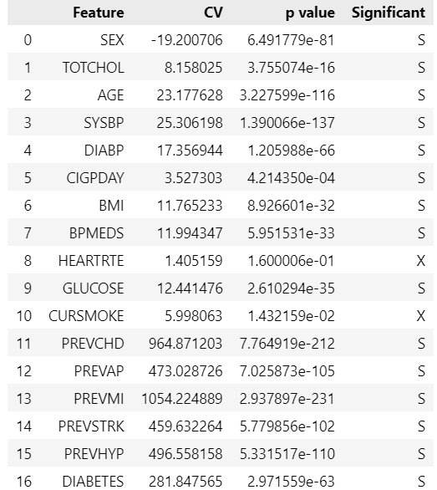
Data Pre-Processing
Feature Selection
All target-variable columns were dropped, retaining only the target variables (CVD and DIFCVD).
A subset of significant features for predicting CVD risk was identified using t-Tests (99% C.I.) for continuous variables and Chi-square Tests (99% C.I.) for categorical variables, excluding the target variables.
DIFCVD → Time of event
CVD → Event.

Slide 33
Exploratory Data Analysis (EDA)
Following is a description of the regressive features of the dataset prior to any pre-processing:
Feature | Mean Value | Min. Value | Max. Value
TOTCHOL | 241.162418 | 107 | 696
AGE | 54.792810 | 32 | 81
SYSBP | 136.324116 | 83.5 | 295
DIABP | 83.037757 | 30 | 150
CIGPDAY | 8.330180 | 0 | 90
BMI | 25.874615 | 14.43 | 56.80
HEARTRTE | 76.781516 | 37 | 220

Slide 34
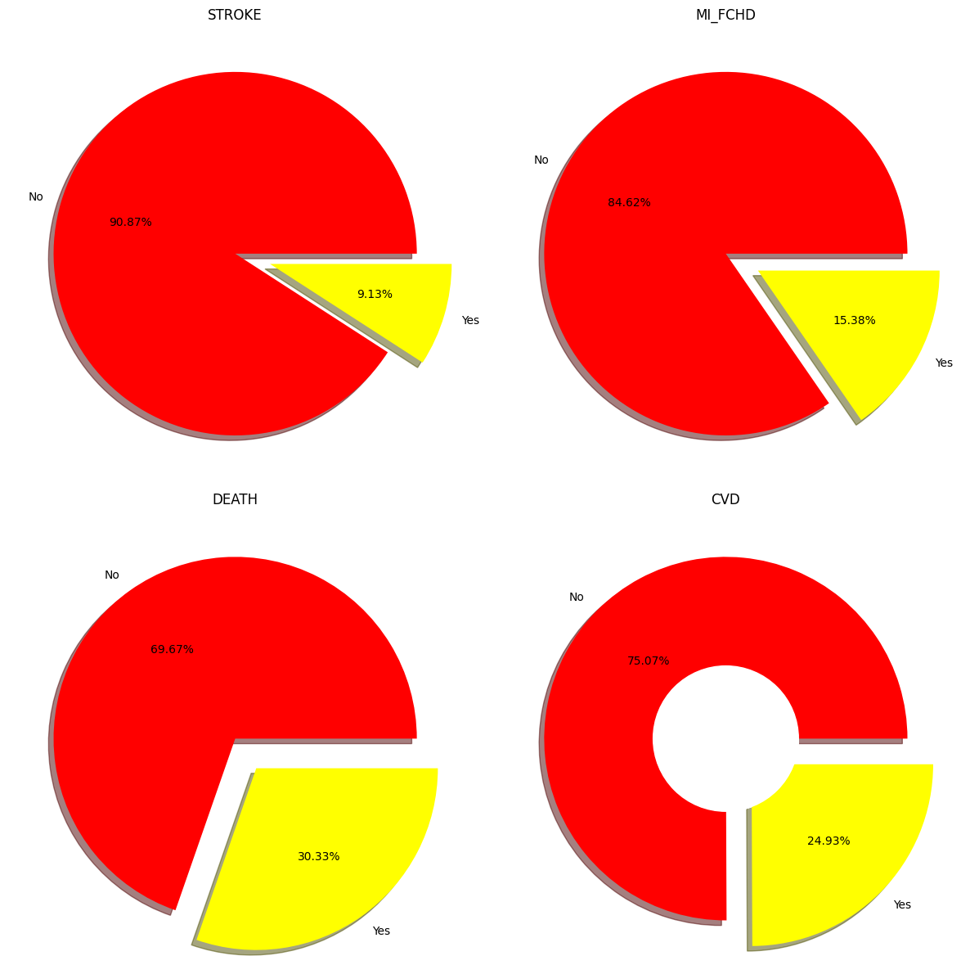
Dataset Visualization
Very High Class Imbalance - Observable from distribution of any of the target variables

Slide 35
Dataset Visualization

Slide 36
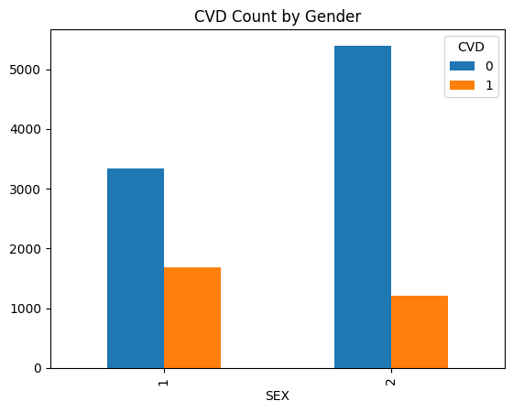
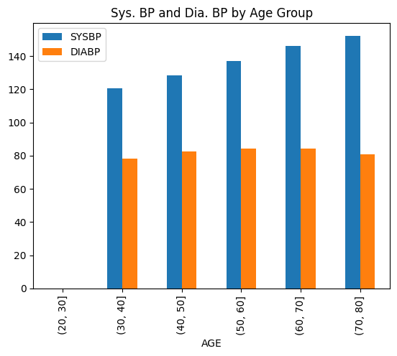
Dataset Visualization
Very few number of people are diagnosed with CVD
sysBP is Increasing by Age Group, while diaBP does not show such a trend

Slide 37
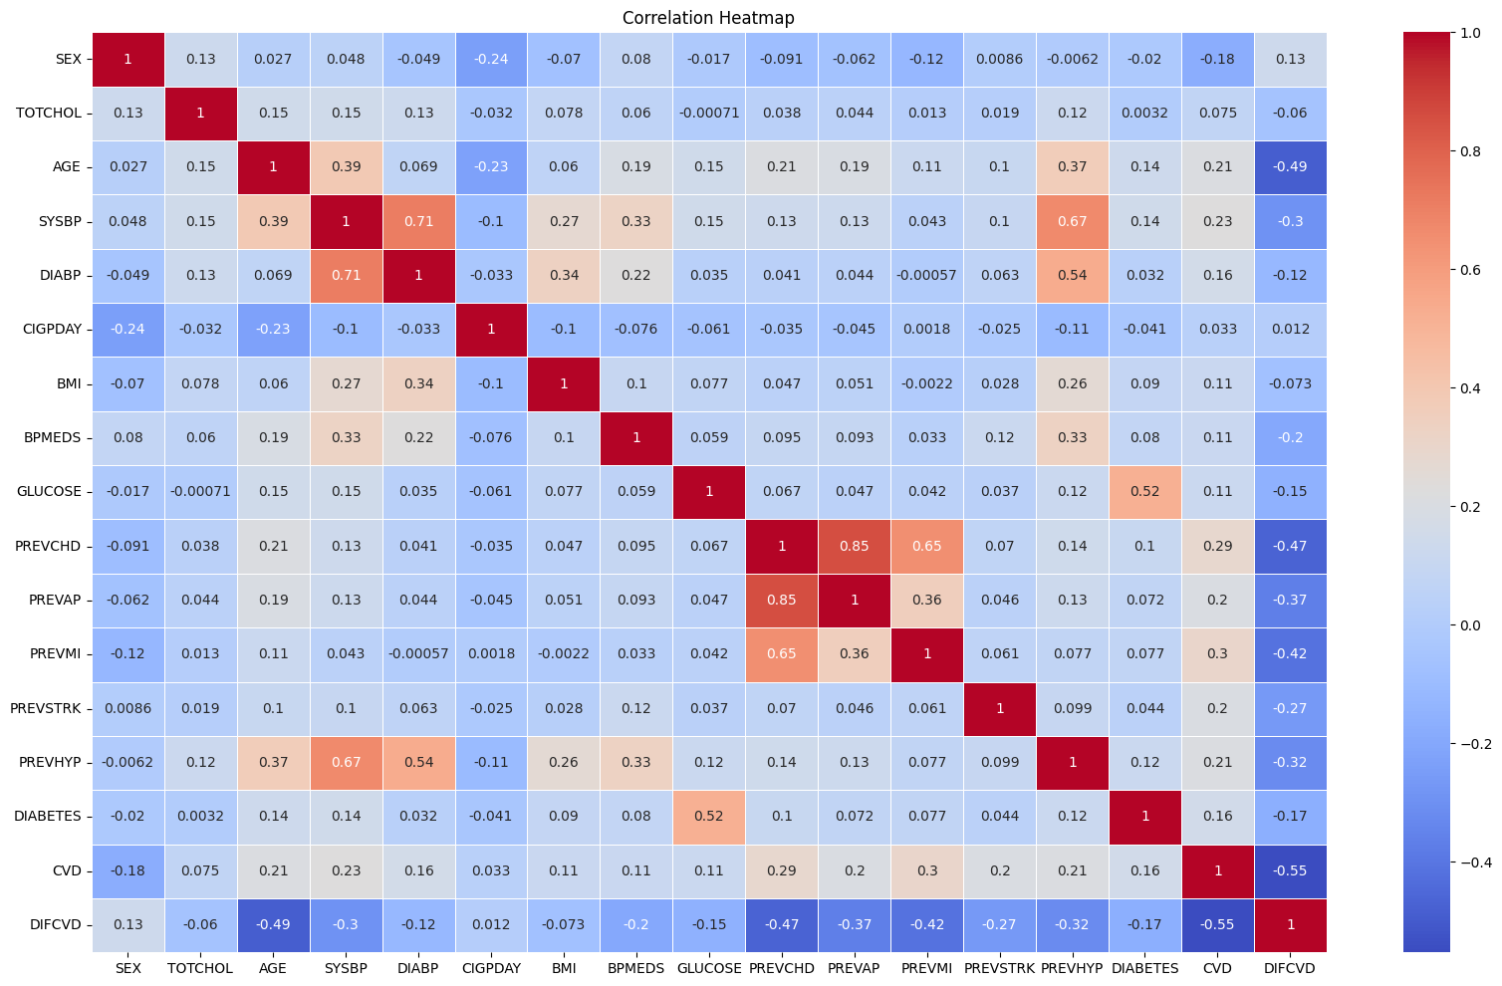
Dataset Visualization
Correlation Heatmap
CURSMOKE & CIGPDAY has strong correlation
GLUCOSE & DIABETES are positively correlated
sysBP & diaBP also show a high positive correlation coefficient

Slide 38
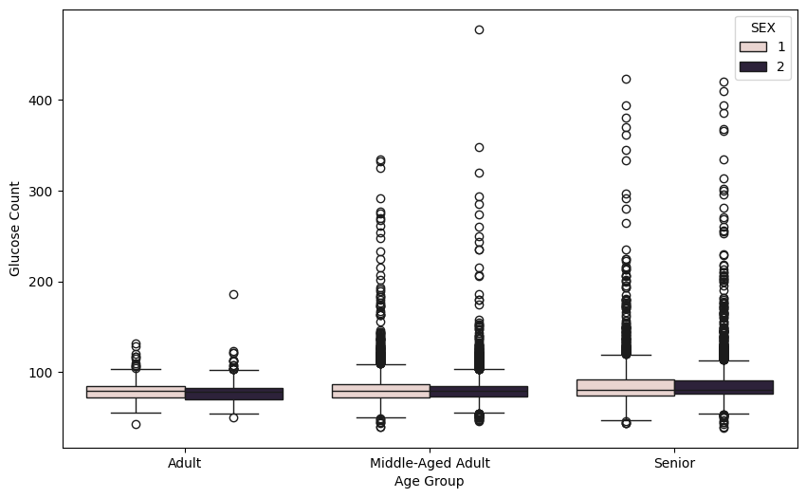
Dataset Visualization
Boxplot of Glucose Count by Age group & Gender
As age increases the count of Glucose increases too.
Gender wise Glucose Count has similar median with few outliers in each.

Slide 39
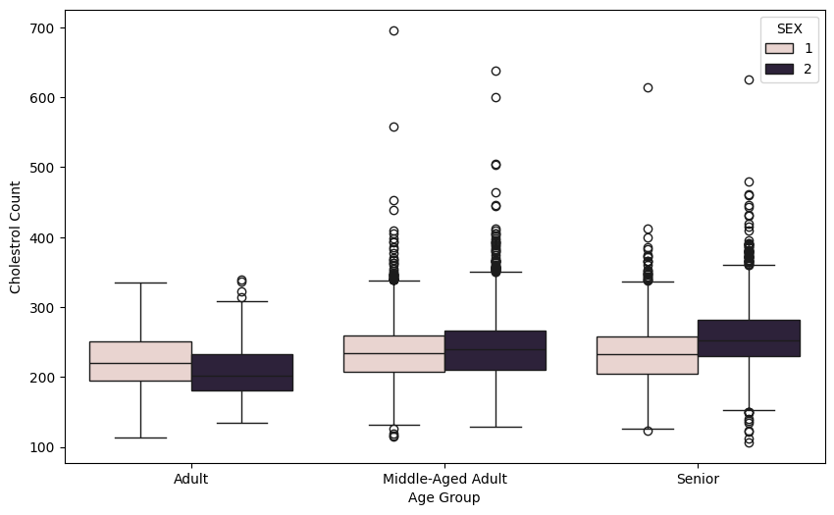
Dataset Visualization
Boxplot of Cholesterol Count by Age group & Gender
For Males, Cholesterol level is increasing by age
For Females, Cholesterol level is almost similar for each age group.

Slide 40
Methodology

Slide 41
Methodology Overview
Evaluation Metrics
C-score, C^{td}-index for Survival Analysis problems
Metrics like Accuracy, Precision, Recall, etc are not as indicative of an effective classifier in such problems
Algorithm Choices
Cox Proportional Hazards Model
Random Survival Forests
Kaplan-Meier Estimator

Slide 42
Evaluation Metrics
Specialized Metrics
Survival Analysis models require a distinct set of metrics for evaluation, such as the C-score or Ctd-index, in contrast to conventional metrics like Accuracy and Precision.
Our study consistently employs the C-score as the primary evaluation metric to assess model performance.

Slide 43
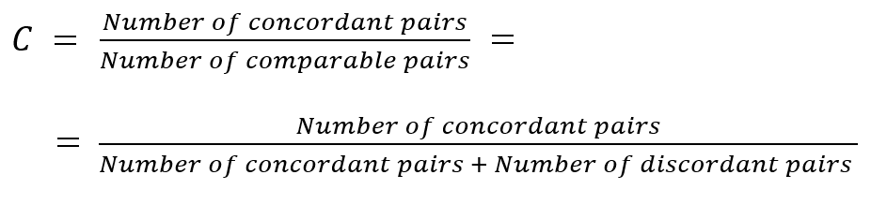
C-index
The C-index is a measure of the probability that the predicted event times (tˆi , tˆj ) of two randomly selected individuals have the same relative order as their true event times (ti , tj), i.e. P(tˆi > tˆj |ti > tj ).

Slide 44
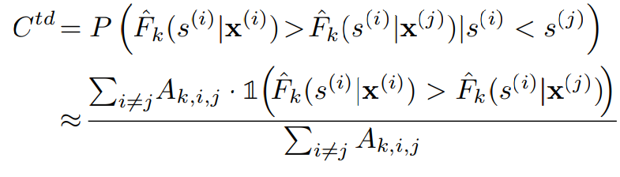
C^{td}-index
Ctd index, or time-dependent concordance index, measures how well a model predicts the order of events happening over time.
The regular C-index is computed at the start of observation and doesn't consider changes in risk over time. In contrast, the time-dependent concordance index accounts for the influence of time.

Slide 45
Problem with Traditional Algorithms
Multi-output Challenge:
Dealing with a dataset that demands simultaneous prediction of both a binary classification (the occurrence of the event of interest) and a regression label (the time of the event) introduces a challenging multi-output scenario.
Traditional machine learning models, such as Logistic Regression and Random Forest Classifier, excel in single-task scenarios but falter when faced with the dual prediction requirement.
Reason?
These models assume independence between observations, a condition that doesn't hold in the realm of time-to-event data.

Slide 46
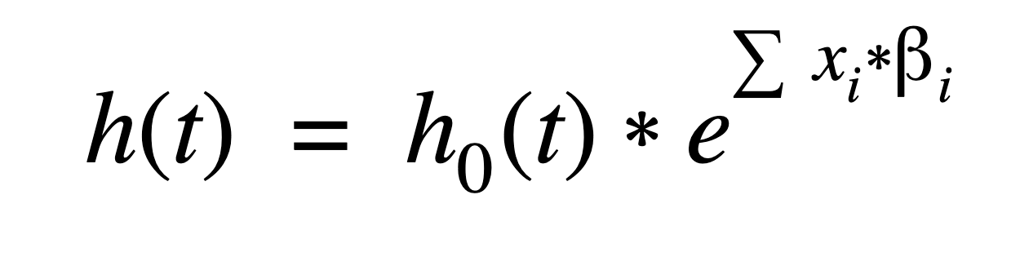
Cox Proportional Hazards (CoxPH)
CoxPH is a statistical method used specifically to analyze survival data by assessing how different factors or variables influence the risk of an event occurring over time.
The CoxPH model estimates the hazard function, which is the risk of an event happening at a particular time.
It does so by considering the influence of multiple variables, like age, gender, and treatment, on this hazard.
Hazard at time t:

Slide 47
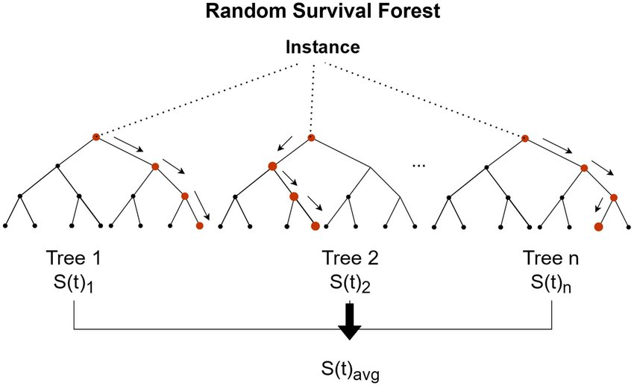
Random Survival Forests
Random Survival Forests are unique in that they combine the strengths of decision trees with survival analysis:
They don't assume a linear relationship between factors and survival
By using multiple trees and randomness, they're less likely to overfit the data.
They don't assume the data follows a specific statistical distribution.

Slide 48
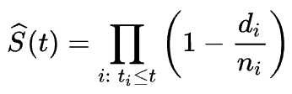
Kaplan-Meier Estimator
The Kaplan-Meier Estimator calculates survival probabilities at each time point, considering how many patients are still alive and how many have experienced the event.
It's like a step-by-step survival analysis without making any complex assumptions.
For each time interval, survival probability is calculated as the number of subjects surviving divided by the number of patients at risk:

Slide 49
Results and Analysis

Slide 50
CoxPH Results
The first model trained on the processed data was the CoxPH model.
The results from the initial training process were:
Mean C-index = 0.8078 0.7585
Mean C^{td}-index = 0.6701 0.7303
Both these metrics indicate very good performance, the C^{td}-index, however, is not consistent when running the training loop multiple times now consistent irrespective of the number of times the fit() function is called.

Slide 51
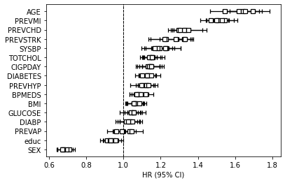
CoxPH Results
OLD!!
Following is a graph that depicts the variation of Hazard Ratios w.r.t each of the features in the processed dataset with a 95% C.I. -

Slide 52
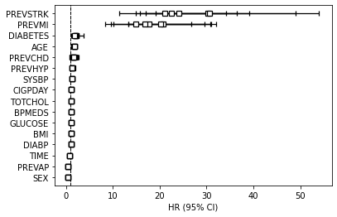
CoxPH Results
NEW!!
Following is a graph that depicts the variation of Hazard Ratios w.r.t each of the features in the processed dataset with a 95% C.I. -

Slide 53
Random Survival Forest Model
NEW!!
The second model trained was the Random Survival Forest model with the same 5-fold stratified split strategy:
Clearly, CoxPH showed better performance, but RSF is able to capture more complexities within the data given its ensemble nature
METRIC | VALUE
C-index | 0.6901
C^{td}-index | 0.6661

Slide 54
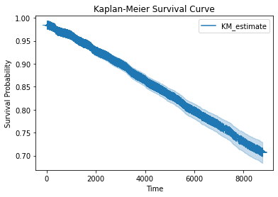
Kaplan-Meier Estimator
NEW!!
Estimated survival probabilities at each instance of time recorded within this data with a 95% confidence interval
Used to visualize the estimated relation of the survival probabilities with passing time

Slide 55
Mortality Prediction Models
NEW!!
MP models were manufactured from traditional ML models such as ADABoost, Logistic Regression and Random Forests
Treated the survival analysis problem as a classification problem with the event of interest being CVD
Performance is much poorer than dedicated survival analysis models clearly indicating that this strategy is not suitable for this problem
Model | C^{td}-index
MP-ADABoost | 0.5456
MP-Logit | 0.5800
MP-RandomForest | 0.5408

Slide 56
Individual team members’ contributions

Slide 57
Individual team members’ contributions
Akshat Gupta
Motivation, Dataset Identification, Risk Stratification & Survival Analysis, Literature Review, Results and Analysis, Presentation Slides
Code → Kaplan Meier Estimator, Mortality Prediction Package
Swati Sharma
Dataset Identification, Data Visualization, Identifying optimal Pre-processing steps, Literature Review, Traditional v/s Survival Analysis Models, CoxPH Model, Presentation Slides
Code → CoxPH, Preprocessing
Rajorshi Mondal
Motivation, Identifying relevant Previous Work, Literature Review, Dataset Identification, CoxPH Model, Presentation Slides
Code → Random Survival Forest

